Slide 1


ED Report on Planning for the OSG Futures Council Meeting August 10th 2009 Ruth Pordes OSG Executive Director

Slide 2
OSG – Planning for the Future, Mar 2009..
OSG Funding – Key dates
OSG DOE funding ends 3/15/2011
OSG NSF funding ends 8/31/2011
OSG Fiscal Year5 ends 9/30/2011
We need a plan beyond the currently allocated budget to maintain stakeholder confidence and continue
Support for evolving needs of Stakeholders
Ongoing support for US-LHC & LIGO
Retention of Staff and Expertise

Slide 3
OSG Future Planning Schedule (from Ruth Pordes based on March 2009 Council Mtg)
Phase 1 by June 2009
Gather and document requirements & expectations from major stakeholders for 2010 to 2015 Partially Done, Summary to follow
Solicit guidance from OSG Council on key directions for future Done at May and June Council meetings.
Phase 2 by Aug 2009
Face-to-Face Council Mtg
2-page plan for each OSG work area (or functional unit) Some 2 page strategy documents written. Summary of status to follow.
List/abstract of satellite proposals More Satellites being proposed and some funded. More to Follow
Phase 3 by Dec 2009
Analysis => outline for proposal
Document Architecture
Identify particpating senior personnel (and institutions)
Phase 4 at March 2010 All Hands Meeting
Endorsement of proposal by stakeholders
Note: The one eJot since the January Review was in March 2009.
The Program Manager in DOE HEP has left.
No eJot since then.
OSG Dropped from bi-weekly LHC US agency/management meetings.

Slide 4
2 Page “Plans” - The Federated National CyberInfrastructure
Currently these plans are Strategy Documents. They subscribe to the vision of OSG as a major player and contributor to the Federated National CyberInfrastructure.
Current guidance and interest mainly from NSF MPS.
NSF OCI has XD and 6 Task Forces to help guide the future program:
“Perceived” thrust from MPS and OCI for increased OSG TeraGrid collaboration.
“Perceived” DOE thrust on networks and exascale.

Slide 5
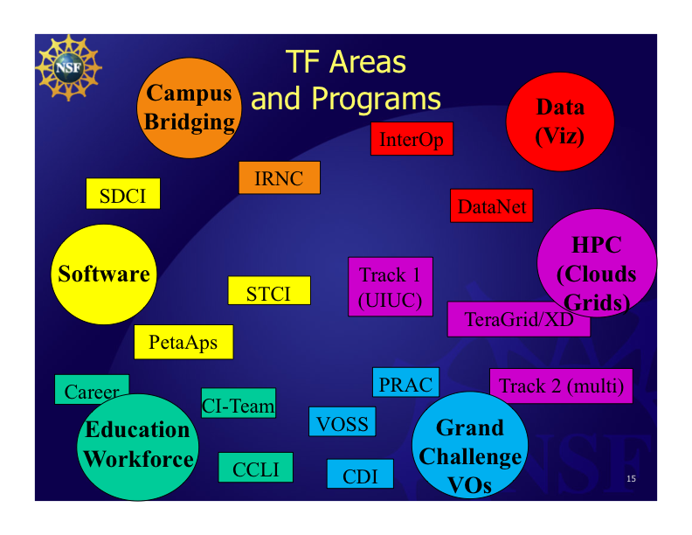
Internet2 meeting – Jen Schopf

Slide 6
OCI Task Forces
Campus Bridging Task Force
Chair: Craig Stewart (IU),
Jim Bottum (Clemson)
NSF OCI Liaison: J. M. Schopf
Data and Visualization Task Force
Chair: Shenda Baker, E. Lyon (Bath)
NSF OCI Liaison: J. Stoffel
HPC Task Force
Chair: Thomas Zacharia (DOE liason);
Co-chair: Jim Kinter (GEO)
NSF OCI Liaison: Rob Pennington
Learning and Workforce Development Task Force
Chair: Diana Oblinger (EHR); Co-chair: Alex Ramirez (CEOSE);
NSF OCI Liaison: Rob Pennington
Software and Tools Task Force
Chair: D. Keyes (Columbia), V. Taylor (Texas A&M)
NSF OCI Liaison: A. Patra
Cyberscience, Grand Challenge Communities
and Virtual Organizations Task Force
Chair: Tinsley Oden (Texas/Austin)
Co-Chairs: John King (Michigan),
James Kinter (COLA)
NSF Liaison: Barry Schneider

Slide 7
DOE Exascale and S/W
Aug 17- 19, 2009: Biology Workshop: Opportunities in Biology at the Extreme Scale of Computing
Aug 13-15, 2009: Material Science and Chemistry Workshop: Discovery in Basic Energy Sciences: The Role of Computing at the Extreme Scale
July 30-31, 2009: Workshop on Enabling Data-Intensive Computing
May 11-12, 2009: Nuclear Energy Workshop: Science Based Nuclear Energy Systems Enabled by Advanced Modeling and Simulation at the Extreme Scale
March 18-20, 2009: Fusion Science Workshop: Scientific Grand Challenges in Fusion Energy Sciences and the Role of Computing at the Extreme Scale
Feb 24-25, 2009: Collaboratories: Potentials and Realities of Distributed Science Communities
Jan 26-28 2009: Nuclear Physics Workshop: Forefront Questions in Nuclear Science and the Role of High Performance Computing
Dec 9-11 2008: High Energy Physics Workshop: Scientific Challenges for Understanding the Quantum Universe and the Role of Computing at Extreme Scale
Nov 6-7, 2008: Climate Workshop: Challenges in Climate Change Science and the Role of Computing at the Extreme Scale

Slide 8
2 page ‘plans’
Software Hardening http://osg-docdb.opensciencegrid.org/cgi-bin/ShowDocument?docid=866
Campus https://twiki.grid.iu.edu/twiki/pub/Council/Agenda2009Aug11/NCI__the_Campuses_v3.pdf
Workforce development http://osg-docdb.opensciencegrid.org/cgi-bin/ShowDocument?docid=864
OSG TG Collaboration - input to MPS request https://osg-docdb.opensciencegrid.org:440/cgi-bin/ShowDocument?docid=879
OSG TG Principles of Collaboration https://twiki.grid.iu.edu/twiki/pub/Council/Agenda2009Aug11/OSG_TG_SharedPriciples_v4-3.docx

Slide 9
OSG Futures - Goals https://twiki.grid.iu.edu/twiki/pub/Council/Agenda2009Aug11/OSG_Future_Requirements_v1.docx
OSG will provide the LHC and LIGO communities with a common virtual facility…
OSG will provide a common, shared distributed computing infrastructure which can be used, ..by all members of the Consortium...
OSG will continue as a grass-roots hands-on collaboratory…
OSG will play a leadership role in the US National Cyberinfrastructure...
OSG aims to have recognized responsibilities in partnership with the NSF XD…
OSG aims to have recognized responsibilities as part of the next round of the DOE SciDAC program….

Slide 10
Key Directions:
Program of work driven by current and anticipated stakeholders.
Solidify the concept and practice of OSG Satellites.
Effort in core project ~same # of FTEs as current project (~33FTEs)
Strategic plans informed by sponsors (NSF MPS, NSF OCI, DOE ASCR, DOE HEP, DOE NP, NIH?).
Increased role and responsibilities on and across the university campuses.
Core mission to support of the US LHC Tier-3s.
Core mission to provide US operational services for the WLCG.
Support for and working with Community Grids is a core activity, including the LIGO Data Grid.
Plan for a 5-year program of work.
Well understood and agreed to relationships, cooperation and interfaces with XD projects.

Slide 11
Core Mission - 1
Continue operations of the production infrastructure:
Improve the usability and reduce the effort to operate at all levels.
Maintain a usable, secure, robust, distributed facility open to all contributors (resources and applications) in the scientific, research, and education domains. (No commercial use).
Continue support for the OSG Virtual Data Toolkit for the OSG Consortium and other projects, including the evolution of WLCG and EGI.
Solidify presence and usability of shared cyberinfrastructure within the US University campuses and transparent use of local and wide area cyberinfrastructure nationally.

Slide 12
Core Misson - 2
Extend:
The capabilities and capacities offered for the stakeholders at the table, including those represented on the OSG Consortium Council, VOs represented by the “at-large” Council member, and users through the Campus, Engagement, Education and Outreach activities.
Strengthen organizational, operational and technical gateways between OSG and other peer infrastructures including the TeraGrid and XD, and EGI and NGIs in Europe, Campus and regional grids in the US and off-shore, and commercial cloud resource providers.
Workforce training for the future…TBA.

Slide 13
Software..
Sustain support for the VDT.
Client Toolkits
Web services (LIGO, ATLAS)
Data encryption and data security capabilities (SBGrid).
Application level portals and gateway software.
Integration with industry could be useful (SBGrid).
Better define and publish boundaries for software regarding what OSG supports and what it doesn't support (SLAC)
Full support for use of Virtual Machines (STAR).
Better error code reporting and translation through the s/w stack (STAR, ATLAS?)
Better end-to-end support for data management and storage use.
Include more components for network management and allocation.
Track evolution and ensure interoperability with EGEE/EGI (CMS).
Gradually adopt components of software sustainability paper.

Slide 14
Operations Services, Security, Sites
Critical operations center services – problem recording, triaging, ticketing and ownership; gateways and publishing to the WLCG services.
Provide frameworks and exemplars for general utility to the communities within the operations framework
Lower the barrier to use, improve usability of all services and installations.
Increase automation, alarming.
Reduce the impact of site-to-site variability and lower the barrier to use.
Operational support for US LHC Tier 3s and small sites in general.
Active monitoring and notification of software bugs in s/w.
Support for Virtual Machines across all operational services impacted (STAR).
Improve usability of end-to-end security infrastructure – identity token acquisition and management.
Support for MPI (CIGI, LIGO?, SBGrid)
Increase the resources accessible for sharing (CDF, D0)
Help grow sustainable and usable (lower the barrier to entry) regional grids (NYSGrid).
Campus grids. (GPN, GROW)

Slide 15
Community Specific
Support for more dynamic and flexible VOs and groups (SBGrid, Council).
Sharing and use of storage by communities that don't own it using reservation, allocation (SBGrid, LIGO, Council)
Strengthen relationships with Community Grids for Security Incident Response and alerts.
Strengthen relationships on workflow and community capabilities, condor etc.
Develop policies as to how a regional grid interacts with the OSG (NYSGrid)

Slide 16
Future Capabilities and Capacities
Understand role, impact, requirements, interfaces to and integration with commercial clouds, if any (Council).
Develop appropriate interfaces, integration with TeraGrid.
Virtual Machine technologies as supported resources and environments.
Extend capabilities and capacities for managing and using data and (dynamically allocated) networks across the shared distributed infrastructure.
Workflow – understand usability and scope of Pegasus and DAGMAN (LIGO).
Commonly adopted standards (LIGO, ATLAS)

Slide 17
Today
Get feedback and input to the current strategy, goals and principles.
By end of August –finalize the Requirements (Goals?) and Principles document.
Check that current schedule is still what we aim for:
Phase 3 by Dec 2009
Analysis => outline for proposal
Document Architecture
Identify particpating senior personnel (and institutions)
Phase 4 at March 2010 All Hands Meeting
Endorsement of proposal by stakeholders

Slide 19
Satellite Projects
Reminder: “Current OSG Project is funded to provide staff for specific aspects of managing and sustaining the OSG.”
OSG Satellite projects are projects that contribute to the goals of the Consortium and are aligned with its activities.
Satellite Projects allow us to scale without growing the size of any specific project. Growing the size of projects has management, coherence, effectiveness overheads.
Part of the original ideas in 2005: Solicitation for Preproposals, https://osg-docdb.opensciencegrid.org:440/cgi-bin/ShowDocument?docid=207
The Council encourges efforts to adiabatically extend participating groups and research communities through collaborative proposals that benefit and make leveraged contributions across the communities and the organizations involved.

Slide 20
Satellite Projects cont
Development of needed software and extensions in the same. E.g. CorralWMS proposal.
Increase in scope of the OSG driven by the stakeholder needs and vision of the Executive Team and Consortium e.g. “Adopt a Cluster” proposal.
Address holes in the funded work of the existing OSG Project e.g. EIE4CI CI-Team.
Enable collaborative work with other groups e.g. Advanced Network and Distributed Storage Laboratory (ANDSL)
proposal.

Slide 21
Current List
“Embedded Immersive Engagement for Cyberinfrastructure”, (CI-Team, OCI funded, NSF 0753335)
Structural Biology Grid: based from Harvard Medical School; (MCB funded)
VOSS: “Delegating Organizational Work to Virtual Organization Technologies: Beyond the Communications Paradigm” (OCI funded, NSF 0838383)
CILogon: “Secure Access to National-Scale CyberInfrastructure” (OCI funded, NSF 0850557)
Proposals in the works that we are aware of:
CorralWMS –Proposal to OCI STCI for 3 years from FY10.
“Adopt-a-Cluster” –Proposal to OCI STCI for 2 years from FY10;
Advanced Network and Distributed Storage Laboratory (ANDSL) proposal to DOE Advanced Networks for 3 years from FY10
?CyberIdentity proposal.
An extension framework for Gratia.
MRI for LIGO, LHCb resource accessible to OSG.
To Come: Cooperative work with TG (more later this afternoon).

Slide 22
Are there Satellite Projects we should encourage?
Security Infrastructure enhancements/revamp?
Campus Infrastructures?
Storage and Data management?
…

