Slide 1
glideinWMS Training @ IU
Condor overview
by Igor Sfiligoi (UCSD)

Slide 2
Acknowledgement
These slides are heavily based on the presentation Todd Tannenbaum gave at CERN in Feb 2011
https://indico.cern.ch/conferenceTimeTable.py?confId=124982#20110214.detailed

Slide 3
Outline
What is Condor
Condor principles
Condor daemons
Condor protocol overview

Slide 4
What is Condor

Slide 5
What is Condor
Condor is a Workload Management System
  i.e. a batch system
Strong points
  Fault tolerant
  Robust feature set
  Flexible
Development team dedicated to working closely w/ scientific community as priority #1

Slide 6
How can Condor be used
Managing local processes (local)
Managing local cluster (~vanilla)
Connecting clusters (flocking)
Handling resource overlays (glideins)
Swiss-knife for accessing other WMS
(Condor-G)
  e.g. Grid, Cloud, pbs, etc.
Only vanilla
in this talk

Slide 7
(Vanilla)
Condor principles

Slide 8
(Vanilla) Condor principles
Two parts of the equation
  Jobs
  Machines/Resources
Jobs
  Condor’s quanta of work
  Like a UNIX process
  Can be an element of a workflow
Machines
  Represent available resources
  Mostly CPU, but indirectly memory and disk as well

Slide 9
Jobs Have Wants & Needs
Jobs state their requirements and preferences:
  Requirements:
    I require a Linux/x86 platform
  Preferences ("Rank"):
    I prefer a machine owned by CMS
Jobs describe themselves via attributes:
  Standard, i.e. defined by Condor:
    I am owned by Albert
  Custom, i.e. specified by the user (or the administrator):
    I am a Monte Carlo job
    I will be done within 12h

Slide 10
Machines Do Too!
Machine requirements and preferences:
  Requirements:
    I require that jobs declare a runtime shorter than 18h
  Preferences ("Rank"):
    I prefer Monte Carlo jobs
Machine attributes:
  Standard, i.e. defined by Condor:
    I am a Linux node
    I control 2GB of memory
  Custom, i.e. specified by the administrator:
    I have been paid with CMS money

Slide 11




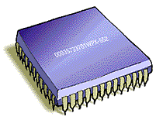
Condor brings them together
Central manager
Condor
Job repository
Machine
Condor
Condor

Slide 12
Condor ClassAds
Classified Ads

Slide 13
What are Condor ClassAds?
ClassAds is a language for objects (jobs and machines) to
  Express attributes about themselves
  Express what they require/desire in a match (similar to personal classified ads)
Structure
  Set of attribute name/value pairs
  Value : Literals (string, bool, int, float)
  or an expression

Slide 14
Example ClassAd
MyType = "Machine"
TargetType = "Job"
Name = "glidein_999@cabinet-2-2-1.t2.ucsd.edu"
Machine = "cabinet-2-2-1.t2.ucsd.edu"
StartdIpAddr = "<169.228.131.179:56787>"
State = "Claimed"
Activity = "Busy"
Cpus = 1
Memory = 36170
Disk = 231463800
OpSys = "LINUX"
Arch = "X86_64"
Requirements = JOB_Is_ITB != true
Rank = 1
KFlops = 972989
Mips = 3499
HasFileTransfer = true
IS_GLIDEIN = true
GLIDEIN_SEs = "bsrm-1.t2.ucsd.edu"
DaemonStartTime = 1324784426

Slide 15
ClassAd Expressions
Similar look to C : operators, references, functions
Operators: +, -, *, /, <, <=,>, >=, ==, !=, &&, and || all work as expected
  Type checking ops: =?=, =!=
Functions: if/then/else, string manipulation,
list operations, dates, randomization, …
References: to other attributes in the same ad, or attributes in an ad that is a candidate for a match
True==1 and False==0 (guaranteed)
  e.g. (3 == (2+True)) is identical to True
Explicit UNDEFINED
http://www.cs.wisc.edu/condor/manual/v7.6/4_1Condor_s_ClassAd.html#SECTION00512300000000000000

Slide 16
Example Expression
ifthenelse(LastVacateTime=?=UNDEFINED,
ifthenelse(NormMaxMins=!=UNDEFINED,
(NormMaxMins*60)<(ToRetire+JobMaxTime-MyCurrentTime),
(8*3600)<(ToRetire+JobMaxTime-MyCurrentTime)),
ifthenelse(MaxMins=!=UNDEFINED,
(MaxMins*60)<(ToRetire+JobMaxTime-MyCurrentTime),
(16*3600)<(ToRetire+JobMaxTime-MyCurrentTime)))&&
(ImageSize<(MaxMemMBs*1024))&&
(stringListMember(GLIDEIN_SEs,DESIRED_SEs,",")=?=True)&&
(JOB_Is_ITB =!= TRUE)

Slide 17
ClassAd Types
Condor has many types of ClassAds
  A "Job Ad" represents a job to Condor
  A "Machine Ad" represents a computing resource
  Others types of ads represent instances of
  other services, users, licenses, etc
glideinWMS defines some

Slide 18
Central Manager holds them all
Machine
Central manager
Machine
Job repository
Machine
Condor
Job repository
Machine
Job repository
Job Ad
Machine
Machine
Ad
Condor
Condor

Slide 19
Match & start
Machine
Central manager
Machine
Job repository
Machine
Condor
Job repository
Machine
Job repository
Machine
Condor
Job
Condor
Job

Slide 20
The Magic of Matchmaking
Two ads match if both their Requirements expressions
evaluate to True
  If more than one match, the match with
  the highest Rank is preferred (float)
Condor evaluates job ads in the context
of a candidate machine ad looking for a match
  MY.name – Value for attribute “name” in local ClassAd
  TARGET.name – Value for attribute “name” in match candidate ClassAd
  Name – Looks for “name” in the local ClassAd, then the candidate ClassAd

Slide 21
Example Fancy Match
Pet Ad
MyType = “Pet”
TargetType = “Buyer”
Requirements =
DogLover =?= True
Rank = 0
PetType = “Dog”
Color = “Brown”
Price = 75
Breed = "Saint Bernard"
Size = "Very Large"
...
Buyer Ad
MyType = “Buyer”
TargetType = “Pet”
Requirements =
(PetType == “Dog”) &&
(TARGET.Price <= MY.AcctBalance) &&
(Size == "Large"||Size == "Very Large")
Rank = (Breed == "Saint Bernard")
AcctBalance = 100
DogLover = True
. . .
Dog == Resource ~= Machine
Buyer ~= Job

Slide 22
(Vanilla)
Condor Daemons

Slide 23
Condor Daemons –
Mix’n Match Components
Negotiator
Collector
Master
Shadow
Schedd
Procd
Startd
Starter
Job

Slide 24
Condor Daemons –
Mix’n Match Components
Central
Manager
Negotiator
Collector
Submit
Node
(job repo)
Master
Shadow
Schedd
Procd
Startd
Starter
Job
Execute node (Machine)

Slide 25
condor_master
Central manager
Submit node
Execute node
You start it, it starts up the other Condor daemons
  If a daemon exits unexpectedly, restarts deamon and emails administrator
  If a daemon binary is updated (timestamp changed), restarts the daemon
Provides access to many remote administration commands:
  condor_reconfig, condor_restart,
  condor_off, condor_on, etc.
Default server for many other commands:
  condor_config_val, etc.

Slide 26
condor_procd
Submit node
Execute node
Monitors all other processes on the node
  Information then used by the other daemons
Builds process tree
  Tracks birth and death of processes
  Monitors resource consumption (memory, CPU)

Slide 27
condor_schedd
Submit node
Represents jobs to the Condor pool
Maintains persistent queue of jobs
  Queue is not strictly first-in-first-out (priority based)
  Each machine running condor_schedd maintains its own independent queue
Responsible for contacting available machines and spawning waiting jobs
  When told to by condor_negotiator
Services most user commands:
  condor_submit, condor_rm, condor_q

Slide 28
condor_shadow
Submit node
Spawned by condor_schedd
Represents a running job on the submit machine
  Yes, one per running job
Handles file transfers
Enforces Periodic_* expressions
  Hold, release, remove, ...

Slide 29
condor_startd
Execute node
Represents a machine willing to run jobs to the Condor pool
Run on any machine you want to run jobs on
Enforces the wishes of the machine owner (the owner’s “policy”)
Starts, stops, suspends jobs
Provides other administrative commands
  for example, condor_vacate

Slide 30
condor_starter
Execute node
Spawned by the condor_startd
Handles all the details of
starting and managing the job
  Transfer job’s binary to execute machine
  Send back exit status
  Etc.
One per running job
  The default configuration is willing to run one condor_starter per CPU

Slide 31
condor_collector
Central manager
Collects information from all other Condor daemons in the pool
Each daemon sends a periodic update called
a ClassAd to the collector
  Old ClassAds removed after a timeout (~15 mins)
Services queries for information:
  Queries from other Condor daemons
  Queries from users (condor_status)

Slide 32
condor_negotiator
Central manager
Performs matchmaking in Condor
  Pulls list of available machines from condor_collector, gets jobs from condor_schedds
  Matches jobs with available machines
  Both the job and the machine must satisfy each other’s requirements (2-way matching)
Handles user priorities and accounting

Slide 33
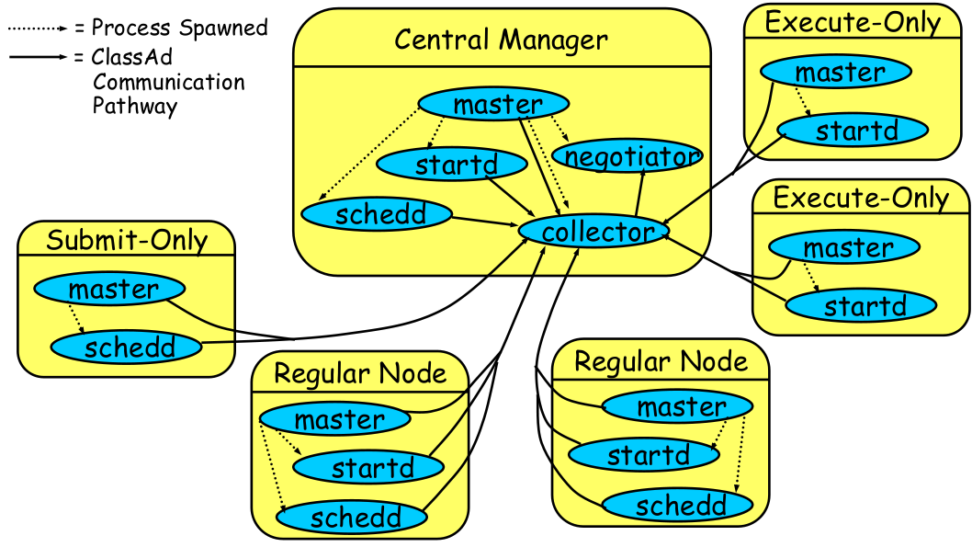
Sample Condor pool

Slide 34
Sample Condor pool
Central manager
Master
Machine
Collector
Machine
Job repository
Machine
Job repository
Negotiator
Machine
Job repository
Machine
Master
Master
Schedd
Startd
Shadow
Shadow
Job

Slide 35

CCB: Condor Connection Broker
Condor wants two-way p2p connectivity
With CCB, one-way is good enough
  Collector requests reversed connections for clients
Execute
Node
CCB
Job Submit Point
Call me back
I want to connect
to the execute node
transfer files
reversed connection
CCB_ADDRESS=ccb.host.name

Slide 36
Limitations of CCB
Collector (CCB Broker) needs to be accessible by everyone
Requires outgoing connectivity
Can’t have BOTH submit and execute points behind different firewalls
Execute
Node
Job Submit Point
no go!
CCB_ADDRESS=ccb2.host
CCB_ADDRESS=ccb1.host

Slide 37
(Vanilla)
Condor protocol

Slide 38
Claiming Protocol
Central Manager
Negotiator
Collector
S
Submit Machine
Execute Machine
S
Schedd
Startd
S
J
J
J
Submit

Slide 39
Claiming Protocol
Central Manager
Q
Negotiator
Collector
J
S
S
Submit Machine
Execute Machine
S
Schedd
Startd
S
J
J

Slide 40
Claiming Protocol
Central Manager
Q
Negotiator
Collector
J
S
S
Submit Machine
Execute Machine
CLAIM
J
S
S
Q
Schedd
Startd
S
J
J

Slide 41
Claim Activation
Central Manager
Negotiator
Collector
Submit Machine
Execute Machine
Schedd
CLAIMED
Startd
Activate
Claim
Starter
Job
Shadow

Slide 42
Repeat until Claim released
Central Manager
Negotiator
Collector
Submit Machine
Execute Machine
Schedd
CLAIMED
Startd
Activate
Claim
Starter
Job
Shadow

Slide 43
When is claim released?
When relinquished by one of the following
  lease on the claim is not renewed
    Why? Machine powered off, disappeared, etc
  schedd
    Why? Out of jobs, shutting down, schedd didn’t “like” the machine, etc
  startd
    Why? Policy re claim lifetime, prefers a different match (via Rank), non-dedicated desktop, etc
  negotiator
    Why? User priority inversion policy
  explicitly via a command-line tool
    E.g. condor_vacate
Defining Rank is dangerous!
(preemption)

Slide 44
The end

Slide 45
The Condor Project (Established ‘85)
Research and Development in the Distributed High Throughput Computing field
Team of ~35 faculty, full time staff and students
  Face software engineering challenges in a distributed UNIX/Linux/NT environment
  Are involved in national and international grid collaborations
  Actively interact with academic and commercial entities and users
  Maintain and support large distributed production environments
  Educate and train students

Slide 46
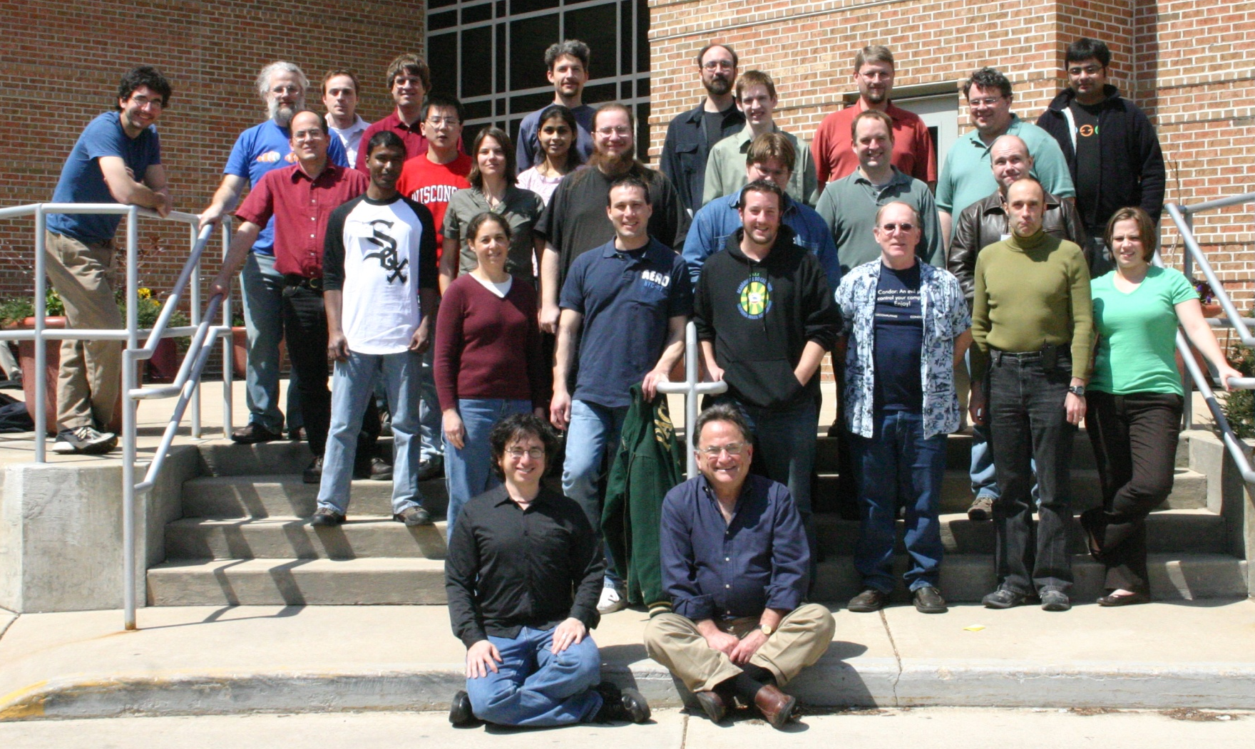
The Condor Team

Slide 47
Pointers
Condor Home Page
http://www.cs.wisc.edu/condor/
Condor Manual
http://www.cs.wisc.edu/condor/manual/v7.6/
Support
condor-user@cs.wisc.edu
condor-admin@cs.wisc.edu

