Slide 1

Security in OSG
Tuesday afternoon, 3:15pm
Igor Sfiligoi <isfiligoi@ucsd.edu>
Member of the OSG Security team
University of California San Diego

Slide 2
Logistical reminder
It is OK to ask questions
  During the lecture
  During the demos
  During the exercises
  During the breaks
If I don't know the answer,
I will find someone who likely does

Slide 3

Grid and DHTC
Grid, as a form of DHTC, is about computing on more than one cluster
Scheduler
Scheduler
Scheduler

Slide 4
Single sign-on
The user should use the same mechanism to submit jobs to any site
  And there are 100s of them in OSG
Hi. I am Igor
Hi. I am Igor
Hi. I am Igor

Slide 5
OSG Auth not password based
OSG not using password authentication
  For several reasons
For starters, it is effectively a
shared secret between
the user and the service provider
  And secrets stay secret only
  if few entities know it
  Imagine sharing passwords
  between 100s of site operators

Slide 6


Adding an intermediary
An alternative approach is to introduce a highly trusted intermediary
Have been used in real life for ages
  e.g. States as issuers of IDs/Passports
  Getting the ID can be a lengthy process,
  but using it is easy afterwards
Hi. Here is my ID
Hi. I am Igor
Hi. Here is my ID
Use this ID
Hi. Here is my ID

Slide 7
Adding an intermediary
An alternative approach is to introduce a highly trusted intermediary
Have been used in real life for ages
  e.g. States as issuers of Ids/Passports
  Getting the ID can be a lengthy process,
  but using it is easy afterwards
Chain of trust.
You are trusted because
the site trusts the issuer,
and the issuer trusted you.
Hi. Here is my ID
Hi. I am Igor
Hi. Here is my ID
Use this ID
Hi. Here is my ID

Slide 8
Technical implementations
Many technical solutions
  x.509 PKI
  Kerberos
  OpenID
  many more...
All based on the same basic principle
  Each has strengths and weaknesses
  OSG standardized on x.509
Will not argue
if it is the best one.

Slide 9
x.509 PKI
Based on public key cryptography
  A user has a (private,public) key pair
    One signs, the other verifies
The highly trusted entity is called a
Certification Authority (CA)
  The user is given a certificate
  Cert. has user name in it
  Cert. also contains the (priv,pub) key pair
  Cert. has a limited lifetime
  Cert. is signed by the CA private key
You should
have one
by now.

Slide 10



x.509 authentication
Sites have CA public key pre-installed
User authenticates by signing a site provided string and providing the public part of the cert
Igor's
Pub Cert
Hi, here is my pub cert
Please sign “10011011”
Here it is “00111011”
Hi, Igor
Associated
Private Key
CA pub

Slide 11
Mutual authentication
The OSG clients also require servers to authenticate
  Same principle as before
  The site's server owns a x.509 certificate
  User client must have the CA pre-installed
So we have mutual authentication

Slide 12
Impersonation
Sometimes your jobs need to impersonate you
  For example to access remote data
CE
Scheduler
SE
Hi... ehm... I am Igor
Job
Storage Element

Slide 13
Impersonation
Sometimes your jobs need to impersonate you
  For example to access remote data
Obviously will not work.
The job does not have
your private key.
CE
We have similar problems in real life, too
  e.g. attorney representing you in court
  Nobody will buy it that he is you,
  yet he can speak on your behalf
Scheduler
SE
Hi... ehm... I am Igor
Job
Storage Element

Slide 14

Proxy delegation
One more reason
why we do not use
passwords
The job is indeed not you
Create a proxy certificate for the job
A proxy is a new certificate issued by your (old) existing certificate
  Just add another level of trust delegation
Job

Slide 15

Proxy delegation
One more reason
why we do not use
passwords
The job is indeed not you
Create a proxy certificate for the job
  Add another level of trust delegation
And send it with the job
CE
Scheduler
SE
Hi... I am Igor
Job
Storage Element

Slide 16
Proxy delegation
One more reason
why we do not use
passwords
The job is indeed not you
Create a proxy certificate for the job
  Add another level of trust delegation
And send it with the job
YES!
You are sending the
proxy's private key
to the WN.
CE
Scheduler
SE
Hi... I am Igor
Job
Storage Element

Slide 17
Risk mitigation
Proxy delegation is risky
  Your proxy could be stolen
In OSG, we mitigate by limiting lifetime
  At most few hours recommended
  After the proxy expires, the proxy is useless
Can be annoying
  Must keep renewing, if long running job!
But we don't have
anything better.

Slide 18
Risk mitigation
Proxy delegation is risky
  Your proxy could be stolen
In OSG, we mitigate by limiting lifetime
  At most few hours recommended
  After the proxy expires, the proxy is useless
Can be annoying
  Must keep renewing, if long running job!
If using HTCondor,
it will automatically
create a short lived proxy
and keep re-delegating it.
Completely
transparent
to you.
But we don't have
anything better.

Slide 19
Authentication vs. Authorization
Just because you can authenticate yourself, it does not mean you are authorized, too
  e.g. your passport tells who you are,
  but does not allow you to drive a car
x.509 PKI only covers authentication
  Tells the site who you are
Need a different mechanism
for authorization

Slide 20
Per-user authorization not an option
The naive approach is using a list
  Since we do not want let just anyone in!
However, the problem is scale
  OSG has ~10,000 users!
  Sites do not want to decide on
  a user-by-user basis!
Server authorization is easy.
Just require host name
in the certificate name;
CA will enforce this.
The client decides
which host to talk to.

Slide 21
Adding roles
Sites want to operate on higher level concepts
  Some kind of attribute
Like in real life
  Think about passport vs driver's license
  Both tell a cop who you are
  (and to 1st approx. are issued by the same entity)
  But the driver's license tells him
  you are allowed to use a car, too
    “Class:C”

Slide 22
Need for an attribute authority
Users can have many roles
  But don't want to have multiple certs
  e.g. I may be running HEP jobs or School jobs
So the attributes cannot come from the CA
  And you would not just trust the user
In OSG, we use VOMS
  Virtual Organization Management System
  OSG expects well organized VOs (e.g. CMS)

Slide 23

VO and VOMS
VO decides who is worthy of an attribute
  Site decides based on that attribute
Register
VOMS
Get proxy+attrs
Hi. I work for CMS
Hi. Here is my ID
Hi. I am Igor
Hi. Here is my ID
Use this ID
Hi. Here is my ID

Slide 24
VO and VOMS
VO decides who is worthy of an attribute
  Site decides based on that attribute
Site still knows who you are
and can act on your name alone.
But they will do it only
for exceptional cases.
Register
VOMS
Get proxy+attrs
Hi. I work for CMS
Hi. Here is my ID
Hi. I am Igor
Hi. Here is my ID
Use this ID
Hi. Here is my ID

Slide 25
More security considerations
There is much more than authentication and authorization to security
  But we don't have the time to cover everything
Just briefly
  Sharing of resources
  Privacy
  Acceptable conduct

Slide 26
Sharing of resources
Modern CPUs are many-core, so
  Very likely your job will be
  sharing the node with other jobs
Sites will map your Grid name into UID
  Hopefully unique... be sure to ask
Standard *NIX protections
  Act accordingly
  e.g. no file should be world writable

Slide 27
Privacy
By default, no privacy in OSG
  Assume all your files are publicly readable
  Apart from your proxy
If you need privacy, you will have to take explicit measures
  Both during network transfers, and
  For files on disk
x.509 can be used for encryption
  But remember, proxy has new keys

Slide 28
Acceptable conduct
Each OSG user is bound by its AUP
(Acceptable User Policy)
  And sites are allowed to have additional rules in place
In a nutshell
  Use only for the declared science purpose
  Do not overload the system
  Do not attempt to circumvent security
Else,
you will be banned!

Slide 29
Questions?
Questions? Comments?
  Feel free to ask me questions later:
  Igor Sfiligoi <isfiligoi@ucsd.edu>
Upcoming sessions
  Now – 5:00pm
    Hands-on exercises
  5:00pm - 7:00pm
    On your own
  7:00pm – 9:00pm
    Evening work session (optional but recommended)

Slide 30
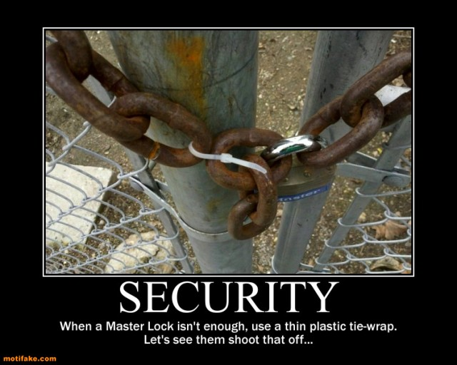
Security is serious business

