Slide 1
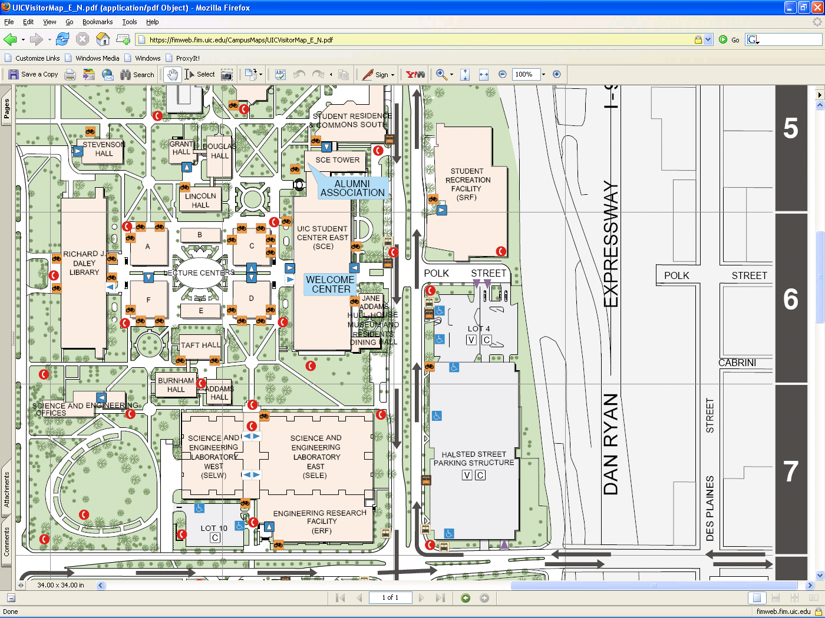
CTA Blue Line UofI/Halstead stop
Workshop
Is in SCE Tower
605 & 401
Parking facility Entrance/exit
Park Here
Enter SCE Here
Parking facility Entrance/exit

