Slide 1

Security in Distributed Computing
Von Welch
June 22, 2011
Notes:
OSG Summer School
June 30, 2011

Slide 2
Overview of talk
First Hour:
What is cybersecurity?
How to think like a cybersecurity person:
  Attacks
  Defenses
Second Hour:
OSG and Cybersecurity:
Mapping the first hour onto the OSG.
Notes:
Attacks and defenses go hand-in-hand, need to be able to think about the former to think about the latter.

Slide 3
What is cybersecurity?

Slide 4
“The objective of computer security includes protection of information and property from theft, corruption, or natural disaster, while allowing the information and property to remain accessible and productive to its intended users." https://secure.wikimedia.org/wikipedia/en/wiki /Cybersecurity
"Security is the process of maintaining an acceptable level of perceived risk." - Richard Bejtlick
"measures taken to protect a computer or computer system (as on the Internet) against unauthorized access or attack"
http://www.merriam-webster.com/dictionary /cybersecurity

Slide 5
My version...
The art and science of maintaining an acceptable level of perceived risk under threat of attacks by malicious parties.
Notes:
"art and science" - it's not a science yet
"acceptable level of risk" - it's not about total safety; trade-offs involved.
"perceived risk" - it's impossible to completely predict the risk.

Slide 6
Cybersecurity uses a number of tools
Training and policy
Identity Management
Cryptography
Limited Privilege
Monitoring and Auditing
Revocation
More on these later...

Slide 7
Let's take a simple scenario...
Online credit card purchase.

Slide 8
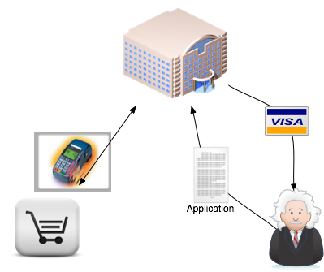
Registration
Notes:
Relationships established between customer and bank and merchant and bank.

Slide 9
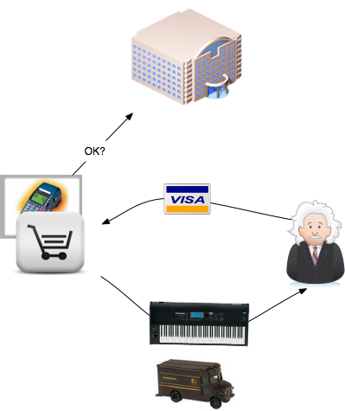
Purchase
Notes:
Purchase by customer. Merchant does an check of card #, expiration, CCV. Ships goods to customer.

Slide 10
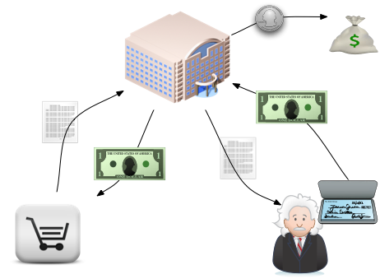
Reconciliation
Notes:
Merchant bills bank, bank bills customer. Bank keeps small percent.

Slide 11
How do we go about securing credit card transactions?
First step, what is it we are securing?

Slide 12
Assets
Things of value.
May be tangible or intangible.
Are often the goals of attack.

Slide 13
Assets
What are the assets in the credit card scenario?

Slide 14
Some assets in credit card scenario...
  Money
  Merchandise
  Credit Card

Slide 15
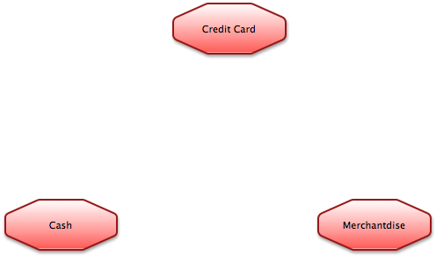
Building an Attack diagram

Slide 16
How would we go about attacking?
First step to figuring out how to defend

Slide 17
Some types of attack...
Impersonation
Stealing confidential information/eavesdropping
Tampering with data/messages
Compromising an entity
Fraud (lying)
Abusing trust

Slide 18
How would you attack the credit card scenario?

Slide 19
Some attack ideas...
Impersonate a customer to get a card.
Run up a bunch of debt and don't pay.
Eavesdrop on the connection and steal card #.
Tamper with order and change ship-to address.
Merchant lies to the bank about a sale.
Employee at merchant steals card #s
Customer lies to the bank about a sale not taking place.
Hacker compromises customer computer and buys stuff.
And many more...

Slide 20
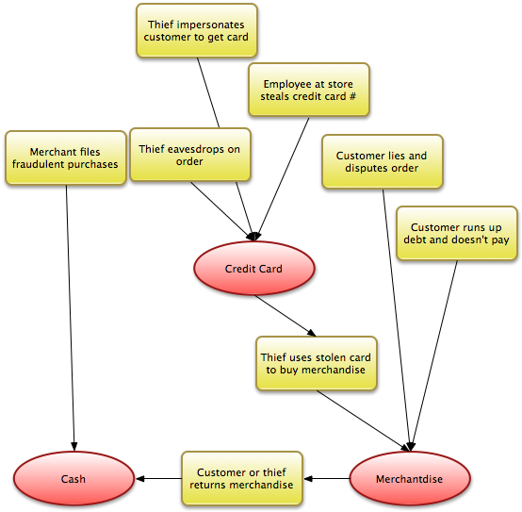
Attack Diagram

Slide 21
Now let's turn to defending...
But first, let's consider our constraints....

Slide 22
Constraints...
Cost
Performance
Usability
Level of trust in participants
Dealing with Failure
Notes:
Will cover examples of all these...

Slide 23
Cost
What is the asset we're guarding worth?
How much will it cost if it is compromised?
How much loss is tolerable?

Slide 24
Performance
How much time can security take?
How much can we slow down the different processes?

Slide 25
Usability
How tolerant are all the participants of extra effort?
How much training do they have?
How often do they need to use the system?

Slide 26
Trust level
We expect all the participants to behave appropriately.
How much do we trust them to do so?
Notes:
Bank, merchant, customer
Bank employees
Merchant employees

Slide 27
What happens if security breaks?
If our security breaks what happens?
Can we fall back to less secure methods?
How much failure can we afford? Retries OK?

Slide 28
Let's talk defense...
Set of processes for preventing, detecting, and responding to attacks.

Slide 29
For each attack...
Consider how it will be:
Prevented
Detected
Responded to

Slide 30
Defense tools
Training and policy
Identity Management
Cryptography
Limited Privilege
Monitoring and Auditing
Revocation

Slide 31
Training and policy
All participants have roles that they play - procedures they follow (and things they avoid doing).
Some is enforced by technology.
Much is enforced because of policy and training.
What training do all the participants in the credit card scenario have?

Slide 32
Training and policy
Examples...
Customers trained to keep CC# secret
Stores don't allow merchandise bought with
CC to be returned for cash.
Merchants must check with bank during purchase.

Slide 33
Identity Management
Vetting and enrolling users
Establishing an authentication mechanism
(passwords, certificate, etc.)
Establishing privileges
Conveying that information to services
Compromised identities - Revocation

Slide 34
Cryptography
Protecting data via:
Confidentiality (secrecy)
Integrity (protection from tampering)
Authentication (who is it from)

Slide 35
Limiting Privilege
Limiting trust in participants.
Preventing abuse.
Limiting fallout if something bad happens.
May cause usability problems if limits are hit often.

Slide 36
Monitoring and Auditing
Watching what is happening.
Keeping records of what is happening.
Reviewing those records
Detecting suspicious events in real time.
Following up later and making sure what happened is what should have happened.
(Policy was followed.)

Slide 37
Revocation
Taking away a privilege you gave out.
Can be difficult...
Take credential back.
Or have to tell everyone credential is no good.

Slide 38
Applying defenses to our credit card scenario...
You can't prevent all the attacks all of the time.
Try to prevent most,
detect all.

Slide 39
Applying defenses to our credit card scenario...
What defenses can you name?

Slide 40
Attack Diagram

Slide 41
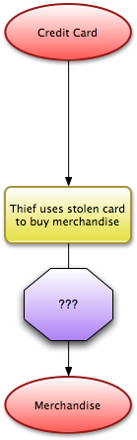
Focusing in on an attack...

Slide 42
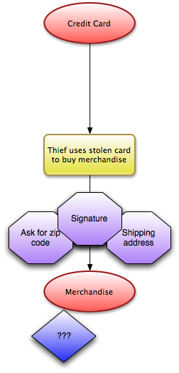
Prevention

Slide 43
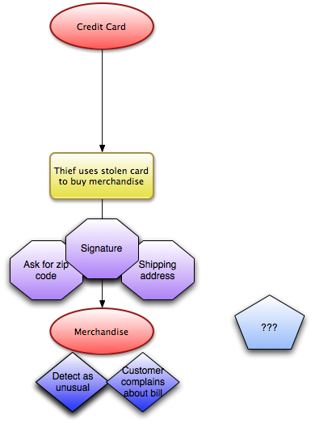
Detection

Slide 44
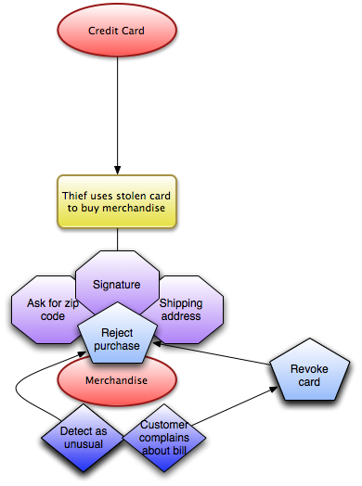
Response

Slide 45
Summary of process
Determine what you are defending
Determine how it could be attacked
Determine what your limitations are for defending it
Apply defenses:
prevention, detection, response.

Slide 46
Break

Slide 47
Cybersecurity and OSG

Slide 48
Let's apply the cybersecurity concepts to OSG...
Let's start with assets again...
But first, let's talk about "secondary assets"

Slide 49
Secondary assets
Something that isn't valuable in itself, but is a significant step to obtaining something valuable.
For example, car keys aren't that valuable unto themselves, ‘but they make getting a car much easier.

Slide 50
What OSG Assets can you name?

Slide 51
Some OSG Assets
Compute elements
Science data
Storage elements

Slide 52
OSG Secondary Assets
User credentials
VOMS membership database
Software stack

Slide 53

OSG Assets

Slide 54
Some types of attack (review)
Impersonation
Stealing confidential information/eavesdropping
Tampering with data/messages
Compromising an entity
Fraud (lying)
Abusing trust

Slide 55
How would you go about attacking the OSG?

Slide 56
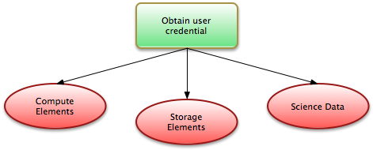
An example OSG attack

Slide 57
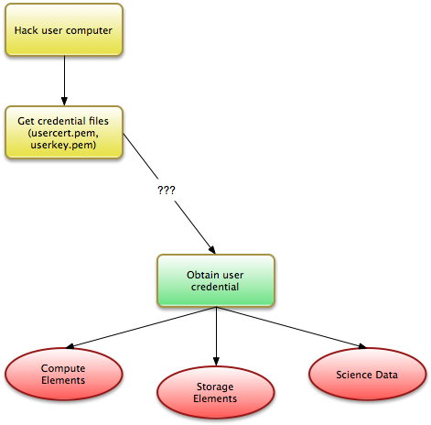
An example OSG attack

Slide 58
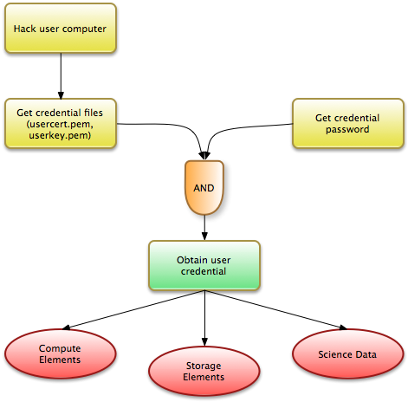
An example OSG attack

Slide 59
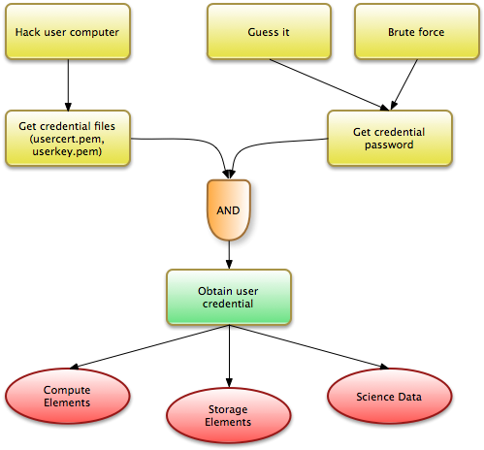
An example OSG attack

Slide 60
Defending the OSG
As before, let's review our constraints.

Slide 61
Cost
What is the asset that we're guarding worth?
How much will it cost if it is compromised?
How much loss is tolerable?

Slide 62
Performance
How much time can security take?

Slide 63
Usability
How tolerant are all the participants of extra effort?
How much training do they have?
How often do they need to use the system?

Slide 64
Trust level
We expect all the participants to behave appropriately.
How much do we trust them to do so?

Slide 65
What happens if security breaks?
If our security breaks what happens?
Does the system break?
Do we fall back to less secure methods?
How much failure can we afford?

Slide 66
Defense tools
Training and policy
Identity Management
Cryptography
Limited Privilege
Monitoring and Auditing
Revocation

Slide 67
Training and policy
All participants have roles that they play - procedures they follow (and things they avoid doing).
Some is enforced by technology.
Much is enforced because of policy and training.
OSG examples?

Slide 68
Training and policy
Acceptable use policy
Password protecting credentials
Keeping systems patched
Summer schools
Training for sites
etc.

Slide 69
Identity Management
Vetting and enrolling users
Establishing an authentication mechanism
(passwords, certificate, etc.)
Establishing privileges
Conveying that information to services
Compromised identities - Revocation

Slide 70
Identity Management
PKI for authentication
with Proxy Certificate for single sign-on
(voms-proxy-init)
VOMS for virtual organization support
PRIMA/GUMS for service-side authorization

Slide 71
Cryptography
Protecting data via:
Confidentiality (secrecy)
Integrity (protection from tampering)
Authentication (who is it from)

Slide 72
Cryptography
Used in SSL to encrypt communications
(job submission, data transfer, etc.)
Used in identity management for certificates,
proxy certificates, securing VOMS data.

Slide 73
Limiting Privilege
Limiting trust in participants.
Preventing abuse.
Limiting fallout if something bad happens.
May cause usability problems if limits are hit often.

Slide 74
Limited Privilege
Authorization based on membership
Processes run in unix accounts
Quotas on computation and storage

Slide 75
Monitoring and Auditing
Watching what is happening.
Keeping records of what is happening.
Detecting suspicious events in real time.
Following up later and making sure what happened is
what should have happened.
(Policy was followed.)

Slide 76
Monitoring and Auditing
Per-job auditing records via Gratia
VDT includes syslog-ng for centralized logging
Sites have their own IDS mechanisms

Slide 77
Revocation
Taking away a privilege you gave out
Can be difficult...
Take credential back
Or have to tell everyone credential is no good

Slide 78
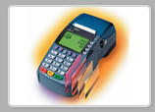
Revocation
PKI revocation is done by CAs
Distributed as a certificate revocation list (CRL)
Resources must pull down CRL frequently
and check certificates against it.

Slide 79
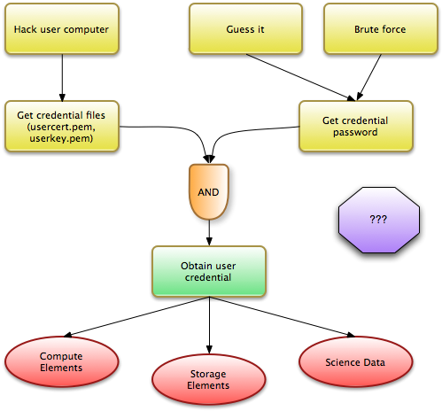
An example OSG attack

Slide 80
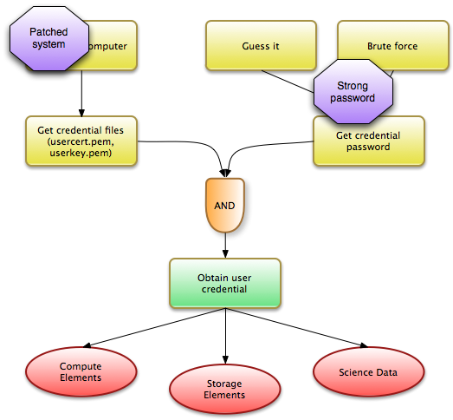
An example OSG attack

Slide 81
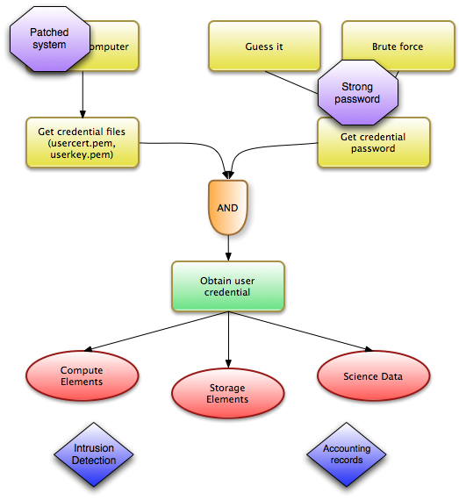
An example OSG attack

Slide 82
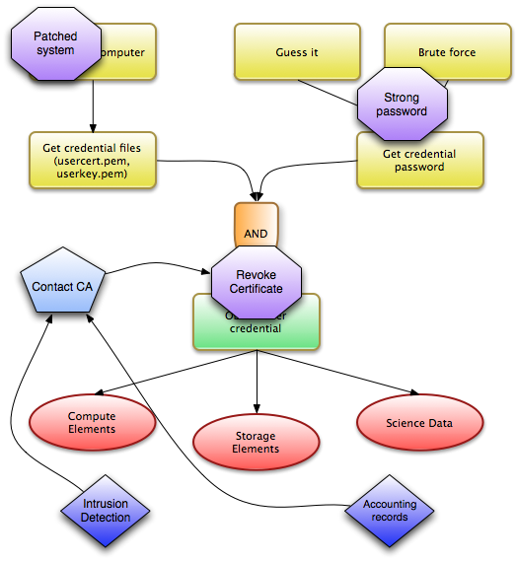
An example OSG attack

Slide 83
Summary of process
Discussed a process for planning cybersecurity defenses based on assets, attacks and constraints
Discussed categories of defenses
Discussed how OSG is defended based on those categories

Slide 84
Some extra thoughts....

Slide 85
Where are the incentives?
Who pays for security? Who suffers the loses?
What if they don't line up?
What if the damage to your infrastructure is largely
born by someone else?
Classic example: nuclear plant next to large city
Policy and law may be needed

Slide 86
Attackers have different motivations...
Some are after what is valuable to you and me
Some are joy riding
Proving your security is too weak
Activism
Hoping to get elsewhere through you

Slide 87
The world changes...
Security needs to be re-evaluated on a regular basis
For example:
Price of copper goes up, it becomes an interesting asset
Mechanisms weaken over time
Motivations of attackers change

Slide 88
Never assume you thought of every attack...
Get multiple sets of eyes to review
Even then assume you've missed something
Insider threat is particularly hard
Audit, audit, audit...

Slide 89
Some uncovered issues...
Privacy
The feeling of safety
Vulnerabilities/coding errors
Ethics, responsible disclosure
Notes:
Not going to talk about these today.
Relationship between security and privacy is complicated - it is not one vs the other.
How security people feel is not necessarily correlated with how secure they are.
Human nature plays into phishing and similar issues
Incentives - how motivated are participants to play their role.

Slide 90
Thank you.
Acknowledgements
Thanks to Mine Altunay and Jim Basney for input on this presentation.
Cheryl Bennet, Dara Eckart, Kristy Kallback-Rose, Ryan Hartman, Suresh Marru, George Turner, Jim Williams for feedback on early version of this presentation.
vwelch@indiana.edu

