Slide 1
OSG Site installation and Maintenance
Suchandra Thapa
Computation Institute
University of Chicago

Slide 2
Introduction to OSG
Introduction to OSG
Site Policies and Requirements
Installing an OSG site
Maintaining a site
Q&A time

Slide 3
Introduction to OSG
OSG stands for Open Science Grid
Provides high-throughput computing across US
Currently more than 75 sites
Recent stats:
282,912 jobs for 433,051 hours
Used 75 sites
Jobs by ~20 different virtual organizations
92% of jobs succeeded
Underestimate: 4 sites didn’t report anything
Provides opportunistic computing for VOs
Focus on high-throughput computing rather than high performance computing

Slide 4
Basic Terms
CE – Compute Element
SE – Storage Element
VO – Virtual Organization
WN – Worker Node
GOC – Grid Operations Center
GUMS – Grid User Management Server

Slide 5
Site Policies and Requirements
Introduction to OSG
Site Policies and Requirements
Installing an OSG site
Maintaining a site
Q&A time

Slide 6
Your role as an admin
As a site admin, you should:
Keep in touch with OSG (downtime, security, etc.)
Provide the GOC with a site policy and register your site with the GOC
Respond to trouble tickets or inquiries from GOC
Plan your site’s layout
Update software as needed (within limits)
Participate and be a good community member

Slide 7
Support provided for admins
OSG provides:
Software and ancillary information (configuration tools, documentation, recommendations)
Assistance in keeping site running smoothly
Help in troubleshooting and installing software
Users for your site
An exciting, cutting-edge, 21st-century collaborative distributed computing grid cloud buzzword-compliant environment

Slide 8
Incident Response Policy
Incident: any real or suspected event that poses a real or potential threat
You MUST Report and Respond
Report: email security@opensciencegrid.org
abuse@opensciencegrid.org
+1 317-278-9699
https://twiki.grid.iu.edu/twiki/bin/view/Security/IncidentDiscoveryReporting
Respond: follow this policy in collaboration with OSG

Slide 9
Incident Response Policy (Part 2)
When contacting OSG, let us know:
If any certs are compromised, or suspicious
If any VO accounts are affected
Have you informed any CA for revocation ?
Have you shut down the node ? Will you ?
Any suspicious connection out of your node to another grid resource ?
Any corrupted data
Please KEEP US INFORMED, keep emailing during your forensics, even if you think it is embarrassing – We are ALL in this together
Notes:
Mention 2 cnaf incidents we can work with you and had incidents before. Your support is important.

Slide 10
Installing an OSG Site
Introduction to OSG terms and operations
Site Policies and Requirements
Installing an OSG site
Maintaining a site
Q&A time

Slide 11
Site planning
Bureaucratic details
Cluster layout
Disk layout / sharing
Authorization

Slide 12
Bureaucracy
Certificates (personal/host)
VO registrations
Registration with OSG
Need a site name (e.g. UC_ITB)
Need contacts (security, admin, etc.)
Site policy on web

Slide 13
Starting out
Everyone using OSG gets a personal certificate because it is required to do any activity on an OSG resource
Will need to know or contact someone with DOEGrids certificate in order to obtain a personal certificate

Slide 14
Site Registration using OIM
Done using OIM at https://oim.grid.iu.edu/
Will need to register first,
After GOC approves registration :
Registrations > Resources > Add New Resource

Slide 15
Cluster Layout
How is software / data being shared
NFS can work but gets bogged down with larger workloads
Where do services run?
Single server vs. dedicated servers
Worker node software?
Locally present on worker nodes vs. served over nfs
Certificates shared?

Slide 16
Required Directories for CE / Cluster
OSG_APP: Store VO applications
Must be shared (usually NFS)
Must be writeable from CE, readable from WN
Must be usable by whole cluster
OSG_GRID: Stores WN client software
May be shared or installed on each WN
May be read-only (no need for users to write)
Has a copy of CA Certs & CRLs, which must be up to date
OSG_WN_TMP: temporary directory on worker node
May be static or dynamic
Must exist at start of job
Not guaranteed to be cleaned by batch system

Slide 17
Optional directories for CE
OSG_DATA: Data shared between jobs
Must be writable from the worker nodes
Potentially massive performance requirements
Cluster file system can mitigate limitations with this file system
Performance & support varies widely among sites
0177 permission on OSG_DATA (like /tmp)

Slide 18
Space Requirements
Varies between VOs
Some VOs download all data & code per job (may be Squid assisted), and return data to VO per job.
Other VOs use hybrids of OSG_APP and/or OSG_DATA
OSG_APP used by several VOs, not all.
1 TB storage is reasonable
Serve from separate computer so heavy use won’t affect other site services.
OSG_DATA sees moderate usage.
1 TB storage is reasonable
Serve it from separate computer so heavy use of OSG_DATA doesn’t affect other site services.
OSG_WN_TMP is not well managed by VOs and you should be aware of it.
~100GB total local WN space
~10GB per job slot.
Notes:
For testing purposes much less space (~5GB total) can be provided

Slide 19
Worker Node Storage
Provide about 12GB per job slot
Therefore 100GB for quad core 2 socket machine
Not data critical, so can use RAID 0 or similar for good performance

Slide 20
Authorization
Two major setups:
Gridmap setup
File with list of mappings between DN and local account
Can be generated by edg-mkgridmap script
Doesn’t handle users in mulitple VOs or with VOMS roles
GUMS Service with list of mappings
A little more complicated to setup
Centralizes mappings for entire site in single location
Handles complex cases better (e.g. blacklisting, roles, multiple VO membership)
Preferred for sites with more complex requirements
Ideally on dedicated system (can be VM)

Slide 21
CE Installation Overview
Prerequistes
Certificates
Users
Installation
Pacman
Configuration
Getting things started

Slide 22
Local accounts
You need following local accounts:
User for RSV
Daemon account used by most of VDT
Globus user is optional but will be used if found

Slide 23
Basic installation and configuration
Install Pacman
Download
http://physics.bu.edu/pacman/sample_cache/tarballs/pacman-3.26.tar.gz
Untar (keep in own directory)
Source setup
Make OSG directory
Example: /opt/osg symlink to /opt/osg-1.0
Run pacman commands
Get CE (pacman –get OSG:ce)
Get job manager interface (pacman –get OSG:Globus-Condor-Setup)
Configure
Run edg-mkgridmap or gums-host-cron
Configure CA certificates updater
Edit config.ini
Run configure_osg.py (configure-osg.py –c)
Start services (vdt-control –on)

Slide 24
Site Maintenance
Introduction to OSG terms and operations
Site Policies and Requirements
Installing an OSG site
Maintaining a site
Q&A time

Slide 25
Updating CAs
CAs are regularly updated
New CAs added
Old CAs removed
Tweaks to existing CAs
If you don’t keep up to date:
May be unable to authenticate some user
May incorrectly accept some users
Easy to keep up to date
vdt-update-certs
Runs once a day, gets latest CA certs

Slide 26
Monitoring Site Status
Several tools available
RSV
Part of install
Will present a web page with quick status update site functionality
Can integrate with nagios
Nagios/Ganglia/Cacti
Presents information on non-grid specific details of cluster
Can set up alerts, pages, etc.
Gratia
Provides accounting information on jobs running on your site
Useful to see who is using your site and how much utilization comes from various users
Daily/Weekly email reports
Provides quick information on your site and osg at large at a glance

Slide 27
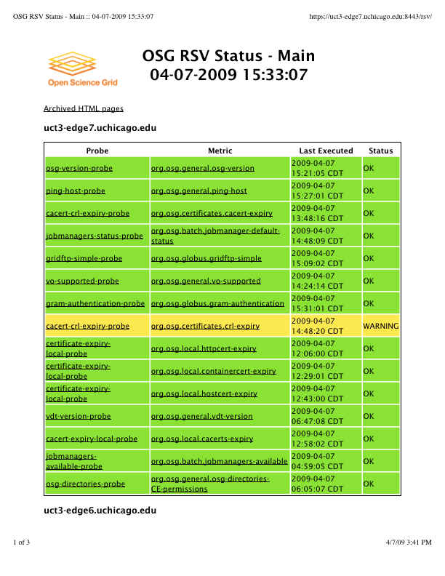
RSV output for UC_ITB resource
Web page generated by RSV showing the output of various probes. Clicking on the probe output will give history for last few invocations and error output

Slide 28
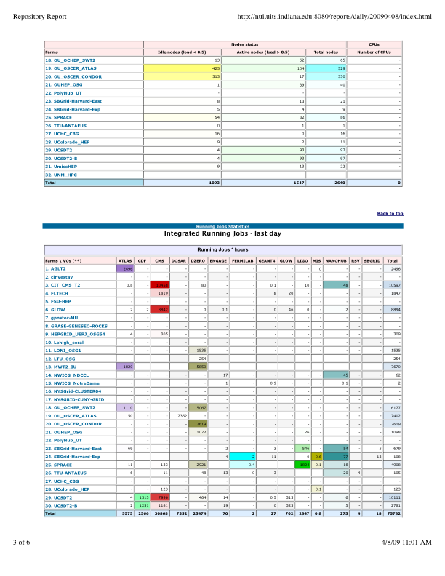
Daily Email report on Production Sites
Example of the daily email sent out to administrators with information on jobs and sites over the last day

Slide 29
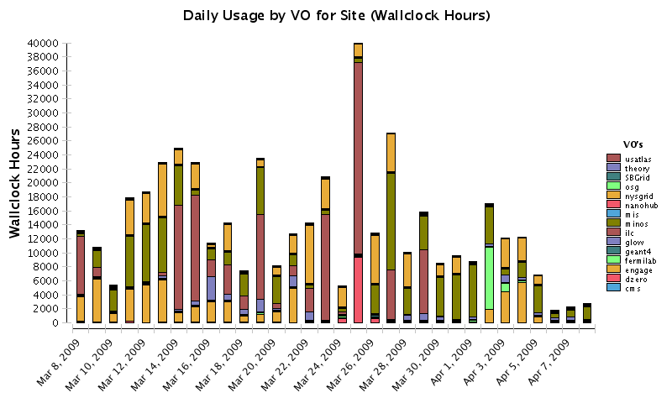
Gratia Report for the last Month at Fermigrid
This shows the daily usage by VOs of the Fermigrid resource over the last month as VO validations were run

Slide 30
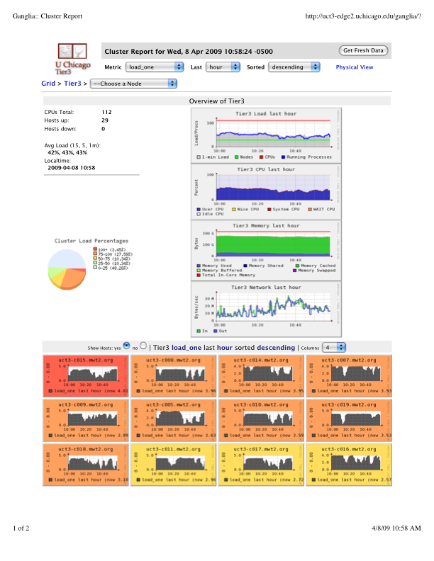
Ganglia Output for Cluster at UC
Top level information on the servers and compute nodes at a small cluster at the University of Chicago, clicking on hosts will allow more detailed information on each host to be obtained

Slide 31
Incremental Updates
Frequent (Every 1-4 weeks)
Can be done within a single installation
Either manually:
Turn off services
Backup installation directory
Perform update (move configuration files, pacman updates, etc.)
Re-enable services
Or use vdt-updater script (automates the above steps)

Slide 32
Major Updates
Irregular (Every 6-12 months)
Must be a new installation
Can copy configuration from old installation
Process:
Point to old install
Perform new install
Turn off old services
Turn on new services

Slide 33
Questions? Thoughts? Comments?
Introduction to OSG terms and operations
Site Policies and Requirements
Installing an OSG site
Maintaining a site
Q&A time

Slide 34
Acknowledgements
Alain Roy
Terrence Martin

