Slide 1

OSG Executive Retreat Update
Brooklin Gore, Project Manager
June 4, 2013
Dan Fraser (Prog. Mgr), Miha Ahronovitz (UX), Derek Weitzel, Marco Mambelli, Jaime Frey (Developers)

Slide 2
Version 1.2
Released June 3, 2013 - one month late.
You will notice right away that it is much easier to install…handle more jobs than ever before, will send clearer error messages…
Now - drive usage
Great training tool (UC3). OSG Summer School?

Slide 3
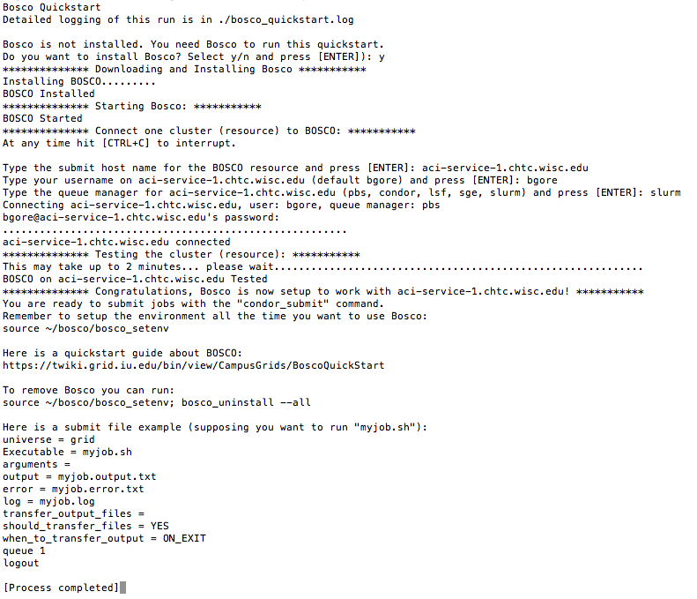
Quickstart

Slide 4
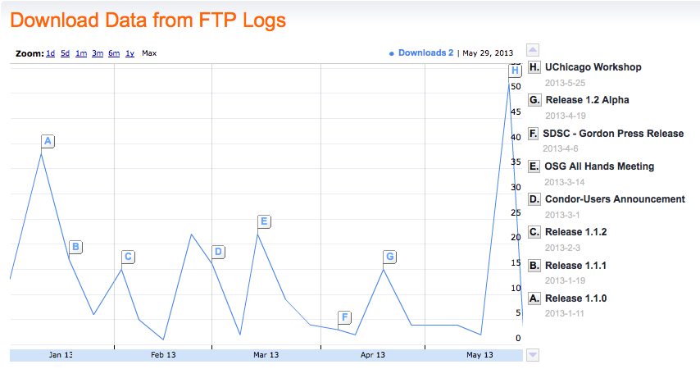
Anemic Adoption

Slide 5
Version 1.3 (2.0)
Can we get rid of the command line?
Mac GUI
Integrate with R
GridR integration underway (Derek)
Introduce at R user conference (Dan, July, Spain)
Then, MatLab, Galaxy, etc…..(v.next)
Release target Sept. 1, 2013

Slide 6
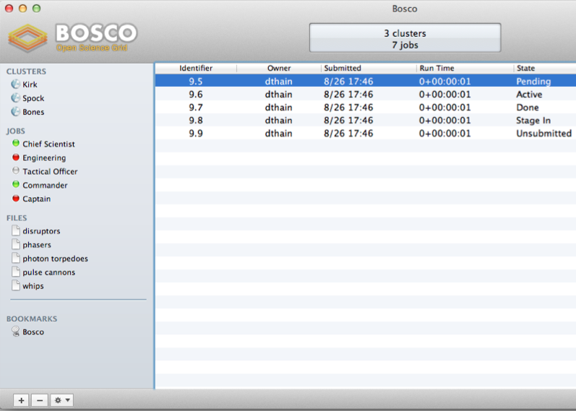
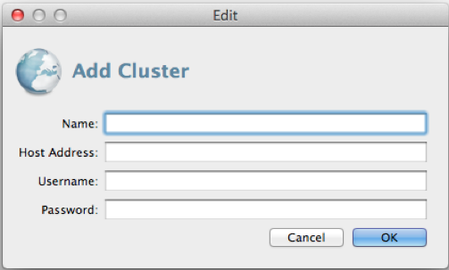
Mac GUI?

