Slide 1
Security for Open Science Center for Enabling Technology
Lead PI - Deb Agarwal, Lawrence Berkeley National Laboratory
-
Lawrence Berkeley National Laboratory - Brian Tierney, Mary Thompson
Argonne National Laboratory - Frank Siebenlist, Ian Foster
Pacific Northwest National Laboratory - Jeff Mauth, Deb Frincke
University of Illinois, NCSA - Von Welch, Jim Basney
University of Virginia - Marty Humphrey
University of Wisconsin - Miron Livny, Bart Miller
National Energy Research Scientific Computing Center - Howard Walter
Energy Science Network - Michael Helm
University of Delaware – Martin Swany

Slide 2
Guiding Principles
Focus on capabilities that are priorities for and are NEEDED by DOE applications and facilities
Work closely with a few committed applications and facilities to develop capabilities
Provide development and deployment of security solutions with and in support of DOE applications and facilities
Deliverables
  18 months - Concrete near term goals for deployment activities
  year 3 and year 5 - Longer term deliverables for deployment and possible research activities
Will provide extensive deployment support

Slide 3
Management Structure
Project Lead – Deb Agarwal
Participating Organizations:
  LBNL, ANL, PNNL, NCSA, Univ. Wisconsin, Univ. Virginia, ESnet, NERSC, Univ. Delaware
Currently Planned application Partnerships
  OSG, Fusion, Astronomy (LANL), ESG, etc
Currently Planned Facilities Partnerships
  NERSC, NCSA, ESnet, NLCF, etc

Slide 4
Distributed Science Security Problem
Applications and Middleware poorly integrated with site security
Difficult to track users and usage across sites
Virtual organizations and sites do not have all the tools needed to manage security
Forensics in distributed environments is tedious and information is scarce
Grid middleware poses a potentially inviting hacker target in the future as we deploy these large grids
Credential revocation is very difficult currently
Firewalls often limit the application connectivity options

Slide 5
Interrelated Topic Areas
Auditing and forensics
  Services to enable sites, communities, and application scientists to determine precisely who did what, where and when.
Dynamic ports in firewalls
  Services to open and close ports dynamically for applications while enforcing site policy.
Identity management
  Services to seamlessly manage identity and access control across sites and collaborations, and to allow for rapid response to security incidents.
Secure middleware
  Services to proactively find and fix software vulnerabilities and guarantee deployed security software is current and correctly configured.

Slide 6
Auditing/Forensic Tools
The Problem:
  Multi-institutional collaborations with extensive remote access
  Virtual organizations need to be able to track resource usage, credential usage, data access, etc
  Difficult to get consistent audit information across sites
  Different groups need different audit information
  Sample questions that are currently hard to answer:
    Give me a list of all data files opened by User X in the last week
    What are the list of sites that user X accessed in the past week?
    How much CPU did VO X use at site Y in the past month?
    Give me a list of all users who used shared account X on resource Y yesterday.
    Who made requests to the dynamic firewall service yesterday?
    Did the IDS see any traffic on ports that where supposed to be closed, based on auditing information from the dynamic firewall service?

Slide 7
Auditing/Forensic Tools cont.
High-Level Approach:
  An end-to-end auditing infrastructure which uses a policy language to allow resource (both systems and data) owners specify where auditing information may be published and who may access the audit logs.
Components
  Logging software (instrumentation) - Applications call easy-to-use libraries to log events with detailed information.
  Normalizers– Agents transform existing logs so that they can be incorporated into the common schema of the audit system.
  Collection sub-system (forwarder) – Audit logs are collected by a dependable, secure collection system.
  Repository (database, publisher) – Audit logs are sent over the network, normalized, and archived. Then they are made available through a query interface.
  Forensic tools (analysis) – Forensic tools query and process the audit data to find problems and answer questions.

Slide 8
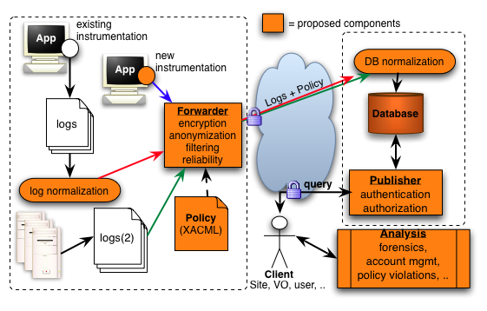
End-to-End Auditing System

Slide 9
Dynamic Host Firewall Ports
The Problem:
  Ports needed by Grid middleware are often blocked by firewalls
    These firewalls are both host-based and network-based.
    Dynamically assigned ports are particularly problematic
      E.g.: GridFTP data ports
  Many sites allow outgoing, but not incoming connections
    How do a Grid FTP between 2 sites that both only allow outgoing connections?

Slide 10
Dynamic Firewalls, cont.
High-level Approach:
  Tools and services to dynamically open and close ports needed by applications and middleware based on authentication and authorization
Components
  Configuration Broker maintains the overall state of the firewall configuration for the site, validates user credentials, and verifies that requested actions are consistent with site policy restrictions.
  Firewall Agent interacts with the existing site firewall systems, receiving direction from the Configuration Broker.
  The Validation Service receives information about the completed firewall changes and continually analyzes network traffic to insure there are no errors in the firewall configuration.
  The Programming API is the mechanism for software to make requests to the broker.

Slide 11
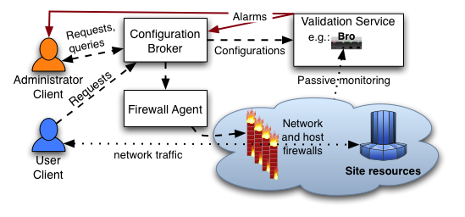
Dynamic Firewall System

Slide 12
Identity Management
Problem:
  Revocation mechanisms are slow and cumbersome
  Level of integration amongst various solutions incomplete
  Nagging issues of credential renewal, configuration management, etc.
Near Term Approach:
  Build on existing solutions:
    VOMS, CAS, GUMS, MyProxy, GSI, OCSP
  Integrate and deploy, e.g.
    Deploy OCSP service; client support in GT, MyProxy, etc.
    VOMS support in GridFTP, MyProxy
    GUMS callout into GT, MyProxy

Slide 13
Identity Management
Longer term:
  XKMS support to ease configuration management
  Integrate data access control policy with work on semantic workflows
  PKCS 11 support
  Ubiquitous hooks in middleware for site security integration
    E.g. Kerberos, auditing,

Slide 14
Secure Middleware
Problem
  Grid middleware has become an essential part of the science infrastructure security of this infrastructure is an essential consideration
Approach - steps
  Architectural analysis to understand the system level view of a middleware component and its external interactions
  Identify trust boundaries/threat model to understand the dependencies and areas of concern
  Component and system analysis of the particular software to understand vulnerabilities
  Disclosure of results process is handled carefully to allow time for mitigation efforts
  Mitigation mechanisms to provide means of patching or mitigating the potential security vulnerability

Slide 15
Status
Project starts October 1, 2006
Five year development and implementation plan
Aggressive schedule and tight funding
Expect to be able to work closely with and leverage extensively other efforts already underway internationally

