Slide 1
OSG Area Report
Production – Operations – Campus Grids
Jan 11, 2011
Dan Fraser

Slide 2
Current Production Focus
Transition to RPMs
  ABCD team continuing to support Software
  Main RPM packages have been released
    Still to come
      GUMS
      Gratia
  Restructuring the Documentation for RPMs
    https://twiki.grid.iu.edu/bin/view/Documentation/Release3/WebHome
    Doc Fest Mon-Tues this week

Slide 3
Other Production Items
LIGO - Einstein at Home is no longer being supported under the new contract
  Still some work on LIGO – PULSAR (Britta)
  Britta working until end March
Atlas, CMS, and other VOs steadily moving
  Major issue involving VOMS-RS/ VOMS-Admin / GUMS
  No major RPM issues yet
OSG – XSEDE Collaboration
  Chander is leading this effort

Slide 4
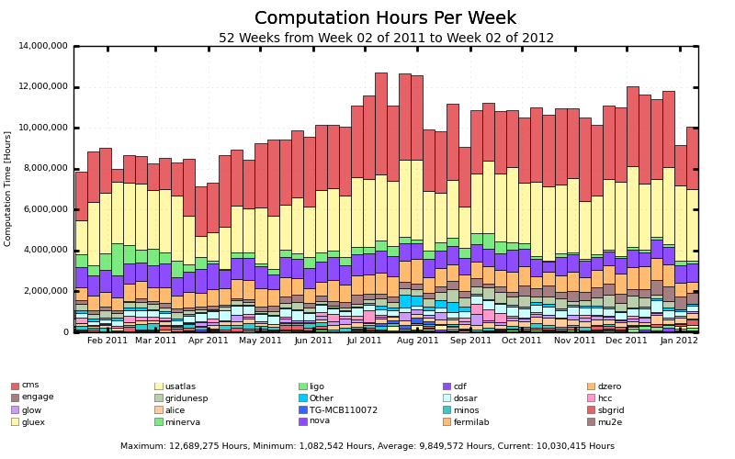
Overall Production

Slide 5
Some Production Issues…
Effort from the entire team
  Transition to BDII v5 – still problems
  Successful Gratia upgrade to new version
    Not sure yet about performance improvements
  Recent compromise of TTU
  Security vulnerabilities w/Apache, OpenSSL
  …

Slide 6
Campus Grid Status
Campus grid working in production:
  Glow, Diagrid (All Condor campus grids)
  Nebraska
  University of Florida (not being used much yet)
Pre-Production:
  RENCI
  Virginia Tech (Bio-tech)
    http://gratiaweb.grid.iu.edu/gratia/xml/glidein_hours_bar_smry?probe=condor:dhcpseven237.bioinformatics.vt.edu
  Virginia Tech (Belle, DayaBay)
  FIU
Discussions with UWashington

Slide 7
Campus Grid Direction
Make the factory easier to install / maintain
  Current factory = flocking + glide-in + BLAH
  Fewer “assumptions” about the existing environment
Parallel path of using SSH + BLAH
  Have been working with Condor & CG team
  BOSCO (Blah over SSH Condor Overlay)
  http://www.boscoworld.com/ ☺
New Documentation
  Focus on end user
  Manage multiple sites from one submit host (SSH)
The hard part is not “technology” but finding / keeping users

Slide 8
Campus Grids Draft Project Plan
Release of BOSCO #1 Q1
  New Documentation for SSH
  New Docs for SSH + Central Factory
  Testing plan (tbd)
Plan for handling CG accounting Q1
Release of BOSCO #2 Q2
  RPM package for the VDT
  Include Centralized Campus Factory
  Distribution plan

