Slide 1
OSG Finance Board
Project & Resource Management Report
Chander Sehgal
09 May 2008

Slide 2
Outline
Year 2 Status
  Finances
  Staffing
  WBS Execution Status
  Project Management Processes
Observations from OSG NSF/DOE Review on Jan 22,23
Year 3 Planning
  Year3 Planning Process Overview
  Strategic Roadmap (years 3-5)
  Master Schedule

Slide 3
OSG Year2

Slide 4
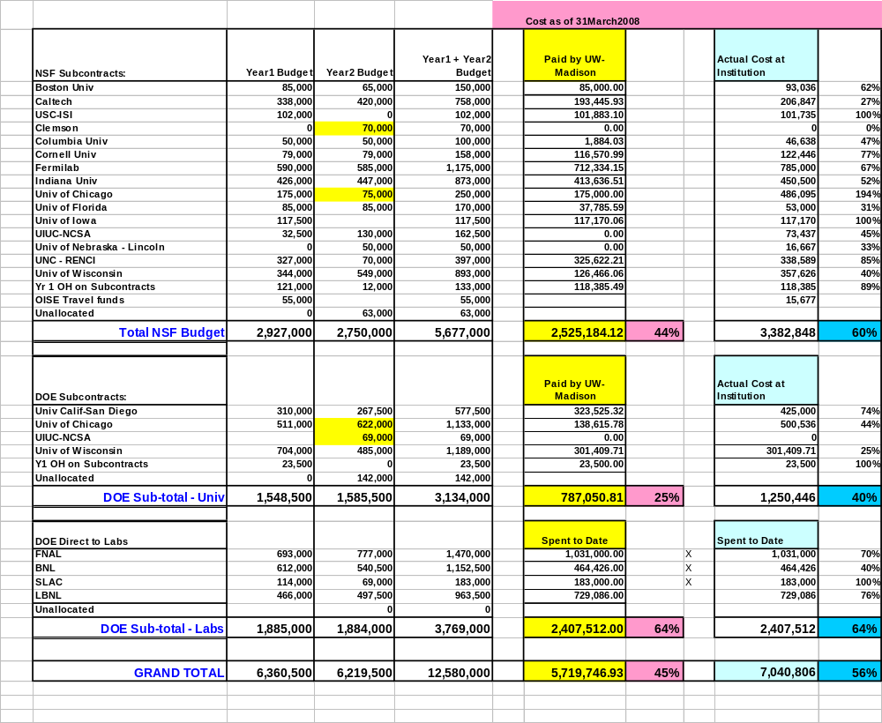
Year2 Financial Update
Budget & Cost

Slide 5
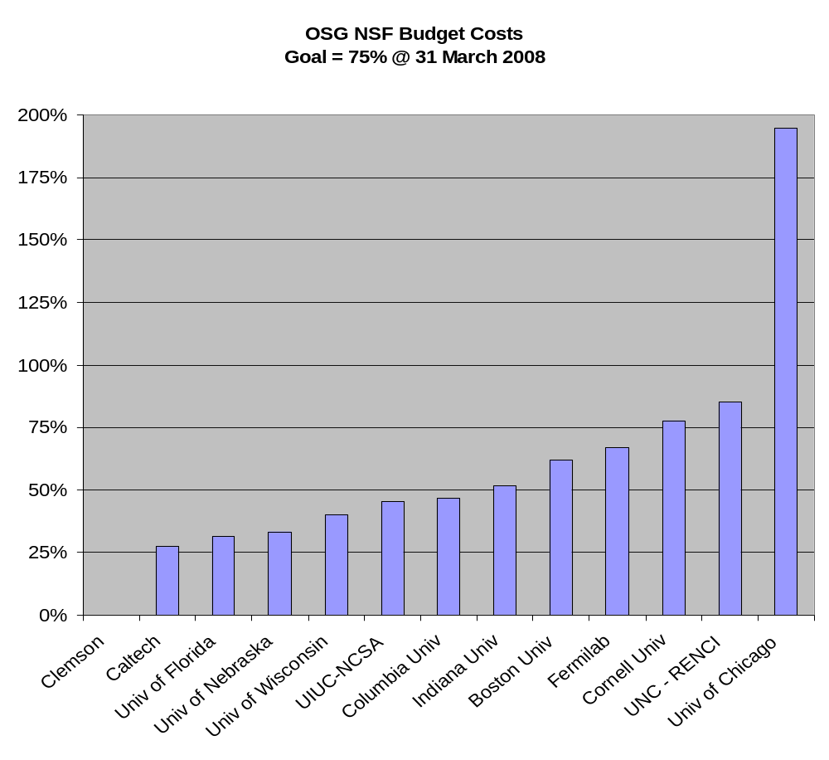
Year2 Financial Update
NSF Funds Utilization
NSF Funding Provided so far covers till 10/1/06 to 9/30/08
U-Chicago costs being moved to DOE (NSF+DOE cost is within budget)

Slide 6
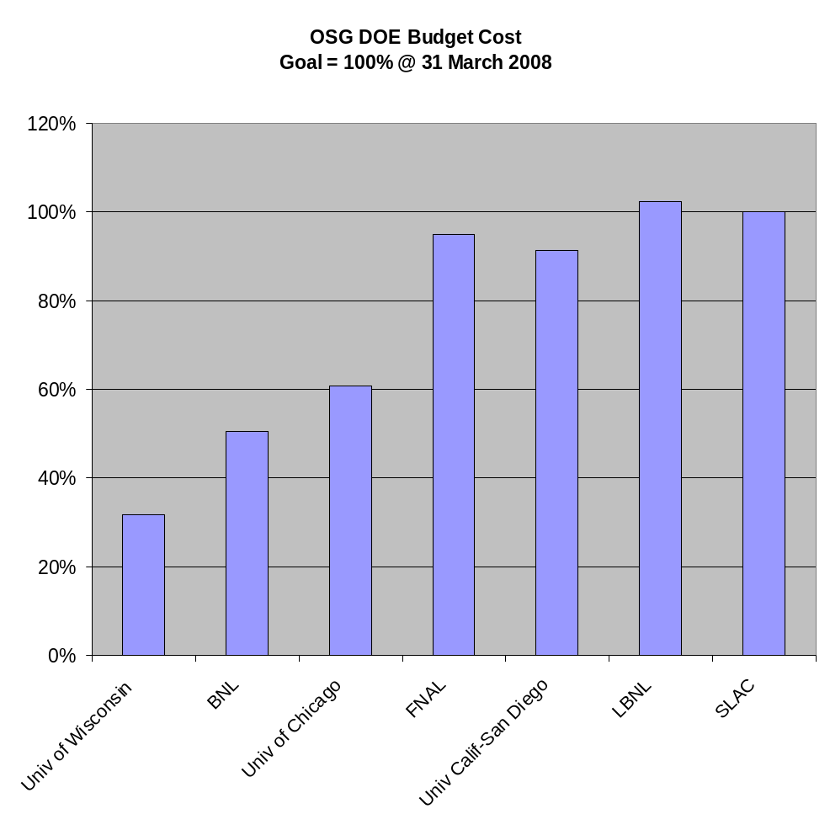
Year2 Financial Update
DOE Funds Utilization
DOE budget provided so far covers 10/1/06 to 3/31/08
U-Chicago pending transfer of costs currently against NSF (NSF+DOE cost is within budget)

Slide 7
Year2 Budget Process
Observations
NSF FastLane Process for authorizing new sub-contracts can take a long time
Moving DOE money between National labs and Universities requires Supplemental Proposal via Grants.gov
Unclear if “Savings” at National Labs result in funding being lost due to nature of FWP process? [We are waiting to see amount funded to national labs and UW-Madison for period starting 4/1/08]

Slide 8
Year2 Key Staffing Changes
Institutions
  Added Nebraska, Clemson (finally!) – one year commitment
  SLAC can no longer continue on Security Work; transitioned to UIUC/NCSA
  South Africa WITS status (via Columbia – part of EOT program) may need review due to movement of key staff
  Cornell status will need review due to lay-off of OSG staff (0.5 FTE)
Staff Changes
  FNAL redeployed 0.7 FTE from Communications/Technical Documentation short term to fill iSGTW USA position (since EGEE now deploying 1.0 FTE)
  U-Chicago 0.5 FTE re-directed to Education & Release Documentation
  UIUC/NCSA deployed 0.5 FTE to work on OSG Security
Staff Vacancies
  Deputy Facility Coordinator (at Wisconsin) - Interim 0.2 FTE in-place
  VDT Software Engineer (at Wisconsin)
  LIGO Applications Software Engineer (at Caltech)
  Software Engineer (at Cornell) ?
  Grad Student (at Florida) ?

Slide 9
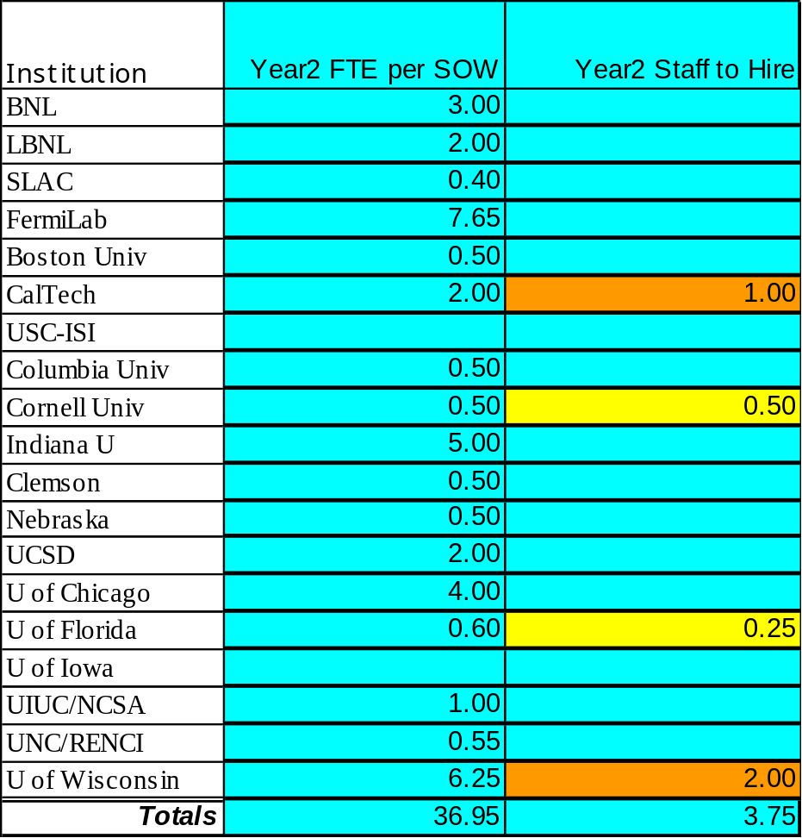
Year2: Staffing Status

Slide 10
Year2 WBS Execution Status
WBS posted on OSG Reports Twiki
  https://twiki.grid.iu.edu/twiki/bin/view/OSGReports/UpdateWbs
Monthly Update using Twiki based WBS update tool
  Process updates from last month
  Issue Email Alerts on (potentially) late milestones
Current year2 WBS Statistics (on 30Apr08)
  264 total tasks
    65 summary tasks
    199 non-summary tasks
      33 tasks complete – 17%
      110 tasks on-plan – 55%
      56 tasks late – 28%
Started documenting agreements with external projects

Slide 11
Year2 Agency Milestones
WBS | Task | Owner | Finish | Percent | Projected
1.1.5.1 | Package dCache version 1.8 for OSG V1.0 | Hesselroth | 12/01/07 | 100%
1.5.1 | Production use of OSG by a 3rd new Research Group | McGee | 03/01/08 | 100%
3.3.1.4 | Wits (South Africa) cluster running jobs submitted from OSG | Dodd, Connell | 03/31/08 | 100%
2.1.4 | V2 of Security Management Plan | Altunay | 04/04/08 | 100%
1.3.1.1.2 | Integrate and test OSG 1.0 | Gardner | 02/15/08 | 25% | 06/02/08
1.5.4 | Support & Integrate 1st new additional campus grid with OSG | Goasguen | 03/01/08 | 0% | 08/15/08
1.3.1.2.2 | Integrate and test OSG 1.2 | Gardner | 08/15/08 | 0%
5.2.3 | Final report on operational metrics for year2 | Bockelman | 09/15/08 | 0%

Slide 12
Year2 Science Milestones - 1
WBS | TaskName | InCharge | Finish | %Complete
6.1 | CMS |  | 05/30/08 | 65%
6.1.1 | CMS: 30K Batch slot hours of Opportunistic Computing in Support of CMS CSA07 | Ian Fisk | 10/30/07 | 50%
6.1.2 | CMS: 70K Batch slot hours of Opportunistic Computing in Support of CMS Cosmic running | Ian Fisk | 12/30/07 | 100%
6.1.3 | CMS: Support of CMS Tier-2s delivering 1.1M Batch slot hours during CSA07 | Ian Fisk | 12/30/07 | 100%
6.1.4 | CMS: Support of CMS Tier-2s delivering 0.75M Batch slot hours during Cosmic running | Ian Fisk | 12/30/07 | 0%
6.1.5 | CMS: Support of CMS Tier-2s delivering 3.8M Batch slot hours during Computing Commisioning | Ian Fisk | 05/30/08 | 100%
6.1.6 | CMS: 300K Batch slot hours of Opportunistic Computing in Support of CMS Computing Commisioning | Ian Fisk | 05/30/08 | 33%
6.1.7 | CMS: Wide area network: Data distribution throughput bursts of 50-500MB/sec at each Tier2 | Ian Fisk | 11/12/07 | 77%
6.1.8 | CMS: Local area network: 400-800 MB/sec from mass store to each Worker Node. | Ian Fisk | 11/12/07 | 50%

Slide 13
Year2 Science Milestones - 2
WBS | TaskName | InCharge | Finish | %Complete
6.2 | ATLAS | Jim Shank | 07/01/08 | 65%
6.2.1 | Successful support for M3-M6 cosmic sample processing | Jim Shank | 01/05/08 | 80%
6.2.2 | Support for data distribution for T1, T2 at 95% average data availability with 48hr latency | Jim Shank | 03/01/08 | 60%
6.2.3 | 100% utilization of full T1 & T2 processing capacity | Jim Shank | 07/01/08 | 90%
6.2.4 | Use of 10 non-ATLAS opportunistic sites | Jim Shank | 07/01/08 | 40%
6.3 | CDF |  | 11/12/07 | 0%
6.3.1 | CDF: opportunistic Monte Carlo and Analysis on OSG sites at 5,000 jobs/day | Rick Snider, Stephan Lammel | 11/12/07 | 0%
6.3.2 | CDF: Completion of V7 reprocessing on FermiGrid and CDF OSG sites | Rick Snider, Stephan Lammel | 11/12/07 | 0%

Slide 14
Year2 Science Milestones - 3
WBS | TaskName | InCharge | Finish | %Complete
6.4 | D0 | Brad Abbott | 06/15/08 | 100%
6.4.1 | D0: Generate an average of 4 million Monte Carlo events/week on OSG | Brad Abbott | 06/15/08 | 100%
6.4.2 | D0: Process data within 5 days of it being collected using OSG | Brad Abbott | 12/15/07 | 100%
6.4.3 | D0: D0 analysis code fully running on OSG | Brad Abbott | 06/15/08 | 100%
6.5 | STAR: 10,000 jobs/day | Jerome Lauret | 11/12/07 | 0%
6.6 | LIGO: Demonstrate use of OSG grid accessible storage for LIGO application | Blackburn | 11/30/07 | 10%
6.7 | NanoHUB: 200 hours/day on OSG sites with 90% success rate | Gerhart Klimeck | 11/12/07 | 0%

Slide 15
Project Management Processes
Instituted quarterly phone meetings with experiments to understand their progress and issues; and to learn of their needs from OSG.
  Action items recorded in action item register; need to insure follow up.
Instituted bi-weekly Area Coordinator Review phone call (instead of quarterly written reports); rotating agenda; each area reports about every 2 months
  Enhance communication between areas
  Increase accountability for WBS milestones
  Create visibility on issues and get assistance from OSG leaders
  Attendance is only adequate; we are identifying and working important issues.
Key Project Indicators used in OSG
  Monthly individual work reports
  Monthly WBS Update
  Quarterly PI Financial Reports
  Quarterly PI Work Progress Reports
  Semi-annual Agency Reports
  Change Management Process
  Internal OSG staff support for Project Management processes continues to be a challenge (many reminders needed); OSG-ET can be more pro-active in pressing for adoption of our agreed upon processes.

Slide 16
List of OSG Area Coordinators
1.1Software/Middleware – Alain Roy
1.2 Operations – Rob Quick
1.3 Integration and Site Coordination – Rob Gardner
1.4 Troubleshooting – Shaowen Wang
1.5 Engagement – John McGee
1.6 Campus Grids - Sebastien Goasguen
2.0 Security – Mine Altunay
3.0 Education & Training – Alina Bejan
4.1 Usability and Scalability – Frank Wuerthwein
4.2 Work Load Management – Maxim Potekhin
4.3 Users Support – Abhishek Rana & Chris Green
4.4 Storage Management – Ted Hesselroth
5.1 External Communication & Coordination – Ruth Pordes
5.2 Metrics – Brian Bockelman ( & Ruth )
5.3 Resource & Project Management – Chander Sehgal
5.4 Users & OSG Community Communication – Anne Heavey
6.0 Science Usage Goals and Requirements – Ruth Pordes

Slide 17
Observations from Jan 22,23
NSF/DOE OSG Review

Slide 18
OSG NSF/DOE Review
Timeline and Situation Overview
Review Held Jan 22 (all day) and Jan 23 (morning)
Verbal Briefing from Reviewers on Jan 23 morning
Anonymous reviewer comments delivered to OSG Executive Director on March 6
Formal written summary and list of issues from review currently pending
Should OSG proceed to address key feedback items based on our own analysis? If so, need to develop plan, assignments, and monitor progress

Slide 19
OSG NSF/DOE Review
Candidate Prioritized Feedback/Messages
(Analysis of Reviewer Comments by OSG Project Manager)
OSG Requirements driven by LHC/LIGO requirements; demonstrate linkage
Metrics that inform of the progress of OSG and contributions to science, especially LHC [1]
Scalability of operations model
Ever increasing scope of software stack
How to manage/prioritize ever increasing demands
Increase tracking of Impact on research
[1] ASCR may need special reporting to demonstrate leverage of software asset investments

Slide 20
OSG Year3 Planning

Slide 21
Year3 Planning Overview
Year3 planning based on Key Project Drivers
  Goals & Plans of the experiments (Ruth)
    Functionality
    Volume of usage
  OSG Strategic Roadmap (OSG-ET)
  Feedback from DOE/NSF review (Chander)
High-level process
  Capture the Key Project Drivers (in slides?)
  Share with Area Coordinators & staff as input and catalysts for their year3 goals
  Area Coordinator goals approved by OSG-ET
  Project Manager works with each Area Coordinator to detail WBS, staff, and budget across institutions
  Prepare draft staff plan, budget plan, and WBS for review by OSG-ET and OSG Council
  Write SOWs and baseline budget and WBS
  Write project plan detailing execution plan

Slide 22
OSG Strategic Roadmap
Owned by OSG-ET; shared with stakeholders and OSG staff
Living document subject to review and update every year (or based on significant new inputs)
Multi-year (n, n+1, n+2) view of OSG
Defines the mission, high-level objectives, values, and culture
Defines the multi-year objectives for OSG as a whole and for the functional areas
Provides areas of strategic focus for effort
Plans to adopt new technologies and platforms
Addresses staff and resource changes
Defines specific objectives spanning years “n” to year “n+2”
Provides guidance on sequencing of objectives
And, provides vision beyond currently funded period

Slide 23
Year3 Planning Schedule
Work Item | Date
Document Key Project Drivers Goals & Plans of the experiments OSG Strategic Roadmap Feedback from DOE/NSF review | June 15
Share Key Project Drivers with Area Coordinators to guide their goals; capture Area Goals; complete review of goals by OSG-ET | June 30
Year3 draft WBS, staff plan, budget plan | July 30
Year3 WBS, staff plan, budget plan approved by OSG Council | Aug 30
Draft SOWs ready for approval | Sept 30
Project Plan Document Ready for OSG-ET Approval | Oct 15
Baseline Budget, WBS, Project Plan | Oct 30
85% of SOWs ready for Institutional SRO sign-off | Nov 15

Slide 24
Questions and
Discussion

