Slide 1
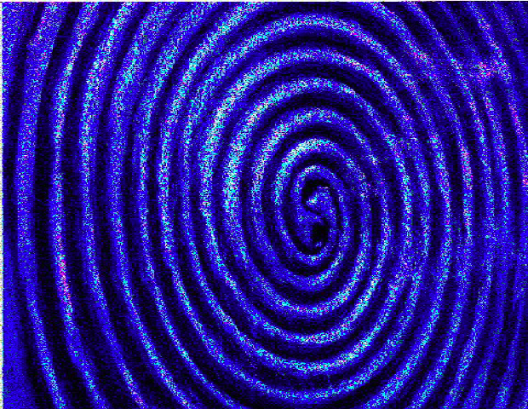



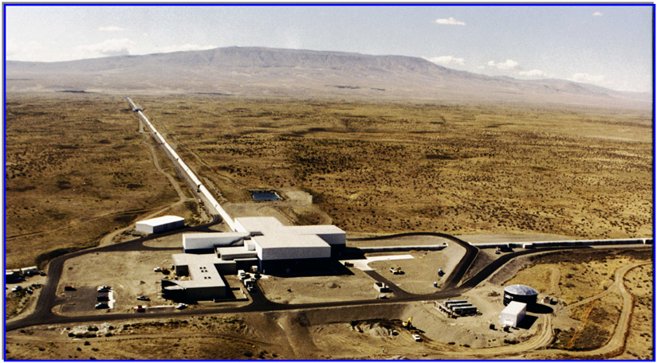
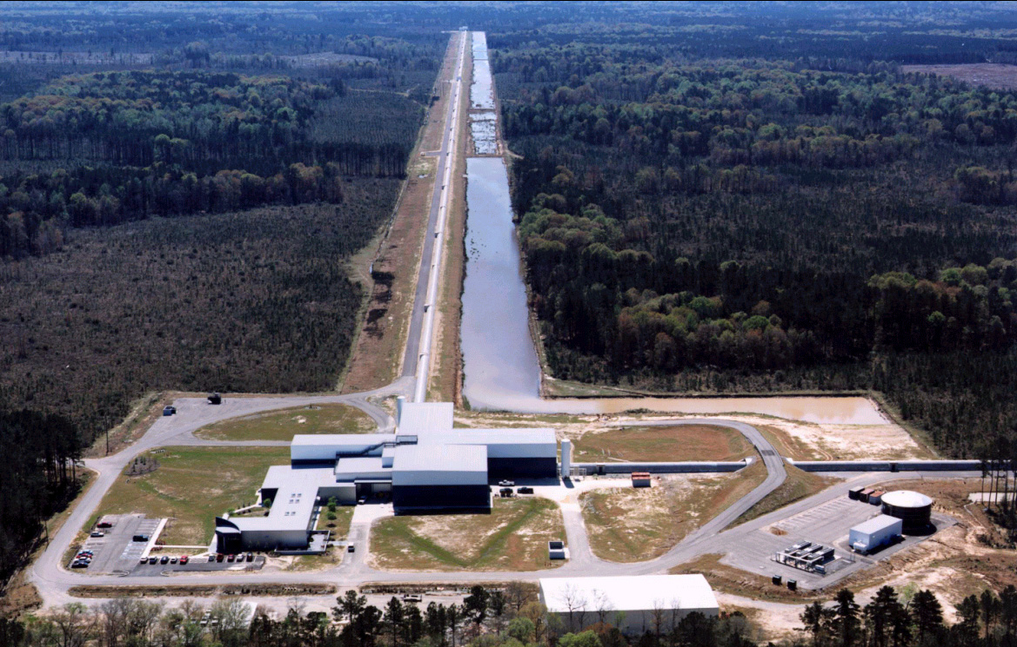
LIGO: The Laser Interferometer Gravitational-wave Observatory
Sarah Caudill
Louisiana State University
Physics Graduate Student
LIGO Hanford
LIGO Livingston

Slide 2
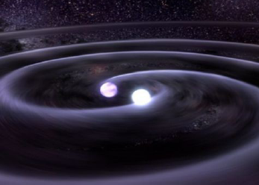
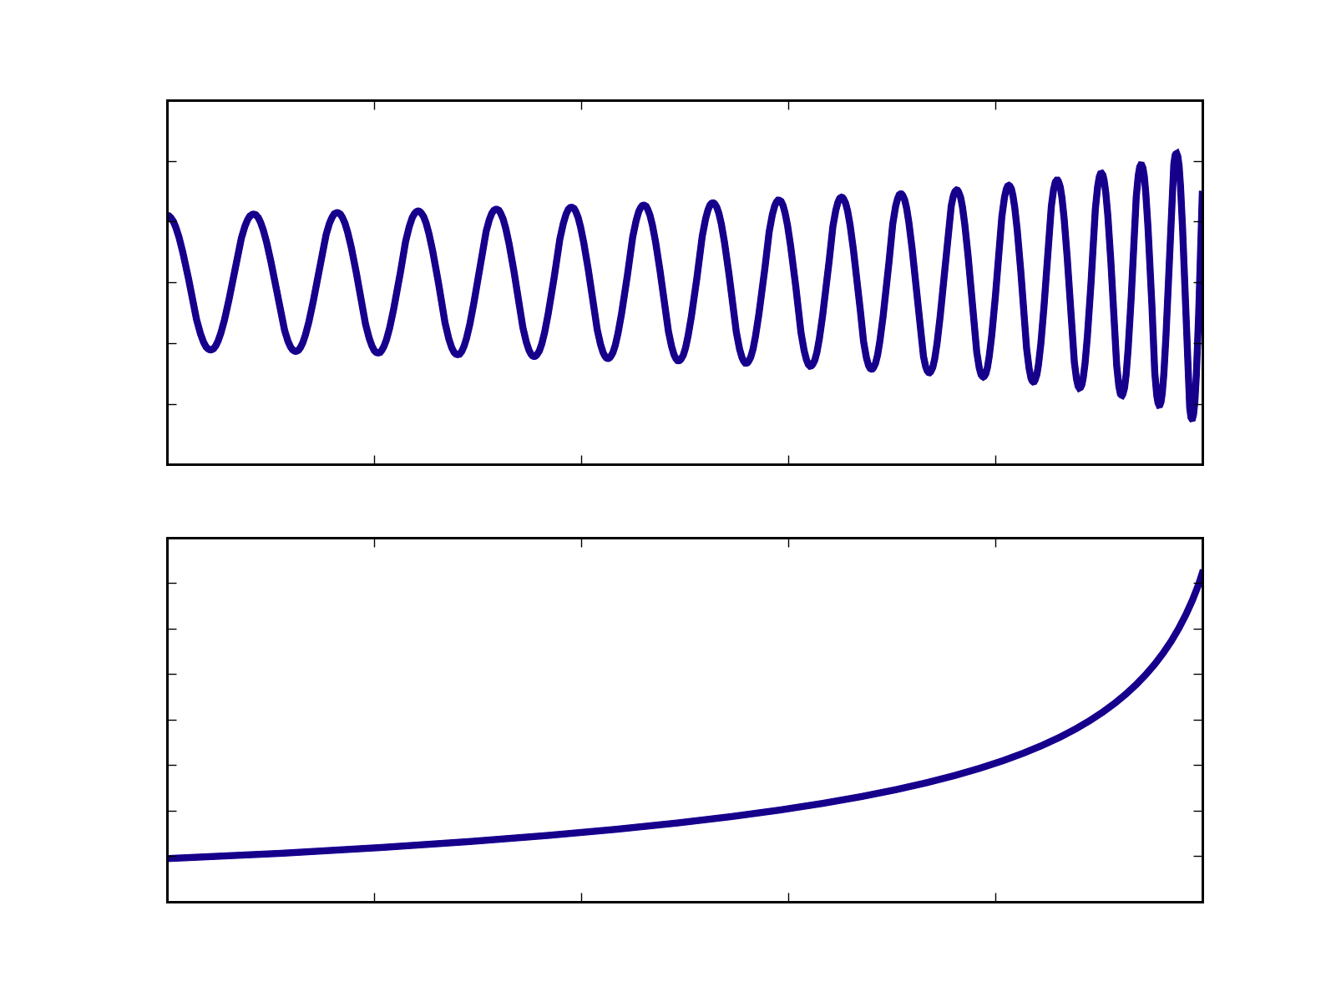
The Compact Binary Coalescence Search
  Binary Neutron Stars
  Binary Black Holes
  Black Hole-Neutron Star Binary
Chirp
Signal
f (Hz)
h (strain)
time (sec)
time (sec)
H1
Data
Generate Template Bank
Matched Filtering
CBC
Search
Pipeline
GW Candidates
H2
Data
Generate Template Bank
Matched Filtering
Coincidence Tests; Data Quality
L1
Data
Generate Template Bank
Matched Filtering

Slide 3
Running CBC Workflows at LSU
(and on the OSG)
A month of LIGO data requires many thousand of jobs, running for days on hundreds of CPUs.
We use Condor to schedule our workflows, currently at Caltech, UWM, Syracuse, Atlas at AEI, and LLO/LHO; we are stretched to the limit.
Can we get our workflows to run at LSU on LONI, the Louisiana Optical Network Initiative, 12 high-performance computing clusters interconnected via a fiber optics network that runs throughout Louisiana?
Dax
Pegasus
Dag
Abstract Work-flow
Resource independent
Logical File Names
No Sites Selection
Work-flow Planner
finds Physical File Names
writes submit files
Concrete Work-flow
Resource dependent
Ready for submission to OSG site(s)

