Slide 1
Optical mapping reveals genomic structure
Steve Goldstein July 22, 2010
Laboratory for Molecular and Computational Genomics – UW Madison
(Lab of David C. Schwartz)

Slide 2
Outline
How variable are DNA sequences?
How can we “see” genomic variation?
  Using genome-wide optical maps.
Algorithms for optical maps.
How Condor enables our analysis
  Makes computations feasible
  Enables programmer efficiency (in lieu of cycles)
  Alters how I think about algorithms.
Some examples:
  Cancer genomic rearrangements
  Uncovering sequence errors
Notes:
Change “results”

Slide 3
How do DNA sequences differ?
20th Century:
  How similar is your DNA to mine?
    Ans: About 99.9%
  A few large differences (e.g. immune response loci).
    Some diseased, abnormal genomes differ at chromosomal scale.
21st Century:
How much does your DNA differ from mine?
Ans: About 10% of the genome is variable.

Slide 4
Human Genomic Structural Variation
Small (single base pair, 10’s of base pairs)
  Single nucleotide polymorphisms (SNPs)
    On the order of 10⁶ out of 10⁹ bases.
  High throughput methods developed in 1990s.
Larger (100’s – millions of base pairs)
  Insertions, deletions.
  Copy number changes.
  Large-scale, complex rearrangements.

Slide 5
Genome-wide restriction maps
SwaI (ATTT^AAAT)
    Human genome (3 Gb) has 220,000 SwaI sites.
    15 kb average fragment size.
Restriction map of a genome
  provides information analogous to sequence (at a coarser resolution).
  is also a sequence (sequence of the lengths between consecutive restriction sites).
Concepts and algorithms from genomic sequence analysis have analogues.

Slide 6
Comparative genomics with optical maps
Discovering genomic structural variation with optical mapping
  Generate genome-wide map.
  Compare to in silico map to discover structural variation.
    Identical regions (up to optical mapping error)
    Local differences.
      Missing and extra cuts
      Indels (within restriction fragment (RFLPs); involving multiple fragments)
      Other
    Major discordances

Slide 7
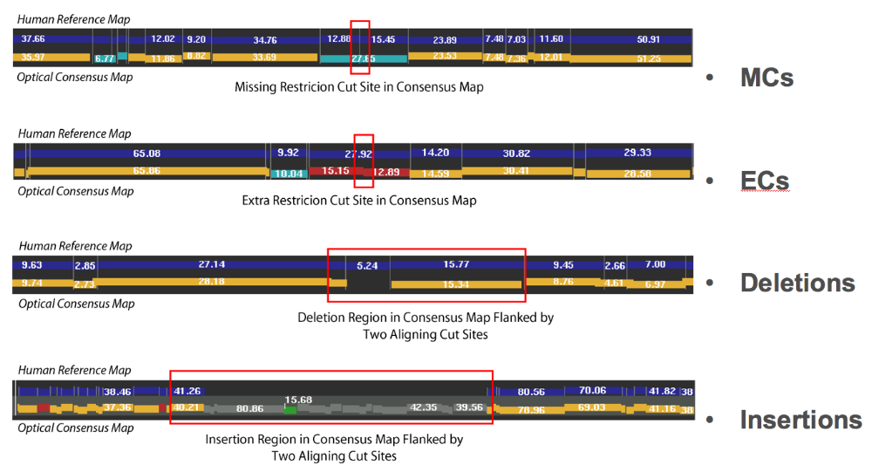
Optical Structural Alterations (OSA)
Notes:
Also: indels in a single restriction fragment.

Slide 8
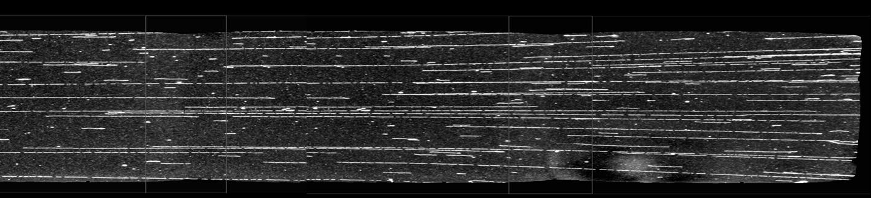
Single-molecule optical maps
Ordered restriction map obtained from a single DNA molecule.
  Stretch DNA molecules and attach to substrate.
  Digest with restriction enzyme.
  Stain with fluorescent dye and process image.
  Analogous to sequence read.
Measurement is error-prone
  Missing, extra cuts; length errors
  Gross errors.

Slide 9
Scaling assembly to mammalian genomes
Initialize:
  number_of_iterations = 8;
  reference_mapset = NCBI build 36;
Main loop:
  for (1 .. number_of_iterations) {
    align optical maps to reference_mapset; //SOMA: S. Kohn
    foreach (cluster of hits) {
      assemble (cluster); // Gentig: Anantharaman,Mishra,Schwartz
    }
    reference_mapset = set of consensus maps from assemblies;
  }
Manual editing:
  resolve redundancies in reference_mapset;

Slide 10
optical mapset
reference mapset
pairwise alignment
reference
aligned optical
maps
reference
local assembly
aligned optical maps
consensus
contiged optical
maps
new
reference mapset
local assembly
consensus
contiged optical
maps
…
local assembly
consensus
contiged optical
maps

Slide 11
Leveraging the power of HTC
Makes computations feasible
Enables programmer efficiency
  Trade programmer time and algorithmic uncertainty for inefficient compute cycles.
Alters how I think about algorithms.

Slide 12
Genome-wide restriction maps
  About 12 human maps
    4 Lymphoblastoid cell lines ; CHM(“normal”)
      GM10860, GM15510, GM18994
    3 stem cell lines, 2 cancer cell lines
    Oligodendroglioma tumor slices
  Other mammalian maps:
    Mouse (C57BL/6)
    Rat (BN and SHR; BNLX)
  Rice
  Maize
  Many bacterial and microbial genomes

Slide 13
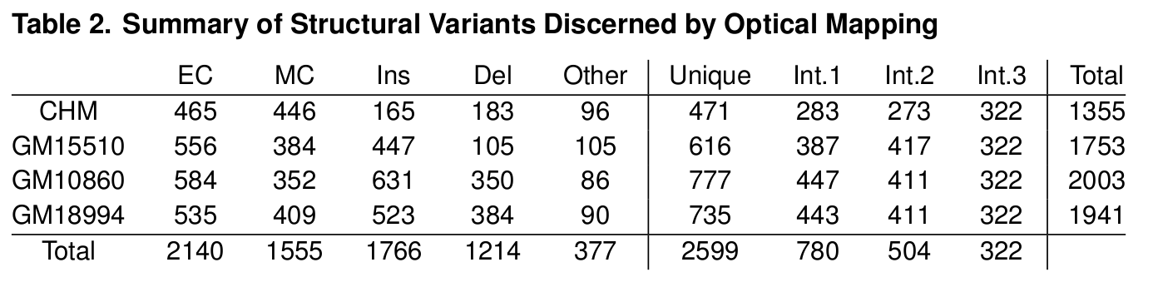
OSAs in lymphoblastoid maps
The human genome is dynamic!
These findings are consistent with the emerging literature on human structural genomic variation. [Wigler (2003), Eichler, McCarroll, Sebat, Redon, Kidd, Redon, Conrad, Sharp, Tuzun, Iafrated, Korbel, …].
Notes:
Count snip SNPs explain snip SNPs here.
Observe intersection high.

Slide 14
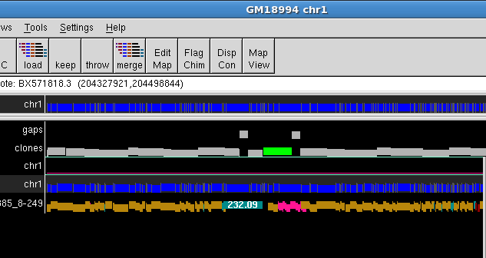
GM18994 at chr1:204.2 Mb
Chr 1
Optical map

Slide 15
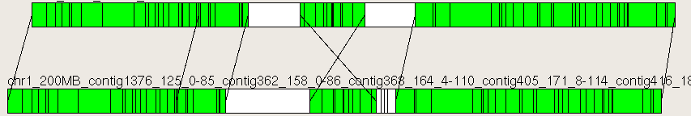
GM18994 at chr1:204.2 Mb
Chr 1
Optical map

Slide 16
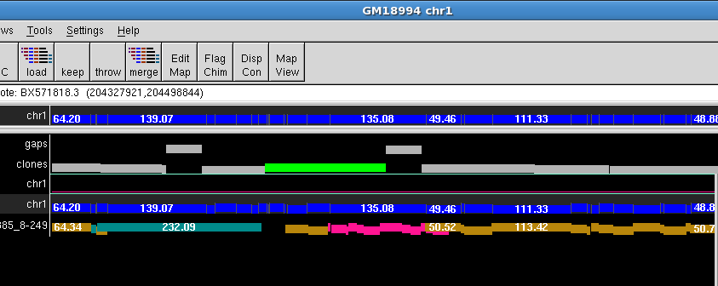
GM18994 at chr1:204.2 Mb
Chr 1
Optical map

Slide 17
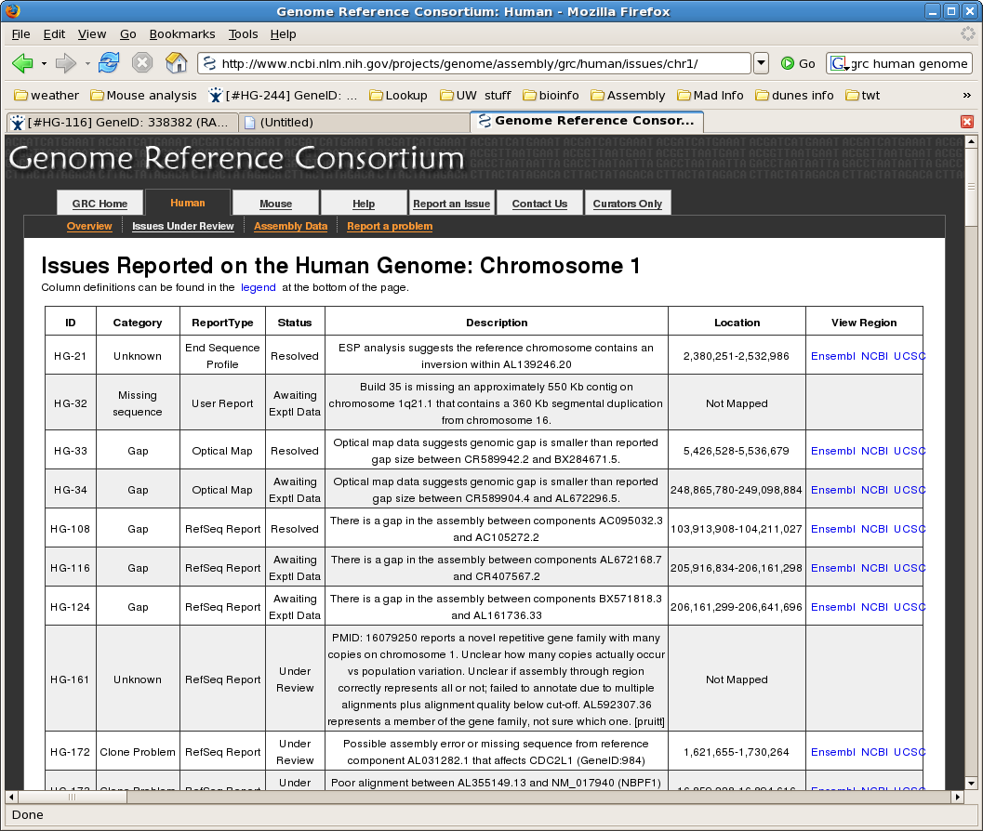

Slide 18
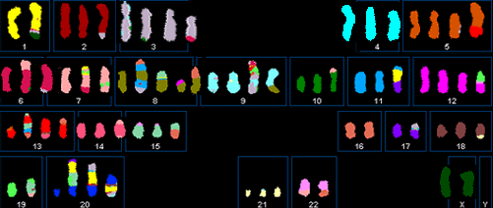
Mapping breakpoints in MCF7
Well-studied breast cancer cell line with abnormal karyotype.
Optical map reveals 58 breakpoints, 7 potential fusion genes.

Slide 19
MCF7 breakpoint assemblies
  Local alignment in first iteration.
LOCAL alignment
optical mapset
reference mapset
pairwise alignment
reference
aligned optical
maps
Notes:
Remove this one

Slide 20
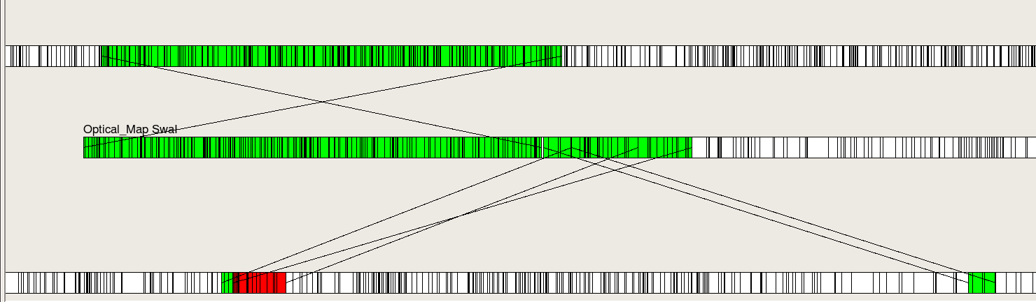
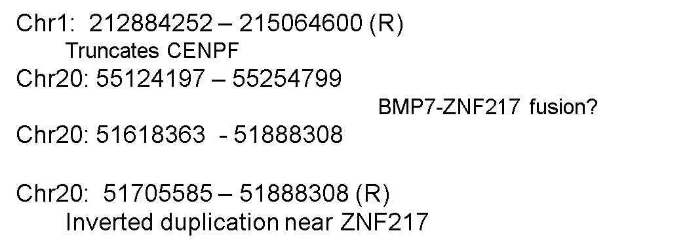
Chr1-20 rearrangement involving CENPF, ZNF217 and BMP7.
CENPF
chr1
ZNF217
BMP7
chr20
}

Slide 21
Collaborators
Deepayan Sarkar and Michael Newton
Rod Runnheim, Mike Bechner, Casey Lamers
Brian Teague, Jill Herschleb, Susan Reslewic
Adam Briska, Scott Kohn
Shiguo Zhou, Gus Potamousis
April Cook (Broad); Deanna Church (NCBI); Jo Wood (Sanger)
Dave Schwartz

Slide 22
Partial list of references
High-resolution human genome structure by single molecule analysis. B. Teague, M. Waterman,S. Goldstein,K. Potamousis,S.Zhou,S. Reslewic, D.Sarkar,A. Valouev,C. Churas,J. Kidd,S. Kohn,R. Runnheim,C. Lamers,D. Forrest,M. Newton,E. Eichler,M. Kent-First,U. Surti,M. Livny,D. Schwartz. PNAS. 107:24. (2010). PDF
Deepayan Sarkar's thesis (UW Stats)
Human genomic variation search in Google scholar
USC optical mapping algorithms
Genome Reference Consortium
6. Anantharaman T, Mishra B, Schwartz DC. Proceedings of the 7th International Conference on Intelligent Systems for Molecular Biology, Genomics via optical mapping. III. (1999)

Slide 24
Many Common “OSAs” are sequence errors
Genome-specifc events
(not snip SNPs)
GM10860 552
GM15510 418
GM18994 536
Common to two
GM10860-GM15510 103
GM10860-GM18994 128
GM15510-GM18994 87
Shared by three
271

