Slide 1

Skeleton Key: Sharing Data Across Campus Infrastructures
Suchandra Thapa
Computation Institute / University of Chicago
January 24, 2013
Notes:
Add OSG branding

Slide 2
Introduction
Data and software access challenges in campus infrastructures
“Unlocking doors” using Skeleton Key
Future Steps

Slide 3
Campus Infrastructure Considerations
Computation is relatively well understood: Condor and Campus Factory/BOSCO allow jobs to be flocked and moved between loosely coupled clusters but…
How to handle data and software access?

Slide 4
Considerations for Campus Infrastructure Data Access
Need to have secure access to data
Don’t want to force users to use X.509 certificates
Need to be able to expand to support applications running on OSG and accessing data
Must be fairly simple for users
Notes:
Motivate skeleton key

Slide 5
Possible solution using Parrot and Chirp
Software components that provide user applications secure remote access to files on a given system
All done in user space
So no need for root access
Provides a solution to data problem:
Users keep their data on local storage and use Chirp and Parrot to allow their applications to access it regardless of where their applications may be running
Track-record of successful use by other groups in OSG (e.g. UW-Madison group) so
Notes:
More technical details on chirp and parrot
Say what chirp and parrot are
Solution is being used elsewhere, features that we liked

Slide 6
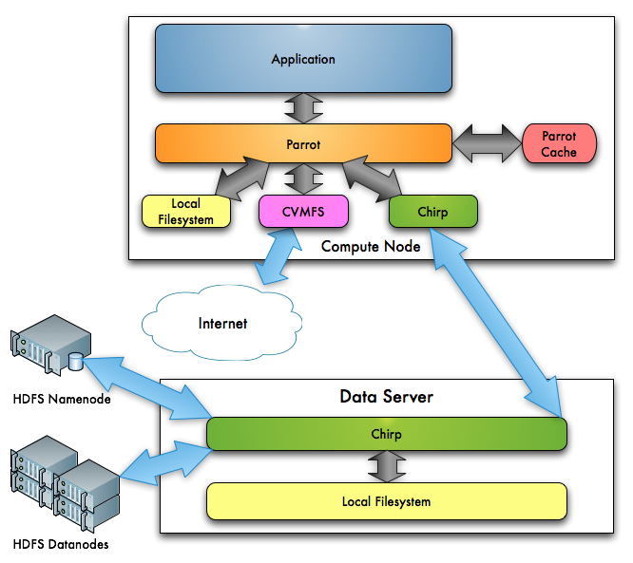
A Parrot-Chirp system: basic idea

Slide 7
Advantages of using Parrot
Allows applications to use remote file systems as if they were mounted locally
Works behind the scenes to make it look like files are present on local filesystem to applications
Supports remote access to CVMFS repositories and file systems (when using Chirp)
Can be downloaded and run from user home directory or scratch space
Notes:
Why parrot?

Slide 8
Why Chirp?
Server software that acts as a proxy to access local filesystem or HDFS filesystem
Run in user space by user
Can use several different authentication methods (unix, tickets, X.509 certificates, hostname verification)
Primarily interested in tickets because it allows access from applications running on arbitrary clusters without the overhead of X.509 certificates
Notes:
Why Chirp? Things we liked

Slide 9
Skeleton Key aims to simplify
Skeleton Key in a nutshell:
Based on Chirp and Parrot
But hides some of complexity of using them
User specifies application parameters and what needs to be shared in a configuration file
Skeleton Key then creates a wrapper, and invokes application in a way that hides data access details to diverse data resources
Notes:
Diagram of workflow
Configuration script example
Creates a job wrapper – change last

Slide 10
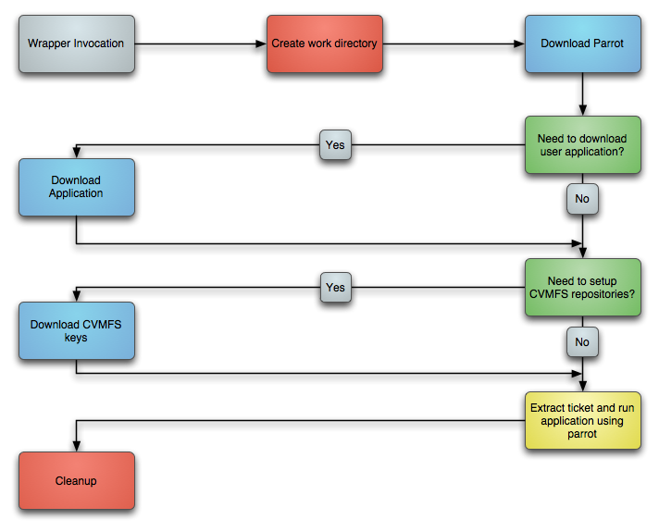
Workflow for generated scripts
Notes:
Revise diagram

Slide 11
Using Skeleton Key
Wrapper configuration done using easy to understand configuration file
Generates a shell script that can then be used in a jobmanager submit file or even copied to another system and then run
Example run on a data server:
skeleton_key –c path_to_config_file
Get a script (job_script.sh) that can then be used in condor submit file

Slide 12
Example of a Configuration File
[Directories]
chirp_base = /mnt/hadoop/sthapa
write = /, chirp, chirp/stats
[Application]
location = http://uc3-data.uchicago.edu/~sthapa/benchmark.tar.gz
script = ./benchmark/get_chirp_performance.sh
arguments =
Location data and directories can be accessed using FUSE mount
Arguments that passed to script or binary, can also give arguments in condor submit file

Slide 13
Using Skeleton Key output in a HT Condor submit file
universe = vanilla
executable = ./job_script.sh
arguments = $(Process)
notification = Error
input =
output = /tmp/chirp_job.out.$(Process)
error = /tmp/chirp_job.err.$(Process)
log = /tmp/chirp_job.log
should_transfer_files = YES
when_to_transfer_output = ON_EXIT
queue 40
Shell script generated by Skeleton Key
Additional arguments passed to user script

Slide 14
What’s the performance?
Ran benchmarks to compare data access using Chirp + Parrot and using a FUSE mounted HDFS filesystem
Both cases had 40 clients simultaneously accessing HDFS filesystem
Clients run using condor to schedule jobs onto lightly loaded clusters in order to more closely simulate actual user jobs

Slide 15
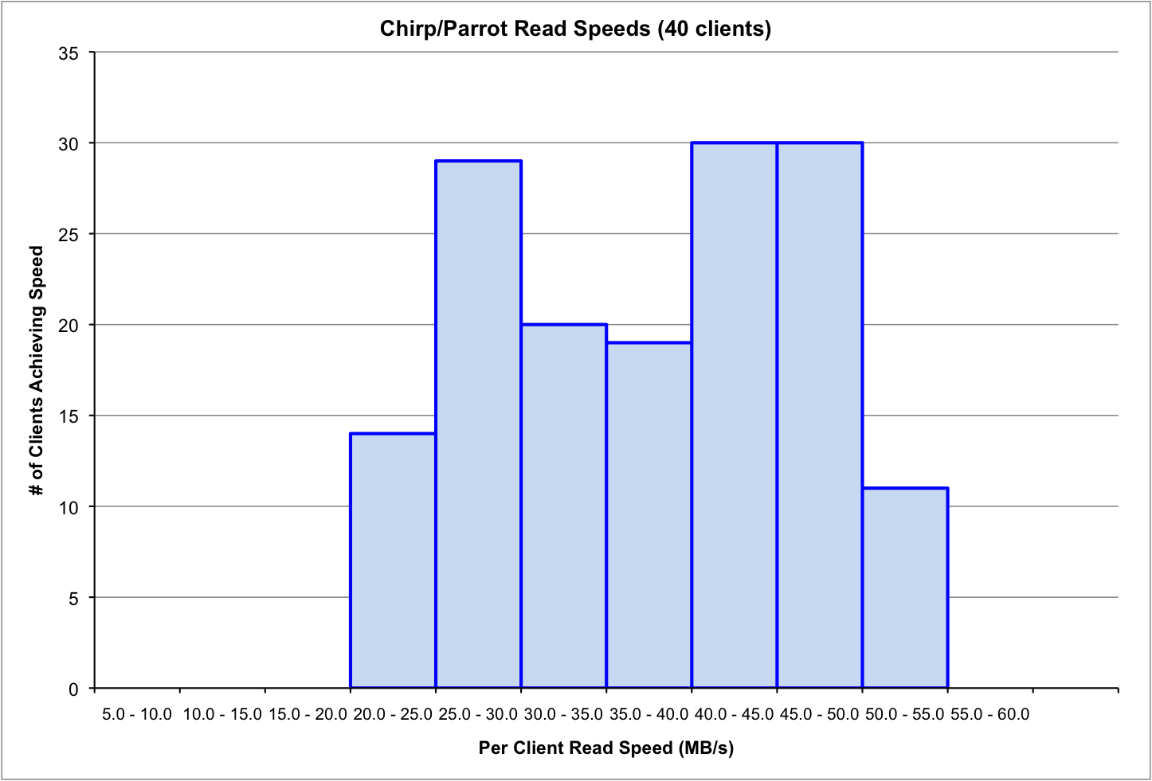
Read performance using Parrot/Chirp with HDFS backend

Slide 16
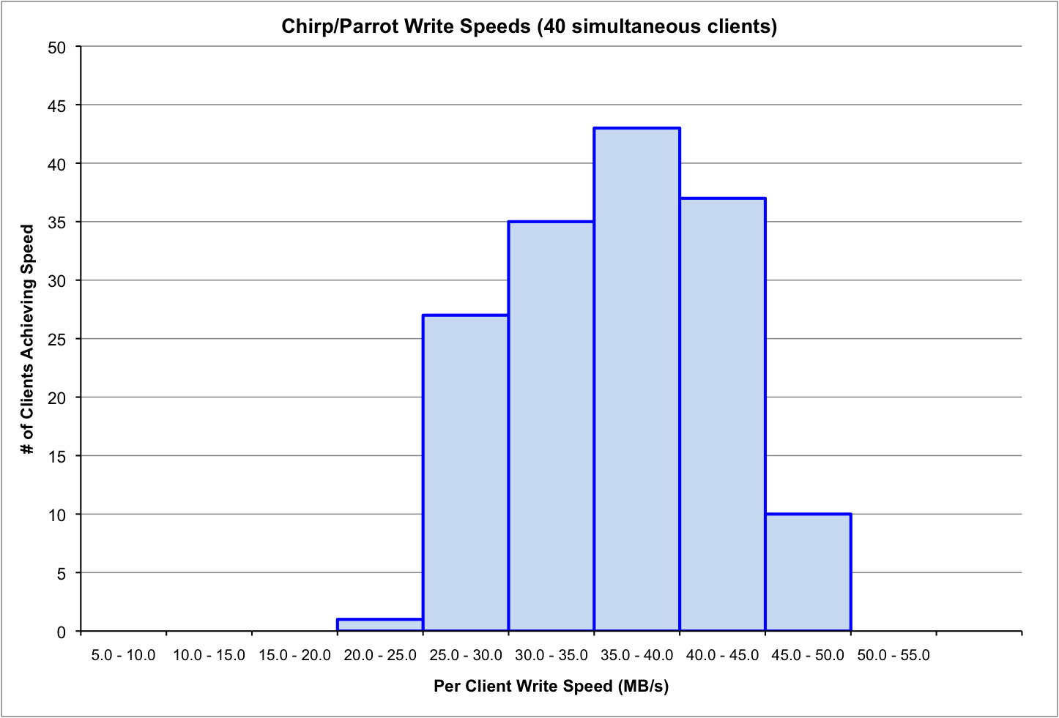
Write performance using Parrot/Chirp with HDFS backend

Slide 17
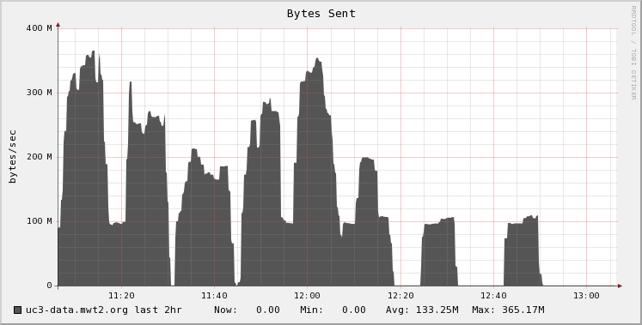
Outbound Data rates using Parrot/Chirp with HDFS

Slide 18
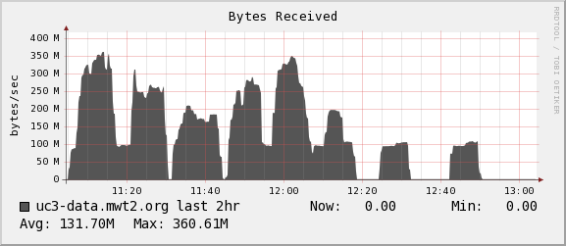
Inbound Data rates using Parrot/Chirp with HDFS

Slide 19
Chirp/Parrot network speeds when using HDFS backend
Inbound and outbound bandwidth used is almost identical since Chirp is acting as a proxy to HDFS filesystem
Chirp/Parrot utilizes approximately 400MB/s although it has extended peaks at 700MB/s
Currently investigating optimizations to get better performance and even out traffic

Slide 20
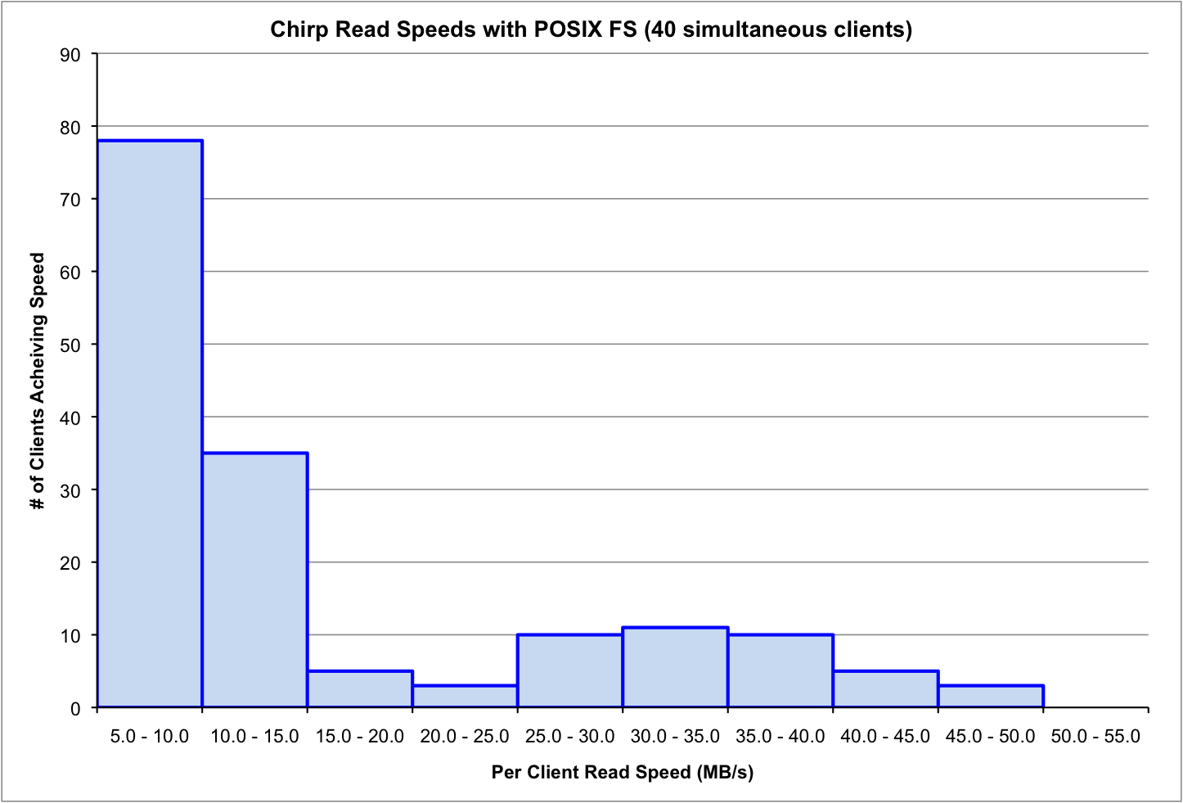
Chirp/Parrot read performance using a POSIX FS backend

Slide 21
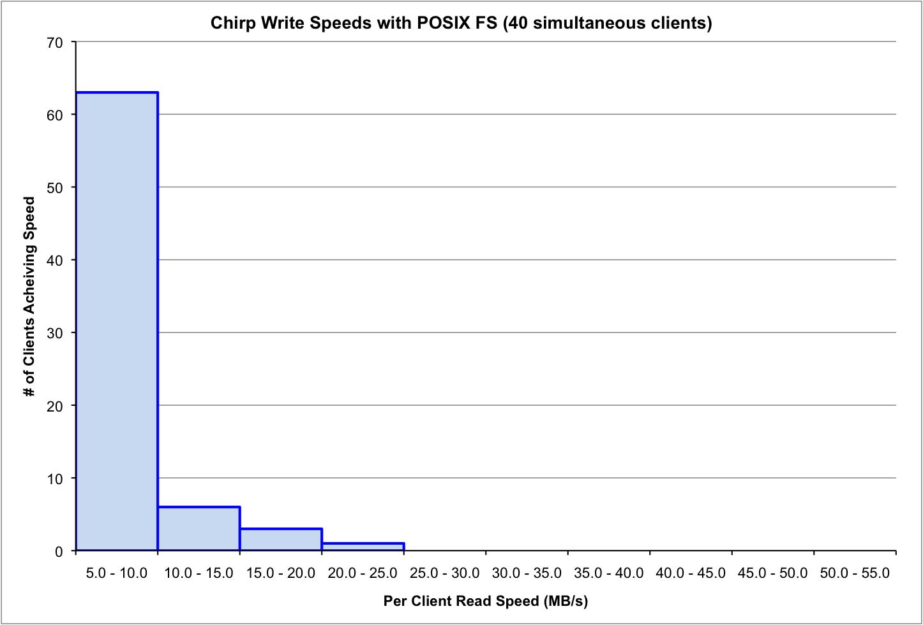
Chirp/Parrot write performance using a POSIX FS backend

Slide 22
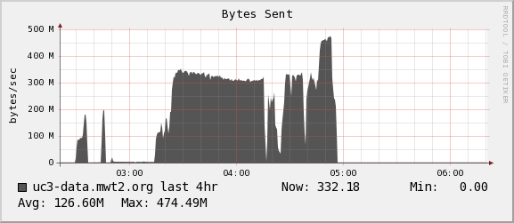
Outbound Data rates using Parrot/Chirp with POSIX filesystem
Benchmark initially writes to filesystem so very few reads occur

Slide 23
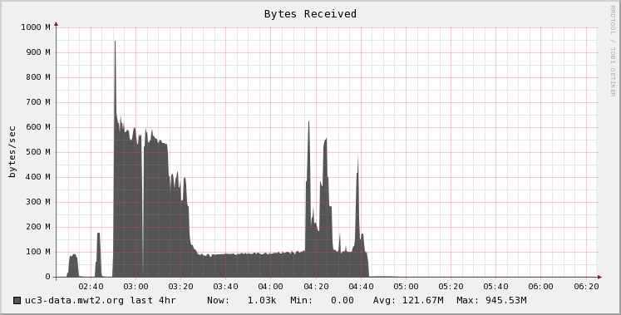
Inbound Data rates using Parrot/Chirp with POSIX filesystem
Writes from first half of benchmark
Most clients completed writes and are reading from Chirp

Slide 24
Chirp/Parrot network speeds when using POSIX backend
Chirp serving data from locally mounted filesystem so inbound and outbound traffic is not tightly coupled
Limited by I/O speed of hardware (2 drives in RAID1 array): ~400MB/s

Slide 25
Mathematica runtimes
Used a simple mathematica script to calculate Mandelbrot set and compared runtime when running Mathematica from local disk vs. over CVMFS using parrot

Slide 26
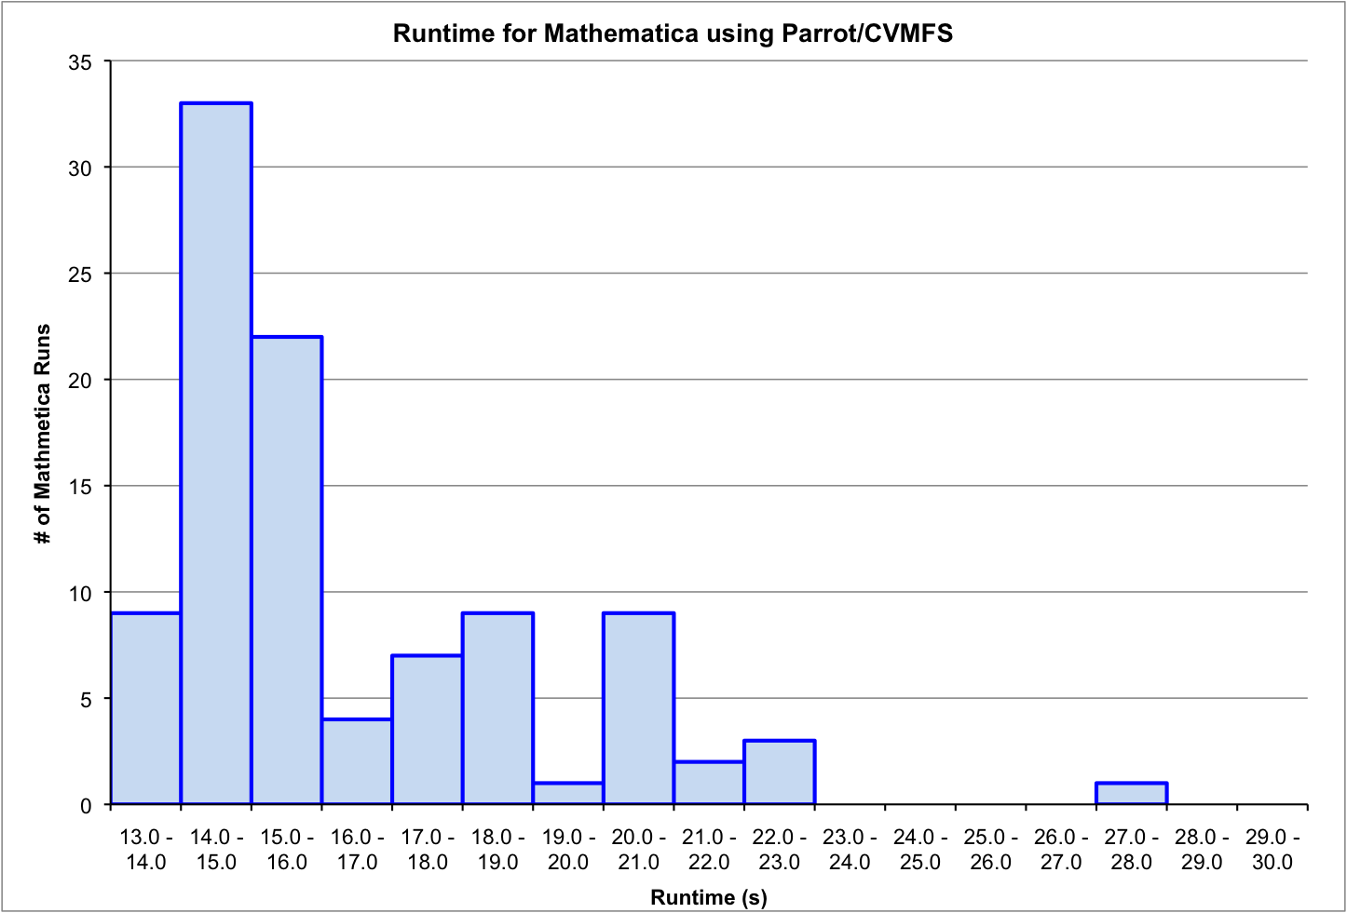
Mathematica runtimes using local filesystem

Slide 27
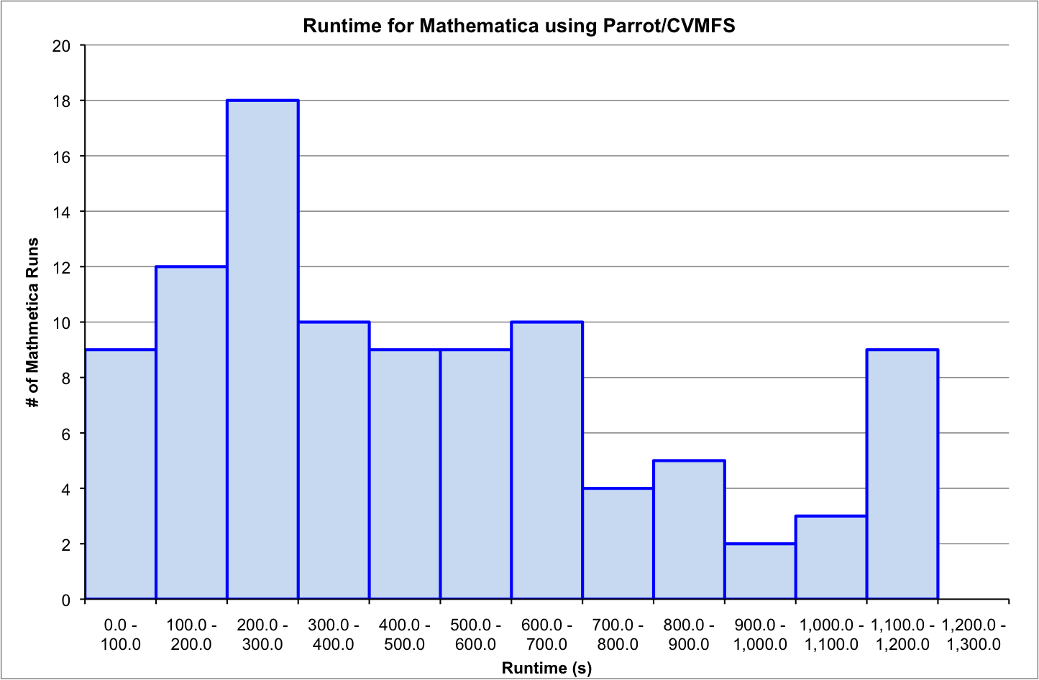
Mathematica runtime using Parrot/CVMFS

Slide 28
Mathmetica runtimes continued
Running Mathematica using Parrot/CVMFS takes 480.7±330.3s while running it on local filesystem takes about 15.9±2.7s
About an order of magnitude greater to run using Parrot/CVMFS
Run time drops to below 60s if Mathematica is run again in same session, majority of runtime in initial invocation due to latency in fetching file and filling Parrot’s local cache

Slide 29
Conclusion
Skeleton Key provides a convenient way to use Chirp and Parrot to remotely access data and software
Performance fairly good for client access
Future directions:
Expand to other users and add enhancements based on user feedback
Questions?

Slide 30
Further information
Skeleton Key:
Git: https://github.com/DHTC-Tools/UC3/tree/master/skeleton_key
Documentation: https://twiki.grid.iu.edu/bin/view/CampusGrids/SkeletonKey
Chirp, Parrot, HDFS
Douglas Thain and Miron Livny,Parrot: An Application Environment for Data-Intensive Computing,Scalable Computing: Practice and Experience, 6(3), pages 9-18, September, 2005.
Douglas Thain, Christopher Moretti, and Jeffrey Hemmes,Chirp: A Practical Global Filesystem for Cluster and Grid Computing,Journal of Grid Computing, 7(1), pages 51-72, March, 2009. DOI: 10.1007/s10723-008-9100-5
Patrick Donnelly, Peter Bui, Douglas Thain,Attaching Cloud Storage to a Campus Grid Using Parrot, Chirp, and Hadoop ,IEEE International Conference on Cloud Computing Technology and Science, pages 488-495, November, 2010. DOI: 10.1109/CloudCom.2010.74

Slide 31
Acknowledgements
CCTools team, http://www.nd.edu/~ccl/
Dan Bradley @ UW-Madison
Colleagues at UC3:
Lincoln Bryant, Marco Mambelli, Rob Gardner

