Slide 1

Introduction to Grid Computing

Slide 2
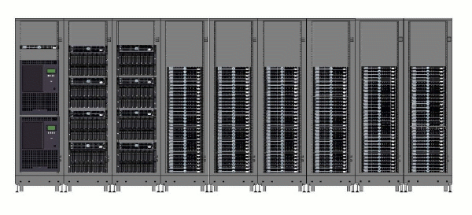
Computing “Clusters” are today’s Supercomputers
Cluster Management
“frontend”
I/O Servers typically RAID fileserver
A few Headnodes, gatekeepers and other service nodes
Disk Arrays
Lots of Worker Nodes
Tape Backup robots
Notes:
A cluster has many “compute nodes”, (plenty of) storage, and network connectivity. (like putting multiple computers to work together)
Basically it provides a shared computing resource for tasks that are too demanding for your PC, where you can't afford to have your own dedicated big computer.
A regular user (you) will probably use it only part of the time, so it makes sense to share it.
It is possible that everyone in your department gets access to this cluster.

Slide 3
Cluster Architecture
Cluster
User
…
Cluster
User
Internet
Protocols
Shared
Cluster
Filesystem
Storage
(applications
and data)
Head Node(s)
Login access (ssh)
Cluster Scheduler
(PBS, Condor, SGE)
Web Service (http)
Remote File Access
(scp, FTP etc)
Node 0
Compute
Nodes
(10 …
10,000
PC’s
with
local
disks)
…
…
…
Job execution requests & status
Node N
Notes:
Elements of grid middleware:
Security to control access and protect communication (GSI)
Directory to locate grid sites and services: (VORS, MDS)
Uniform interface to computing sites (GRAM)
Facility to maintain and schedule queues of work (Condor-G)
Fast and secure data set mover (GridFTP, RFT)
Directory to track where datasets live (RLS)

Slide 4
Scaling up Science:
Citation Network Analysis in Sociology
Work of James Evans, University of Chicago, Department of Sociology
Notes:
Our example problem is the Citation Analysis
Citation Analysis is the most common method of bibliometrics. Citation analysis uses citations in scholarly works to establish links to other works or other researchers. Co-citation coupling and bibliographic coupling are specific kinds of citation analysis.
Citation analysis is the examination of the frequency and pattern of citations in articles and books.
Due to unprecedented growth of electronic resource (e-resource) availability, one of the questions currently being explored is, "how often are e-resources being cited in my field?”
The graph that represents the ‘reference’ relationships is not easy to compute
Picture: citation network analysis for the case of plant biotechnology; the relationships among scientists and the public, private, and nonprofit organizations involved in research on the genetic model organism Arabidopsis thaliana are represented

Slide 5
Scaling up the analysis
Query and analysis of 25+ million citations
Work started on desktop workstations
Queries grew to month-long duration
With data distributed across
U of Chicago TeraPort cluster:
  50 (faster) CPUs gave 100 X speedup
  Many more methods and hypotheses can be tested!
Higher throughput and capacity enables deeper analysis and broader community access.
Notes:
This work illustrates eScience on a Cluster – scaling up from desktop workstations to clusters:
From 30 days to about a 1/3 of a day.
Deeper inquiry is now possible.
So one thing we did was to move the problem onto UC's grid site, the Teraport – using 50 CPUs instead of his one PC, and faster CPUs at that, he got 100x speedup – go from a month back down to running his jobs in hours.
This way, he can get his results faster and he can do much deeper analysis than he could with one PC.
It is possible to expand further, using even more available computing and storage capacity for this application.

Slide 6
Grids consist of distributed clusters
Grid Client
Grid Site 1:
Fermilab
Grid
Storage
Compute
Cluster
Application
& User Interface
Grid
Service
Middleware
Grid Client
Middleware
Grid Site 2:
Sao Paolo
Grid
Storage
Compute
Cluster
Grid
Protocols
Grid
Service
Middleware
Resource,
Workflow
& Data Catalogs
…Grid Site N:
UWisconsin
Grid
Storage
Compute
Cluster
Grid
Service
Middleware
Notes:
Clusters are a form of distributed computing
Grids are distributed sets of clusters, so distributed computing takes place at two levels: within each cluster, and between clusters
(we define distributed computing as anything that involves IPC beyond a host boundary)

Slide 7
HPC vs. HTC
HTC: many computing resources over long periods of time to accomplish a computational task.
HPC tasks are characterized as needing large of amounts of computing power for short periods of time, whereas HTC tasks also require large amounts of computing, but for much longer times (months and years, rather than hours and days).
Fine-grained calculations are better suited to HPC: big, monolithic supercomputers, or very tightly coupled computer clusters with lots of identical processors and an extremely fast, reliable network between the processors.
Embarrassingly parallel calculations are ideal for HTC: more loosely-coupled networks of computers where delays in getting results from one processor will not affect the work of the others. (course grained)
Notes:
HPC environments are often measured in terms of FLOPS. The HTC community, however, is not concerned about operations per second, but rather operations per month or per year. Therefore, the HTC field is more interested in how many jobs can be complete over a long period of time instead of how fast an individual job can complete.As a general rule, HPC systems are tightly couple parallel jobs, and as such they must execute within a particular site with low-latency interconnects. Conversely, HTC systems are independent, sequential jobs that can be individually scheduled on many different computing resources across multiple administrative boundaries. HTC systems achieve this using various grid computing technologies and techniques.

Slide 8

Grids represent a different approach
The OSG
  Building HTC resource by joining clusters together in a grid
  Example:
Current Compute Resources:
  70 Open Science Grid sites, but all very different
  Connected via Inet2, NLR.... from 10 Gbps – 622 Mbps
  Compute Elements & Storage Elements
  Most are Linux clusters
  Most are shared
    Campus grids
    Local non-grid users
  More than 20,000 CPUs
    A lot of opportunistic usage
    Total computing capacity difficult to estimate
    Same with Storage
Notes:
We are now ready to introduce the notion of a grid, and grid computing.
There exists a different approach to the cluster we just saw, which is the grid approach.
instead of building a bigger and bigger single cluster, you federate together a lot of smaller ones.
For example, the OSG has 60 sites used by many thousands of users spread mostly around the United States but also in other countries.
Analogy to the power grid: anyone could “plug-in” the bigger power grid o gain access to electricity -- the same could be true for computing power, instead of electricity. But the problem is that computation is not the same everywhere (as electricity) -- we run into problems due to various platforms, software, etc.

Slide 9

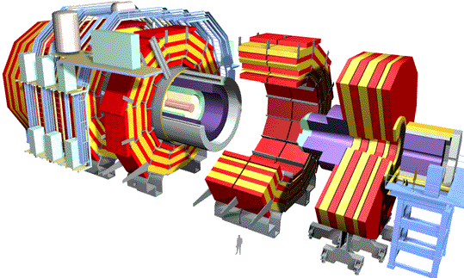
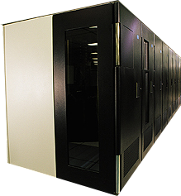
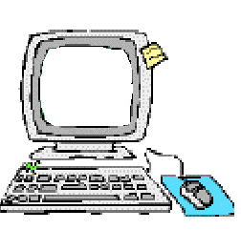
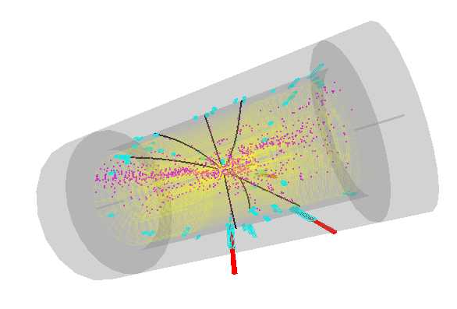
Initial Grid driver: High Energy Physics
~PBytes/sec
Online System
~100 MBytes/sec
1 TIPS is approximately 25,000
SpecInt95 equivalents
There is a “bunch crossing” every 25 nsecs.
There are 100 “triggers” per second
Each triggered event is ~1 MByte in size
Offline Processor Farm
~20 TIPS
~100 MBytes/sec
Tier 0
CERN Computer Centre
HPSS
~622 Mbits/sec or Air Freight (deprecated)
Tier 1
France Regional Centre
HPSS
Germany Regional Centre
HPSS
Italy Regional Centre
HPSS
FermiLab ~4 TIPS
HPSS
~622 Mbits/sec
Tier 2
Caltech ~1 TIPS
Tier2 Centre ~1 TIPS
Tier2 Centre ~1 TIPS
Tier2 Centre ~1 TIPS
Tier2 Centre ~1 TIPS
~622 Mbits/sec
Institute ~0.25TIPS
Institute
Institute
Institute
Physicists work on analysis “channels”.
Each institute will have ~10 physicists working on one or more channels; data for these channels should be cached by the institute server
Physics data cache
~1 MBytes/sec
Tier 3
Pentium II 300 MHz
Pentium II 300 MHz
Physicist workstations
Pentium II 300 MHz
Pentium II 300 MHz
Image courtesy Harvey Newman, Caltech
Notes:
High Energy Physics (HEP) experiments generate huge amounts of data (ex: the LHC Large Hadron Collider at CERN -- to start functioning Spring 2008, for which OSG is the primary data analysis infrastructure)

Slide 10
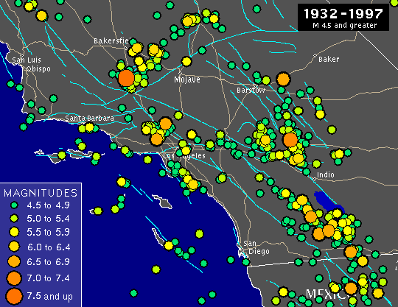
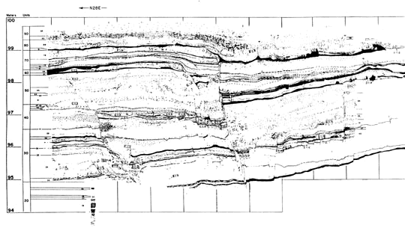
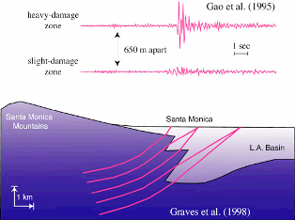
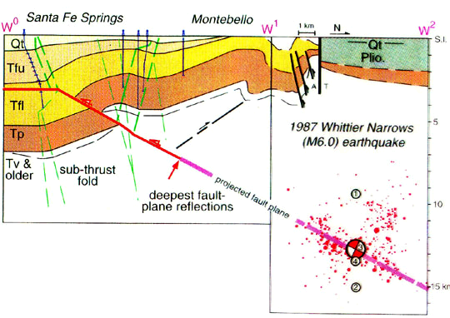
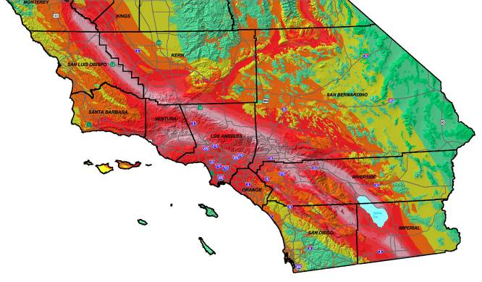
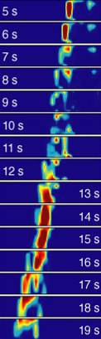
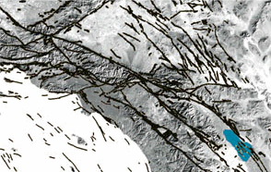
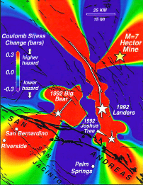
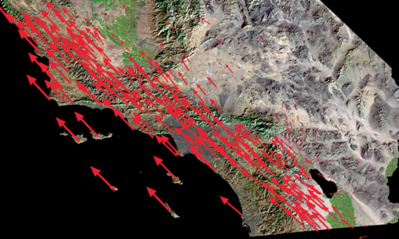
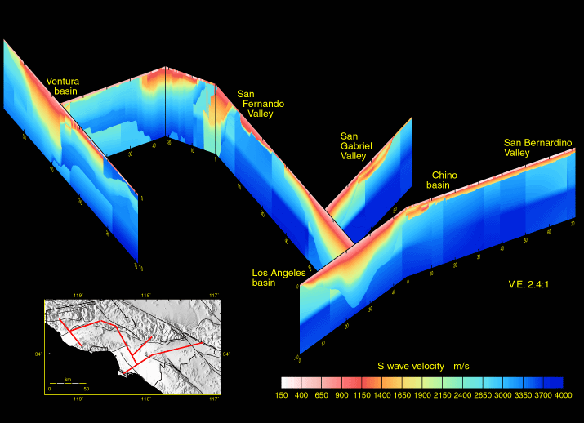
Mining Seismic data for hazard analysis
(Southern Calif. Earthquake Center).
Seismicity
Paleoseismology
Local site effects
Geologic structure
Faults
Seismic
Hazard
Model
Stress
transfer
Crustal motion
Crustal deformation
Seismic velocity structure
Rupture
dynamics

Slide 11
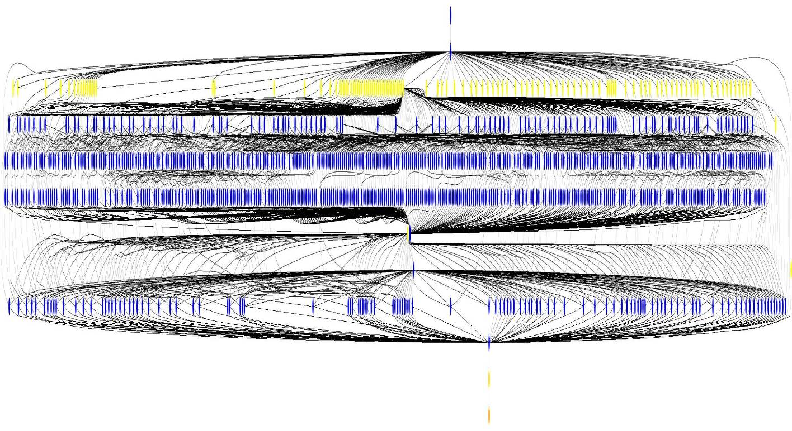
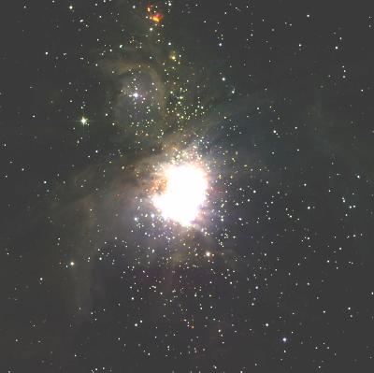
Grids can process vast datasets.
Many HEP and Astronomy experiments consist of:
  Large datasets as inputs (find datasets)
  “Transformations” which work on the input datasets (process)
  The output datasets (store and publish)
The emphasis is on the sharing of these large datasets
Workflows of independent program can be parallelized.
Mosaic of M42 created on TeraGrid
Montage Workflow: ~1200 jobs, 7 levels
NVO, NASA, ISI/Pegasus - Deelman et al.
= Data
Transfer
= Compute
Job

Slide 12
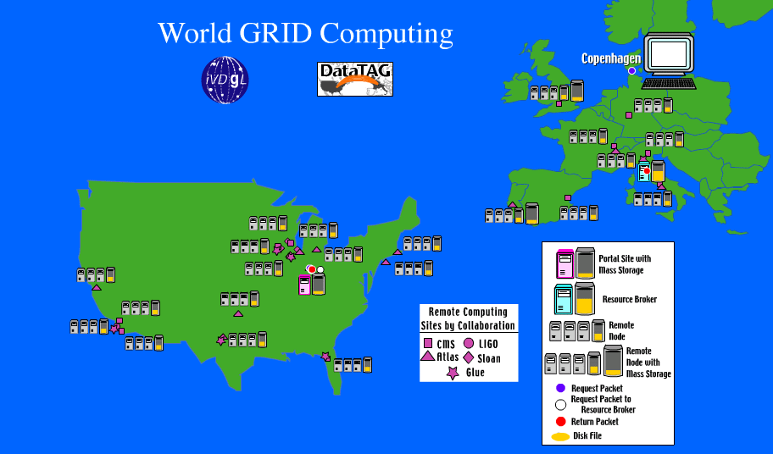
Grids Provide Global Resources
To Enable e-Science
Notes:
E-science: The term e-Science (or eScience) is used to describe computationally intensive science that is carried out in highly distributed network environments, or science that uses immense data sets that require grid computing; the term sometimes includes technologies that enable distributed collaboration, such as the Access Grid. Examples of the kind of science include social simulations, particle physics, earth sciences and bio-informatics. Particle physics has a particularly well developed e-Science infrastructure due to their need for adequate computing facilities for the analysis of results and storage of data originating from the CERN Large Hadron Collider.
Note: the term e-Science is mostly used in Europe; its US equivalent is Cyberinfrastructure (CI)
List and describe the major Grids:
TeraGrid and OSG in US
EGEE in EU – Enabling Grids for E Science
LHC computing grid world wide
(other grids exist)
All of these overlap and engage in healthy competition

Slide 13
Virtual Organizations
Groups of organizations that use the Grid to share resources for specific purposes
Support a single community
Deploy compatible technology and agree on working policies
  Security policies - difficult
Deploy different network accessible services:
  Grid Information
  Grid Resource Brokering
  Grid Monitoring
  Grid Accounting

Slide 14
Ian Foster’s Grid Checklist
A Grid is a system that:
  Coordinates resources that are not subject to centralized control
  Uses standard, open, general-purpose protocols and interfaces
  Delivers non-trivial qualities of service
Notes:
Grid computing has also been called metacomputing, scalable global computing, internet computing

Slide 15
The Grid Middleware Stack (and course modules)
Grid Application
(often includes a Portal)
Workflow system (explicit or ad-hoc)
Job
Management
Data
Management
Grid Information
Services
Grid Security Infrastructure
Core Globus Services
Standard Network Protocols and Web Services
Notes:
Note: web services
Job management
is itself several layers: Client queuing system (eg Condor G), GRAM; Interface to schedulers
Grids are JOB-oriented models - run an application program, get a result
GIS: configuration and status or grid resources, sites (physical collections of resources) and VOs (virtual collections)
Core globus services - these are API-level services for writing grid middleware applications

Slide 16
Job and resource management

Slide 17
How do we access the grid ?
  Command line with tools that you'll use
  Specialised applications
    Ex: Write a program to process images that sends data to run on the grid as an inbuilt feature.
  Web portals
    I2U2
    SIDGrid‏

Slide 18
Grid Middleware glues the grid together
A short, intuitive definition:
the software that glues together different clusters into a grid
taking into consideration the socio-political side of things (such as common policies on who can use what, how much, and what for)

Slide 19
Grid middleware components
Job management
Storage management
Information Services
Security

Slide 20
Globus and Condor play key roles
Globus Toolkit provides the base middleware
  Client tools which you can use from a command line
  APIs (scripting languages, C, C++, Java, …) to build your own tools, or use direct from applications
  Web service interfaces
  Higher level tools built from these basic components, e.g. Reliable File Transfer (RFT)
Condor provides both client & server scheduling
  In grids, Condor provides an agent to queue, schedule and manage work submission

Slide 21
Globus Toolkit
Developed at Uchicago/ANL and USC/ISI (Globus Alliance) - globus.org
Open source
Adopted by different scientific communities and industries
Conceived as an open set of architectures, services and software libraries that support grids and grid applications
Provides services in major areas of distributed systems:
  Core services
  Data management
  Security

Slide 22
Globus - core services
A toolkit that can serve as a foundation to build a grid
Authorization
Message level security
System level services (e.g., monitoring)
Associated data management provides file services
  GridFTP
  RFT (Reliable File Transfer)
  RLS (Replica Location Service)
Notes:
the basic infrastructure needed to create grid services
GridFTP: a high performance, secure, and reliable data transfer protocol based on the standard FTP. GridFTP enhances FTP with GSI security, multiple data channels for parallel transfers, third party transfers, and authenticated reusable channels.
RFT: protocol that provides reliability and fault tolerance for file transfers.
RLS: a component of the data grid architecture. It provides access to mapping information from logical names to physical names of items. Its goal is to reduce access latency, improve data locality, improve robustness, scalability and performance for distributed applications
RLS produces replica catalogs (LRCs), which represent mappings between logical and physical files scattered across the storage system. For better performance, the LRC can be indexed.

Slide 23
Local Resource Managers (LRM)
Compute resources have a local resource manager (LRM) that controls:
  Who is allowed to run jobs
  How jobs run on a specific resource
  Specifies the order and location of jobs
Example policy:
  Each cluster node can run one job.
  If there are more jobs, then they must wait in a queue
Examples: PBS, LSF, Condor
Notes:
Notions needed for job submission.
Naturally, users want to be able to runs their programs – for example, data processing, simulation. This section provides you with the answer on how this task can be accomplished on grids. We can run our jobs on other computers on the grid to make use of those resources. The challenging part is that sites on the grid have different platforms, therefore a uniform way of accessing the grid must be deployed.
This is exactly the purpose of the grid software stack - it tries to deal with some of those differences.
On a particular site, we have a few components involved in job submission.
Closest to the hardware, we have a piece of software called a Local Resource Manager. This is a piece of software which manages the local resource, by specifying the order and location of jobs. In its simplest form, it makes sure only one user is using each compute node at once, and has some kind of queue.
More advanced LRMs can deal with reservations, prioritising between different users and various other parameters. LRMs are not grid specific – an LRM manages jobs on a particular cluster. It is important to realize that an LRM doesn't deal with jobs coming in from elsewhere. You need to, for example, log in directly to the cluster to submit your jobs.

Slide 24
Local Resource Manager: a batch scheduler for running jobs on a computing cluster
Popular LRMs include:
  PBS – Portable Batch System
  LSF – Load Sharing Facility
  SGE – Sun Grid Engine
  Condor – Originally for cycle scavenging, Condor has evolved into a comprehensive system for managing computing
LRMs execute on the cluster’s head node
Simplest LRM allows you to “fork” jobs quickly
  Runs on the head node (gatekeeper) for fast utility functions
  No queuing (but this is emerging to “throttle” heavy loads)
In GRAM, each LRM is handled with a “job manager”
Notes:
Head node == gatekeeper

Slide 25
GRAM
Globus Resource Allocation Manager
GRAM = provides a standardised interface to submit jobs to LRMs.
Clients submit a job request to GRAM
GRAM translates into something a(ny) LRM can understand
  …. Same job request can be used for many different kinds of LRM

Slide 26
Job Management on a Grid
GRAM
Condor
LSF
User
Site A
Site C
PBS
fork
Site B
Site D
The Grid
Notes:
Each cluster has a local resource manager (LRM) on it. We need to be able to access these resources in a homogeneous way -- this can be done my placing a new layer between the user (submission node) and each cluster. In the globus world, this is accomplished by piece of the globus toolkit called GRAM – the Grid Resource Allocation Manager.
GRAM provides a common network interface to various LRMs – so users can go to any site on the grid and make a job submission without really needing to know which LRM is being used. But GRAM doesn't manage the execution – it is up the the LRM to do that. Make sure you understand the distinction between the resource allocation manager (GRAM) and the LRM (for example Condor).
GRAM and the LRM work together – GRAM gets the job to a cluster in a standard way for execution, and the LRM then executes it.
http://www.globus.org/toolkit/docs/4.0/execution/

Slide 27
GRAM’s abilities
Given a job specification:
  Creates an environment for the job
  Stages files to and from the environment
  Submits a job to a local resource manager
  Monitors a job
  Sends notifications of the job state change
  Streams a job’s stdout/err during execution

Slide 28
GRAM components
Gatekeeper
Internet
globus-job-run
Jobmanager
Jobmanager
LRM eg Condor, PBS, LSF
Submitting machine
(e.g. User's workstation)
Worker nodes / CPUs
Worker node / CPU
Worker node / CPU
Worker node / CPU
Worker node / CPU
Worker node / CPU
Notes:
Gatekeeper
Server
Accepts job submissions
Handles security
Clients
eg. globus-job-submit, globus-run
Jobmanager
Knows how to send a job into the local resource manager
Different job managers for different LRMs

Slide 29
Remote Resource Access: Globus
Globus
JobManager
Globus GRAM Protocol
“globusrun
myjob …”
fork()‏
Organization A
Organization B

Slide 30
Submitting a job with GRAM
globus-job-run command
$ globus-job-run workshop1.ci.uchicago.edu /bin/hostname
  Run '/bin/hostname' on the resource workshop1.ci.uchicago.edu
We don't care what LRM is used on ‘workshop1’ This command works with any LRM.

Slide 31
The client can describe the job with GRAM’s Resource Specification Language (RSL)
Example:
  &(executable = a.out)
  (directory = /home/nobody )
  (arguments = arg1 "arg 2")
Submit with:
globusrun -f spec.rsl -r workshop2.ci.uchicago.edu
Notes:
So we have 2 ways of submitting jobs: directly in command line OR via a specs file

Slide 32
Use other programs to generate RSL
RSL job descriptions can become very complicated
We can use other programs to generate RSL for us
  Example: Condor-G – next section

Slide 33
Condor
Condor is a specialized workload management system for compute-intensive jobs (aka batch system)
is a software system that creates an HTC environment
  Created at UW-Madison
  Detects machine availability
  Harnesses available resources
  Uses remote system calls to send R/W operations over the network
  Provides powerful resource management by matching resource owners with consumers (broker)
Notes:
Condor is a specialized workload management system for compute-intensive jobs.
Like other full-featured batch systems, Condor provides a job queueing mechanism, scheduling policy, priority scheme, resource monitoring, and resource management. Users submit their serial or parallel jobs to Condor, Condor places them into a queue, chooses when and where to run the jobs based upon a policy, carefully monitors their progress, and ultimately informs the user upon completion.
Condor is a batch job system that can take advantage of both dedicated and non-dedicated computers to run jobs. It focuses on high-throughput rather than high-performance, and provides a wide variety of features including checkpointing, transparent process migration, remote I/O, parallel programming with MPI, the ability to run large workflows, and more. Condor-G is designed to interact specifically with Globus and can provide a resource selection service to different and multiple grid sites.
A site often uses the same workload management system for all of their resources, but workload management systems in use across a grid often vary. Ideally, which workload management system is ultimately used to submit a job should be transparent to the grid user. In addition to providing a suite of web services to submit, monitor and cancel jobs in a grid environment, Globus provides interface support for several common workload management systems and directions for developing an alternative interface to shield the user from system-specific detail.

Slide 34
Condor manages your cluster
Given a set of computers…
  Dedicated
  Opportunistic (Desktop computers)
And given a set of jobs…
  Can be a very large set of jobs
Condor will run the jobs on the computers
  Fault-tolerance (restart the jobs)
  Priorities
  Can be in a specific order
  With more features than we can mention here…

Slide 35
Condor - features
Checkpoint & migration
Remote system calls
  Able to transfer data files and executables across machines
Job ordering
Job requirements and preferences can be specified via powerful expressions

Slide 36
Condor-G
Condor has a neat feature: instead of submitting just to your local cluster, you can submit to an external grid.
  The “G” in Condor-G
Many grid types are supported:
  Globus (old or new)
  Nordugrid
  CREAM
  Amazon EC2
  … others
Condor-G is a marketing term
  It’s a feature of Condor
  It can be used without using Condor on your cluster

Slide 37
Condor-G
Full-featured Task broker
Condor-G can manage thousands of jobs destined to run at distributed sites.
It provides job monitoring, logging, notification, policy enforcement, fault tolerance, credential management, and it can handle complex job-interdependencies.
allows the user to harness multi-domain resources as if they all belong to one personal domain.
Condor-G is the job management part of Condor. Condor-G lets you submit jobs into a queue, have a log detailing the life cycle of your jobs, manage your input and output files, along with everything else you expect from a job queuing system
Notes:
“way to easily get their jobs running on the resources of the emerging Grids” // http://www.cs.wisc.edu/condor/condorg/versusG.html
The Condor-G system leverages recent advances in two distinct areas: (1) security and resource access in multi-domain environments, as supported within the Globus Toolkit, and (2) management of computation and harnessing of resources within a single administrative domain, embodied within the Condor system.
Condor-G combines the inter-domain resource management protocols of the Globus Toolkit and the intra-domain resource and job management methods of Condor to allow the user to harness multi-domain resources as if they all belong to one personal domain.
Condor-G provides the grid computing community with a powerful, full-featured task broker. Used as a front-end to a computational grid, Condor-G can manage thousands of jobs destined to run at distributed sites. It provides job monitoring, logging, notification, policy enforcement, fault tolerance, credential management, and it can handle complex job-interdependencies. Condor-G's flexible and intuitive commands are appropriate for use directly by end-users, or for interfacing with higher-level task brokers and web portals.

Slide 38
Remote Resource Access:
Condor-G + Globus + Condor
Globus GRAM Protocol
Globus
GRAM
Condor-G
myjob1
myjob2
myjob3
myjob4
myjob5
…
Submit to LRM
Organization A
Organization B
Notes:
Install Condor-G to submit to resources accessible through a Globus interface.
Condor-G will submit jobs that are to be scheduled and run with Globus (therefore “Condor-G’”); if you’re looking for a different LRM, then Condor-G is not applicable.

Slide 39
Why bother with Condor-G?
Globus has command-line tools, right?
Condor-G provides extra features:
  Access to multiple types of grid sites
  A reliable queue for your jobs
  Job throttling

Slide 40
Four Steps to Run a Job with Condor
These choices tell Condor
  how
  when
  where to run the job,
  and describe exactly what you want to run.
Choose a Universe for your job
Make your job batch-ready
Create a submit description file
Run condor_submit
Notes:
There are several steps involved in running a Condor job. These choices tell Condor how, when and where to run the job, and describe exactly what you want to run.

Slide 41
Submitting more complex jobs
express dependencies between jobs
  ⇒ WORKFLOWS
And also, we would like the workflow to be managed even in the face of failures
Notes:
You have seen how to submit a simple job. Now, what happens if the job you’d like to run is more complex? What if you want to establish dependencies between jobs? How can you ensure that your job is resilient to failures?

Slide 42
DAGMan
Directed Acyclic Graph Manager
DAGMan allows you to specify the dependencies between your Condor jobs, so it can manage them automatically for you.
(e.g., “Don’t run job “B” until job “A” has completed successfully.”)‏
Notes:
In the simplest case, DAGMan manages the dependencies between your Condor jobs.

Slide 43
What is a DAG?
A DAG is the data structure used by DAGMan to represent these dependencies.
Each job is a “node” in the DAG.
Each node can have any number of “parent” or “children” nodes –
as long as there are no loops!
Job A
Job B
Job C
Job D
Notes:
a DAG is the best data structure to represent a workflow of jobs with dependencies. children may not run until their parents have finished – this is why the graph is a directed graph … there’s a direction to the flow of work. In this example, called a “diamond” dag, job A must run first; when it finishes, jobs B and C can run together; and when they are both finished, D can run; when D is finished the DAG is finished. Loops are prohibited because they would lead to deadlock – in a loop, neither node could run until the other finished, and so neither would start – this restriction is what makes the graph acyclic

Slide 44
Defining a DAG
A DAG is defined by a .dag file, listing each of its nodes and their dependencies:
  # diamond.dag
  Job A a.sub
  Job B b.sub
  Job C c.sub
  Job D d.sub
  Parent A Child B C
  Parent B C Child D
each node will run the Condor job specified by its accompanying Condor submit file
Job A
Job B
Job C
Job D
Notes:
This is all it takes to specify the example “diamond” dag.
DAGMan will output the log file for each job and use it to determine what to do next.

Slide 45
Submitting a DAG
To start your DAG, just run condor_submit_dag with your .dag file, and Condor will start a personal DAGMan daemon which to begin running your jobs:
  % condor_submit_dag diamond.dag
condor_submit_dag submits a Scheduler Universe Job with DAGMan as the executable.
Thus the DAGMan daemon itself runs as a Condor job, so you don’t have to baby-sit it.
Notes:
Just like any other Condor job, you get fault tolerance in case the machine crashes or reboots, or if there’s a network outage
And you’re notified when it’s done, and whether it succeeded or failed
% condor_q
-- Submitter: foo.bar.edu : <128.105.175.133:1027> : foo.bar.edu
ID OWNER SUBMITTED RUN_TIME ST PRI SIZE CMD
2456.0 user 3/8 19:22 0+00:00:02 R 0 3.2 condor_dagman -f -

Slide 46
Why care about DAGMan?
Submit and forget
  You can submit a large workflow and let DAGMan run it
Fault tolerance
  DAGMan can help recover from many common failures
  Example: You can retry jobs automatically if they fail

Slide 47
Grid Workflow

Slide 48
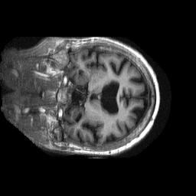
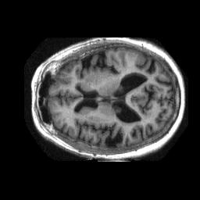
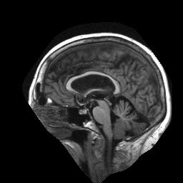
A typical workflow pattern in image analysis runs many filtering apps (fMRI - functional magnetic resonance imaging)
Workflow courtesy James Dobson, Dartmouth Brain Imaging Center
Notes:
Functional magnetic resonance imaging (fMRI) measures the haemodynamic response related to neural activity in the brain or spinal cord of humans or other animals. It is one of the most recently developed forms of neuroimaging.

Slide 49
Workflow management systems
Orchestration of many resources over long time periods
  Very complex to do manually - workflow automates this effort
Enables restart of long running scripts
Write scripts in a manner that’s location-independent: run anywhere
  Higher level of abstraction gives increased portability of the workflow script (over ad-hoc scripting)

Slide 50
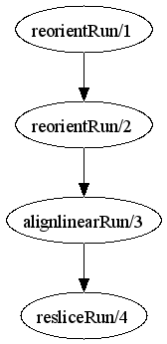
fMRI Example Workflow
(Run resliced) reslice_wf ( Run r)
{
Run yR = reorientRun( r , "y", "n" );
Run roR = reorientRun( yR , "x", "n" );
Volume std = roR.v[1];
AirVector roAirVec =
alignlinearRun(std, roR, 12, 1000, 1000, "81 3 3");
resliced = resliceRun( roR, roAirVec, "-o", "-k");
}
(Run or) reorientRun (Run ir, string direction, string overwrite)
{
foreach Volume iv, i in ir.v {
or.v[i] = reorient (iv, direction, overwrite);
}
}
Collaboration with James Dobson, Dartmouth

Slide 51
Why script in Swift?
Orchestration of many resources over long time periods
  Very complex to do manually - workflow automates this effort
Enables restart of long running scripts
Write scripts in a manner that’s location-independent: run anywhere
  Higher level of abstraction gives increased portability of the workflow script (over ad-hoc scripting)

Slide 52
Swift is…
A language for writing scripts that:
  process and produce large collections of persistent data
  with large and/or complex sequences of application programs
  on diverse distributed systems
  with a high degree of parallelism
  persisting over long periods of time
  surviving infrastructure failures
  and tracking the provenance of execution

Slide 53
Swift programs
A Swift script is a set of functions
  Atomic functions wrap & invoke application programs
  Composite functions invoke other functions
Data is typed as composable arrays and structures of files and simple scalar types (int, float, string)
Collections of persistent file structures (datasets) are mapped into this data model
Members of datasets can be processed in parallel
Statements in a procedure are executed in data-flow dependency order and concurrency
Variables are single assignment
Provenance is gathered as scripts execute

Slide 54
A simple Swift script
type imagefile;
(imagefile output) flip(imagefile input) {
app {
convert "-rotate" "180" @input @output;
}
}
imagefile stars <"orion.2008.0117.jpg">;
imagefile flipped <"output.jpg">;
flipped = flip(stars);

Slide 55
OSG & job submissions
OSG sites present interfaces allowing remotely submitted jobs to be accepted, queued and executed locally.
OSG supports the Condor-G job submission client which interfaces to either the pre-web service or web services GRAM Globus interface at the executing site.
Job managers at the backend of the GRAM gatekeeper support job execution by local Condor, LSF, PBS, or SGE batch systems.

Slide 56
Data Management
\

Slide 57
High-performance tools needed to solve several data problems.
The huge raw volume of data:
  Storing it
  Moving it
  Measured in terabytes, petabytes, and further …
The huge number of filenames:
  10¹² filenames is expected soon
  Collection of 10¹² of anything is a lot to handle efficiently
How to find the data

Slide 58
Data Questions on the Grid
Where are the files I want?
How to move data/files to where I want?

Slide 59
Data management services provide the mechanisms to find, move and share data
GridFTP
  Fast, Flexible, Secure, Ubiquitous data transport
  Often embedded in higher level services
RFT
  Reliable file transfer service using GridFTP
Replica Location Service (RLS)
  Tracks multiple copies of data for speed and reliability
Storage Resource Manager (SRM)
  Manages storage space allocation, aggregation, and transfer
Metadata management services are evolving

Slide 60
Data Management
Moving data - scenarios:
  Store long term in appropriate places (e.g., tape silos)‏
  Move input to where your job is running
  Move output data from where your job ran to where you need it (eg. your workstation, long term storage)‏
Notes:
What we have covered so far relates to jobs and execution.
One of the other very big areas in using the grid is dealing with large amounts of data.
We need to deal with things such as moving data around, storing it somewhere long term, keeping track of where we've stored it, for large amounts (terabytes, and heading towards petabytes) and large numbers of files.
So, like the GRAM case, we have some grid software to do this. For data movement, he standard is GridFTP.
There are various other pieces of software to deal with storing data within a site (similar to an LRM but designed for data) such as dCache, and for keeping track of where data is places (such as the Globus Replica Location Service).

Slide 61
GridFTP
high performance, secure, and reliable data transfer protocol based on the standard FTP
  http://www.ogf.org/documents/GFD.20.pdf
Extensions include
  Strong authentication, encryption via Globus GSI
  Multiple data channels for parallel transfers
  Third-party transfers
  Tunable network & I/O parameters
  Authenticated reusable channels
  Server side processing, command pipelining
Notes:
GridFTP: a high performance, secure, and reliable data transfer protocol based on the standard FTP. GridFTP enhances FTP with GSI security, multiple data channels for parallel transfers, third party transfers, and authenticated reusable channels.
RFT: protocol that provides reliability and fault tolerance for file transfers.

Slide 62
GridFTP usage
globus-url-copy
Convensions on URL formats:
  file:///home/YOURLOGIN/dataex/largefile
    a file called largefile on the local file system, in directory /home/YOURLOGIN/dataex/
  gsiftp://osg-edu.cs.wisc.edu/scratch/YOURLOGIN/
    a directory accessible via gsiftp on the host called osg-edu.cs.wisc.edu in directory /scratch/YOURLOGIN.
Notes:
Please note the triple slash: file:///home/etc…

Slide 63
Grids replicate data files for faster access
Effective use of the grid resources – more parallelism
Each logical file can have multiple physical copies
Avoids single points of failure
Manual or automatic replication
  Automatic replication considers the demand for a file, transfer bandwidth, etc.

Slide 64
File catalogues tell you where the data is
File Catalog Services
  Replica Location Service (RLS)
Requirements
  Abstract the logical file name (LFN) for a physical file
  maintain the mappings between the LFNs and the PFNs (physical file names)
  Maintain the location information of a file

Slide 65
RLS -Replica Location Service
RLS
  component of the data grid architecture (Globus component)
  It provides access to mapping information from logical names to physical names of items
  Goal:
  reduce access latency, improve data locality, improve robustness,
  scalability and performance for distributed applications
RLS produces replica catalogs (LRCs), which represent mappings between logical and physical files scattered across the storage system.
  For better performance, the LRC can be indexed.

Slide 66
RLS -Replica Location Service
RLS maps logical filenames to physical filenames.
Logical Filenames (LFN)
  Names a file with interesting data in it
  Doesn’t refer to location (which host, or where in a host)‏
Physical Filenames (PFN)
  Refers to a file on some filesystem somewhere
  Often use gsiftp:// URLs to specify
Two RLS catalogs:
  Local Replica Catalog (LRC) and
  Replica Location Index (RLI)

Slide 67
Globus RLS
site A
rls://serverA:39281
LRC
file1
file2
file1→ gsiftp://serverA/file1
file2→ gsiftp://serverA/file2
RLI
file3→ rls://serverB/file3
file4→ rls://serverB/file4
site B
rls://serverB:39281
LRC
file3
file4
file3→ gsiftp://serverB/file3
file4→ gsiftp://serverB/file4
RLI
file1→ rls://serverA/file1
file2→ rls://serverA/file2

Slide 68
Globus RLS
Quick Review
  LFN → logical filename (think of as simple filename)
  PFN → physical filename (think of as a URL)
  LRC → your local catalog of maps from LFNs to PFNs
    H-R-792845521-16.gwf → gsiftp://dataserver.phys.uwm.edu/LIGO/H-R-792845521-16.gwf
  RLI → your local catalog of maps from LFNs to LRCs
    H-R-792845521-16.gwf → LRCs at MIT, PSU, Caltech, and UW-M
  LRCs inform RLIs about mappings known
Can query for files is a 2-step process: find files on your Grid by
  querying RLI(s) to get LRC(s)
  then query LRC(s) to get URL(s)
Notes:
So querying for files is a 2-step process

Slide 69
Related Work - SRMs
Storage Resource Manager (SRM)
  Equivalent of a job scheduler for storage; allocates space, makes sure it doesn’t get swapped out before you are done (pinning); handles staging to and from tape
  http://sdm.lbl.gov/indexproj.php?ProjectID=SRM
  Examples:
    dCache
      provide a system for storing and retrieving huge amounts of data, distributed among a large number of heterogenous server nodes, under a single virtual filesystem tree with a variety of standard access methods.
      http://www.dcache.org/
    BeSTMan (Berkeley Storage Manager)
      http://datagrid.lbl.gov/bestman/

Slide 70
What is SRM?
Storage Resource Managers (SRMs) are middleware components
  whose function is to provide
    dynamic space allocation
    file management
    on shared storage resources on the Grid
  Different implementations for underlying storage systems are based on the same SRM specification
Notes:
Brief history will follow after this slide

Slide 71
SRMs role in grid
SRMs role in the data grid architecture
  Shared storage space allocation & reservation
    important for data intensive applications
  Get/put files from/into spaces
    archived files on mass storage systems
  File transfers from/to remote sites, file replication
  Negotiate transfer protocols
  File and space management with lifetime
  support non-blocking (asynchronous) requests
  Directory management
  Interoperate with other SRMs
Notes:
Brief history will follow after this slide

Slide 72
SRM: Main concepts
  Space reservations
  Dynamic space management
  Pinning file in spaces
  Support abstract concept of a file name: Site URL
  Temporary assignment of file names for transfer: Transfer URL
  Directory management and authorization
  Transfer protocol negotiation
  Support for peer to peer request
  Support for asynchronous multi-file requests
  Support abort, suspend, and resume operations
  Non-interference with local policies

Slide 73
OSG & Data management
OSG relies on GridFTP protocol for the raw transport of the data using Globus GridFTP in all cases except where interfaces to storage management systems (rather than file systems) dictate individual implementations.
OSG supports the SRM interface to storage resources to enable management of space and data transfers to prevent unexpected errors due to running out of space, to prevent overload of the GridFTP services, and to provide capabilities for pre-staging, pinning and retention of the data files.
OSG currently provides reference implementations of two storage systems the BeStMan and dCache

