Slide 1
USCMS Grid Infrastructure Troubleshooting
Shaowen Wang
USCMS & GROW
OSG Operations & Support Centers Workshop
May 16, 2006

Slide 2
Collaborative Troubleshooting
A newly established USCMS Grid troubleshooting team
  Ransom Briggs
  Yan Liu
  Anand Padmanabhan
  Eric Shook
  Shaowen Wang
The Tier-1 + 7 Tier2s

Slide 3
Troubleshooting HelpDesk
Interface to users
  cms-help@list.uiowa.edu
Functions
  Triaging
  Solving USCMS Grid infrastructure problems
    Interfacing with OSG and LCG GGUS
  Directing CMS application-level problems to experts at the Tier-1 and Tier-2s when appropriate

Slide 4
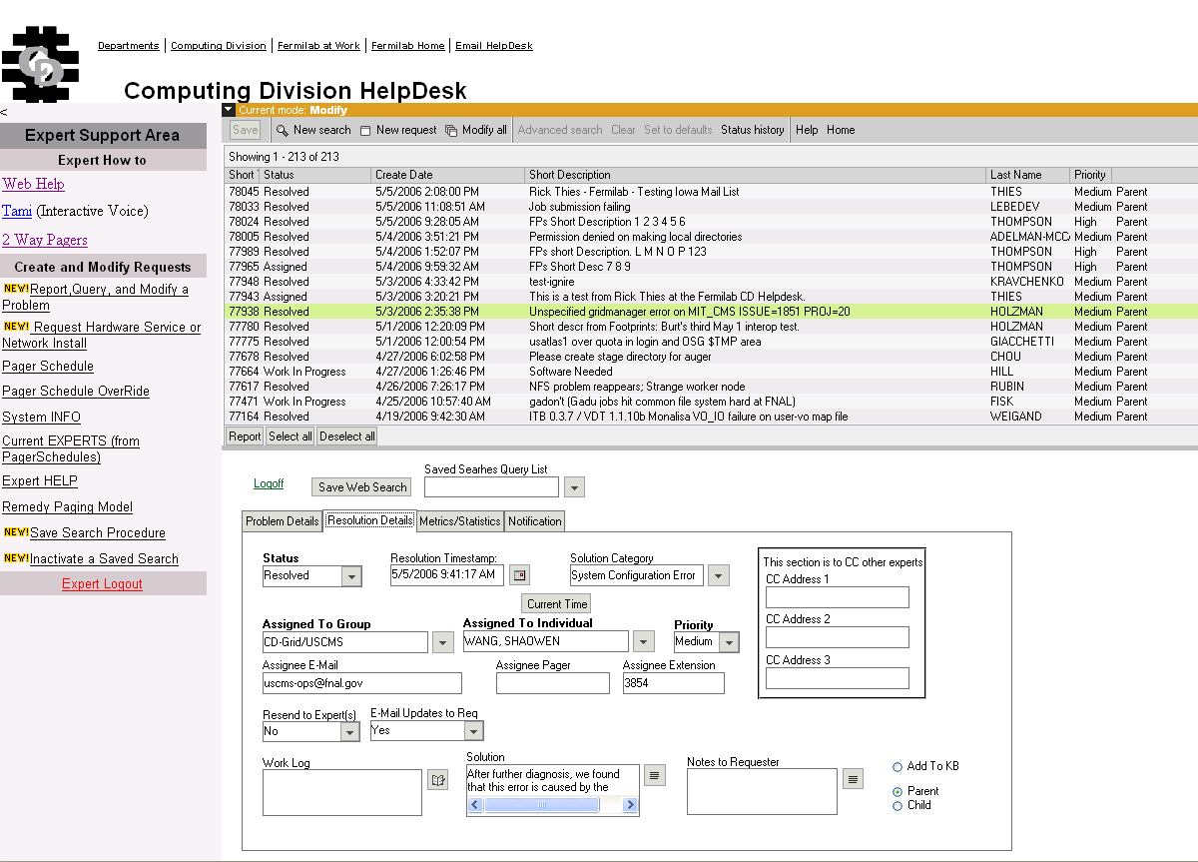
FNAL Remedy

Slide 5
Grid-Related CMS Application Tools
CRAB
  LCG
    LCG Resource Broker
  OSG
    Condor-G
SRM/dCache
PhEDEx (Physics Experimental Data Export)
  CMS data placement and file transfer system
Developing components
  gLite
  Condor Glidin

Slide 6
Toward Achieving Proactive Responses
Currently
  Understanding the complexity of troubleshooting Grids
  Reconciling monitoring services
    MonALISA
    Condor
    Other monitoring and information services
Future
  To diagnose with the support of OSG information and accounting services
  To help establish troubleshooting flowchart and automatic alert mechanisms
  To leverage our troubleshooting experience for OSG use

Slide 7
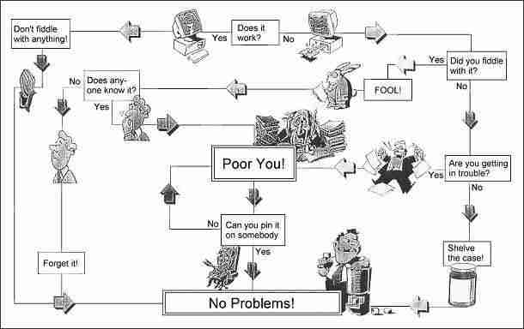
Troubleshooting Workflow
The secret is to follow the path.

Slide 8
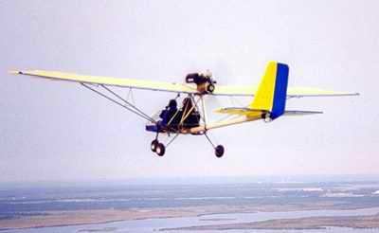

Slide 9
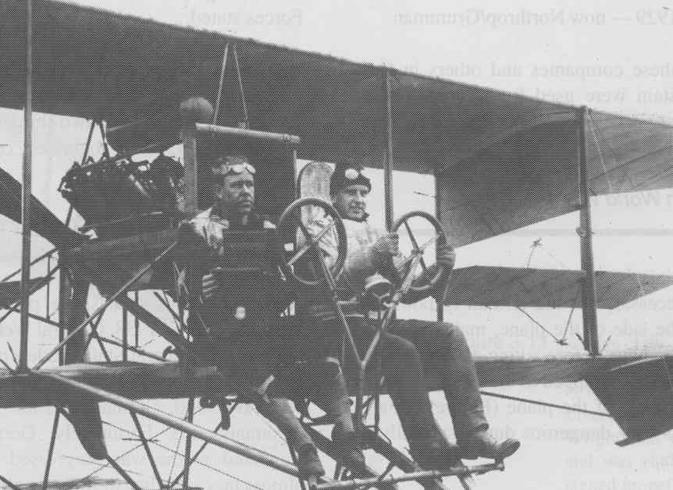

Slide 10
Thanks!
Questions and comments?

