Slide 1
NDT
August 9th 2011, OSG Site Admin Workshop
Jason Zurawski – Internet2 Research Liaison

Slide 2

Agenda
Tutorial Agenda:
  Network Performance Primer - Why Should We Care? (30 Mins)
  Introduction to Measurement Tools (20 Mins)
  Use of NTP for network measurements (15 Mins)
  Use of the BWCTL Server and Client (25 Mins)
  Use of the OWAMP Server and Client (25 Mins)
  Use of the NDT Server and Client (25 Mins)
  perfSONAR Topics (30 Mins)
  Diagnostics vs Regular Monitoring (20 Mins)
  Use Cases (30 Mins)
  Exercises
<number> – 11/08/26, © 2011 Internet2

Slide 3
Hands on Testing of NDT
MLab (Commodity Networking)
  http://ndt.iupui.donar.measurement-lab.org:7123/
Internet2 (R&E Networking)
  http://ndt.atla.net.internet2.edu:7123/
  To not overwhelm the server, also try replacing ‘atla’ with:
    chic
    hous
    kans
    losa
    newy
    salt
    seat
    wash
<number> – 11/08/26, © 2011 Internet2

Slide 4
NDT User Interface
Web-based JAVA applet allows testing from any browser
  One Click testing
  Option to dig deep into available results
  Send report of results to network administrators
Command-line client allows testing from remote login shell
  Same options available
  Client software can be build independent of server software
<number> – 11/08/26, © 2011 Internet2

Slide 5
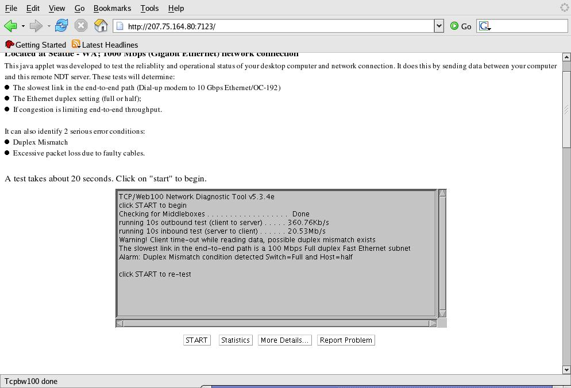
NDT Results
<number> – 11/08/26, © 2011 Internet2

Slide 6
Motivation for Work
Measure performance to users desktop
  Lots of tools to measure performance to a nearby server
  Also ‘plugable’ hardware to measure everything up to the network cable
  Want something to accurately show what the user is seeing
Develop “single shot” diagnostic tool that doesn’t use historical data
Combine numerous Web100 variables to analyze connection
Develop network signatures for ‘typical’ network problems
  Based on heuristics and experience
  Lots of problems have a smoking gun pattern, e.g. duplex mismatch, bad cable, etc.
<number> – 11/08/26, © 2011 Internet2

Slide 7
How It works
Simple bi-directional test to gather end to end data
  Test from client to server, and the reverse
  Gets the ‘upload’ and ‘download’ directions
Gather multiple data variables from server
  Via Web100, also some derived metrics (packet inter arrival times)
Compare measured performance to analytical values
  How fast should a connection be given the observations of the host and network
Translate network values into plain text messages
Geared toward campus area network
<number> – 11/08/26, © 2011 Internet2

Slide 8
Web100 Project
Joint PSC/NCAR project funded by NSF
Develop a system mib, similar to data that is exposed via SNMP
‘First step’ to gather TCP data
  Kernel Instrument Set (KIS)
Requires patched Linux kernel
Geared toward wide area network performance
Goal is to automate tuning to improve application performance
Patches available for vanilla kernels (e.g. non vendor modified)
<number> – 11/08/26, © 2011 Internet2

Slide 9
Web Based Performance Tool
Operates on Any client with a Java enabled Web browser
  No additional client software needs to be installed
  No additional configuration required
What it can do:
  State if Sender, Receiver, or Network is operating properly
  Provide accurate application tuning info
  Suggest changes to improve performance
What it can’t do
  Tell you where in the network the problem is
  Tell you how other servers perform
  Tell you how other clients will perform
<number> – 11/08/26, © 2011 Internet2

Slide 10
Finding Results of Interest
Duplex Mismatch
  This is a serious error and nothing will work right. Reported on main page, on Statistics page, and mismatch: on More Details page
Packet Arrival Order
  Inferred value based on TCP operation. Reported on Statistics page, (with loss statistics) and order: value on More Details page
Packet Loss Rates
  Calculated value based on TCP operation. Reported on Statistics page, (with out-of-order statistics) and loss: value on More Details page
Path Bottleneck Capacity
  Measured value based on TCP operation. Reported on main page
<number> – 11/08/26, © 2011 Internet2

Slide 11
Bottleneck Link Detection
What is the slowest link in the end-to-end path?
  Monitors packet arrival times using libpcap routine
    Data and ACK packets
    Is aware of packet sizes – used to calculate speed
  Use TCP dynamics to create packet pairs
  Quantize results into link type bins
    Broad classification, e.g. “FastE”
    No fractional or bonded links currently
Example:
  Consider the following setup
    1G network card on Host
    1G LAN
    100M (FastE) Wall Jack
  NDT will report there is a slow link somewhere in the path. It can’t tell you where, but something is limiting the test speed
<number> – 11/08/26, © 2011 Internet2

Slide 12
Duplex Mismatch Detection
Duplex Mismatch:
  Operation between a host and an interface are at different duplex modes (e.g. one half, one full)
  Common in networks where auto negotiation is disabled, or faulty
  Classic example of a “soft failure”, connectivity is present and speeds are poor
Developed analytical model to describe how Ethernet responds
Expanding model to describe UDP and TCP flows
Develop practical detection algorithm
Test models in LAN, MAN, and WAN environments
<number> – 11/08/26, © 2011 Internet2

Slide 13
Faulty Hardware or Link
Detect non-congestive loss due to
  Faulty NIC/switch interface
  Bad Cat-5 cable
  Dirty optical connector
<number> – 11/08/26, © 2011 Internet2

Slide 14
Congestion Detection
Shared network infrastructures will cause periodic congestion episodes
  Detect/report when TCP throughput is limited by cross traffic
  Detect/report when TCP throughput is limited by own traffic
<number> – 11/08/26, © 2011 Internet2

Slide 15
Additional Functions and Features
Provide basic tuning information
Features:
  Basic configuration file
  FIFO scheduling of tests, support for testing with simultaneous clients
  Simple server discovery protocol and ability to federate (e.g. load balance) servers
  Logging of all test results on the server side
Command line client support
Other Clients can be developed against open Javascript API:
  http://www.internet2.edu/performance/ndt/api.html
Posted on Google Code:
  http://code.google.com/p/ndt/
<number> – 11/08/26, © 2011 Internet2

Slide 16
Architecture
Well Known
NDT Server
Web Request
NDT - Server
Client
Redirect msg
Web
Browser
Web
Server
Web Page Request
Web page response
Testing
Engine
Test Request
Java
Applet
Spawn child
Control Channel
Child
Test Engine
Specific test channels
<number> – 11/08/26, © 2011 Internet2
Notes:
This is the basic flow chart for the NDT program.
The process starts with the user opening a browser and entering the NDT servers URL
An optional step is to point to a well known server and accept a redirect message (Federated mode)
Otherwise the URL points to the NDT server itself (either an apache or the fakewww process answer the request)
The web server responds by returning the page, with an embedded java applet (class or jar file is also returned)
The user must then manually request a test be performed by clicking the “start” button
The applet then opens a connection back to the server’s testing engine (web100srv process)
A child process is created to handle the test and the parent goes back to listening for more test requests. The parent also keeps the FIFO queue needed to process multiple requests.
A control channel is then created between the server and client to control the clients actions and synchronize the start of the various tests.
The client then opens 2 new data channels back to the client, allowing the client to open connections allows the tests to get past client side firewall boxes.
The client opens and closes a connection to perform the middlebox test
The client then streams data back to the server to measure the clients upload speed.
The client then opens another connection and the server streams data back to the client measuring the clients download speed
The server then extracts the web100 data and analyzed the connection for faults.
The results are recorded in the servers’ log file and the results are returned to the client for display to the user.

Slide 17
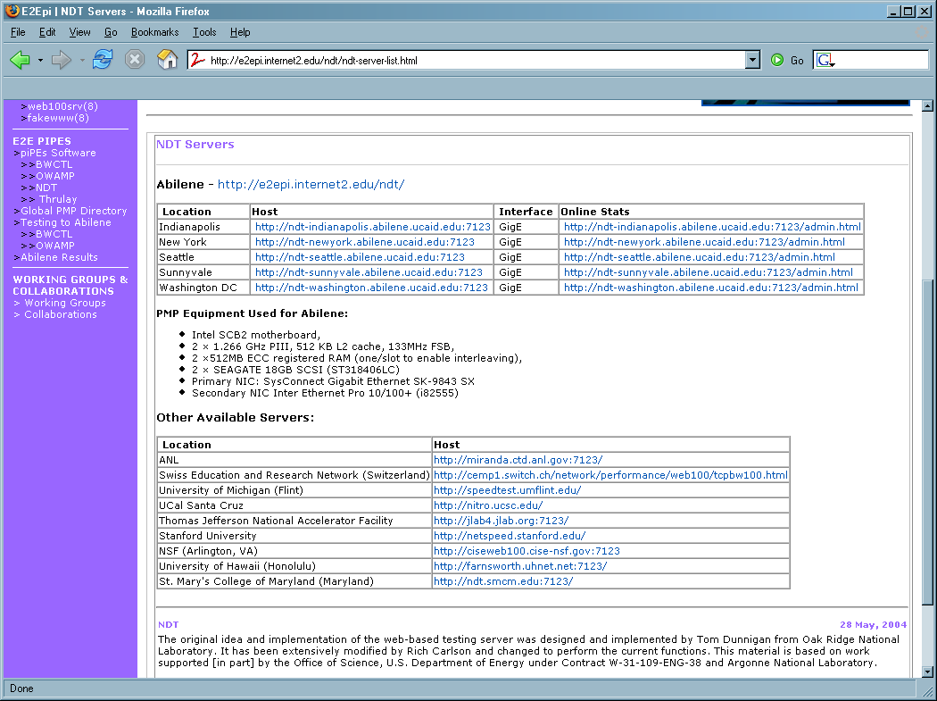
Finding a Server – The Old Way
Static List of servers – doesn’t scale
<number> – 11/08/26, © 2011 Internet2

Slide 18
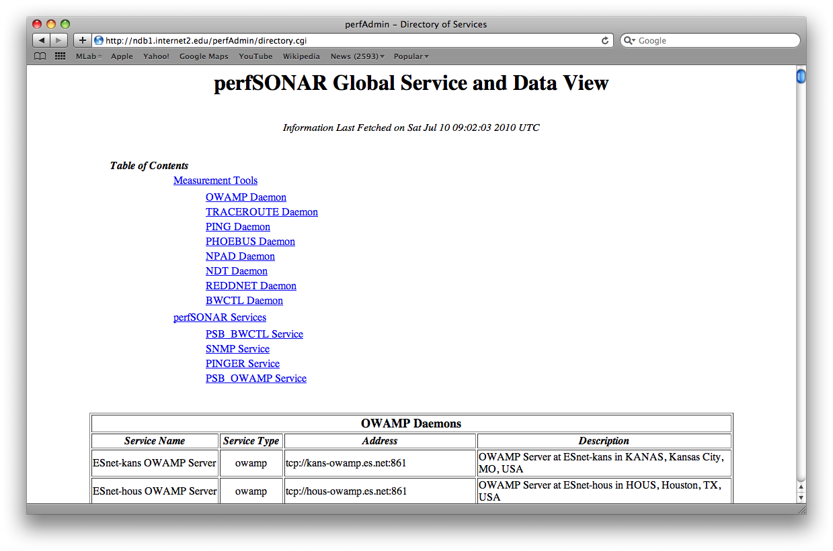
Finding a Server – The New Way
perfSONAR Infrastructure – automatically search for instances
<number> – 11/08/26, © 2011 Internet2

Slide 19
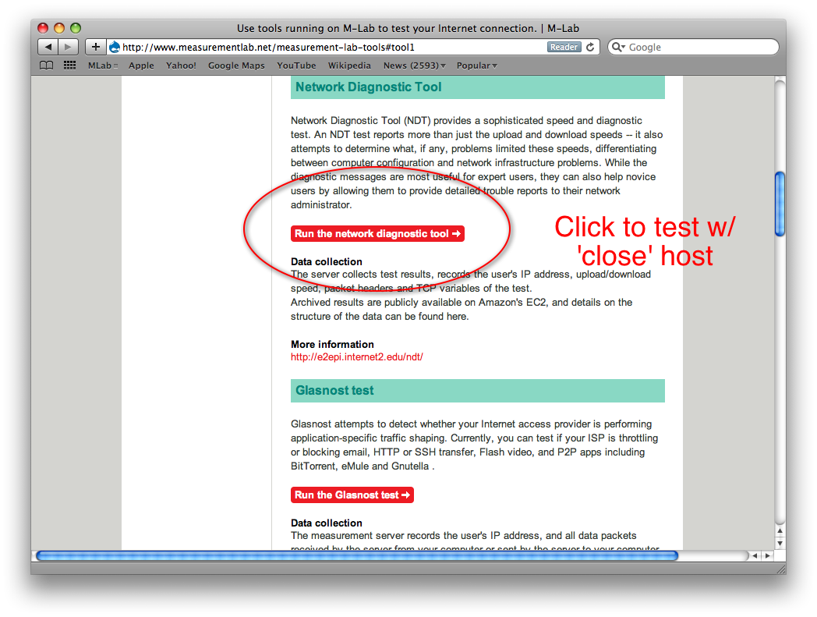
Finding a Server – MLab
Measurement Lab
  Joint Project between several partners
  More Info Here: http://www.measurementlab.net/
Locate a ‘close’ NDT server using DONAR (http://donardns.org/)
<number> – 11/08/26, © 2011 Internet2

Slide 20
General Requirements – Support
Source should compile for all modern *NIX
  *BSD, Linux, OS X
  configure/make/make install
Web100 Patched Kernel
  perfSONAR-PS Project also offers two alternatives:
    pS Performance Toolkit (bootable ISO)
    Pre-packaged kernel with Web100 for CentOS (http://software.internet2.edu)
Other Software
  Java SDK
  Libpcap
RPMs compiled specifically for CentOS 5.5
  May work with other RPM based systems (Fedora, RHEL)
<number> – 11/08/26, © 2011 Internet2

Slide 21
Recommended Settings
There are no settings or options for the Web based java applet.
  It allows the user to run a fixed set of tests for a limited time period
Test engine settings
  Turn on admin view (-a option)
  If multiple network interfaces exist use –i option to specify correct interface to monitor (ethx)
Simple Web server (fakewww)
  Use –l fn option to create log file
  Could also use a ‘real’ web server like Apache
<number> – 11/08/26, © 2011 Internet2

Slide 22
Potential Risks
Non-standard kernel required
  Web100 patching may be difficult to apply to new kernels
  Hard to keep up with vendor patching
  GUI tools can be used to monitor other ports
  Consider using pS Performance Toolkit enhancements if this scares you…
Public servers generate trouble reports from remote users
  Respond or ignore emails
Test streams can trigger IDS alarms
  Configure IDS to ignore NDT server
<number> – 11/08/26, © 2011 Internet2

Slide 23
Availability
Main Page:
  http://www.internet2.edu/performance/ndt
  http://software.internet2.edu
Mailing lists:
  ndt-users@internet2.edu
  ndt-announce@internet2.edu
<number> – 11/08/26, © 2011 Internet2

Slide 24
NDT
August 9th 2011, OSG Site Admin Workshop
Jason Zurawski – Internet2 Research Liaison
For more information, visit http://www.internet2.edu/workshops/npw
<number> – 11/08/26, © 2011 Internet2

Slide 25
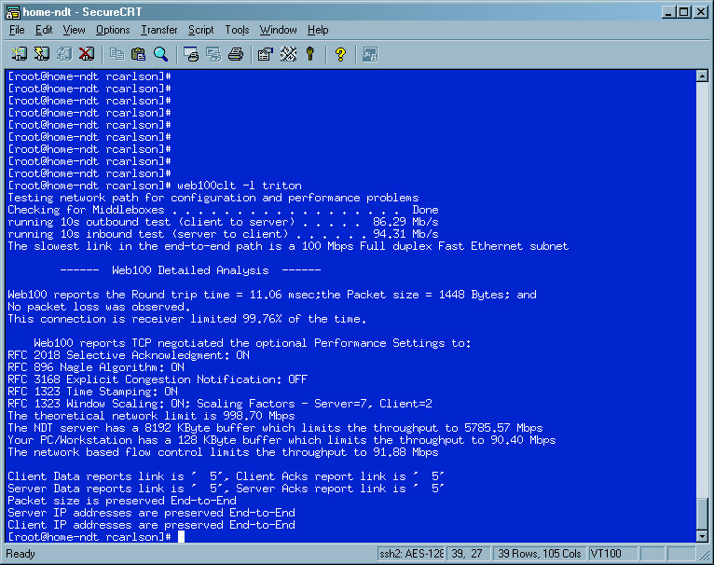
NDT Testing – Normal Operation
<number> – 11/08/26, © 2011 Internet2

Slide 26
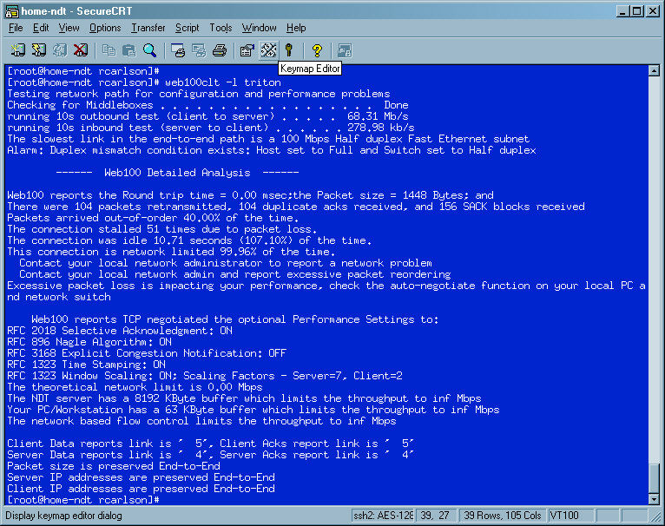
NDT Testing – Duplex Mismatch
<number> – 11/08/26, © 2011 Internet2

Slide 27
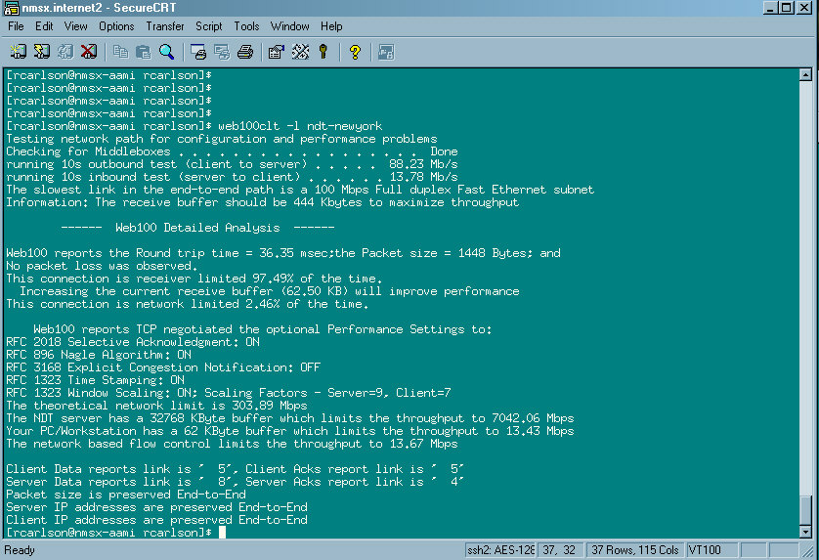
NDT Testing – Low Throughput
<number> – 11/08/26, © 2011 Internet2

Slide 28
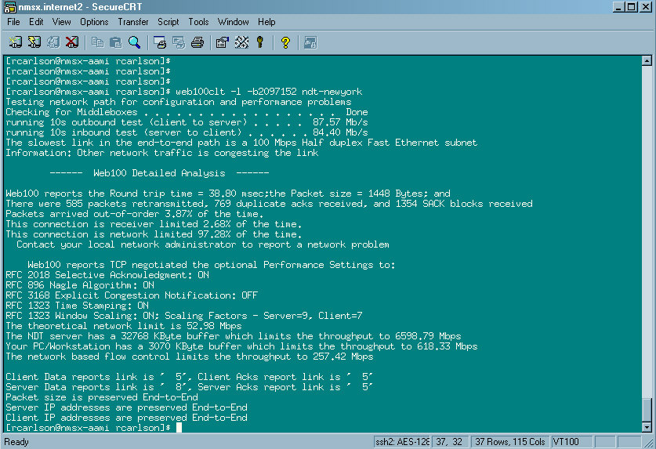
NDT Testing – Increase TCP Buffer Size
<number> – 11/08/26, © 2011 Internet2

