Slide 1
Me
Lawrence Eric Meyer

Slide 2
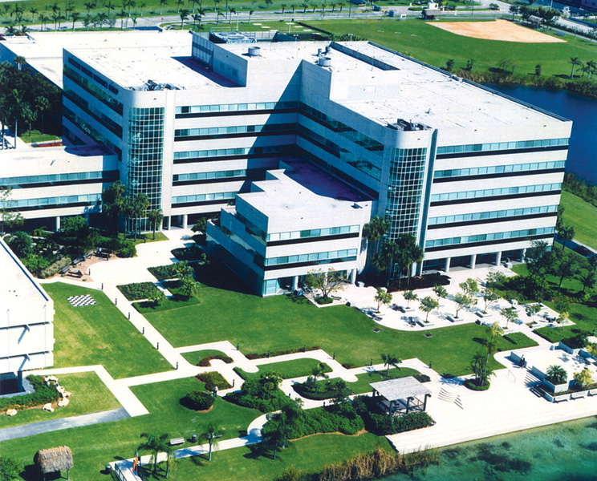
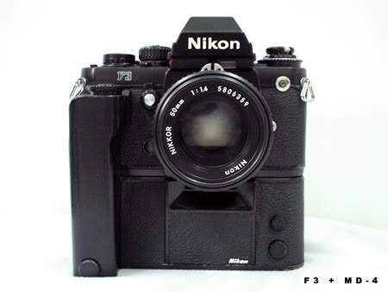



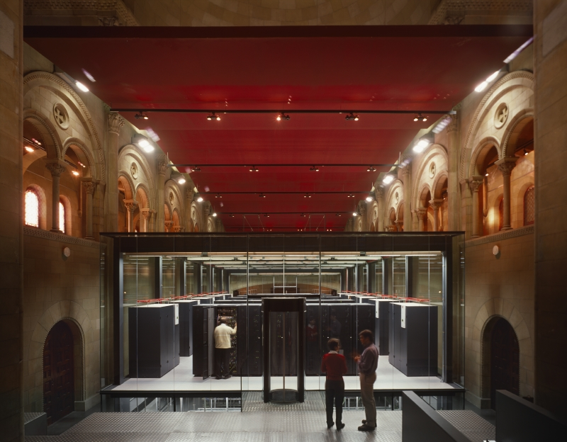

Background

Slide 3

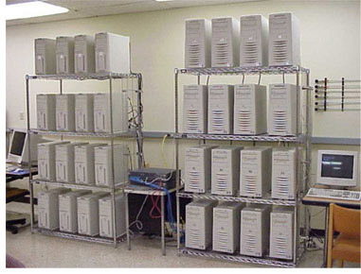
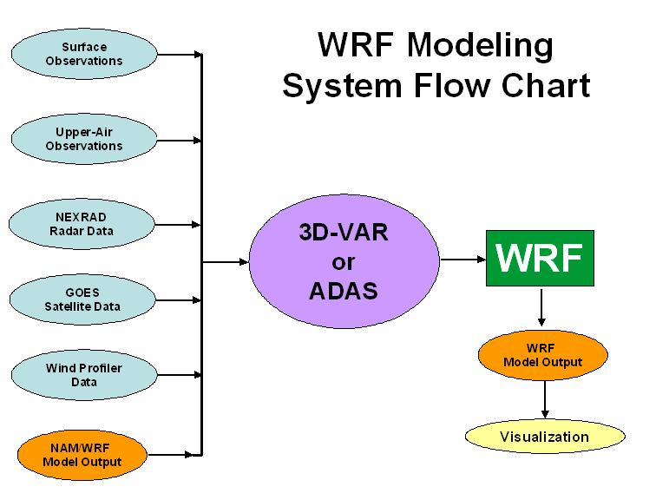

Research Directions
WRF Portal

Slide 4
Current
Architecting the WRF Portal
Running traces on WRF
Using Mare Nostrum
Dimemas
Paraver
Looking at timing for runtime predictions

Slide 5
Future
Add more resources (grid systems)
Automate the process through our
Job Flow Manager
Meta-Scheduler
Feedback controls for runtime performance
Timing
Resource selection
Fault tolerance
Advanced Portal Design

