Slide 1
Virtual Machines and Grid Computing
Borja Sotomayor
University of Chicago (Dept. of CS)
borja@cs.uchicago.edu

Slide 2
Index
Virtual Machines and Grid Computing
Virtual Workspaces
GT4 Workspace Service

Slide 3
Index
Virtual Machines and Grid Computing
Virtual Workspaces
GT4 Workspace Service

Slide 4
Virtual Machines
VM technology allows multiple virtual machines to run on a single physical machine.
App
App
App
App
App
Xen
Guest OS
(Linux)
Guest OS
(NetBSD)
Guest OS
(Windows)
VMWare
VM
VM
VM
Virtual Machine Monitor (VMM) / Hypervisor
UML
Denali
Hardware
etc.
Performance: Paravirtualization (e.g. Xen) is
very close to raw physical performance

Slide 5
Virtual Machines and
Grid Computing
VMs have several qualities that make them an appealing technology in Grid systems:
  Security and isolation
  Customization of execution environment
  Resource control
  Site independence
Grid sites could perform their work on dynamically deployed VMs.

Slide 6
Index
Virtual Machines and Grid Computing
Virtual Workspaces
GT4 Workspace Service

Slide 7
What is a workspace?
What do I do if I want to “run something in the Grid”?
  We have to encapsulate our work in a job abstraction.
  This abstraction imposes a lot of restrictions on the resource consumer.
    For example: Resource consumers can specify what libraries their jobs require, but they (usually) can't have those libraries dynamically installed when the job is submitted. If the library is not already available in the resources, they generally have to make a prior arrangement with resource providers to make sure that software is installed.
  However, these restrictions are usually perfectly acceptable.
  But... what if they're not?

Slide 8

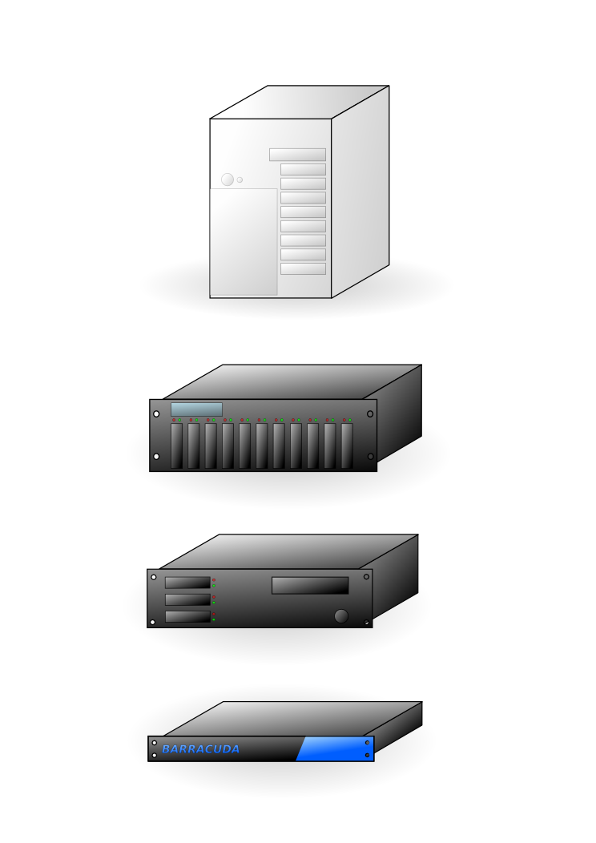
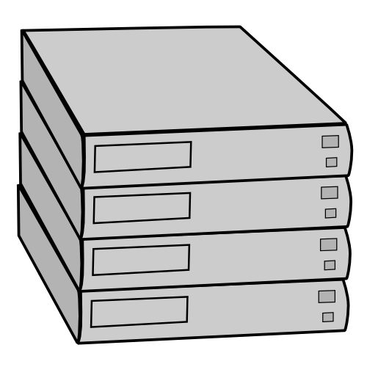

Resource provider
Resource consumers
Provides computational, storage, and
network resources
Want to run experiments on the resources,
but they each have different software
and hardware requirements
Has to provide resources to
several users at once
Wants as many resources
as possible
Has to balance the software
needs of multiple users
Wants to use certain
software packages
Has to provide a limited execution
environment for security reasons
Wants as much control
as possible over resources

Slide 9
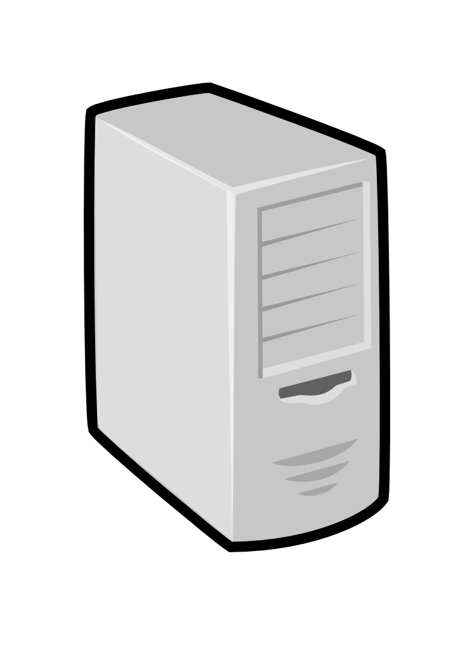
What is a workspace?
In some cases, resource consumers need execution environments to be dynamically deployed on remote resources.
The virtual workspace is an abstraction for such an execution environment.
2GB memory
500MB scratch disk
Software:
FOO, BAR, BAZ
Ideal environment
is deployed
and can be managed
Run jobs in ideal execution environment
Dream up an ideal environment
for your jobs (or anything else!)

Slide 10
What is a workspace?
A virtual workspace is an execution environment that can be deployed dynamically and securely on the Grid.
  Dynamic: Started and stopped on an on-demand basis.
  Secure: Environment encapsulated inside the workspace and the user submitting the workspace are both trustworthy.
Of course, this is not an entirely new idea... It is possible to create custom execution environments by:
  Dynamically setting up cluster nodes:
    CoD: http://www.cs.duke.edu/nicl/cod/
    bcfg: http://trac.mcs.anl.gov/projects/bcfg2/
  Providing access to existing installation
    Dynamic Accounts: http://workspace.globus.org/da/
  Refining site configuration
    Pacman: http://www.archlinux.org/pacman/

Slide 11
What is a workspace?
Main two aspects of workspaces:
  Environment definition: Users get exactly the (software) environment they need.
  Resource allocation: Provision and guarantee all the resources the workspace needs to function correctly (CPU, memory, disk, bandwidth, availability), allowing for dynamic renegotiation to reflect changing requirements and conditions
Existing implementations either don't provide both, or...
  Quality of life: Setting up a new software environment takes a long time, and still doesn't give the resource consumer full control.
  Quality of service: Little or no enforcement.
Quality of
Life
Quality of
Service

Slide 12
What is a workspace?
  What to do?
  Virtual Machines are a promising vehicle to
  achieve higher quality workspaces

Slide 13
Use cases
Use cases that drive our work on virtual workspaces:
  Virtual labs
  Event-driven applications
  Batch jobs with strict software requirements

Slide 14
Virtual labs
A CS department wants to teach a course on Parallel Programming.
Unfortunately, they do not have a computing cluster the students can use. And, even if they do, the cluster admin won't give the students root access.
Solution: Deploy a virtual workspace that provides the students with a ready-to-use cluster.

Slide 15
Event-driven applications
Some applications need large amounts of computational power the instant a specific event arrives.
Science comes at you fast!
Current solutions include job preemption or allowing urgent requests to skip to the front of the queue.
Solution: VMs allow seamless suspend/resume of execution environments. “Urgent environment” can be placed on standby, activated when the event arrives, and all other VMs can be paused.

Slide 16
Strict software requirements
Resource consumers can have strict software requirements:
  Jobs that will only run with a specific version of a library.
  Legacy software.
  Special access privileges
Managing multiple software requirements can be problematic for the resource provider
  Conflicting software requirements.
  Switching between software environments can be costly (e.g., reimaging cluster nodes)
  Avoid malicious use of resources.
Solution: Encapsulate desired software environment inside a VM.

Slide 17
Index
Virtual Machines and Grid Computing
Virtual Workspaces
GT4 Workspace Service

Slide 18
GT4 Workspace Service
The GT4 Virtual Workspace Service (VWS) is a VM-based workspace implementation.
  GT4 WSRF frontend
    WSRF: Web Services Resource Framework
    Collections of specifications (maintained by OASIS) for state management with web services (“stateful” web services)
  Xen-based, but other VMMs could potentially be used.
  http://workspace.globus.org/

Slide 19

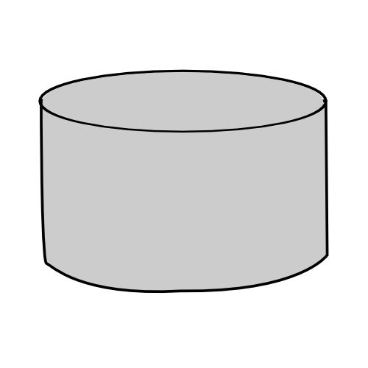
Virtual Workspace
Specification and Deployment
Virtual Workspace
Deployment
Virtual Workspace
Specification
XML
XML
Metadata
Deployment
Request
VM Image
Some configuration (such as the IP address) may not be specified in the image itself, but in the metadata file.
Information which may be preserved between deployments:
VMM and kernel requirements
NICs + IP addresses
VM image/s to use
Resource allocation: Duration, CPU %, memory, network bandwidth, ...

Slide 20
GT4 Workspace Service
Architecture
The workspace service has
a WSRF frontend that allows
users to deploy and manage
virtual workspaces
VWS
Node
Pool
node
Pool
node
Pool
node
Workspace
Service
The VWS manages a set of nodes
(typically a cluster).
This is called the node pool.
Pool
node
Pool
node
Pool
node
Each node must have a VMM (Xen)
installed, along with the workspace
backend (software that manages
individual nodes)
Image
Node
Pool
node
Pool
node
Pool
node
Pool
node
Pool
node
Pool
node
VM images are stored in a
separate node.
Resource Provider

Slide 21
GT4 Workspace Service
Typical Deployment (1/2)
VWS
Node
Pool
node
Pool
node
Pool
node
Workspace
Service
Workspace
- Workspace metadata
- Deployment request
- Does not include the VM image itself (metadata includes the location of the image)
Pool
node
Pool
node
Pool
node
Image
Node
Pool
node
Pool
node
Pool
node
Pool
node
Pool
node
Pool
node
Resource Provider

Slide 22
GT4 Workspace Service
Typical Deployment (2/2)
The workspace service publishes
information on each workspace
as standard WSRF Resource
Properties.
VWS
Node
Pool
node
Pool
node
Pool
node
Workspace
Service
Pool
node
Pool
node
Pool
node
Users can query those
properties to find out
information about their
workspace (e.g. what IP
the workspace was bound to)
Image
Node
Pool
node
Pool
node
Pool
node
Pool
node
Pool
node
Pool
node
Users can interact directly with their workspaces the same way the would with a physical machine.
Resource Provider

Slide 23
GT4 Workspace Service
Workspace Service is a Globus incubator project.
  http://workspace.globus.org/
Current release TP1.2.2 (01/04/07)
  Provides the functionality described in the previous slides (managing a pool of nodes, and deploying single-machine workspaces to those nodes)
  We are currently working on supporting virtual clusters.

Slide 24
Questions?
Borja Sotomayor
University of Chicago (Dept. of CS)
borja@cs.uchicago.edu

