Slide 1
nanoHUB GridProbe Validation of 4 Taskforce-sites
February 18, 2009
Site validation success rate for previous 31 days is 93.4%.
Success rate for the month, excluding Purdue & UCSD downtimes, is 98.8%.

Slide 2
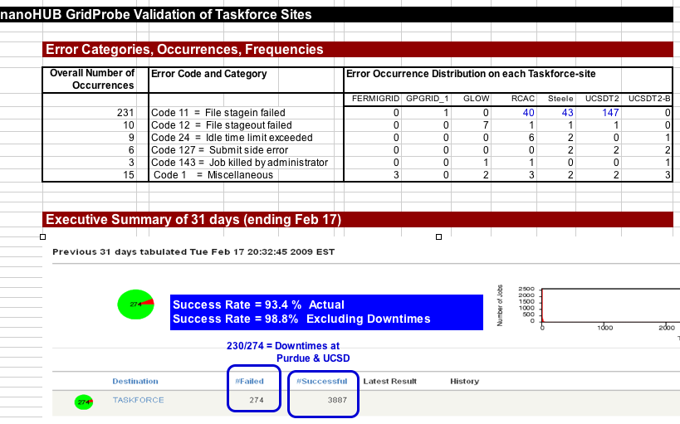

Slide 3
