Slide 1
Open Science Grid
Education, Training and Outreach
OpenScienceGrid.org/Education
OpenScienceGrid.org/About/Outreach eot@OpenScienceGrid.org
Team: Dr. Alina Bejan, Mike Wilde, Ben Clifford
Computation Institute, The University of Chicago and
Argonne National Laboratory

Slide 2
Open Science Grid (OSG)
takes High Throughput Computing to the next level, to transform data-intensive science through a cross-domain, self-managed nationally distributed cyber-infrastructure.
brings together campuses and communities, and facilitates the needs of Virtual Organizations at all scales.
The OSG Consortium includes
  universities
  national laboratories
  scientific collaborations
  software developers
working together to meet these goals

Slide 3
OSG EOT Mission
Organize and deliver training for OSG
  OSG End Users
  Site Administrators
  Support new communities / VOs joining OSG
Engage young people in (e)Science and CS
  Primary focus: undergraduate and early graduate students
  Reach high schools through I2U2 (QuarkNet follow-on)
  Promote and train in interdisciplinary collaboration
Reach out
  To under-represented communities
    Engage and assist minority students and minority serving institutions by providing resources and opportunities.
  internationally
    Strengthen and assist emerging, underserved regions of strategic importance to form bonds to US science and Grid communities
    Focus (for outreach) is on Latin America and Africa
    OISE focus on engagement in Europe and Asia

Slide 4
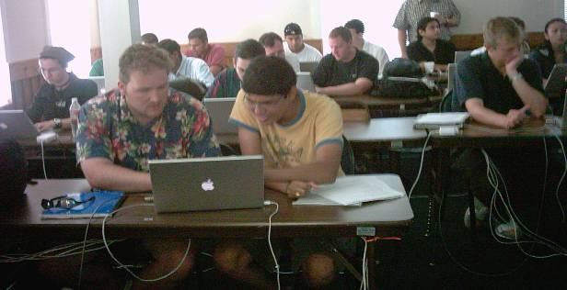
OSG EOT Program Overview
End User Education
  In-person workshops
  Online training
  EOT VO for student engagement, access and support
Community Outreach
  International student/faculty exchange via OISE
  Supporting under-represented and under-resourced communities in US, Latin America and Africa through workshops, technical assistance and grid access
  High School Education – I2U2 support - http://ed.fnal.gov/uueo/i2u2.html
Site Admin Training
  Training grid administrators in setup and support of OSG sites using the OSG/VDT software stack

Slide 5
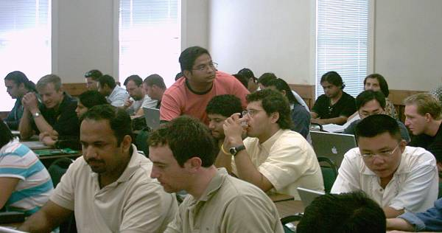
2007-08 Workshop Program www.opensciencegrid.org/workshops
Florida International Grid School 2008, Jan 23-25, at Florida International University, Miami, Florida
Supercomputing ’07 tutorials, Nov 11 & 13, at Reno, Nevada
Great Plains Grid School (GPGS’07), Aug 8-10, at the U. of Nebraska-Lincoln
Rio Grande Grid School (RGGS’07), Jun 8-10, at the U. of Texas at Brownsville, coordinated with UT-Pan American
TeraGrid Conference tutorials, Jun 4-8, at the U. of Wisconsin-Madison
South Africa Workshop, Mar 26-30, at the IFIP School on Software (ISS’07), Gordon's Bay, South Africa
Midwest Grid Workshop (MGW’07), Mar 24-25 at the U. of Illinois at Chicago
Argentine Grid Workshop, Mar 12-14 at Santa Fe, Argentina
OSG Collaboration Meeting, Mar 5-7 at the Renaissance Computing Institute, Chapel Hill, North Carolina.

Slide 6
Grid School Syllabus
Intro to distributed computing and the Grid
Grid security and basic Grid access
Grid resource and job management
Grid data management
Building, monitoring, maintaining & using Grids
Grid applications and frameworks
Workflow and related issues (scheduling, provenance)
Future:
  Porting applications to the Grid
  Web services and the resource framework
  Advanced networking; data mining
Notes:
Dual purpose moving forward

Slide 7
Self-paced / online instruction
www.ci.uchicago.edu/osgedu/schools/gridlab/
Flexible roadmaps for navigating the material
Lectures and labs
Access to online community to provide support
Online office hours

Slide 8
I2U2
Interactions In Understanding the Universe
The Grid for Secondary Science Education
“educational virtual organization”
creates an infrastructure to develop
  hands-on laboratory course content and
  an interactive learning experience that
    brings tangible aspects of each experiment into a “virtual laboratory.”
These labs use the Grid for education in the same way that science uses the Grid.
www.i2u2.org

Slide 9
I2U2
"e-Labs”
  delivered as Web-based portals accessible in the classroom and at home
  implemented with of Web-based media capabilities
"i-Labs”
  delivered as interactive interfaces typically located within science museums and similar public venues
  leverage the latest advances in
    display technology and
    human-computer interaction,
  and bring the experiences and appreciation of scientific investigation and inquiry to the wide audience of informal education

Slide 10
List of e-Labs
  Cosmic Ray e-Lab
    High school students investigate data from a cosmic ray detector array. (not necessary to have a detector to participate.)
    Possible investigations:･Muon Lifetime･Diurnal changes in flux･Effects of shielding･High-energy showers･Altitude effects
  CMS Test Beam e-Lab (Beta Version)
    High school students analyze CMS test beam data in an online graphical ROOT environment.
    Shower Depth･Lateral Shower Size･Beam Purity･Detector Resolution
  LIGO e-Lab (Beta version)
    High school and middle school students investigate seismic behavior with data from LIGO ( Laser Interferometer Gravitational-wave Observatory).
    Earthquake Studies･Frequency Band Studies･Microseismic Studies･Studies of Human-induced Seismic Activity
  ATLAS e-Lab
  STAR e-Lab

Slide 11
i-Labs
To engage the general public in science, we envision using appealing museum exhibits to attract visitors' attentions and engage them in a short taste of exploration
they will use virtual data tools and techniques to access, process and publish data, report their results as online posters, have online discussions about their work with peers, and then present posters and meet scientists at museums.

Slide 12
i-Lab Example
Adler Planetarium
  is developing a cosmic ray i-Lab with support from QuarkNet and the Compact Muon Solenoid (CMS) experiment.
  effort to research an informal-education model

Slide 13
International Outreach
South Africa Program
  Led by Jeremy Dodd, Columbia/ATLAS
  Providing mentorship to University of Witwatersrand, Johannesburg
  Grid site development
  Student mentorship; students/teachers to US Workshops to facilitate S. African workshops
  Ian Foster lecture at Cape Town IFIP Workshop
South American Efforts
  Argentine Grid School, March 12-14 2007
  Linking to HEP via Brazil, CHEPREO; Columbia.
Projects for Pan-Am and S. Africa schools

Slide 14
OISE Interoperability Project
OSG - NorduGrid interoperability of information systems applications and applications:
  Interoperability of Information Services between the OSG and the European Grid infrastructures.
    Using Glue Schema
    bring the NorduGrid (NGDF) information structure to be compatible with EGEE and OSG
    involves junior faculty from the University of Iowa (Shaowen Wang) and University of South Florida traveling to Lund University to work with the NGDF group.
    Part of the OSG External Project led by Gabriele Garzoglio, Fermilab
  D0, LHC and IceCube applications running across the NorduGrid and OSG infrastructures.
    Junior faculty from the University of Wisconsin (coordinated through Albrecht Karleand) and the University of Maryland (coordinated through Nick Hadley and Greg Sullivan)
    The participants travel to the Stockholm University for this collaboration.

Slide 15
OISE Grid Training
US Grid Schools - European International Schools on Grid Computing
  OSG as co-organizer for ISSGC’07 and ISSGC’08
  Each year 5-7 alumni of US Grid Schools will attend the International Summer school.
  Joint lectureships and material sharing / development efforts
  Content sharing
  Sponsor US junior faculty instructor at the International School
  Potential participants: University of Chicago, ISI, Notre Dame, University of Wisconsin

Slide 16
Education VO
Join OSGEDU VO
  Use OSG resources
  Contribute resources
Wiki, email lists, followup discussions
Support, engagement
Postings of opportunities for students

Slide 17
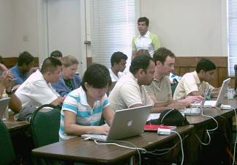
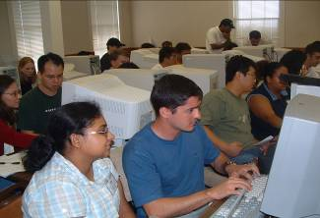
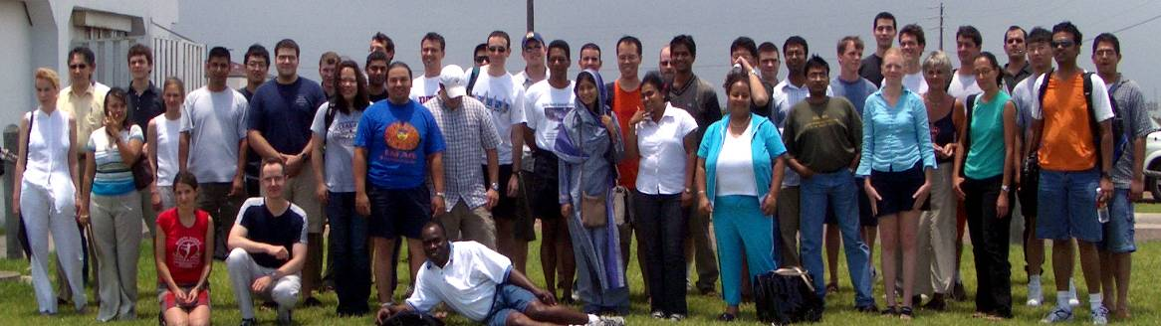
Students
2004-2007 facts:
International participation:
  Argentina , Brazil, Canada, Columbia, India, Mexico, New Zealand, Russia, South Africa, Uruguay
Women
  Aprox. 25%
Minorities
  Aprox 10%
Try to improve these statistics
Notes:
Important demographic – 50% science apps – 50% computer science.
Broad range of sciences represented – from HEP to Earth Systems
Collaboration was one of the things we were striving to teach.

Slide 18
Participants’ domains
Computer Science
Image processing
Communications
Networking
Physics
Astrophysics
High Energy Nuclear Physics
Optical Networks
Theoretical solid state physics
Atomic Physics
Computational Physics
Chemistry
Computational Chemistry
Molecular Dynamics & Simulation
Applied Mathematics
Geosciences
Computational Multibody Dynamics for Distributed computing
Judicial Administration
Engineering
Materials Science
Quantum theory
…and others …

Slide 19
Acknowledgments
The OSG Education, Outreach and Training program is supported by
DOE grant DE-FC02-06ER41436
and
NSF grant PHY-0621704.

Slide 20
Conclusion
Integrate efforts with TeraGrid
Measurement tools for success metrics
International outreach started in South America, South Africa, and via OISE
Education VO starting to provide engagement and access to resources
Contact us: eot-team@opensciencegrid.org
Subscribe to:
Grid-EDU-announce@opensciencegrid.org

