Slide 1


Slide 2
Part Three:
Data Management

Slide 3
3: Data Management
A: Data Management — The Problem
B: Moving Data on the Grid
  FTP, SCP
  GridFTP, UberFTP
  globus-URL-copy
  RFT
C: Lab 3 — Data Management

Slide 4
A: Data Management —
The Problem

Slide 5
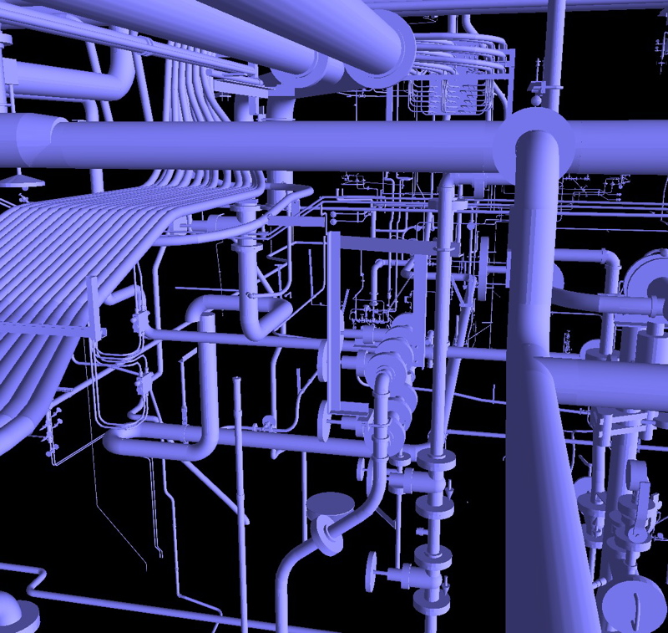
General Principle
Not all pipes
are created equal.

Slide 6
Extremely Large Data Sets
LIGO
  Generates data at 10 MB per second, just under 1 TB (= 1000 GB) per day
Sloan Digital Sky Survey
  More than 15 TB of data catalogs
Compact Muon Solenoid and ATLAS
  100 MB per second, about 1 Petabyte (= 1000 TB) per year (per detector)

Slide 7
Big Files, Big Directories
There are really two issues here.
The individual files can be quite large
  How do you move such big blocks of data?
  How do you store such big blocks of data?
The number of files to be handled can also be quite large
  Literally billions of filenames alone throughout a project

Slide 8
Data Duplication
Sometimes the best way to store a file is to store it twice
  Local copies saves transmission times
But there are new problems introduced with this approach
  Maintaining copies
  Locating copies

Slide 9
Data Management Questions
What data and/or files exist on the grid?
Where is a given file actually stored on the grid?
How do I move a file from Point A to Point B?

Slide 10
B: Moving Data on the Grid

Slide 11
Requirements for Moving Data
Speed
  Preferably, as fast as the wires will allow, i.e. no significant performance overhead
Security
  Files should be shared only with authenticated clients
Robustness
  Fault tolerance and general code stability

Slide 12
GridFTP
Extends established FTP (File Transfer Protocol)
Authentication via GSI
  Encryption
Multiple parallel channels
Third-party transfers
Tunability for network and I/O parameters

Slide 13
Pedantic Semantics
GridFTP is a protocol, not a utility
A server or client is “GridFTP-enabled”
“GridFTP” doesn’t always mean “Globus’ GridFTP-enabled server”
… except that it usually does.

Slide 14
Globus GridFTP Server
Built on top of wuftpd
Hence, configuration is similar to wuftpf
Runs as a inetd (xinetd) service
  Connection is attempted on port 2811
  xinetd looks up port in /etc/services and finds responsible service
  xinetd starts service according to configuration with data from communication send on stdin

Slide 15
GridFTP Environment Variables
LD_LIBRARY_PATH
  Point to $GLOBUS_LOCATION/lib
GRIDMAP — (server side only!)
  Path to grid-mapfile for authentication
  Generic GSI environment variable
X509_CERT_DIR
  Directory in which CA signing certificates held
  Generic GSI environment variable
Notes:
Some of these are generic -- not specifically for GridFTP

Slide 16
globus-url-copy
Another GridFTP client from Globus
Copy files from one URL to another URL
  One URL is usually a gsiftp:// URL
  Another URL is usually a file:// URL
    A file, not a directory!

Slide 17
“globus-url-copy” syntax
Server to local:
$ globus-url-copy gsiftp://<source> file:/<dest>
Local to server:
$ globus-url-copy file:/<source> gsiftp://<dest>
Remote server A to remote server B:
$ globus-url-copy gsiftp://<source> \ gsiftp://<dest>
Notes:
Come up with better examples --
Here -> there
There -> here
There -> other there

Slide 18
Single and Multiple Channels
By default, globus-url-copy uses 1 channel
Monitor performance using -vb flag
globus-url-copy -vb gsiftp://ldas-cit.ligo.caltech.edu:15000/usr1/grid/smallfile file:/tmp/smallfile
  9437184 bytes 658.09 KB/sec avg 512.95 KB/sec inst
Multiple channels dramatically boosts xfer rate
$ globus-url-copy -vb -p 4 gsiftp://ldas-cit.ligo.caltech.edu:15000/usr1/grid/largefile file:/tmp/largefile
523960320 bytes 5814.25 KB/sec avg 5568.27 KB/sec inst

Slide 19
More Performance Tweakage
Still faster by using large TCP windows
$ globus-url-copy -vb -p 4 -tcp-bs 1048576 gsiftp://ldas-cit.ligo.caltech.edu:15000/usr1/grid/largefile file:/tmp/largefile
514392064 bytes 6609.67 KB/sec avg 8639.71 KB/sec inst
Still faster by using large memory buffers
$ globus-url-copy -vb -p 4 -bs 1048576 -tcp-bs 1048576 gsiftp://ldas-cit.ligo.caltech.edu:15000/usr1/grid/largefile file:/tmp/largefile
523304960 bytes 7300.56 KB/sec avg 9311.99 KB/sec inst

Slide 20
What If You Can’t Authenticate?
Unauthenticated, globus-url-copy is still a general purpose, single-channel URL copying tool
No GSI authentication used
Parallel channels etc. won’t work
  $ globus-url-copy http://news.bbc.co.uk file:/tmp/news

Slide 21
UberFTP
Developed and supported at NCSA
Interactive like ftp
Use –a GSI for GSI authentication
Supports multiple channels using –c flag
  $ uberftp -H ldas-grid.ligo-la.caltech.edu -a gsi
  220 ligo-server.ncsa.uiuc.edu GridFTP Server 1.12 GSSAPI type Globus/GSI wu-2.6.2 (gcc32dbg, 1069715860-42) ready.
  230 User mfreemon logged in.
  uberftp>

Slide 22
SCP: Secure Copy
scp from […] to
  scp <sourcefile> <destfile>
  scp host:<sourcefile> <destfile>
  scp user@host:<sourcefile> <destfile>
Syntax is like cp
  -r flag to recursively copy directories
  man scp for more options

Slide 23
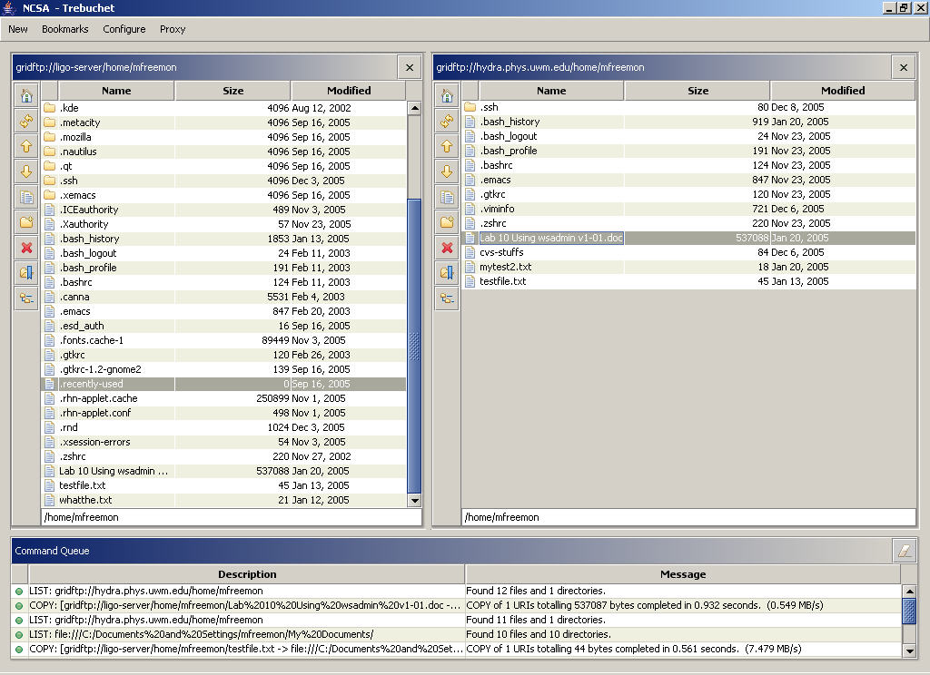
Trebuchet
GUI for
Grid-enabled
file transfer
Developed at
NCSA

Slide 24
RFT: Reliable File Transfer
An OGSA service for queuing file transfer requests
  Server-to-server transfers
  Checkpointing for restarts
  Database back-end for failovers
Allows clients to requests transfers and then “disappear”
  No need to manage the transfer
  Status monitoring available if desired

Slide 25
Lab 3: Data Management

Slide 26
Lab 3: Data Management
In this lab:
  Use SCP (Secure Copy)
  Use globus-url-copy
  Use UberFTP
  Use UberFTP for a third-party file move

Slide 27
Credits
NSF disclaimer
Portions of this presentation were adapted from the following sources:
  GryPhyN Grid Summer Workshop
  Jaime Frey, UW-Madison Condor Group

