Slide 1

More HTCondor
2014 OSG User School, Monday, Lecture 2
Greg Thain
gthain@cs.wisc.edu
University of Wisconsin-Madison

Slide 2

Questions so far?
2

Slide 3
Goals For This Session
• Understand the mechanisms of HTCondor (and HTC in general) a bit more deeply
• Use a few more HTCondor features
• Run more (and more complex) jobs at once
3

Slide 4
HTCondor in Depth
4

Slide 5
Why Is HTC Difficult?
• System must track jobs, machines, policy, …
• System must recover gracefully from failures
• Try to use all available resources, all the time
• Lots of variety in users, machines, networks, …
• Sharing is hard (e.g., policy, security)
• More about the principles of HTC on Thursday
2013 OSG User School
Cartwright - More HTCondor
5

Slide 6
Main Parts of HTCondor
2013 OSG User School
Cartwright - More HTCondor
6

Slide 7

Main Parts of HTCondor
Function
Track waiting/running jobs Track available machines Match jobs and machines Manage one machine
Manage one job (on submitter) Manage one job (on machine)
6

Slide 8
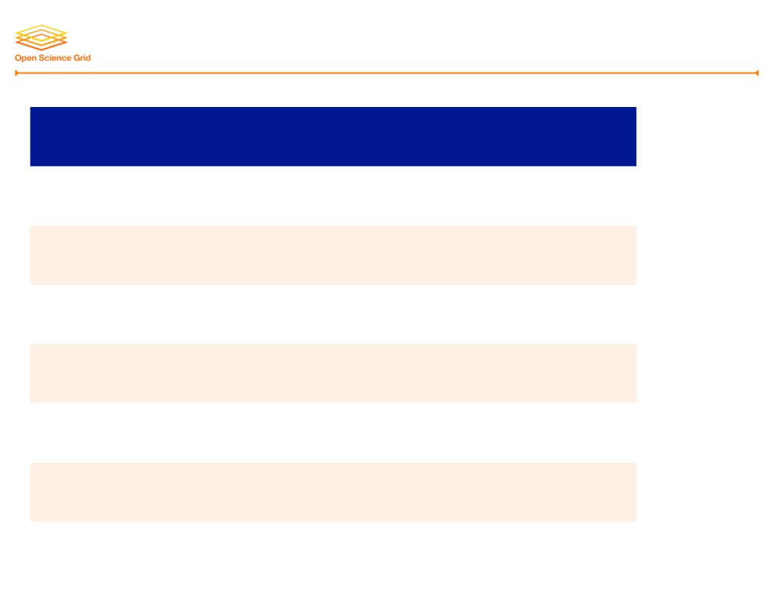
Main Parts of HTCondor
Function
HTCondor Name
Track waiting/running jobs Track available machines Match jobs and machines Manage one machine
schedd (“sked-dee”) collector
negotiator startd (“start-dee”)
Manage one job (on submitter) shadow
Manage one job (on machine) starter
2013 OSG User School
Cartwright - More HTCondor
6

Slide 9
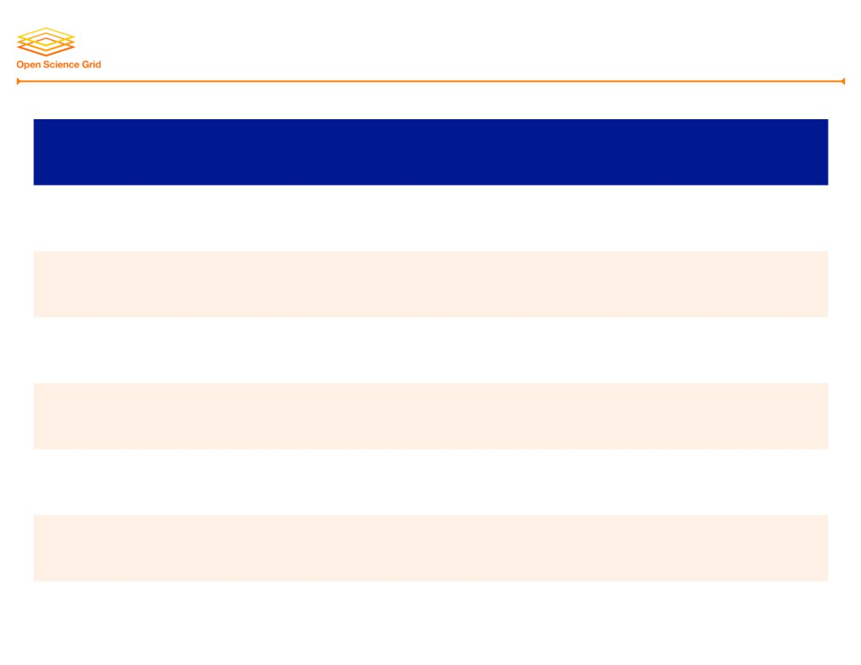
Main Parts of HTCondor
Function
HTCondor Name
#
Track waiting/running jobs Track available machines Match jobs and machines Manage one machine
schedd (“sked-dee”) collector
1+
1
negotiator startd (“start-dee”)
1
per
machine
Manage one job (on submitter) shadow Manage one job (on machine) starter
per job
running
per job
running
6

Slide 10
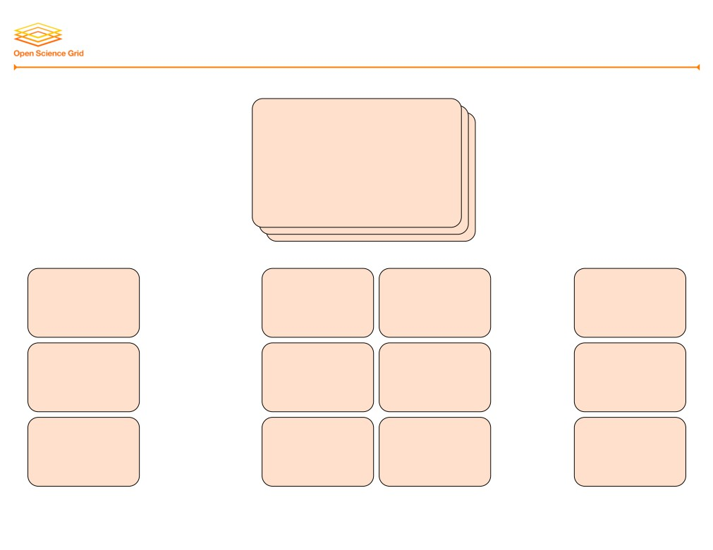
Typical Architecture
Central Manager
collector + negotiator
Submit
Execute Execute
Execute
schedd
startd startd
startd
Submit
Execute Execute
· · ·
Execute
schedd
startd startd
startd
Submit
Execute Execute
Execute
schedd
startd startd
startd
7

Slide 11
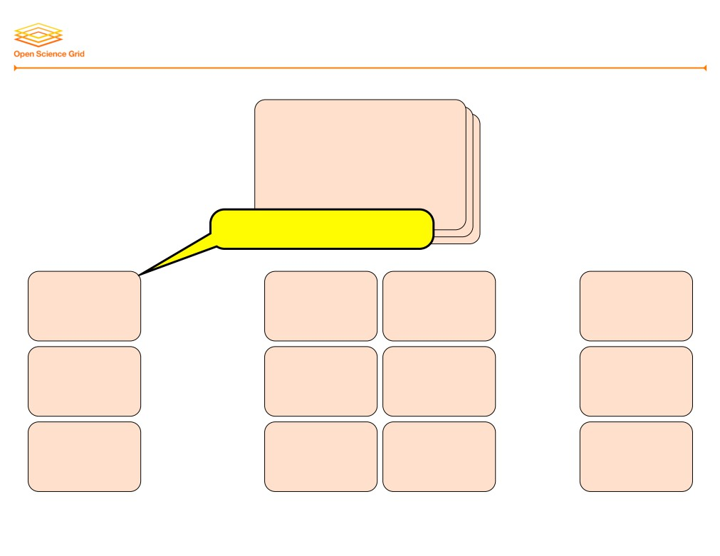
Typical Architecture
Central Manager
collector + negotiator
osg-ss-submit
Submit
Execute Execute
Execute
schedd
startd startd
startd
Submit
Execute Execute
· · ·
Execute
schedd
startd startd
startd
Submit
Execute Execute
Execute
schedd
startd startd
startd
7

Slide 12
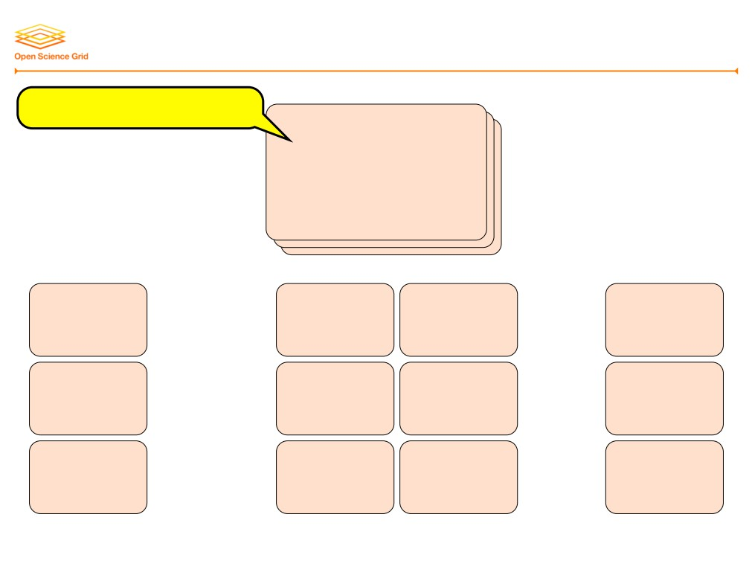
Typical Architecture
cm.chtc.wisc.edu
Central Manager
collector + negotiator
Submit
Execute Execute
Execute
schedd
startd startd
startd
Submit
Execute Execute
· · ·
Execute
schedd
startd startd
startd
Submit
Execute Execute
Execute
schedd
startd startd
startd
7

Slide 13
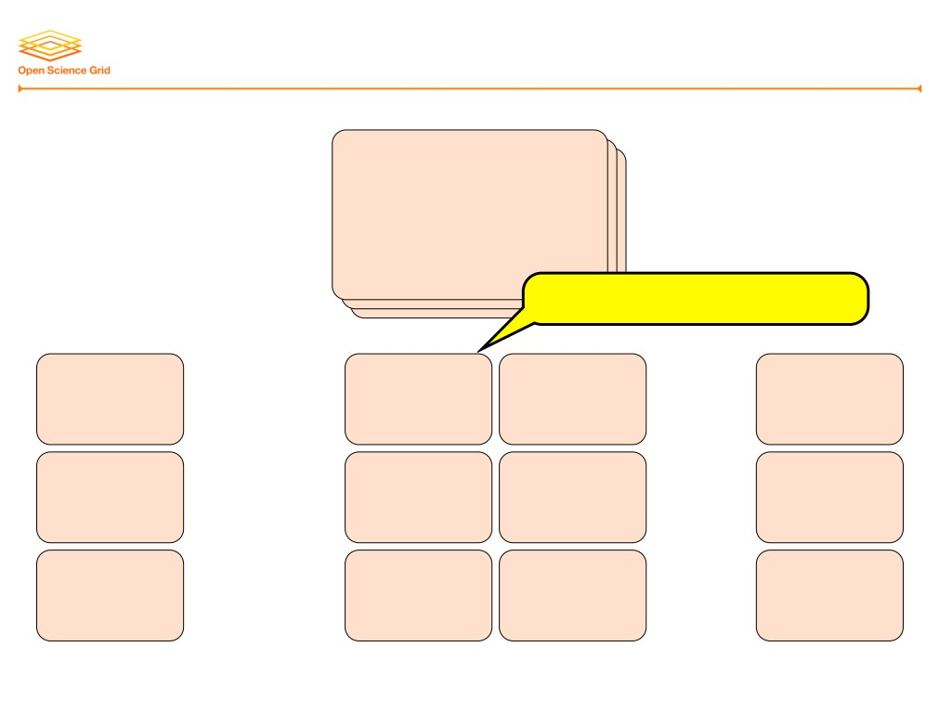
Typical Architecture
Central Manager
collector + negotiator
eNNN.chtc.wisc.edu
Submit
Execute Execute
Execute
schedd
startd startd
startd
Submit
Execute Execute
· · ·
Execute
schedd
startd startd
startd
Submit
Execute Execute
Execute
schedd
startd startd
startd
7

Slide 14
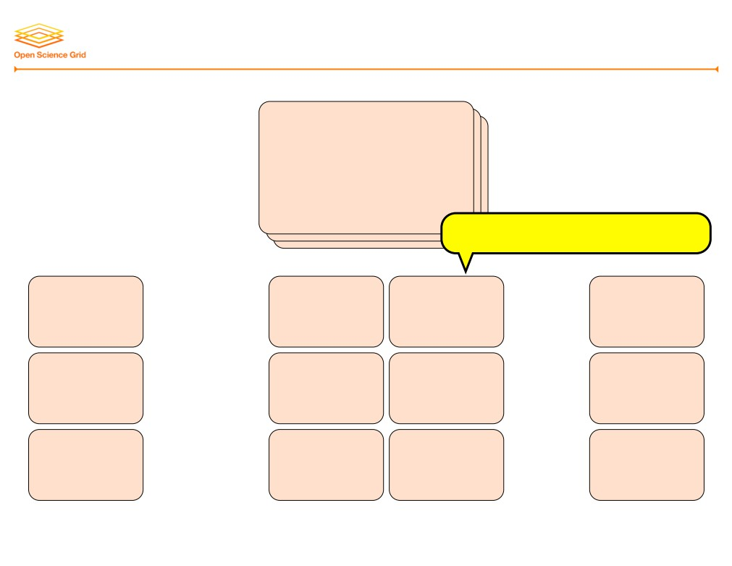
Typical Architecture
Central Manager
collector + negotiator
cNNN.chtc.wisc.edu
Submit
Execute Execute
Execute
schedd
startd startd
startd
Submit
Execute Execute
· · ·
Execute
schedd
startd startd
startd
Submit
Execute Execute
Execute
schedd
startd startd
startd
7

Slide 15
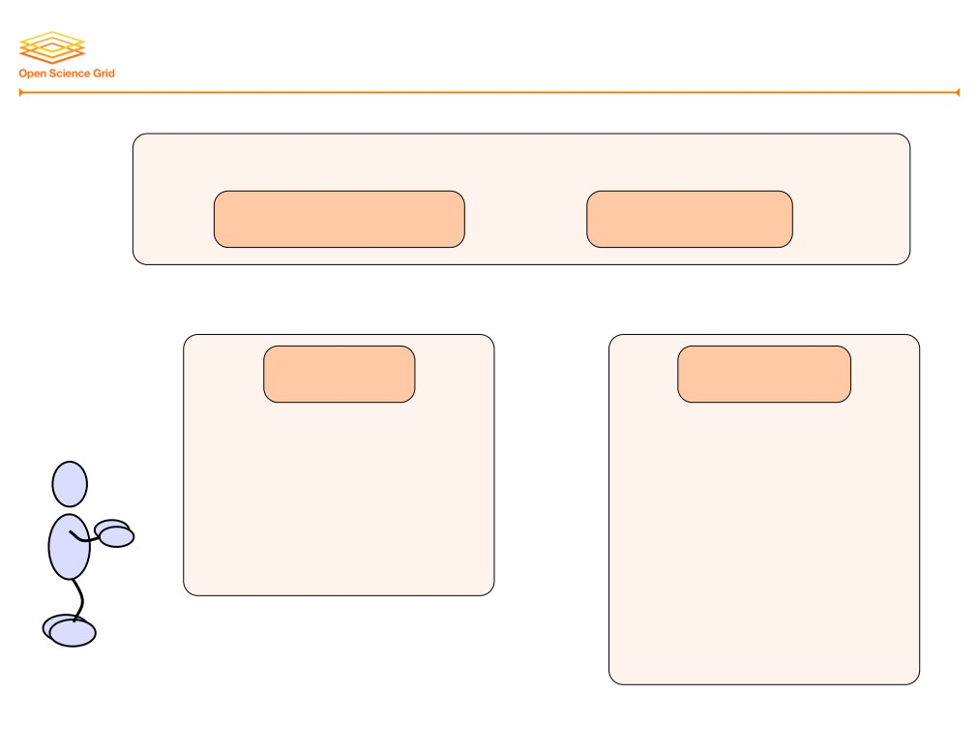
The Life of an HTCondor Job
Central Manager
negotiator
collector
schedd
startd
Submit Machine
Execute Machine
8

Slide 16
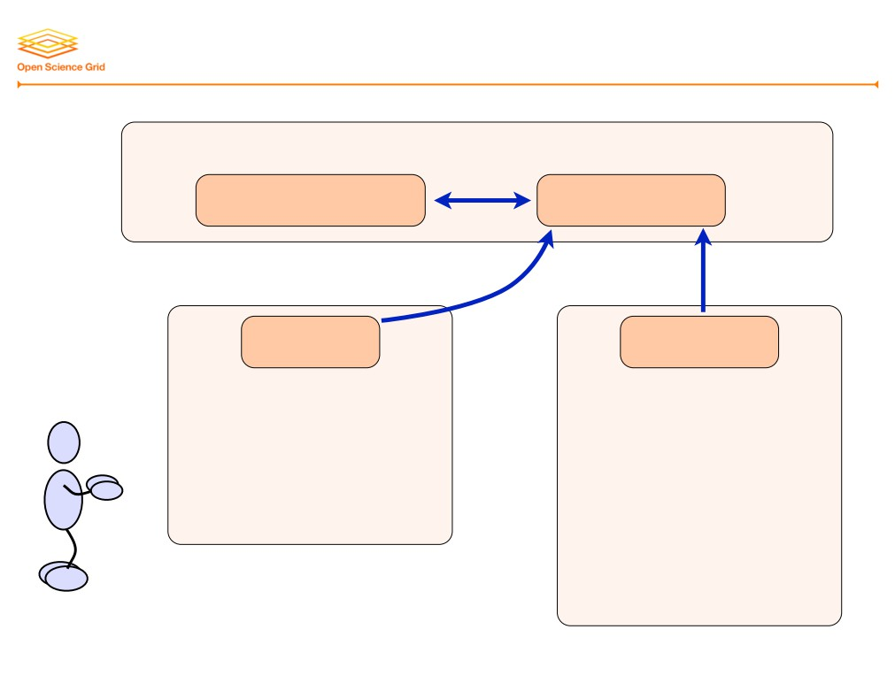
The Life of an HTCondor Job
Central Manager
negotiator
collector
send periodic
updates
schedd
startd
Submit Machine
Execute Machine
8

Slide 17
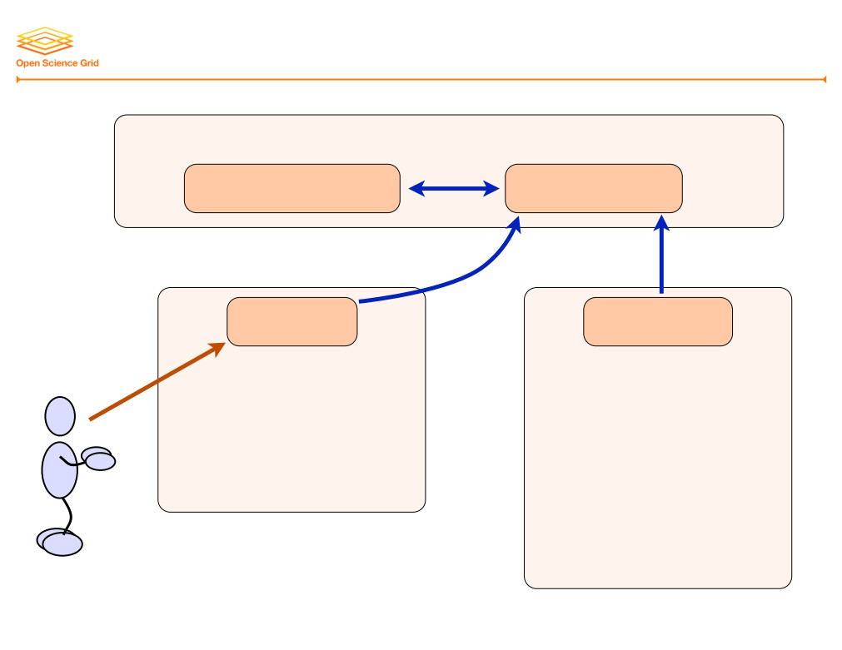
The Life of an HTCondor Job
Central Manager
negotiator
collector
send periodic
updates
schedd
startd
1. submit job
Submit Machine
Execute Machine
8

Slide 18
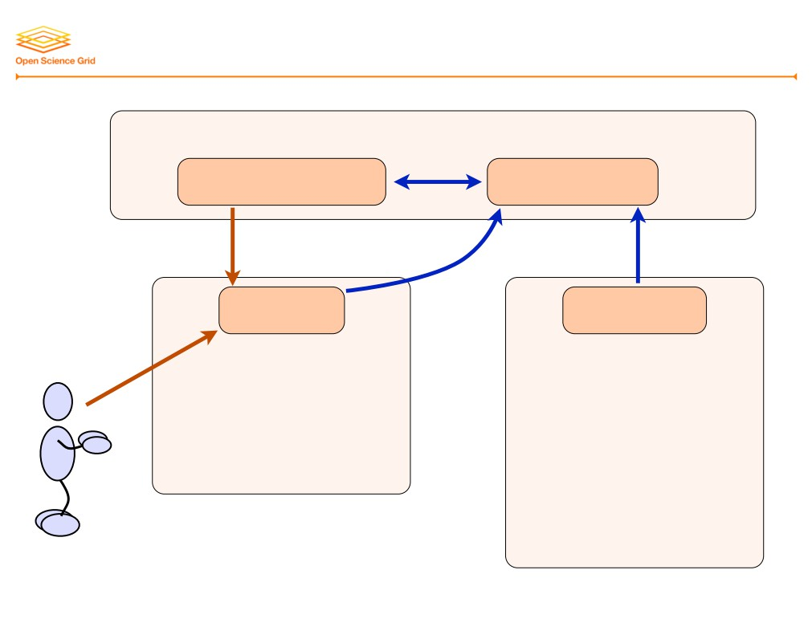
The Life of an HTCondor Job
Central Manager
negotiator
collector
2. request
send periodic
job details
updates
schedd
startd
1. submit job
Submit Machine
Execute Machine
8

Slide 19
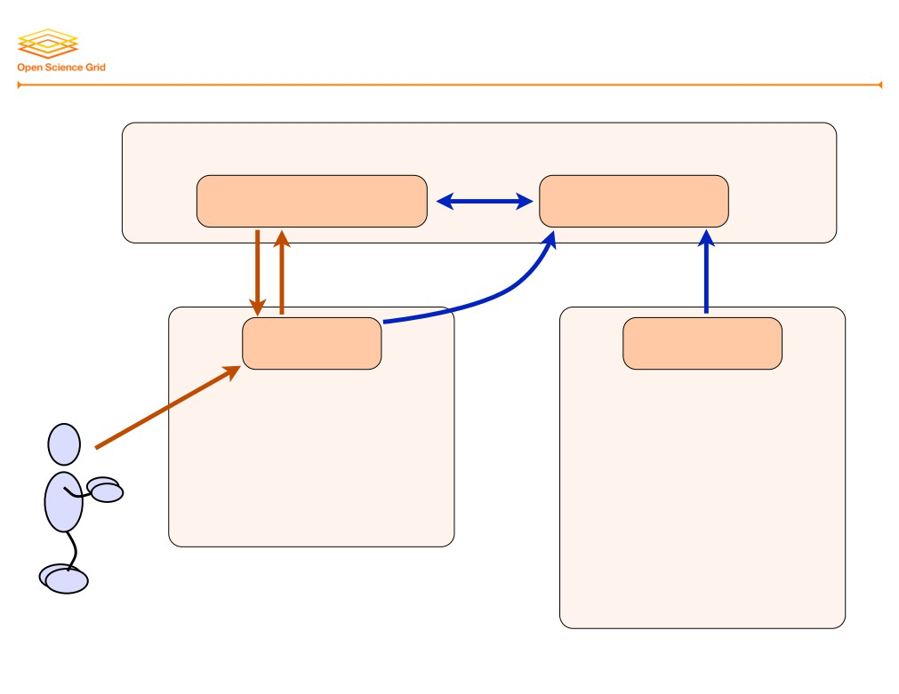
The Life of an HTCondor Job
Central Manager
negotiator
collector
2. request
3. send
send periodic
job details
jobs
updates
schedd
startd
1. submit job
Submit Machine
Execute Machine
8

Slide 20
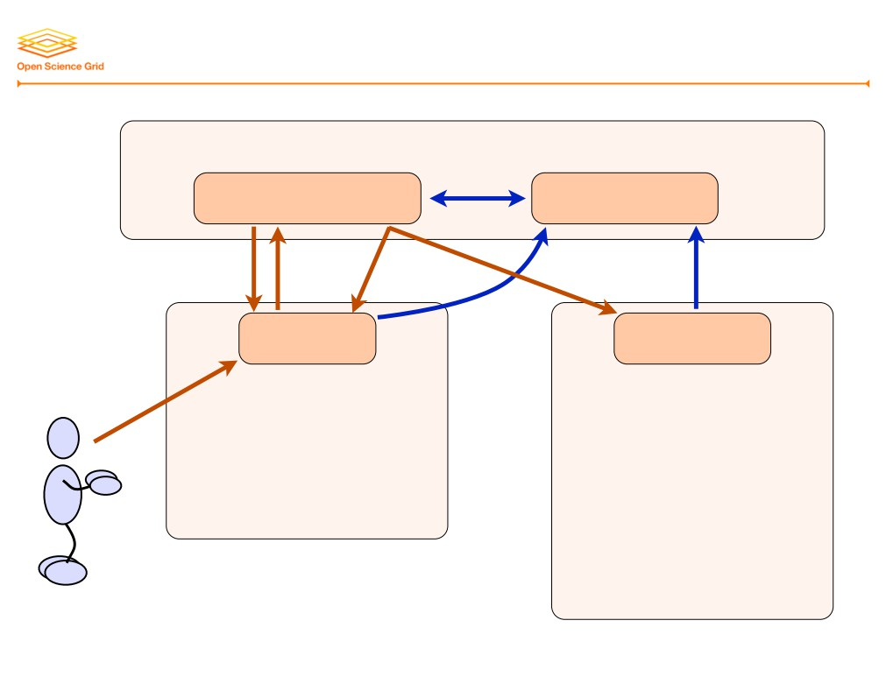
The Life of an HTCondor Job
Central Manager
negotiator
collector
2. request
3. send
4. notify
send periodic
job details
jobs
of match
updates
schedd
startd
1. submit job
Submit Machine
Execute Machine
8

Slide 21
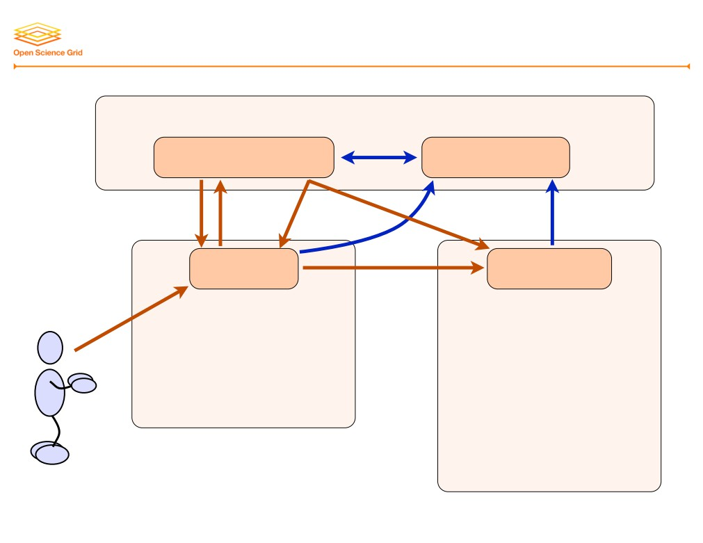
The Life of an HTCondor Job
Central Manager
negotiator
collector
2. request 3. send 4. notify
send periodic updates
job details jobs of match
schedd
5. claim
startd
1. submit job
Submit Machine
Execute Machine
8

Slide 22
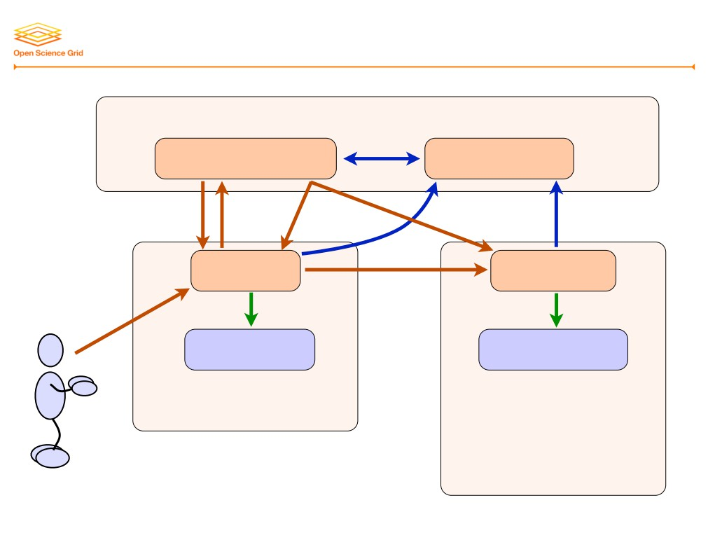
The Life of an HTCondor Job
Central Manager
negotiator
collector
2. request 3. send 4. notify
send periodic updates
job details jobs of match
schedd
5. claim
startd
1. submit job
6. start
6. start
shadow
starter
Submit Machine
Execute Machine
8

Slide 23
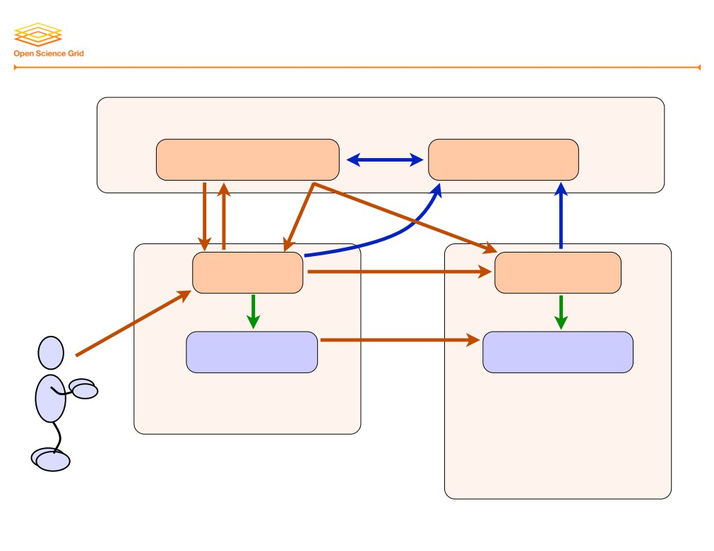
The Life of an HTCondor Job
Central Manager
negotiator
collector
2. request 3. send 4. notify
send periodic updates
job details jobs of match
schedd
5. claim
startd
1. submit job
6. start
6. start
7. transfer exec, input
shadow
starter
Submit Machine
Execute Machine
8

Slide 24
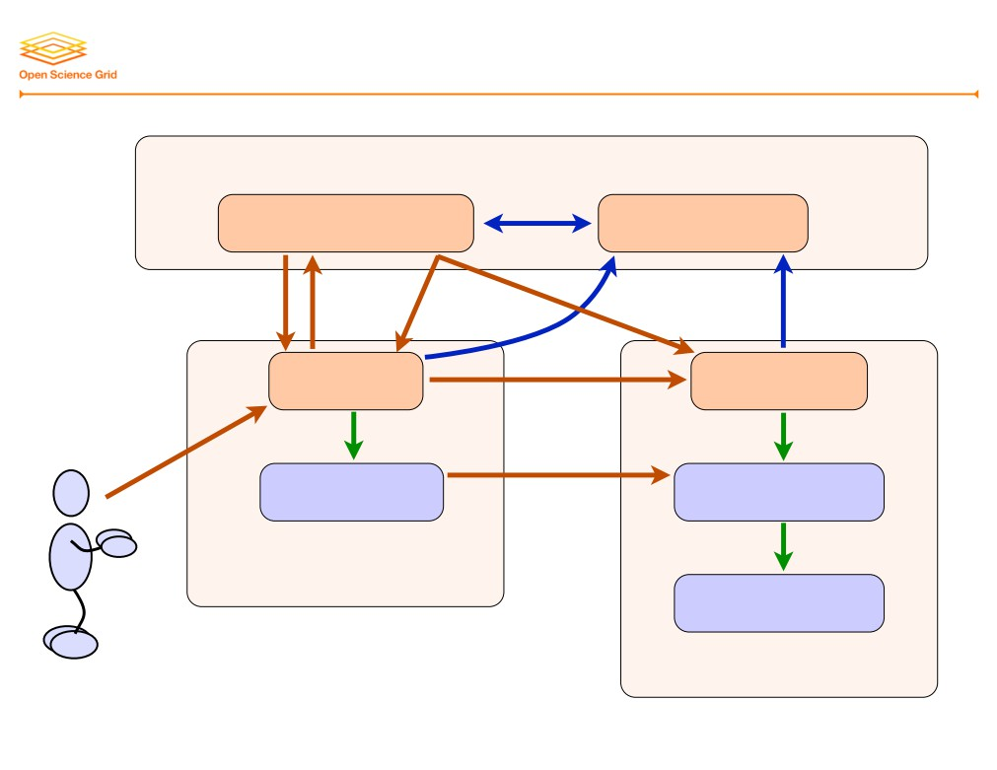
The Life of an HTCondor Job
Central Manager
negotiator
collector
2. request 3. send 4. notify
send periodic updates
job details jobs of match
schedd
5. claim
startd
6. start
6. start
1. submit job
7. transfer exec, input
shadow
starter
8. start
Submit Machine
job
Execute Machine
8

Slide 25
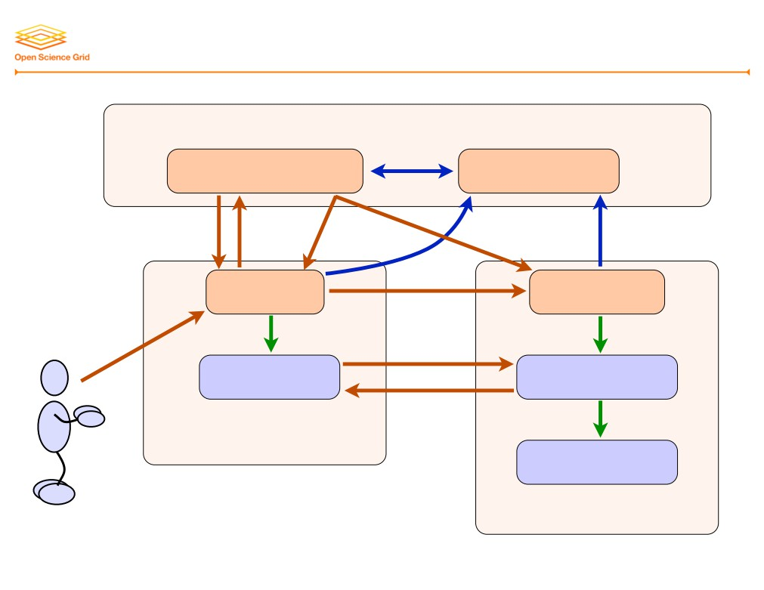
The Life of an HTCondor Job
Central Manager
negotiator
collector
2. request 3. send 4. notify
send periodic updates
job details jobs of match
schedd
5. claim
startd
6. start
6. start
1. submit job
7. transfer exec, input
shadow
starter
9. transfer output
8. start
Submit Machine
job
Execute Machine
8

Slide 26
Matchmaking Algorithm (sort of)
A. Gather lists of machines and waiting jobs
B. For each user:
1. Compute maximum # of slots to allocate to user
(the user’s “fair share”, a % of whole pool)
2. For each job (until maximum matches reached):
a. Find all machines that are acceptable
(i.e., machine and job requirements are met)
b. If there are no acceptable machines, skip to next job
c. Sort acceptable machines by job preferences
d. Pick the best one
e. Record match of job and slot
9

Slide 27
ClassAds
• In HTCondor, information about machines and jobs (and more) are represented by ClassAds
• You do not write ClassAds (much), but reading them may help understanding and debugging
• ClassAds can represent persistent facts, current state, preferences, requirements, …
• HTCondor uses a core of predefined attributes, but users can add other, new attributes, which can be used for matchmaking, reporting, etc.
10

Slide 28

Sample ClassAd Attributes
MyType = "Job"
TargetType = "Machine" ClusterId = 14
Owner = "cat"
Cmd = "/.../test-job.py"
Requirements = (Arch == "X86_64") && (OpSys == "LINUX")
Rank = 0.0
In = "/dev/null"
UserLog = "/.../test-job.log" Out = "test-job.out"
Err = "test-job.err" NiceUser = false ShoeSize = 10
11

Slide 29
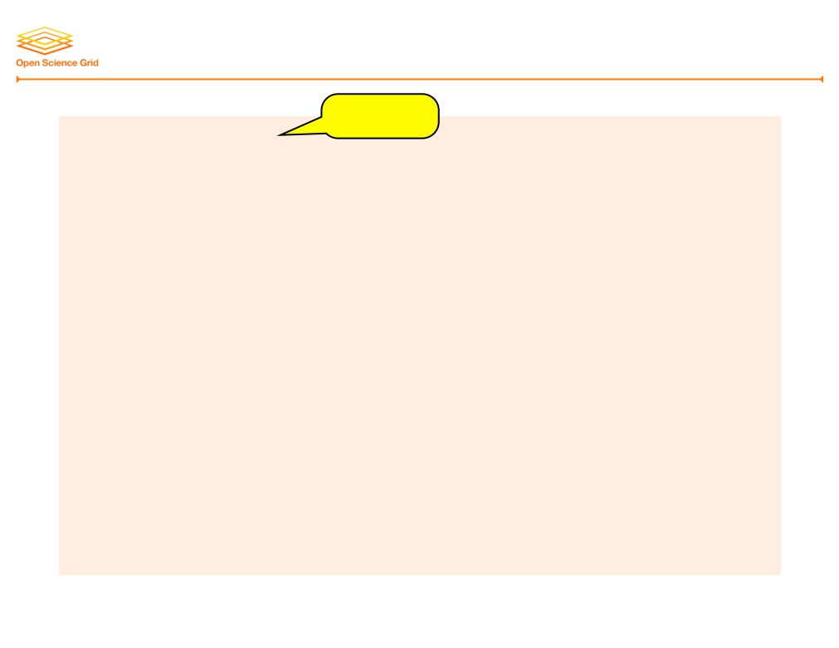
Sample ClassAd Attributes
string
MyType = "Job"
TargetType = "Machine" ClusterId = 14
Owner = "cat"
Cmd = "/.../test-job.py"
Requirements = (Arch == "X86_64") && (OpSys == "LINUX")
Rank = 0.0
In = "/dev/null"
UserLog = "/.../test-job.log" Out = "test-job.out"
Err = "test-job.err" NiceUser = false ShoeSize = 10
11

Slide 30

Sample ClassAd Attributes
MyType = "Job"
TargetType = "Machine"
ClusterId = 14 Owner = "cat"
number
Cmd = "/.../test-job.py"
Requirements = (Arch == "X86_64") && (OpSys == "LINUX")
Rank = 0.0
In = "/dev/null"
UserLog = "/.../test-job.log" Out = "test-job.out"
Err = "test-job.err" NiceUser = false ShoeSize = 10
11

Slide 31
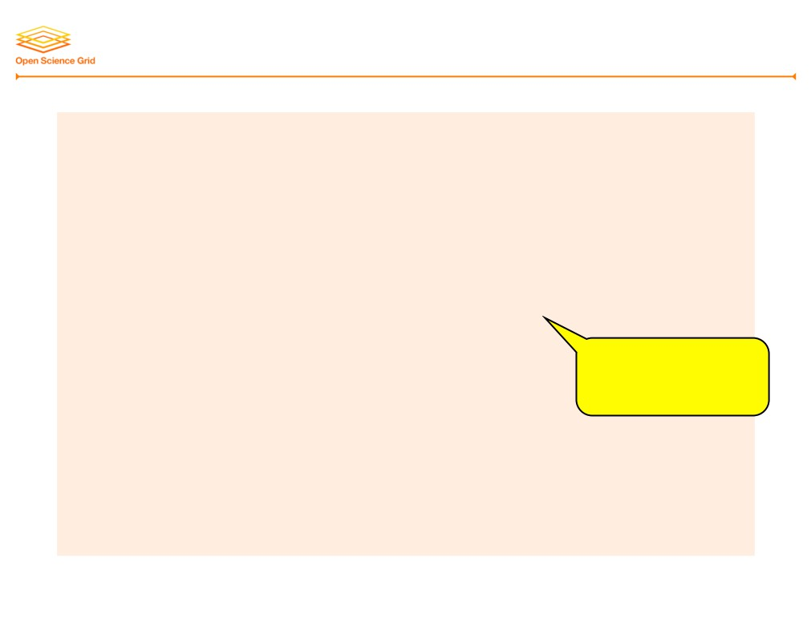
Sample ClassAd Attributes
MyType = "Job"
TargetType = "Machine" ClusterId = 14
Owner = "cat"
Cmd = "/.../test-job.py"
Requirements = (Arch == "X86_64") && (OpSys == "LINUX")
Rank = 0.0
operations/ expressions
In = "/dev/null"
UserLog = "/.../test-job.log" Out = "test-job.out"
Err = "test-job.err" NiceUser = false
ShoeSize = 10
11

Slide 32

Sample ClassAd Attributes
MyType = "Job"
TargetType = "Machine" ClusterId = 14
Owner = "cat"
Cmd = "/.../test-job.py"
Requirements = (Arch == "X86_64") && (OpSys == "LINUX")
Rank = 0.0
In = "/dev/null"
UserLog = "/.../test-job.log" Out = "test-job.out"
Err = "test-job.err" NiceUser = false
boolean
ShoeSize = 10
11

Slide 33
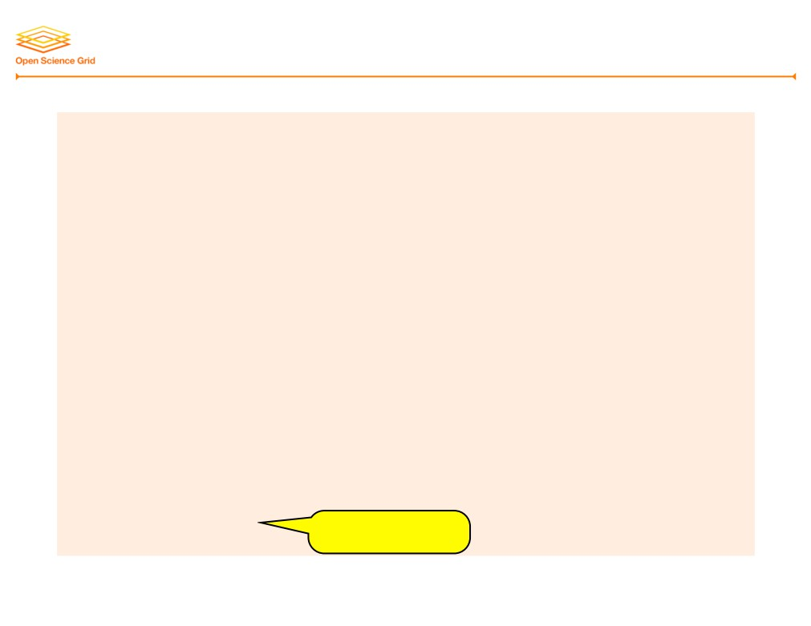
Sample ClassAd Attributes
MyType = "Job"
TargetType = "Machine" ClusterId = 14
Owner = "cat"
Cmd = "/.../test-job.py"
Requirements = (Arch == "X86_64") && (OpSys == "LINUX")
Rank = 0.0
In = "/dev/null"
UserLog = "/.../test-job.log" Out = "test-job.out"
Err = "test-job.err" NiceUser = false
ShoeSize = 10
arbitrary

Slide 34

HTCondor Universes
• Different combinations of configurations and features are bundled as universes:
vanilla A “normal” job; default, fine for today
standard Supports checkpointing and remote I/O
java
Special support for Java programs
parallel
Supports parallel jobs (such as MPI)
grid
Submits to remote system (more tomorrow)
… and more!
12

Slide 35
HTCondor Priorities
• Job priority
‣ Set per job by the user (owner) ‣ Relative to that user’s other jobs
‣ Set in submit file or change later with condor_prio ‣ Higher number means run sooner
• User priority
‣ Computed based on past usage
‣ Determines user’s “fair share” percentage of slots ‣ Lower number means run sooner (0.5 is minimum)
• Preemption
‣ Low priority jobs stopped for high priority ones (stopped jobs go back into the regular queue)
‣ Governed by fair-share algorithm and pool policy ‣ Not enabled on all pools
13

Slide 36
HTCondor Commands
14

Slide 37
List Jobs: condor_q
• Select jobs: by user (e.g., you), cluster, job ID
• Format output as you like
• View full ClassAd(s), typically 80-90 attributes (most useful when limited to a single job ID)
• Ask HTCondor why a job is not running
‣ May not explain everything, but can help
‣ Remember: Negotiation happens periodically
• Explore condor_q options in next exercises
15

Slide 38
List Slots: condor_status
• Select slots: available, host, specific slot
• Select slots by ClassAd expression
E.g., slots with SL 6 (OS) and ≥ 10 GB memory
• Format output as you like
• View full ClassAd(s), typically 120-250 attributes (most useful when limited to a single slot)
• Explore condor_status options in exercises
2013 OSG User School
Cartwright - More HTCondor
16

Slide 39
Submit Files
17

Slide 40

Resource Requests
request_cpus = ClassAdExpression request_disk = ClassAdExpression request_memory = ClassAdExpression
• Ask for minimum resources of execute machine
• May be dynamically allocated (very advanced!)
• Check job log for actual usage!!!
request_disk = 2000000
# in KB by default
request_disk = 2GB
# KB, MB, GB, TB
request_memory = 2000
# in MB by default
request_memory = 2GB
# KB, MB, GB, TB
18

Slide 41

File Access in HTCondor
• Option 1: Shared filesystem
‣ Easy to use (jobs just access files)
‣ But, must exist and be ready handle load should_transfer_files = NO
• Option 2: HTCondor transfers files for you
‣ Must name all input files (except executable)
‣ May name output files; defaults to all new/changed should_transfer_files = YES
when_to_transfer_output = ON_EXIT
transfer_input_files = a.txt, b.tgz
19

Slide 42

Email Notifications
notification = Always|Complete|Error|Never
• When to send email
‣ Always: job checkpoints or completes ‣ Complete: job completes (default) ‣ Error: job completes with error ‣ Never: do not send email
notify_user = email
• Where to send email
• Defaults to user@submit-machine
20

Slide 43

Requirements and Rank
requirements = ClassAdExpression
• Expression must evaluate to true to match slot
• HTCondor adds defaults! Check ClassAds …
• See HTCondor Manual (esp. 2.5.2 & 4.1) for more
rank = ClassAdExpression
• Ranks matching slots in order by preference
• Must evaluate to a FP number, higher is better
‣ False becomes 0.0, True becomes 1.0
‣ Undefined or error values become 0.0
• Writing rank expressions is an art form
21

Slide 44

Arbitrary Attributes
+AttributeName = value
• Adds arbitrary attribute(s) to job’s ClassAd
• Useful in (at least) 2 cases:
‣ Affect matchmaking with special attributes ‣ Report on jobs with specific attribute value
• Experiment with reporting during exercises!
22

Slide 45

Many Jobs Per Submit File, Pt. 1
• Can use queue statement many times
• Make changes between queue statements
‣ Change arguments, log, output, input files, …
‣ Whatever is not explicitly changed remains the same
executable = test.py
log
= test.log
output = test-1.out
arguments = "test-input.txt 42"
queue
output = test-2.out
arguments = "test-input.txt 43"
queue
23

Slide 46

Many Jobs Per Submit File, Pt. 1
• Can use queue statement many times
• Make changes between queue statements
‣ Change arguments, log, output, input files, …
‣ Whatever is not explicitly changed remains the same
executable = test.py
log
= test.log
output = test-1.out
arguments = "test-input.txt 42"
queue
output = test-2.out
arguments = "test-input.txt 43"
queue
log = test.log (still)
23

Slide 47

Many Jobs Per Submit File, Pt. 2
queue N
• Submits N copies of the job
‣ One cluster number for all copies, just as before ‣ Process numbers go from 0 to (N-1)
• What good is having N copies of the same job?
‣ Randomized processes (e.g., Monte Carlo)
‣ Job fetches work description from somewhere else ‣ But what about overwriting output files, etc.?
• Wouldn’t it be nice to have different files and/or arguments automatically applied to each job?
24

Slide 48

Separating Files by Run
output = program.out.$(Cluster).$(Process)
• Can use these variables anywhere in submit file
‣ Often used in output, error, and log files
• Maybe use $(Process) in arguments?
‣ Can’t perform math on values; code must accept as is
output = test.$(Cluster)_$(Process).out
log
= test.$(Cluster)_$(Process).log
arguments = "test-input.txt $(Process)"
queue 10
25

Slide 49

Separating Directories by Run
initialdir = path
• Use path (instead of submit dir.) to locate files
‣ E.g.: output, error, log, transfer_input_files ‣ Not executable; it is still relative to submit directory
• Use $(Process) to separate all I/O by job ID
initialdir = run-$(Process)
transfer_input_files = input-$(Process).txt output = test.$(Cluster)-$(Process).out
log
= test.$(Cluster)-$(Process).log
arguments = "input-$(Process).txt $(Process)"
queue 10
26

Slide 50
Your Turn!
27

Slide 51
Exercises!
• Ask questions!
• Lots of instructors around
• Reminder: Get your X.509 certificate today!
• Coming next:
Now - 12:15
Hands-on exercises
12:15-1:15
Lunch
1:15-5:30
Afternoon sessions
28

