Slide 1
Education, Outreach and Training
Michael Wilde – wilde@mcs.anl.gov
Computation Institute, Argonne and The University of Chicago
Open Science Grid Joint Oversight Team Meeting
February 20th 2007

Slide 2
OSG EOT Mission
Organize and deliver training for OSG
  New communities / VOs joining OSG
  OSG End Users
  Site Administrators – requested but not yet staffed in the plan
Engage young people in (e)Science and CS
  Primary focus: undergraduate and early grads
  Reach high schools through I2U2 (QuarkNet follow-on)
Reach out to under-represented communities
  Provide resources and opportunities to minority students and minority serving institutions
Reach out internationally
  Focus is Latin America and Africa
  Activities underway in Brazil (OSG), Argentina (LSU)
  Columbia/ATLAS program in South Africa (Wits)

Slide 3
OSG EOT Program Overview
End User Education
  In-person workshops
  Online training
  VO for student engagement and support
Community Outreach
  South Africa
  International student/faculty exchange
  Reaching out to under-represented communities in US and the Americas
  High School Education – I2U2 support
Site Admin Training

Slide 4
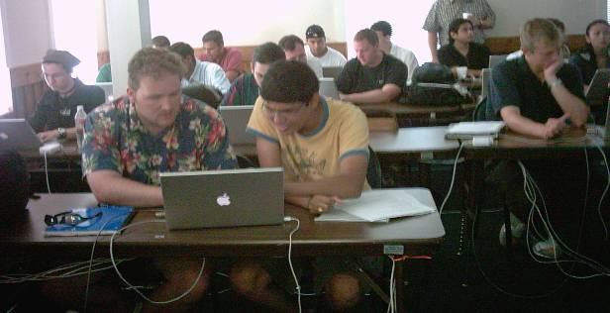
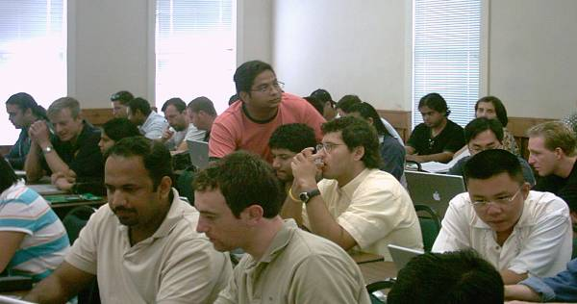
Hands-on Workshop Goals
Educate future work force for e-science.
Introduce skills for emerging cyberinfrastructure
Motivate young undergraduate students
Promote interdisciplinary collaboration
Engage and assist minority students and MSIs

Slide 5
Workshop Syllabus
Intro to distributed computing and the Grid
Grid security and basic Grid access
Grid resource and job management
Grid data management
Building, monitoring and maintaining a Grid
Grid applications and frameworks
Workflow and related issues
Porting applications to the Grid (Lab)
Web services and the resource framework
Advanced networking; data mining (2007)
Notes:
Dual purpose moving forward

Slide 6
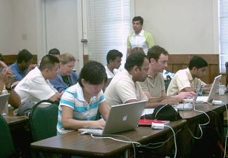
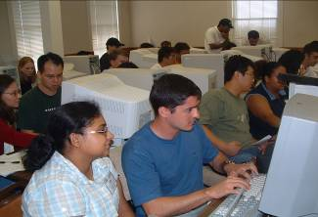
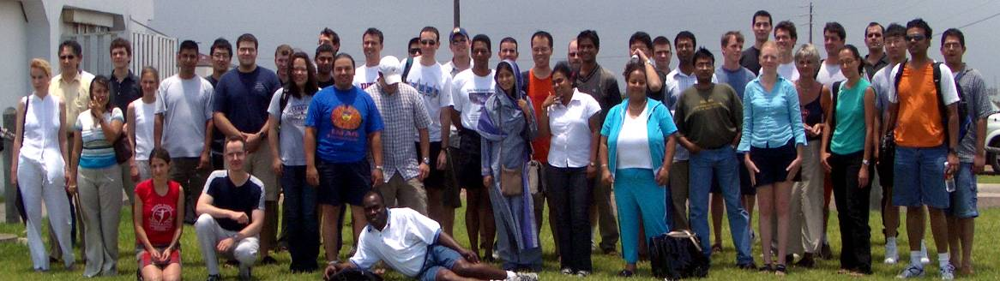
Students
2004:
  36 students from 19 universities, 4 MSIs
  4 international students (Brazil, Canada, Mexico, Russia)
  12 members of minority groups, 10 women
2005:
  42 students from 23 universities; 4 MSIs
  6 international students (Argentina, Brazil, India)
  16 members of minority groups, 10 women.
2006
  40 students from 24 universities; 5 MSIs
  4 International (Argentina, Columbia, Uruguay, New Zealand)
  2 students from Puerto Rico
  9 members of minority groups, 9 women
Notes:
Important demographic – 50% science apps – 50% computer science.
Broad range of sciences represented – from HEP to Earth Systems
Collaboration was one of the things we were striving to teach.

Slide 7
Student Survey Feedback
2006: 33 detailed surveys (out of 40 students)
Initial findings
  Students found the workshop very relevant to their work
  Hands-on lab sessions were very valuable
  Labs were valued more than lectures
  Interaction with other students was valued
  Most students want to follow on with further participation
  Detailed per-module feedback was provided

Slide 8
2007 Workshop Program
Midwest Grid Workshop
  Jointly sponsored by UIC and Northwestern (Grossman, J. Mambretti)
  March 24-25 at UIC
Summer Grid Workshop
  UTexas Brownsville
  Same 5-day format; CS Department sponsorship
Great Plains Workshop
  Fall 2007 target, location TBD
Other 2-day workshops possible

Slide 9
Content Enhancement
Lectures
  Add intro to distributed computing and systems
  Better intro material with more pragmatic details
Lab Exercises
  Graduated exercises that provide more exploration and problem solving
  Examples that show real science challenges – enable students to translate to their own needs
  Use of realistic science data and applications

Slide 10
New Modules Planned
Technical content
  Campus Grid Deployment
  Portal usage and development
  Grid information systems
  More on Grid services
  Connect to MPI and parallel programming
  More on storage management
  More on application deployment
Prerequisite training
  UNIX skills
  Networking concepts

Slide 11
Education VO
Wiki, email lists, follow on
Support, engagement
Create durable certs in workshops
Online lab facilities – sandboxed and “live” resources
Vetting process for student users
Mentor pool and project idea bank

Slide 12
Self-paced online instruction
Flexible roadmaps for navigating the material
Lab that (valid) students can access, any time
Lecture material needs to be made more book-like – must stand alone.
Provide good set of UNIX and Networking pre-reqs and reference materials
Thoughts about video/Flash-based tutorials
  Audio track and screen shots

Slide 13
International Outreach
South Africa Program
  Led by Jeremy Dodd, Columbia/ATLAS
  Providing mentorship to University of Wittwatersrand, Johannesburg
  Grid site development
  Student mentorship
South American Efforts
  Argentine Grid School, 2007
  Linking to Brazil, Columbia, CHEPREO

Slide 14
OISE Interoperability Project
OSG-NorduGrid interoperability of applications and information systems
Interoperability of Information Services between the Open Science Grid and the European Grid infrastructures.
  Using “Glue Schema V1.3”
  bring the NorduGrid (NGDF) information structure to be compatible with EGEE and OSG,
  for delivery by the end of 2006.
  involves junior faculty from the University of Iowa (Shaowen Wang) and possibly the University of South Florida travelling to Lund University to work with the NGDF group.
  Part of the OSG External Project led by Gabriele Garzoglio, Fermilab
D0, LHC and IceCube applications running across the NorduGrid and OSG infrastructures.
  Junior faculty from the University of Wisconsin (coordinated through Albrecht Karleand) and the University of Maryland (coordinated through Nick Hadley and Greg Sullivan)
  The participants will travel to the Stockholm University for this collaboration.

Slide 15
OISE Grid Training
Students at the US Grid Workshops to attend the European International School on Grid Computing. ISSGC0x
Will select 5-7 alumni each year from the Grid Workshops to attend the International Summer school.
Students will attend both schools and provide a written report
  Students to present on the opportunities for using the results of their training.
  will use feedback on their experiences to make the US workshops more productive and effective Will encourage common training segments between the 2 Grid schools
Joint lectureships and material sharing / development efforts
Sponsor US junior faculty instructor at the International School (University of Chicago, ISI, Notre Dame, University of Wisconsin are potential participants.)

Slide 16
Conclusion
Workshop program diversifying in 2007
International outreach starting in South America, South Africa, and via OISE
Education VO starting to provide engagement and access to resources
Need to integrate Grid administration training and continue to integrate efforts with TeraGrid

Slide 17
Supplementary Material

Slide 18
Survey results
Does your immediate work, or work planned in the near future, relate to Grid computing?
13 Yes, very much 14 Yes, to some extent 5 Not yet sure 1 No
How useful has this workshop been to you ?
11 Very useful 22 Useful 0 not very useful 0 not useful at all
Did the workshop give you ideas or techniques useful for your research?
2 No 31 Yes
How would you rate this workshop compared to similar workshops you have attended?
12 None to compare to 8 Similar 13 Better
Would you like to participate in similar workshops in the future?
24 Yes, very much 8 Yes, maybe 1 n/a
In what way would you like to participate?
6 Attend same workshop again
29 Attend a more advanced follow-on workshop
9 Develop/review/test lecture or lab material
9 Present lecture
9 Assist in lab
0 No interest in future Grid workshops

Slide 19
Survey Results
Overall, did the lecturers communicate topics effectively?
14 Yes, very much 19 Yes
Were the assistants helpful during the hands-on sessions?
21 Yes, very much 11 Yes 1 not really
Did the curriculum provide a good general overview of Grid computing?
18 Yes, very good 15 Yes
Did the hands-on sessions help you to understand topics better?
18 Yes, very much 11 yes 3 not really 1 n/a
How valuable were the discussion sessions?
13 Very valuable 19 Moderately valuable 1 Not very valuable
How ample was the time provided for discussion?
1 Too little 30 About right 2 Too much
Would you like more time for running your own applications on the Grid?
9 No 23 Yes 1 n/a
The length of this workshop (1 week) was:
10 Too short 23 About right
Overall, the workshop was taught at a level that was:
30 About right 3 Too basic
Did you find it valuable to meet students from other schools?
1 No 32 Yes
Would you like to collaborate on projects with these students in the future?
3 No 30 Yes

Slide 20
Metrics
(slide to be developed)
Student follow-on
  determine longitudinal influence of the workshop
Student eval
Student jobs executed
Student email engagement

Slide 21
History
Three annual week-long workshops
Held at University of Texas Brownsville
Inspired by Manuela Campanelli, Soma Mukherjee, Paul Avery and many others
Nice 2004 coverage from Brownsville TV station and newpapers – inspires this under-resourced community; workshop makes the training available to its students

Slide 22
New concepts tried in 2006
Added more discussion time
Sessions for “bring your apps” to the grid
  Students asked to bring app to port
  Discussion on Grid porting techniques
Used both local, OSG, and TG resources
  Certificates were pre-generated by SDSC and pre-mapped
Still needed
  More work with example apps
  Illustrations of issues in porting
  Pre-planning for apps to port
  UNIX background and reference material

Slide 23
Challenges of Reaching Communities
How to engage women and under-represented minorities
  How to understand and meet the needs of these groups
  Where to best do this (workshop locations)?
How to bring lasting benefits to MSIs?
  Challenges of the UTB experience
  Focus on MSIs and/or minority students everywhere?
How to amplify positive impacts with limited funding?
  How to leverage volunteers and other programs?

Slide 24
Lab Exercise Challenges
Examples that are simple yet interesting and illustrative
Adding creativity and problem solving to the exercises
Enabling students to achieve those “ah ha” moments of scalability and opportunity
Redundancy in case of grid or network failures

Slide 25
Workshop Program Open Issues
How many workshops?
  Tentatively three, but can help support others
What size?
  Too small, not diverse enough (in many dimensions)
  Too large – hard to site & run, less personal
What content and length?
  Solicit & assess content available from other sources
  Jointly develop with TeraGrid and other partners
  What are specific gaps in content
Where to conduct?
  At MSIs, at major research institutions
  Quality of facilities and support make a big difference
  Where to get logistics help?
What audience?
  Students: science research, IT, science support; researchers.

Slide 26
Workshop Chemistry
Relaxing, casual venue with lots of opportunity for student interaction
2-person teams per laptop: students need to, and do, work together.
Combine lecture & lab in half-day sessions
Intellectual benefits of bringing students together across disciplines, experience levels, backgrounds, and geographies
Students start as strangers, leave as colleagues

Slide 27
Contributors
Funders
Facilities and Organization
Content developers
Lab development and admin, networking
Pre-set-up workstations were critical
Grid support
http://twiki.grid.iu.edu/twiki/bin/view/
SummerGridWorkshop/
WorkshopAcknowledgments2006

