Slide 1
Build a Grid Session
Siddhartha E.S
University of Florida

Slide 2
OVERVIEW
As OSG-Site Admins we are responsible for providing some services such as
  gatekeeper
  gridftp
  Monitoring and accounting
There are some tools/packages which help us provide these services
  Pacman
  Osg-CE
    bundle of packages
      VDT/Globus
      Condor
      Gratia(monitoring)

Slide 3
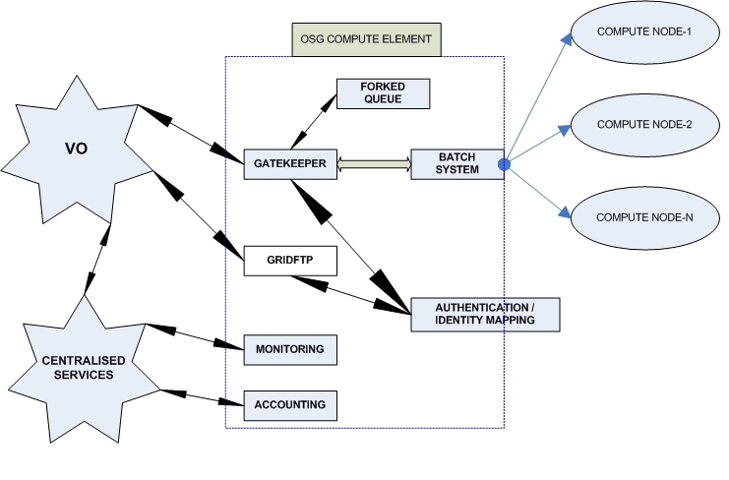
Diagrammatic representation of an OSG-site, VO and Centralised Services

Slide 4
PACMAN
Pacman is a package management tool that allows you to define, install, and configure software.
Different versions of OSG require different versions of Pacman: the newer the OSG software version, the newer the release of Pacman required.
For OSG 0.8.0 we use Pacman-3.21
https://twiki.grid.edu/twiki/bin/view/ReleaseDocumentation/Pacmaninstall#Pacman

Slide 5
SOME NOTES ON PACMAN INSTALLATION
Always remember that we need to have our software installed in a place where we can do something in the network.
“usr/local” or “/nfs/xxx” are good candidates.
It is also advisable to install Pacman in a directory of its own.
Follow the commands in section-1 of the handout to complete installation

Slide 6
THE CONDOR BATCH SYSTEM
Advisable to be created in a separate directory- will allow asynchronous upgrades without loss.
Follow the command sequences in section-2 to install CONDOR using Pacman
If your operating system is not supported by Pacman we need to use an option called -pretend-platform along with Pacman
Give complete paths(No Dots)

Slide 7
Installing OSG CE Services
Services will not necessarily run as root (e.g., by default Globus-ws will run under globus if it exists, or daemon if it doesn't; MySql a will run under daemon)
So one needs to make sure Mysql user and group exists by id ' ing it. If not /etc/group or /etc/passwd or /etc/shadow may require a change.
Choose an installation directory. This need not be shared by the worker nodes. Any software which needs to be seen from the worker nodes may be provided by the worker node client package.
Follow the commands in the handout
vdt-install.log--> can be monitored during installation ( good place to look in for errors)

Slide 8
Obtaining and Configuring PKI certificates
Refer to the handout for the certificate request command(Section-4)
Fill in the requested information in a proper manner
Your host cert request has to be approved and you will receive an email notification when you can download the host cert
configure the OSG CE software

Slide 9
Next 3-steps
Start Services
Start Condor
Set up Managed Fork
  Follow the commands provided in the handout to complete these steps

Slide 10
Testing CE node (Grid maps)
Grid mapfile is a type of identity mapping service
This test is to be done as a normal user and not as root
One has to create a proxy for himself
Then type grid-proxy-info -identity
The as root put an entry in the /etc/grid-security/grid-mapfile
The entry would be “Certificate” <localusername>
Save the changes
Continue the commands for testing Fork-Queue

Slide 11
TESTS CONTINUED
Test the job manager fork
Test the job manager queue
Test the GSIFTP services
  Commands for these tests are explained in sections 7.2,7.3 and 7.4 of the commands handout.

Slide 12
Possible Error
If you encounter “GRAM Job Submission failed because connection to the server failed”, it could possibly due to mismatch in the hostnames in the certificate and what you are generating in the command.
When we are facing this error we need to export GLOBUS_HOSTNAME as the one in the cert.
To do this we could go to vdt-local-setup.sh and vdt-local-setup.csh files in nfs/osg/vdt/etc, where nfs/osg is the place where my vdt and osg ce package is installed.
restart the gatekeeper using the command /etc/init.d/xinetd restart
Use $GLOBUS_HOSTNAME instead of $HOSTNAME

Slide 13
Site-Verification
At this stage it is assumed that you have tested the job-manager queue, gsiftp and are ready to do the site-verify
./site_verify.pl –host = osg.hpc.ufl.edu is the command to be executed in the VDT_LOCATION/verify
Check whether this command returns a bunch of results as untested. Look up to ensure essential results have not failed
You can now give the gatekeeper jobs.

Slide 14
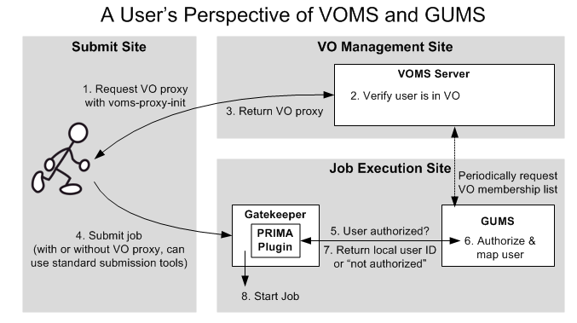
Diagrammatic Representation of GUMS

Slide 15
GUMS
Grid User Management System (GUMS)
The grid credential for each incoming job is associated with an appropriate site credential by GUMS.
suited for environment with multiple gatekeepers
Individual resource administrators are able to assign different mapping policies to different groups of users and define groups of hosts on which the mappings will be used
For installation commands refer to section-8 of the command handout

Slide 16
Further Info
  https://twiki.grid.edu/twiki/bin/view/Documentation/WebHome

