Slide 1
Grid School Module 2:
Grid Security
Prepared by:
Rachana Ananthakrishnan
Argonne National Laboratory
Notes:
Some of the security aspects of grid computing
Discuss scenarios to establish requirements
Discuss solutions to address requirements

Slide 2








Typical Grid Scenario
Resources
Users
Notes:
Large number of resource, pool together
Large user pool
In reality resources are owned and operated by different groups
Restrict access to the resource, yet allow for collaboration

Slide 3
What do we need ?
Identity
Authentication
Message Protection
Authorization
Single Sign On

Slide 4
Identity & Authentication
Each entity should have an identity
Authenticate: Establish identity
  Is the entity who he claims he is ?
  Examples:
    Driving License
    Username/password
Stops masquerading imposters

Slide 5
Message Protection: Privacy
Medical Record
Patient no: 3456
Notes:
- Real life: sensitive data : caBig cancer research; scientific proprietary data.

Slide 6

Message Protection: Integrity
Run myHome/rm –f *
Run myHome/whoami
Notes:
- Hack machine and get access to large computing resource

Slide 7
Authorization
Establishing rights
What can a said identity do ?
Examples:
  Are you allowed to be on this flight ?
    Passenger ?
    Pilot ?
  Unix read/write/execute permissions
Must authenticate first

Slide 8


Grid Security: Single Sign On
Authenticate Once
Notes:
Long running jobs
Jobs require access to different things
workflow.

Slide 9

Grid Security: Single Sign On
Delegation
Notes:
Long running jobs
User cannot be around.

Slide 10
Single Sign-on
Important for complex applications that need to use Grid resources
  Enables easy coordination of varied resources
  Enables automation of process
  Allows remote processes and resources to act on user’s behalf
  Authentication and Delegation
Notes:
Convenience

Slide 11
Solutions
Notes:
tools that do these under the cover
important to understand concepts
so we can keep grid secure

Slide 12

Cryptography for Message Protection
Enciphering and deciphering of messages in secret code
Key
  Collection of bits
  Building block of cryptography
  More bits, the stronger the key
0 1 0 1 0 0 1 1 1 0
1 0 1 1 1 1 0 1 1 1
Notes:
Keys are building blocks
256 bits key is stronger than 128 bits
Computing things using larger key also takes more time.
Most algorithms are well established and tools have been already developed for performing the computations

Slide 13

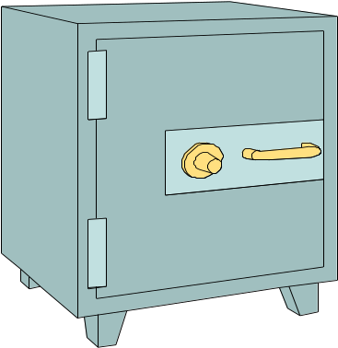
Encryption
Encryption is the process of taking some data and a key and feeding it into a function and getting encrypted data out
Encrypted data is, in principal, unreadable unless decrypted
Data
Encryption
Function
Notes:
Data is treated as bit streams.
House key

Slide 14
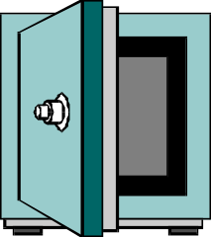
Decryption
Decryption is the process of taking encrypted data and a key and feeding it into a function and getting out the original data
  Encryption and decryption functions are linked
Decryption
Function
Data
Notes:
Well established algorithms and tools that implement them

Slide 15

Asymmetric Encryption
Encryption and decryption functions that use a key pair are called asymmetric
  Keys are mathematically linked

Slide 16

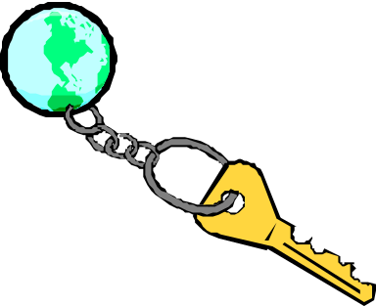
Public and Private Keys
With asymmetric encryption each user can be assigned a key pair: a private and public key
Private key is known only to owner
Public key is given away to the world
Encrypt with public key, can decrypt with only private key
Message Privacy

Slide 17
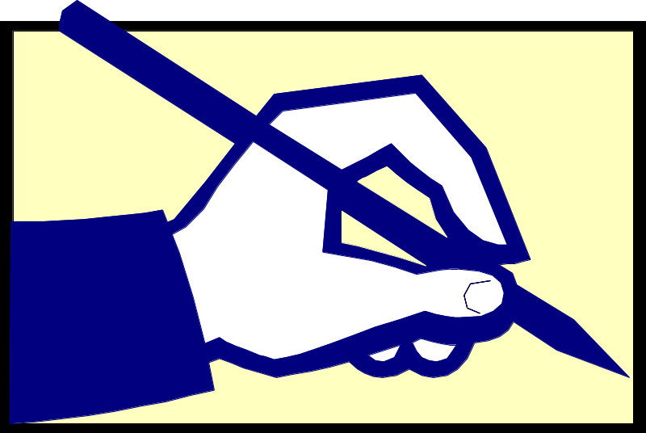
Digital Signatures
Digital signatures allow the world to
  determine if the data has been tampered
  verify who created a chunk of data
Sign with private key, verify with public key
Message Integrity
Notes:
Generated and sent with the message

Slide 18
Public Key Infrastructure (PKI)
PKI allows you to know that a given public key belongs to a given user
PKI builds off of asymmetric encryption:
  Each entity has two keys: public and private
  The private key is known only to the entity
The public key is given to the world encapsulated in a X.509 certificate
Owner
Notes:
Provides a owner tag
Any entity that possess the private key, assumes that entity. So if you have my private key, you are me as far as PKI fabric is concerned.

Slide 19

Certificates
X509 Certificate binds a public key to a name.
Similar to passport or driver’s license
State of Illinois
Name
Issuer
Public Key
Validity
Signature
John Doe
755 E. Woodlawn
Urbana IL 61801
State of
Illinois
Seal
BD 08-06-65
Male 6’0” 200lbs
GRN Eyes
Valid Till: 01-02-2008

Slide 20
Certification Authorities (CAs)
A Certification Authority is an entity that exists only to sign user certificates
The CA signs it’s own certificate which is distributed in a trusted manner
Verify CA certificate, then verify issued certificate
Name: CA
Issuer: CA
CA’s Public Key
Validity
CA’s Signature
Notes:
The CA private key is again a protected key
But the CA public key is distributed widely

Slide 21
Certificate Policy (CP)
Each CA has a Certificate Policy (CP) which states
  who it will issue certificates to
  how it identifies people to issue certificates to
Lenient CAs don’t pose security threat, since resources determine the CAs they trust.
Notes:
- We need certificates from specific CAs to access resources
- Lead: certificate acquisition

Slide 22
Certificate Issuance
User generates public key and private key
CA vets user identity using CA Policy
Public key is sent to CA
  Email
  Browser upload
  Implied
Signs user’s public key as X509 Certificate
User private key is never seen by anyone, including the CA

Slide 23
Certificate Revocation
CA can revoke any user certificate
  Private key compromised
  Malicious user
Certificate Revocation List (CRL)
  List of X509 Certificates revoked
  Published, typically on CA web site.
Before accepting certificate, resource must check CRLs

Slide 24
Authorization
Establishing rights of an identity
Chaining authorization schemes
  Client must be User Green and have a candle stick and be in the library!
Types:
  Server side authorization
  Client side authorization

Slide 25
Gridmap Authorization
Commonly used in Globus for server side
Gridmap is a list of mappings from allowed DNs to user name
ACL + some attribute
Controlled by administrator
Open read access
"/C=US/O=Globus/O=ANL/OU=MCS/CN=Ben Clifford” benc
"/C=US/O=Globus/O=ANL/OU=MCS/CN=MikeWilde” wilde

Slide 26
Globus Security:
The Grid Security Infrastructure
The Grid Security Infrastructure (GSI) is a set of tools, libraries and protocols used in Globus to allow users and applications to securely access resources.
Based on PKI
Uses Secure Socket Layer for authentication and message protection
  Encryption
  Signature
Adds features needed for Single-Sign on
  Proxy Credentials
  Delegation

Slide 27
GSI: Credentials
In the GSI system each user has a set of credentials they use to prove their identity on the grid
  Consists of a X509 certificate and private key
Long-term private key is kept encrypted with a pass phrase
  Good for security, inconvenient for repeated usage

Slide 28
GSI: Proxy Credentials
Proxy credentials are short-lived credentials created by user
  Proxy signed by certificate private key
Short term binding of user’s identity to alternate private key
Same effective identity as certificate
SIGN
Notes:
Motivation:
- Encrypted private key requires some warm body,
- long term credential – prevent theft.
Same identity as the certificate proxy is created off
New key pair signed by your certificate
Clock synchronization issues

Slide 29
GSI: Proxy Credentials
Stored unencrypted for easy repeated access
Chain of trust
  Trust CA -> Trust User Certificate -> Trust Proxy
Key aspects:
  Generate proxies with short lifetime
  Set appropriate permissions on proxy file
  Destroy when done
Notes:
Next: Delegation

Slide 30
GSI Delegation
Enabling another entity to run as you
Provide the other entity with a proxy
Ensure
  Limited lifetime
  Limited capability

Slide 31
Grid Security At Work
Get certificate from relevant CA
Request to be authorized for resources
Generate proxy as needed
Run clients
  Authenticate
  Authorize
  Delegate as required
Numerous resource, different CAs, numerous credentials
Notes:
If you are user, tools
If you are developer, API and software libraries
** Not many slides left **

Slide 32
MyProxy
Developed at NCSA
Credential Repository with different access mechanism (e.g username/pass phrase)
Can act as a credential translator from username/pass phrase to GSI
Online CA
Supports various authentication schemes
  Passphrase, Certificate, Kerberos

Slide 33
MyProxy: Use Cases
Credential need not be stored in every machine
Used by services that can only handle username and pass phrases to authenticate to Grid. E.g. web portals
Handles credential renewal for long-running tasks
Can delegate to other services

Slide 34
Lab Session
Focus on tools
  Certificates
  Proxies
  Gridmap Authorization
  Delegation
  MyProxy

Slide 35
Slide Acknowledgements
Von Welch
Frank Siebenlist

