Slide 1
Grid Security

Slide 2
Grid Security Concerns
Control access to shared services
  Address autonomous management, e.g., different policy in different work groups
Support multi-user collaborations
  Federate through mutually trusted services
  Local policy authorities rule
Allow users and application communities to set up dynamic trust domains
  Personal/VO collection of resources working together based on trust of user/VO

Slide 3
Virtual Organization (VO) Concept
VO for each application or workload
Carve out and configure resources for a particular use and set of users

Slide 4
LAB:
Exclude “bad” countries
Include all LBNL staff and guests
Equipment:
Must have X-Ray training
Effective
permission
R&D Group:
Must be a group member

Slide 5
Security Basics
Privacy
  Only the sender and receiver should be able to understand the conversation
Integrity
  Receiving end must know that the received message was the one from the sender
Authentication
  Users are who they say they are (authentic)‏
Authorization
  Is user allowed to perform the action

Slide 6
Encryption
Encryption is the process of taking some data and a key and feeding it into a function and getting encrypted data out
Encrypted data is, in principal, unreadable unless decrypted
Data
Encryption
Function
Notes:
Data is treated as bit streams

Slide 7
Decryption
Decryption is the process of taking encrypted data and a key and feeding it into a function and getting out the original data
  Encryption and decryption functions are linked
Decryption
Function
Data
Notes:
Well established algorithms and tools exist that implement them

Slide 8
Asymmetric Encryption
Encryption and decryption functions that use a key pair are called asymmetric
  Keys are mathematically linked
Notes:
GSI uses public Key cryptography (aka asymmetric crypto)‏

Slide 9
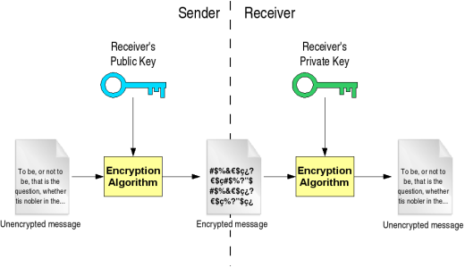
Authentication
Private Key - known only by owner
Public Key- known to everyone
What one key encrypts, the other decrypts
Guarantees
Integrity
Authentication
And Privacy
Borja Sotomayor , http://gdp.globus.org/gt4-tutorial/multiplehtml/ch09s03.html

Slide 10
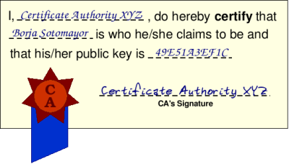
Authentication using
Digital Certificates
Digital document that certifies a public key is owned by a particular user
Signed by 3rd party – the Certificate Authority (CA)‏
To know if you should trust the certificate, you have to trust the CA
Borja Sotomayor , http://gdp.globus.org/gt4-tutorial/multiplehtml/ch09s04.html

Slide 11

Certificates
Similar to passport or driver’s license
State of Illinois
Name
Issuer
Public Key
Validity
Signature
John Doe
755 E. Woodlawn
Urbana IL 61801
State of
Illinois
Seal
BD 08-06-65
Male 6’0” 200lbs
GRN Eyes
Valid Till: 01-02-2008
Rachana Ananthakrishnan

Slide 12
Globus Security
Globus security is based on the Grid Security Infrastructure (GSI)‏
  Set of IETF standards for security interaction
Public-key-based authentication using X509 certificates

Slide 13

Requesting a Certificate
To request a certificate a user starts by generating a key pair
Private Key
Public Key
Rachana Ananthakrishnan

Slide 14
Certificate Request
The user signs their own public key to form what is called a Certificate Request
Email/Web upload
Note private key is never sent anywhere
Public Key
Sign
Certificate
Request
Public Key
Rachana Ananthakrishnan
Notes:
Private key never sent anywhere.

Slide 15
Registration Authority (RA)‏
The user then takes the certificate to a Registration Authority (RA)‏
Vetting of user’s identity
Often the RA coexists with the CA and is not apparent to the user
Registration
Authority
Certificate
Request
Public Key
State of Illinois
ID
Rachana Ananthakrishnan

Slide 16
Certificate Issuance
The CA then takes the identity from the RA and the public key from the certificate request
It then creates, signs and issues a certificate for the user
Certificate
Request
Public Key
Registration
Authority
Name
CA
Name
Issuer
Validity
Public Key
Signature
Rachana Ananthakrishnan
Notes:
CA trusts RA
Lead: How do you revoke ?

Slide 17
GridMap File
Maps distinguished names (found in certificates) to local names (such as login accounts)‏
  schopf@mcs.anl.gov
  jms@nesc.ed.ac.uk
  u11270@sdsc.edu
Can also serve as a access control list for GSI enabled services

Slide 18
Delegation
File X
Transfer a file
from Resource B
to Resource C
Resource
B
Resource
A
Resource
C

Slide 19
Delegation
File X
Transfer a file
from Resource B
to Resource A
Resource
B
Resource
A
File X
Resource
C

Slide 20
Delegation
File X
Transfer a file
From Resource B
to Resource A
Transfer a file
from Resource A
to Resource C
Resource
B
Resource
A
File X
File X
Resource
C

Slide 21
Delegation
File X
Transfer a file
From Resource B
to Resource C
Resource
B
Resource
A
File X
Resource
C

Slide 22
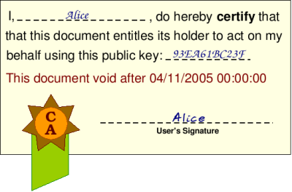
Proxy Certificate
Proxy Certificate allows another user to act upon their behalf
  Credential delegation
Borja Sotomayor , http://gdp.globus.org/gt4-tutorial/multiplehtml/ch10s05.html
Notes:
The certificate shown in Figure 10.5, “A proxy certificate” is a proxy certificate. Webster's Dictionary defines 'proxy' as "The instrument by which a person is empowered to transact the affairs of another". As you can see in the picture, the proxy certificate allows the holder of the certificate to act on A's behalf. In fact, it's very similar to the X.509 digital certificates seen in Section 9.4, “Certificates and certificate authorities”, except that it's not signed by a Certificate Authority; it's signed by an end user. We can be sure that the certificate is authentic by checking its signature (Organization A digitally signs the certificate, as described in Section 9.3, “Public key cryptography”).
But, what about the proxy certificate's public key? Whose public key is it? Organization A's? Organization B'? The answer is 'neither'. A proxy certificate has a private-public key pair generated specifically for the proxy certificate. This private-public key pair is mutually agreed upon by both parties (in this case, A and B), and Organization A will only allow the holder of that private-public key pair to act on its behalf (in this case, B). The exact mechanism by which the proxy certificate is generated by A and B will be explained later on.

Slide 23
Proxy Certificate
Proxy empowers 3rd party to act upon your behalf
Proxy certificate is signed by the end user, not a CA
Proxy cert’s public key is a new one from the private-public key pair generated specifically for the proxy certificate
Proxy also allows you to do single sign-on
  Setup a proxy for a time period and you don’t need to sign in again

Slide 24
Benefits of Single Sign-on
Don’t need to remember (or even know) ID/passwords for each resource.
Automatically get a Grid proxy certificate for use with other Grid tools
More secure
  No ID/password is sent over the wire: not even in encrypted form
  Proxy certificate expires in a few hours and then is useless to anyone else
  Don’t need to write down 10 passwords
It’s fast and it’s easy!

Slide 25
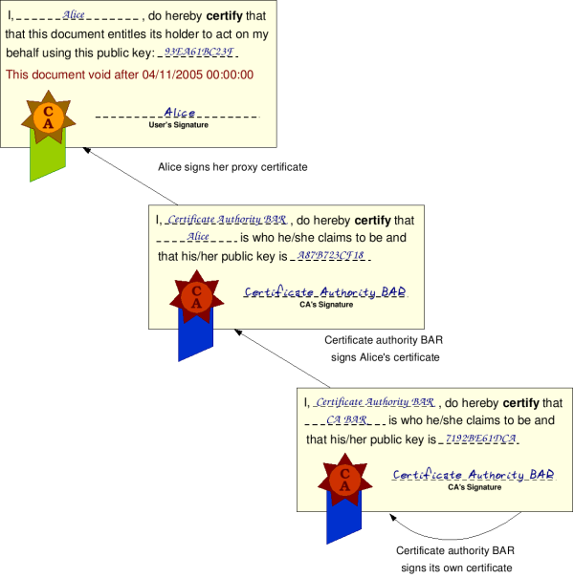
Proxy Certificate Chain
Borja Sotomayor , http://gdp.globus.org/gt4-tutorial/multiplehtml/ch10s05.html

Slide 26
Delegation
Can delegate as part of protocol
Extra round trip with delegation
Types: Full or Limited delegation
Single sign-on
  one password for the whole grid
Let services (eg RFT) act on your behalf
Rachana Ananthakrishnan

Slide 27
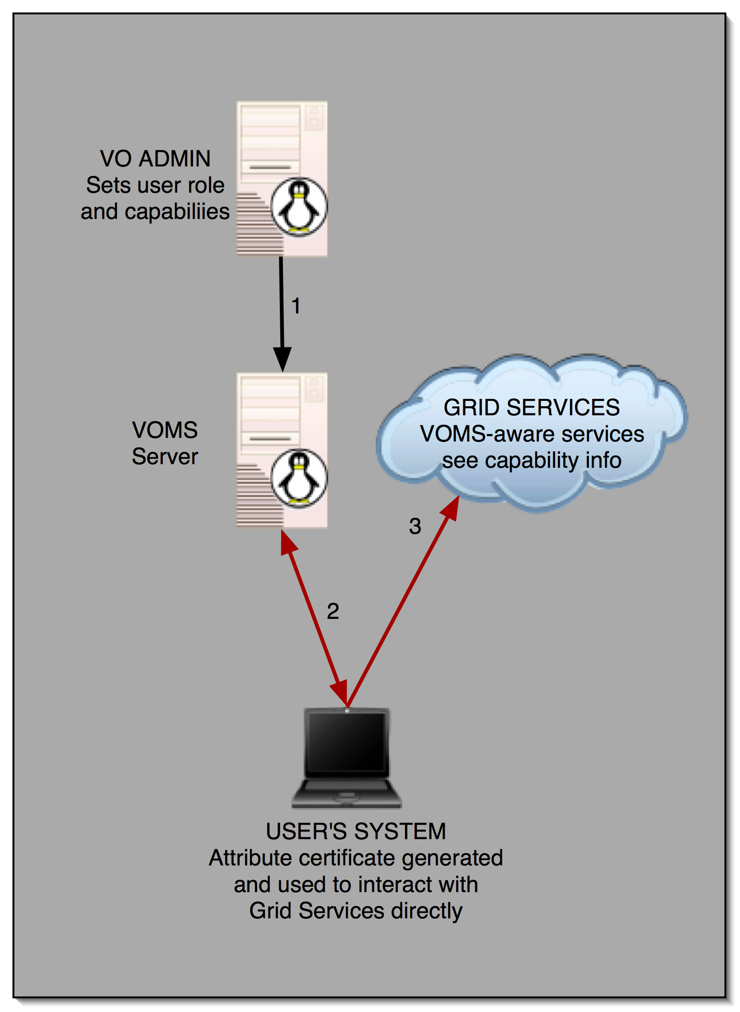
VOMS
A community-level group membership system
Database of user roles
  Administrative tools
  Client interface
voms-proxy-init
  Uses client interface to produce an attribute certificate (instead of proxy) that includes roles & capabilities signed by VOMS server
  Works with non-VOMS services, but gives more info to VOMS-aware services
Allows VOs to centrally manage user roles

Slide 28
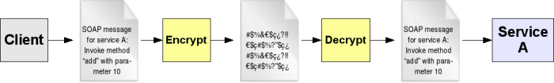
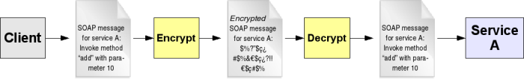
Enabling
Private Communication
GSI enables security at 2 levels
Transport-level Security (https)‏
Message-level Security
Borja Sotomayor , http://gdp.globus.org/gt4-tutorial/multiplehtml/ch10s02.html

Slide 29
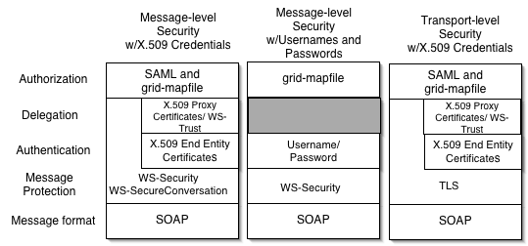
Globus’s Use of
Security Standards
Supported, Supported, Fastest,
but slow but insecure so default

Slide 30
Globus Security
Extensible authorization framework based on Web services standards
  SAML-based authorization callout
    Security Assertion Markup Language, OASIS standard
    Used for Web Browers authentication often
    Very short-lived bearer credentials
  Integrated policy decision engine
    XACML (eXtensible Access Control Markup Language) policy language, per-operation policies, pluggable

Slide 31
Globus-XACML Integration
eXtensible Access Control Markup Language
  OASIS standard, open source implementations
XACML: sophisticated policy language
Globus Toolkit ships with XACML runtime
  Included in every client and server built on Globus core
  Turned-on through configuration
… that can be called transparently from runtime and/or explicitly from application …
… and we use the XACML-”model” for
our Authz Processing Framework

Slide 32
Globus Authorization Framework
PERMIS
VOMS
Shibboleth
LDAP
…
Authorization
Decision
Attributes
PIP
PIP
PIP
PDP
Globus Client
Globus Server

Slide 33
Globus Security
Authz Callout:
SAML, XACML
SSL/WS-Security
with Proxy
Certificates
Services (running
on user’s behalf)‏
Access
Compute
Center
Rights
CAS or VOMS
issuing SAML
or X.509 ACs
Rights
Users
VO
MyProxy
Local policy
on VO identity
or attribute
authority
Rights’
KCA

Slide 34
Globus Security: How It Works
Services
Compute
Center
Users
VO

Slide 35
Globus Security: How It Works
Services
Compute
Center
Users
Rights
VO
Rights

Slide 36
Globus Security: How It Works
Services
Compute
Center
CAS
Users
Rights
VO
Local policy
on VO identity
or attribute
authority
Rights

Slide 37
Globus Security: How It Works
Services (running
on user’s behalf)‏
Services
Access
Compute
Center
Compute
Center
Rights
CAS
Users
Rights
VO
Local policy
on VO identity
or attribute
authority
Rights

Slide 38
Globus Security: How It Works
Authz Callout
Services (running
on user’s behalf)‏
with Proxy
Certificates
Services
Access
Compute
Center
Compute
Center
Rights
CAS
Users
Rights
VO
Local policy
on VO identity
or attribute
authority
Rights

Slide 39
A Cautionary Note
Grid security mechanisms are tedious to set up
  If exposed to users, hand-holding is usually required
  These mechanisms can be hidden entirely from end users, but still used behind the scenes
These mechanisms exist for good reasons.
  Many useful things can’t be done without Grid security
  It is unlikely that an ambitious project could go into production operation without security like this
  Most successful projects end up using Grid security, but using it in ways that end users don’t see much

