Slide 1
Network Time Protocol (NTP)
August 9th 2011, OSG Site Admin Workshop
Jason Zurawski – Internet2 Research Liaison

Slide 2

Agenda
Tutorial Agenda:
  Network Performance Primer - Why Should We Care? (30 Mins)
  Introduction to Measurement Tools (20 Mins)
  Use of NTP for network measurements (15 Mins)
  Use of the BWCTL Server and Client (25 Mins)
  Use of the OWAMP Server and Client (25 Mins)
  Use of the NDT Server and Client (25 Mins)
  perfSONAR Topics (30 Mins)
  Diagnostics vs Regular Monitoring (20 Mins)
  Use Cases (30 Mins)
  Exercises
<number> – 11/07/26, © 2011 Internet2

Slide 3
What is NTP?
NTP is a protocol designed to synchronize the clocks of computers over a network.
  NTP version 3 is an internet draft standard, formalized in RFC 1305
  NTP version 4 is a significant revision of the NTP standard, and is the current development version, but has not been formalized in an RFC
  Simple NTP (SNTP) version 4 is described in RFC 2030
Widely used to synchronize a computer to Internet time servers or other sources, such as a radio or satellite receiver or telephone modem service.
It can also be used as a server for dependent clients
<number> – 11/07/26, © 2011 Internet2

Slide 4
What is NTP?
Used to synchronize a group of servers to UTC
  Servers will present the data in timezones as needed
Attempts to keep time monotonically increasing while minimizing offset and skew
  Sends signals to system clock to correct
  ‘skipping’ may be large to start
These goals contradict
  Stability vs Accuracy
<number> – 11/07/26, © 2011 Internet2

Slide 5
What is NTP?
Provides accuracies typically less than a millisecond on LANs and up to a few milliseconds on WANs
Typical NTP configurations utilize multiple redundant servers and diverse network paths in order to achieve high accuracy and reliability.
  Redundancy – enough choices to pick a ‘good’ clock
  Diverse Paths – Minimize the effect of congestion on a common path
NTP time synchronization services are widely available in the public Internet.
  The public NTP subnet in early 2008 includes several thousand servers in most countries and on every continent of the globe, including Antarctica.
  These servers support a total population estimated at over 25 million computers in the global Internet.
<number> – 11/07/26, © 2011 Internet2

Slide 6
What is NTP?
The NTP subnet operates with a hierarchy of levels, where each level is assigned a number called the stratum.
  Stratum 1 (primary) servers at the lowest level are directly synchronized to national time services.
  Stratum 2 (secondary) servers at the next higher level are synchronize to stratum 1 servers and so on.
Normally, NTP clients and servers with a relatively small number of clients do not synchronize to public primary servers.
  There are several hundred public secondary servers operating at higher strata and are the preferred choice.
For measurement needs, we are not going to recommend the ‘normal’ mode of operation…
<number> – 11/07/26, © 2011 Internet2

Slide 7
Utility for Measurement
Scheduling requires coarse grain agreement on time (lets start/end together)
  Agreement must be “global” in scope – UTC
  Individual servers communicate with multiple other hosts
Stability/Accuracy are important
  Virtualization is still tricky…
One-Way latency requirements
  Jitter (requires stability of offset within sample)
  Latency (requires accuracy)
Sensible compromise
  Well defined error representation
<number> – 11/07/26, © 2011 Internet2

Slide 8
Sensible NTP Policy
Open firewalls and open querying
  Let others know your notion of time
Good error determination requires 4 clocks (4 peers)
  E.g. Try to pick clocks of the same strata (something high, 1 preferred, 2 will work)
Resilient setups will attempt to have the paths to all peers be as divergent as possible
  Asymmetric paths to peers will cause offsets
<number> – 11/07/26, © 2011 Internet2

Slide 9
Sensible NTP Deployment
Hardware/network requirements are minimal
Minimize temperature variations to minimize clock wander
  University of Delaware study – NTP is heavily influenced by the seasons (e.g. AC usage in campus buildings will impact clock skew)
Use “real” NTP - not OpenNTP or something else
  Linux/FreeBSD release distributions should be fine
  You must configure, default config is bad
Default configuration relies on ‘pool’ servers
  Anyone can join the pool
  Choosing from the pool does not mean you will always get the same server
  Any stratum
  No limits on accuracy…
<number> – 11/07/26, © 2011 Internet2

Slide 10
Acceptable clock use
NTP should stabilize the clock over time
Measurements (e.g. OWAMP) will reflect this change
  Less ‘skipping’
  No more ‘negative’ measurements
NTP will remain in a steady state unless there are network/host problems
  Selecting constantly between the best ‘peer’ clocks
  Network routing causing delay between peers
  Host temperature fluctuations, CPU variability
<number> – 11/07/26, © 2011 Internet2

Slide 11
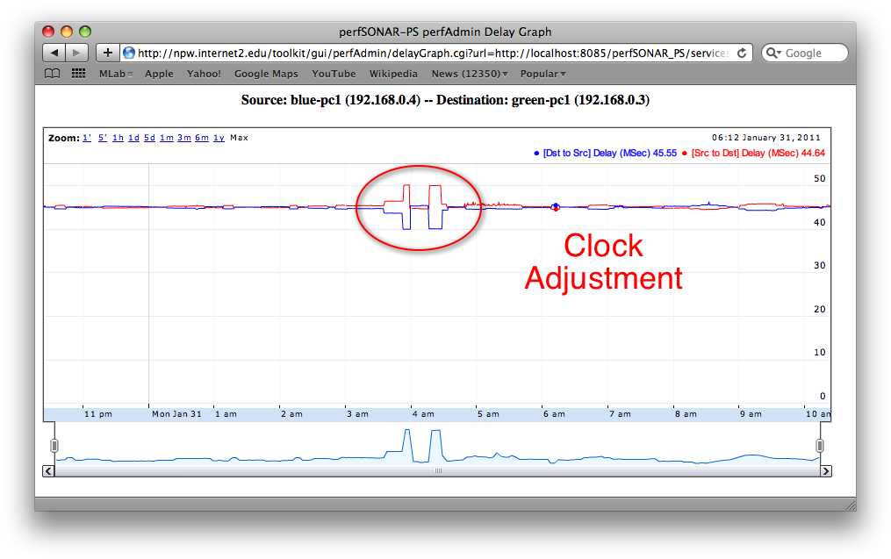
Acceptable clock use – OWAMP Data
<number> – 11/07/26, © 2011 Internet2

Slide 12
Poor clock use
NTP cannot stabilize the clock
  CMOS battery failure
  Poor selection of peers
  Network congestion
  Host invariability (temperature, CPU)
Frequent skips in perceived time
Measurement is unreliable (negative latencies)
High Jitter
<number> – 11/07/26, © 2011 Internet2

Slide 13
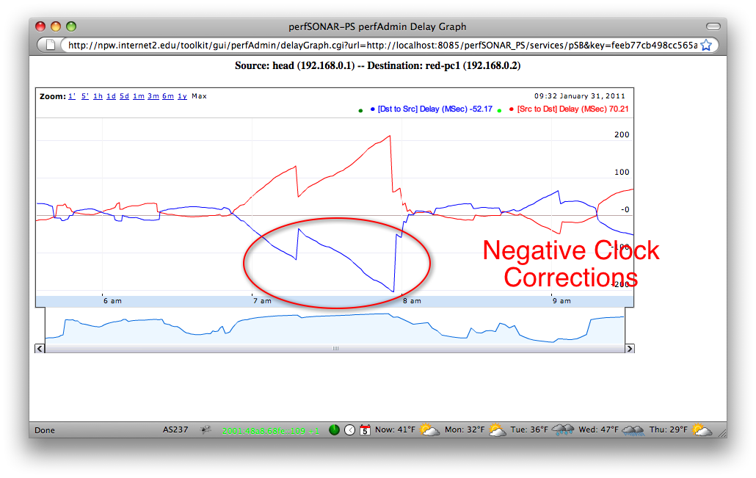
Poor clock use – Skew in OWAMP Data
<number> – 11/07/26, © 2011 Internet2

Slide 14
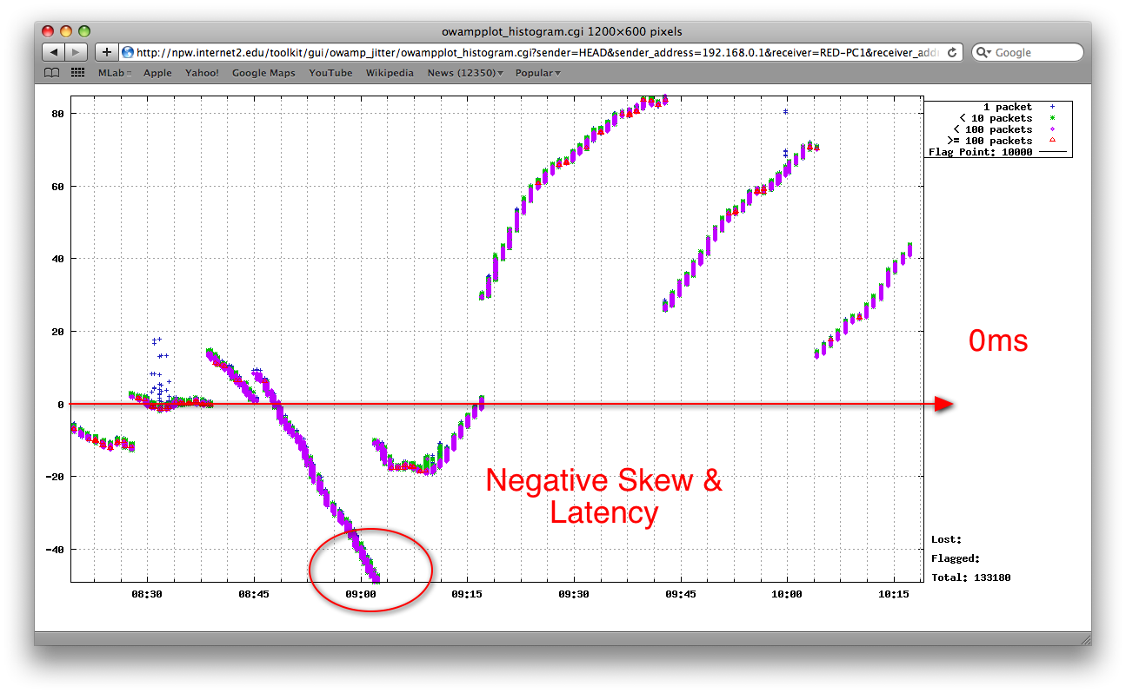
Poor clock use – Jitter in OWAMP Data
<number> – 11/07/26, © 2011 Internet2

Slide 15
Additional Resources
Man ntpd
Man ntp.conf
http://www.internet2.edu/performance/owamp/details.html#NTP
http://twiki.ntp.org/bin/view/Support/SelectingOffsiteNTPServers
Sample Configuration:
  http://www.internet2.edu/performance/owamp/ntp/ntp.conf
<number> – 11/07/26, © 2011 Internet2

Slide 16
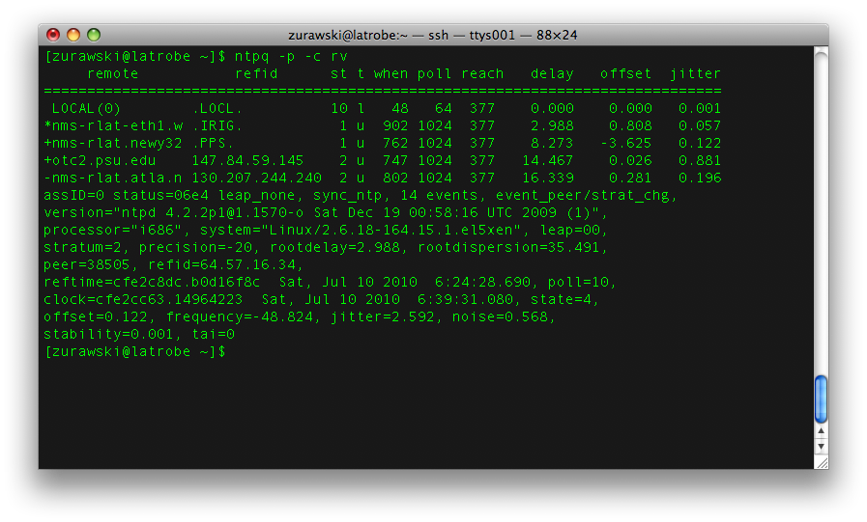
Verify NTP
Ntpq
Ntpd statistics (log files)
<number> – 11/07/26, © 2010 Internet2

Slide 17
Network Time Protocol (NTP)
August 9th 2011, OSG Site Admin Workshop
Jason Zurawski – Internet2 Research Liaison
For more information, visit http://www.internet2.edu/workshops/npw
<number> – 11/07/26, © 2010 Internet2

