Slide 1
Panda, a Pilot-based workflow manager
New Mexico Grid School – April 8, 2009
Marco Mambelli – University of Chicago
marco@hep.uchicago.edu

Slide 2
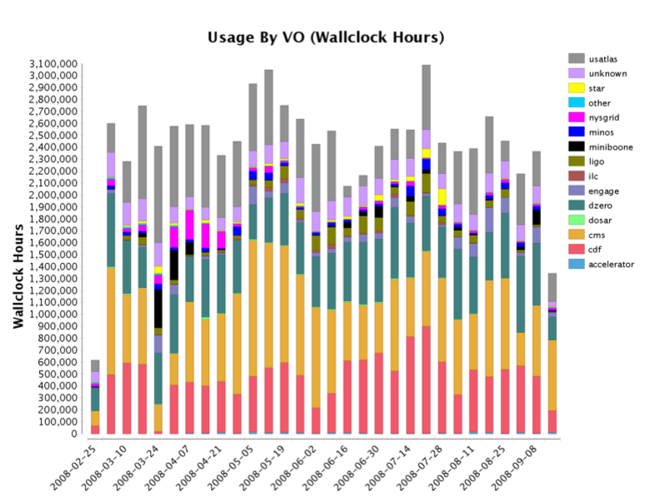
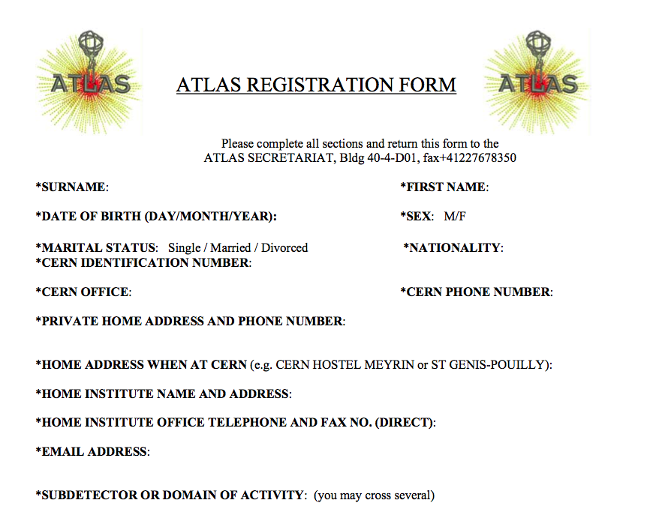
The ATLAS VO
Virtual Organization in OSG (and other Grids)
  In OSG since the beginning
  https://twiki.grid.iu.edu/bin/view/VO/ATLAS
  https://lcg-voms.cern.ch:8443/vo/atlas/vomrs
Collaboration for the ATLAS experiment in the LHC at CERN
  http://atlas.ch/
  http://atlas.web.cern.ch/Atlas/ATLASreg_form.pdf
Panda, Pilot-based WFM - Marco Mambelli

Slide 3
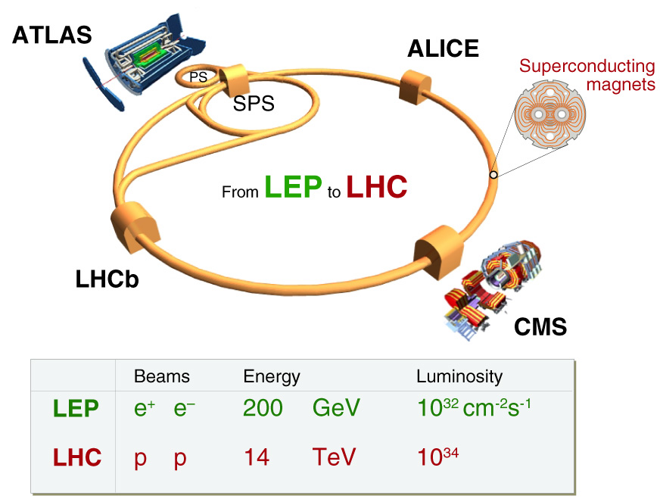
LHC experiment at CERN
http://public.web.cern.ch/public/
http://www.youtube.com/watch?v=j50ZssEojtM
Panda, Pilot-based WFM - Marco Mambelli

Slide 4
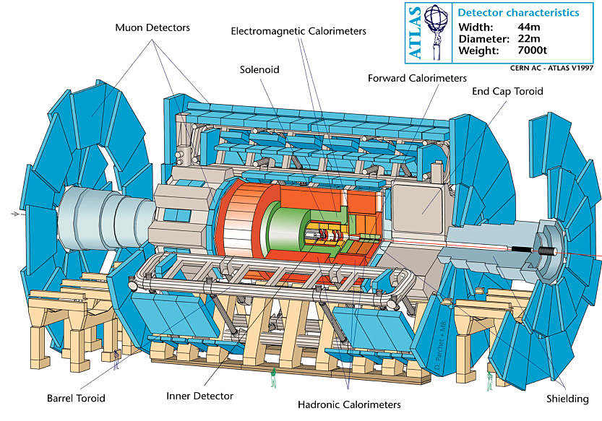
The ATLAS experiment
37 Countries
167 Institutes
~2000 Collaborators
Panda, Pilot-based WFM - Marco Mambelli

Slide 5
PANDA
PANDA = Production ANd Distributed Analysis system
  Designed for analysis as well as production for High Energy Physics
  Works both with OSG and EGEE middleware
A single task queue and pilots
  Apache-based Central Server
  Pilots retrieve jobs from the server as soon as CPU is available  late scheduling
Highly automated, has an integrated monitoring system
Integrated with ATLAS Distributed Data Management (DDM) system
Not exclusively ATLAS: has its first OSG user in CHARMM (Chemistry at HARvard Molecular Mechanics)
Panda, Pilot-based WFM - Marco Mambelli
Notes:
DDM is treated as black box. Moves data around in a reliable fashion.
CHARMM (Chemistry at HARvard Macromolecular Mechanics) is the name of a widely used set of force fields for molecular dynamics as well as the name for the molecular dynamics simulation and analysis package associated with them.[1][2] The CHARMM Development Project involves a network of developers throughout the world working with Martin Karplus and his group at Harvard to develop and maintain the CHARMM program.

Slide 6

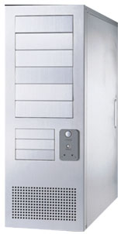

Panda System
DDM
Panda server
ProdDB
LRC/LFC
bamboo
job
send log
logger
pull
http
https
site B
job
job
pilot
https
submit
site A
submit
pilot
condor-g
Autopilot
End-user
Worker Nodes
Panda, Pilot-based WFM - Marco Mambelli

Slide 7
Panda Server
clients
DQ2
https
Panda server
LRC/LFC
PandaDB
Apache + gridsite
logger
pilot
Central queue for all kinds of jobs
Assign jobs to sites (brokerage)
Setup input/output datasets
  Create them when jobs are submitted
  Add files to output datasets when jobs are finished
Dispatch jobs
Panda, Pilot-based WFM - Marco Mambelli

Slide 8
Bamboo
prodDB
Bamboo
Panda server
cx_Oracle
https
Apache + gridsite
cron
https
Get jobs from prodDB to submit them to Panda
Update job status in prodDB
Assign tasks to clouds dynamically
Kill TOBEABORTED jobs
A cron triggers the above procedures every 10 min
Panda, Pilot-based WFM - Marco Mambelli

Slide 9
Panda Job Timeline
DDM
Panda
submitter
Rely on ATLAS DDM
  Panda sends requests to DDM
  DDM moves files and sends notifications back to Panda
  Panda and DDM work asynchronously
Dispatch input files to execution sites and aggregate output files to destination
Jobs get ‘activated’ when all input files are copied, and pilots pick them up
  Pilots don’t have to transfer data (asynchronous)
  Data-transfers and Job-executions can run in parallel
submit Job
subscribe T2 for disp dataset
data transfer
callback
pilot
get Job
run job
finish Job
add files to dest datasets
data transfer
callback
Panda, Pilot-based WFM - Marco Mambelli
Notes:
DDM takes care of moving files around and provides callbacks that can be used for notification or monitoring

Slide 10
How the pilot works
Sends the several parameters to Panda server for job matching (HTTP request)
  CPU speed
  Available memory size on the WN
  List of available ATLAS releases at the site
Retrieves an `activated’ job (HTTP response of the above request)
  activated  running
Runs the job immediately because all input files should be already available at the site
Sends heartbeat every 30min
Copy output files to local Storage Element and register them to Local Replica Catalog
Panda, Pilot-based WFM - Marco Mambelli

Slide 11
Pilot vs ATLAS Job
Pilot
ATLAS Job
Submitted by factories
  remote submit hosts
  local cluster factories
Managed by factories
Python code to support ATLAS Job execution
Submitted continuously
Partially accounted
  no big deal if some fail
Submitted by users or production managers (Bamboo)
Managed by Panda Server
Runs Athena software (ATLAS libraries)
Submitted when needed
Fully accounted
  error statistics are important
Panda, Pilot-based WFM - Marco Mambelli
Notes:
For debug and troubleshoot purposes you want to know if your pilots are running correctly or not, but you will not archive the statistics for accounting purposes.
Jobs statistics instead are archived and accounted world-wide.

Slide 12
Some monitoring resources
The following pages present some monitoring example
Screenshots are just example pages, actual content varies
URLs are one of the possible URLs providing a similar page
  e.g. queries may vary the actual Site or Time interval
Main URLs:
  DDM Dashboard: http://dashb-atlas-data-test.cern.ch/dashboard/request.py/site
  Panda Monitor: http://panda.cern.ch:25880/ or http://panda.atlascomp.org/?redirect=pandamon
  (hostname may change since there are multiple servers)
Take time to navigate Panda Monitor and the Dashboard
Panda, Pilot-based WFM - Marco Mambelli

Slide 13
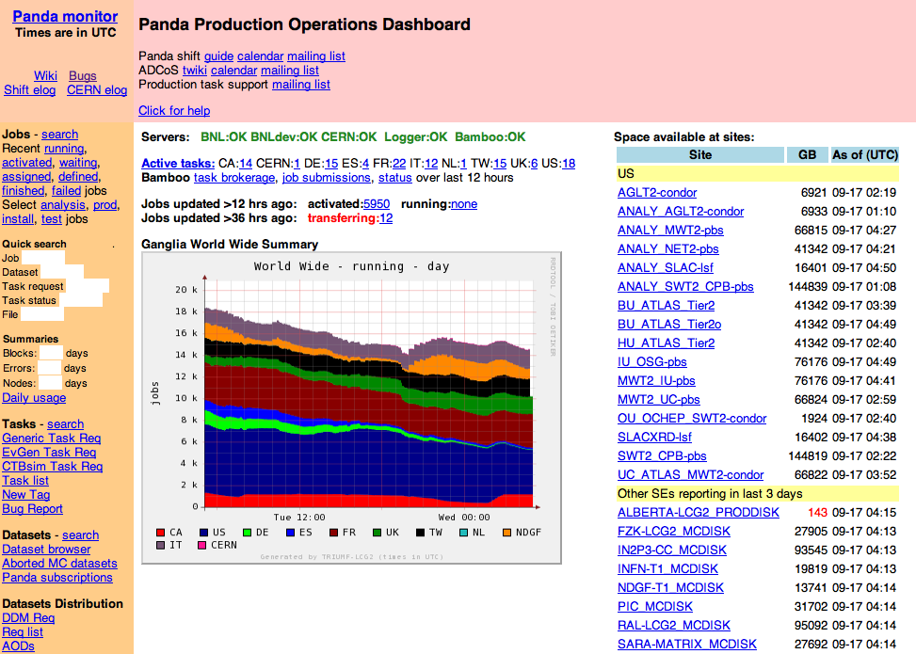
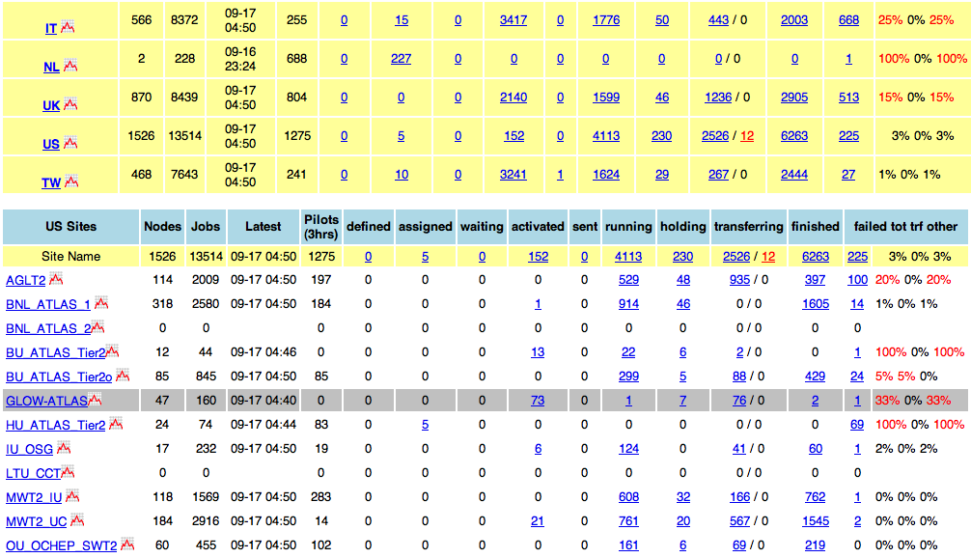
Panda Monitor: production dashboard
http://panda.cern.ch:25880/server/pandamon/query?dash=prod
Panda, Pilot-based WFM - Marco Mambelli
Notes:
Production dashboard: quick overview of production and analysis jobs on all sites managed by Panda. It makes easier to spot problems.

Slide 14
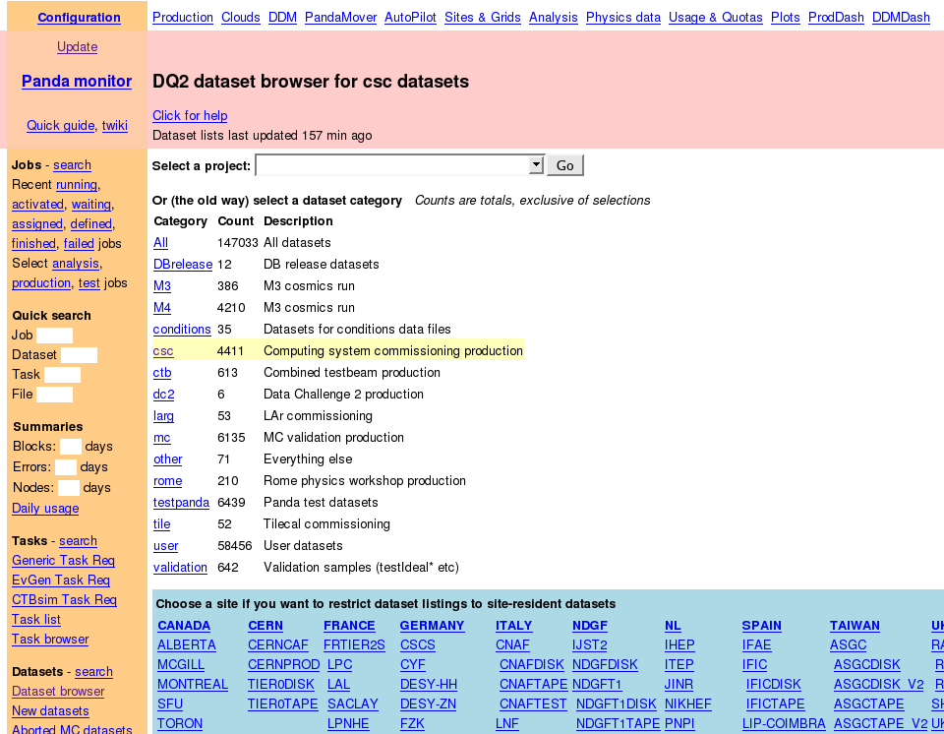
Panda Monitor: Dataset browser
http://panda.cern.ch:25880/server/pandamon/query?overview=dslist
Panda, Pilot-based WFM - Marco Mambelli
Notes:
Allows to browse the available data on the grid and see where it is replicated

Slide 15
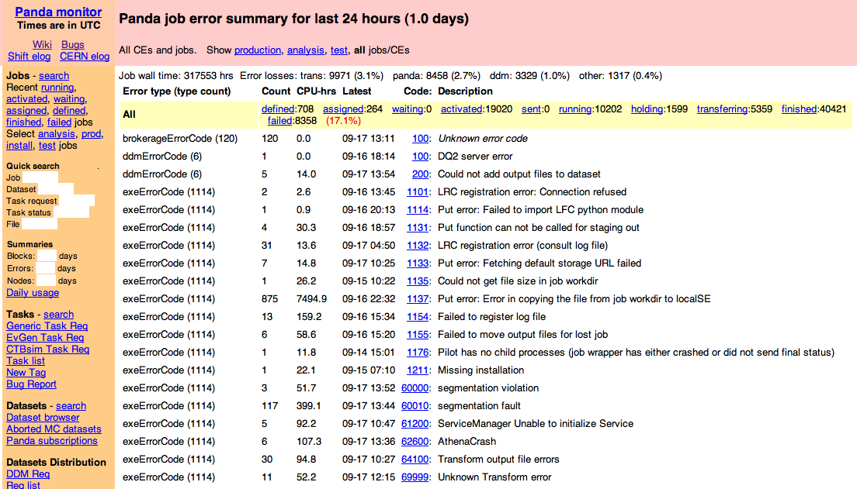
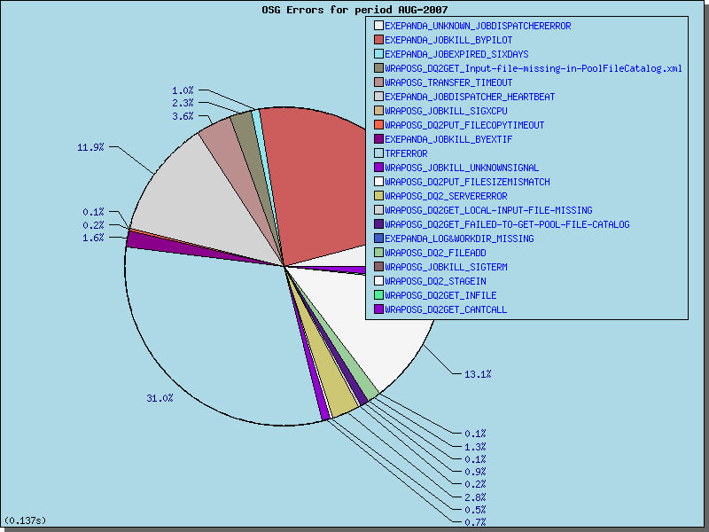
Panda Monitor: error reporting
http://panda.cern.ch:25880/server/pandamon/query?days=1&overview=errorlist
Panda, Pilot-based WFM - Marco Mambelli

Slide 16
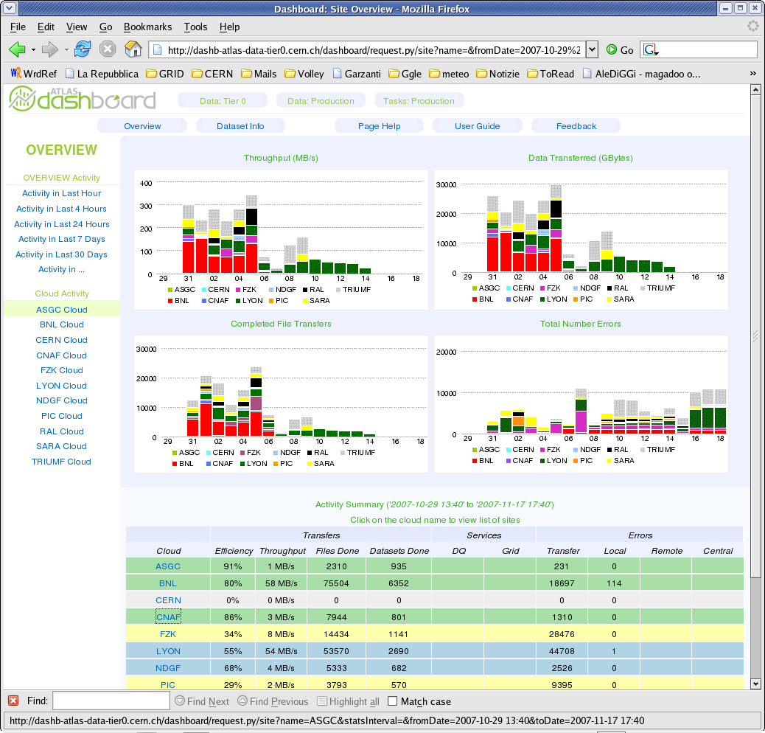
DDM Dashboard: overview
http://dashb-atlas-data-test.cern.ch/dashboard/request.py/site
Panda, Pilot-based WFM - Marco Mambelli
Notes:
Status of the data movement

Slide 17
?
!
Panda, Pilot-based WFM - Marco Mambelli

Slide 18
Client-Server Communication
HTTP/S-based communication (curl+grid proxy+python)
GSI authentication via mod_gridsite
Most of communications are asynchronous
  Panda server runs python threads as soon as it receives
  HTTP requests, and then sends responses back immediately. Threads do heavy procedures (e.g., DB access) in background  better throughput
  Some are synchronous
Panda Server
Pilot/Client
UserIF
Request
mod_python
Python
obj
serialize
(cPickle)
HTTPS
(x-www-form
-urlencode)
mod_deflate
Python
obj
deserialize
(cPickle)
Python
obj
Response
Panda, Pilot-based WFM - Marco Mambelli

