Slide 1
An Introduction to
High-Throughput Computing
Monday morning, 9:15am
Alain Roy <roy@cs.wisc.edu>
OSG Software Coordinator
University of Wisconsin-Madison

Slide 2


Who Am I?
Open Science Grid Software Coordinator
With Condor since 2001
Taught at seven previous summer schools
I have the two cutest kids in the whole world:

Slide 3
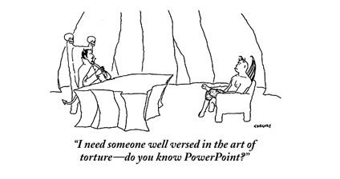
Overview of day
Lectures alternating with exercises
  Emphasis on lots of exercises
  Hopefully overcome PowerPoint fatigue & help you understand better

Slide 4
Some thoughts on the exercises
It’s okay to move ahead on exercises if you have time
It’s okay to take longer on them if you need to
If you move along quickly, try the “On Your Own” sections and “Challenges”
We’ll have an optional evening session if you want more time, and I’ll be there to give help

Slide 5
Most important!
Please ask me questions!
  …during the lectures
  …during the exercises
  …during the breaks
  …during the meals
  …over dinner
  …the rest of the week
If I don’t know, I’ll find the right person to answer your question.

Slide 6
Before we start
Sometime today, do the exercise on getting a certificate.
  It is required for upcoming exercises
  It will be easiest if you do it today

Slide 7
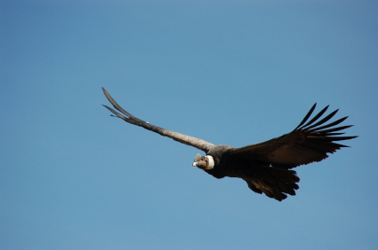
Goals for this session
Understand basics of high-throughput computing
Understand the basics of Condor
Run a basic Condor job

Slide 8
The setup: You have a problem
Your science computing is complex!
  Monte carlo, image analysis, genetic algorithm, simulation…
It will take a year to get the results on your laptop, but the conference is in a week.
What do you do?

Slide 9
Option 1: Use a “supercomputer” aka High Performance Computing (HPC)
“Clearly, I need the best, fastest computer to help me out”
Maybe you do…
  Do you have a highly parallel program?
    i.e. individual modules must communicate
  Do you require the fastest network/disk/memory?
Are you willing to:
  Port your code to a special environment?
  Request and wait for an allocation?

Slide 10
Option 2: Use lots of commodity computers
Instead of the fastest computer, lots of individual computers
May not be fastest network/disk/memory, but you have a lot of them
Job can be broken down into separate, independent pieces
  If I give you more computers, you run more jobs
  You care more about total quantity of results than instantaneous speed of computation
This is high-throughput computing

Slide 11
What is high-throughput computing? (HTC)
An approach to distributed computing that focuses on long-term throughput, not instantaneous computing power
  We don’t care about operations per second
  We care about operations per year
Implications:
  Focus on reliability
  Use all available resources
    That slow four-year old cluster down the hall? Use it!

Slide 12

Think about a race
Assume you can run a four minute mile
Does that mean you can run a 104 minute marathon?
The challenges in sustained computation are different than achieving peak in computation speed
  Our focus is sustained computation

Slide 13
HTC is not for all problems
Do you need real time results?
Do you need to minimize latency to results?
Do you have very parallel code with lots of communication between modules?
You might need HPC instead

Slide 14
An example problem: BLAST
A scientist has:
  Question: Does a protein sequence occur in other organisms?
  Data: lots of protein sequences from various organisms
  Parameters: how to search the database.
More throughput means
  More protein sequences queried
  Larger/more protein data bases examined
  More parameter variation
We’ll try out BLAST later today

Slide 15
Why is HTC hard?
The HTC system has to keep track of:
  Individual tasks (a.k.a. jobs) & their inputs
  Computers that are available
The system has to recover from failures
  There will be failures! Distributed computers means more chances for failures.
You have to share computers
    Sharing can be within an organization, or between orgs
    So you have to worry about security
    And you have to worry about policies on how you share
If you use a lot of computers, you have to deal variety:
  Different kinds of computers (arch, OS, speed, etc..)
  Different kinds of storage (access methodology, size, speed, etc…)
  Different networks interacting (network problems are hard to debug!)

Slide 16
Let’s take one step at a time
Small
Large
Local
Distributed
Can you run one job on one computer?
Can you run one job on another local computer?
Can you run 10 jobs on a set of local computers?
Can you run 1 job on a remote computer?
Can you run 10 jobs at a remote site?
Can you run a mix of jobs here and remotely?
This is the path we’ll take in the school this week

Slide 17
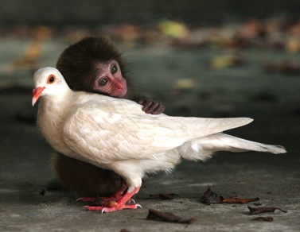
Discussion
For 5 minutes, talk to a neighbor: If you want to run one job in a local cluster of computers:
    What do you (the user) need to provide so a single job can be run?
    What does the system need to provide so your single job can be run?
      Think of this as a set of processes: what needs happen when the job is given? A “process” could be a computer process, or just an abstract task.

Slide 18
Alain’s answer:
What does the user provide?
A “headless job”
  Not interactive/no GUI: how could you interact with 1000 simultaneous jobs?
A set of input files
A set of output files
A set of parameters (command-line arguments)
Requirements:
  Ex: My job requires at least 2GB of RAM
  Ex: My job requires Linux
Control/Policy:
  Ex: Send me email when the job is done
  Ex: Job 2 is more important than Job 1
  Ex: Kill my job if it’s run for more than 6 hours

Slide 19
Alain’s answer:
What does the system provide?
Methods to:
  Submit/Cancel job
  Check on state of job
  Check on state of available computers
Processes to:
  Reliably track set of submitted jobs
  Reliably track set of available computers
  Decide which job runs on which computer
  Manage a single computer
  Start up a single job

Slide 20
Surprise!
Condor does this (and more)
Methods to:
  Submit/Cancel job. condor_submit/condor_rm
  Check on state of job. condor_q
  Check on state of avail. computers. condor_status
Processes to:
  Reliably track set of submitted jobs. schedd
  Reliably track set of avail. computers. collector
  Decide which job runs on where. negotiator
  Manage a single computer startd
  Start up a single job starter

Slide 21
But not only Condor
You can use other systems:
  PBS/Torque
  Oracle Grid Engine (né Sun Grid Engine)
  LSF
  ...
But I won’t cover them.
  Our expertise is with Condor
  Our bias is with Condor
What should you learn at the school?
  How do you think about HTC?
  How can you do your science with HTC?
  … For now, learn it with Condor, but you can apply it to other systems.

Slide 22
A brief introduction to Condor
Please note, we will only scratch the surface of Condor:
  We won’t cover MPI, Master-Worker, advanced policies, site administration, security mechanisms, Condor-C, submission to other batch systems, virtual machines, cron, high-availability, computing on demand, …
Why?
  The goal is to introduce you to HTC by using Condor, not to make you Condor experts.

Slide 23
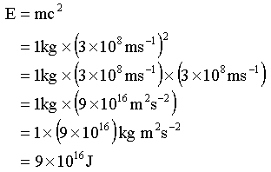
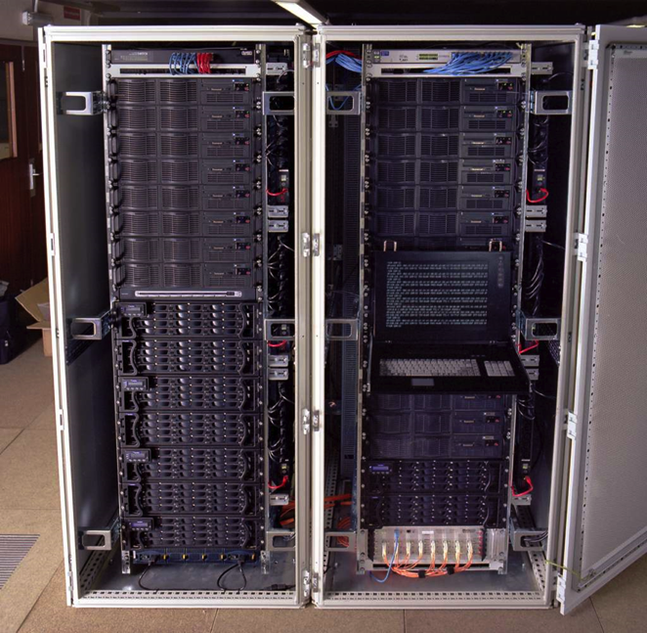
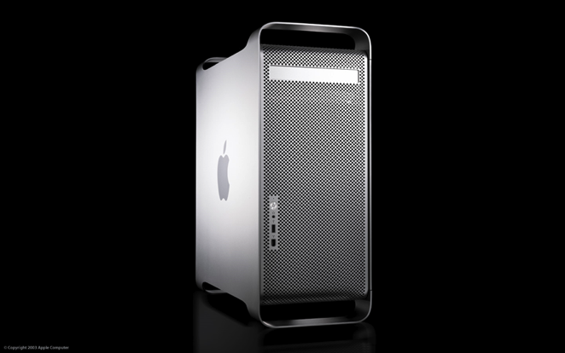
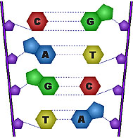
Condor Takes Computers…
…And jobs
…And matches them
I need a Mac!
Dedicated Clusters
Desktop Computers
Matchmaker
I need a Linux box
with 2GB RAM!

Slide 24
Quick Terminology
Cluster: A dedicated set of computers not for interactive use
Pool: A collection of computers used by Condor
  May be dedicated
  May be interactive
Remember:
  Condor can manage a cluster in a machine room
  Condor can use desktop computers
  Condor can access remote computers
  HTC uses for all available resources

Slide 25
Matchmaking
Matchmaking is fundamental to Condor
Matchmaking is two-way
  Job describes what it requires:
  I need Linux && 8 GB of RAM
  Machine describes what it requires:
  I will only run jobs from the Physics department
Matchmaking allows preferences
  I need Linux, and I prefer machines with more memory but will run on any machine you provide me

Slide 26
Why Two-way Matching?
Condor conceptually divides people into three groups:
  Job submitters
  Computer owners
  Pool (cluster) administrator
All three of these groups have preferences
}
May or may not
be the same
people

Slide 27

ClassAds
ClassAds state facts
  My job’s executable is analysis.exe
  My machine’s load average is 5.6
ClassAds state preferences
  I require a computer with Linux
ClassAds are extensible
  They say whatever you
  want them to say

Slide 28
Example ClassAd
MyType = "Job"
TargetType = "Machine"
ClusterId = 1377
Owner = "roy“
Cmd = “analysis.exe“
Requirements =
(Arch == "INTEL")
&& (OpSys == "LINUX")
&& (Disk >= DiskUsage)
&& ((Memory * 1024)>=ImageSize)
…
String
Number
Expression

Slide 29
Schema-free ClassAds
Condor imposes some schema
  Owner is a string, ClusterID is a number…
But users can extend it however they like, for jobs or machines
  AnalysisJobType = “simulation”
  HasJava_1_4 = TRUE
  ShoeLength = 7
Matchmaking can use these attributes
  Requirements = OpSys == "LINUX"
    && HasJava_1_4 == TRUE

Slide 30
Don’t worry
You won’t write ClassAds (usually)
  You’ll create a simple submit file
  Condor will write the ClassAd
  You can extend the ClassAd if you want to
You won’t write requirements (usually)
  Condor writes them for you
  You can extend them
  In some environments (see glideins tomorrow) you provide attributes instead of requirements expressions

Slide 31

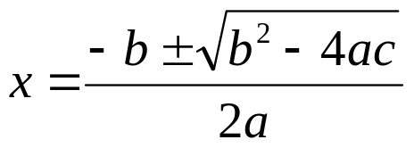
Submitting jobs: condor_schedd
Users submit jobs from a computer
  Jobs described as ClassAds
  Each submission computer has a queue
  Queues are not centralized
  Submission computer watches over queue
  Can have multiple submission computers
  Submission handled by condor_schedd
Queue
condor_schedd

Slide 32

Advertising computers
Machine owners describe computers
  Configuration file extends ClassAd
  ClassAd has dynamic features
    Load Average
    Free Memory
    …
  ClassAds are sent to Matchmaker by condor_startd on computer
ClassAd
Type = “Machine”
Requirements = “…”
Matchmaker
(Collector)

Slide 33
Matchmaking
Negotiator collects list of computers
Negotiator contacts each schedd
  What jobs do you have to run?
Negotiator compares each job to each computer
  Evaluate requirements of job & machine
  If both are satisfied, there is a match
Upon match, schedd contacts execution computer to run job

Slide 34
Matchmaking diagram
Matchmaker
Matchmaking
Service
Information
service
Negotiator
Collector
2
1
condor_schedd
3
Job queue service
Queue

Slide 35
Running a Job
Matchmaker
condor_submit
condor_negotiator
condor_collector
Manages Machine
condor_schedd
condor_startd
Queue
condor_shadow
Manages
Local Job
condor_starter
Job
Manages
Remote Job

Slide 36
Condor processes
Process | Function
Master | Takes care of other processes
Collector | Stores ClassAds
Negotiator | Performs Matchmaking
Schedd | Manages job queue
Shadow | Manages job (submit side)
Startd | Manages computer
Starter | Manages job (executtion side)

Slide 37
If you forget most of these remember two (for other lectures)
Process | Function
Master | Takes care of other processes
Collector | Stores ClassAds
Negotiator | Performs Matchmaking
Schedd | Manages job queue
Shadow | Manages job (submit side)
Startd | Manages computer
Starter | Manages job (executtion side)
Schedd Manages job queue
Startd Manages computer

Slide 38
Some notes
One negotiator/collector per pool
  (Perhaps extras for reliability)
Can have many schedds (submitters)
Can have many startds (computers)
A machine can play multiple roles
  E.g. Can have both schedd & startd

Slide 39
Today’s Condor setup
One submit computer
  One schedd/queue for everyone
  osg-ss-submit.chtc.wisc.edu
Will use local Condor pool
  Have dedicated subset
Tomorrow we will expand the setup

Slide 40

That was a whirlwind tour!
Enough with the theory: let’s use Condor!
Goal: Check out our installation, run some basic jobs.

Slide 41
Questions?
Questions? Comments?
  Feel free to ask me questions later:
  Alain Roy <roy@cs.wisc.edu>
Upcoming sessions
  Now – 10:30
    Hands-on exercises
  10:30 – 10:45
    Break
  10:45 – 12:15
    More!

