Slide 1
Executive Director Report to the OSG Council August 2nd 2011, Ruth Pordes
Status, FY12 planning

Slide 2
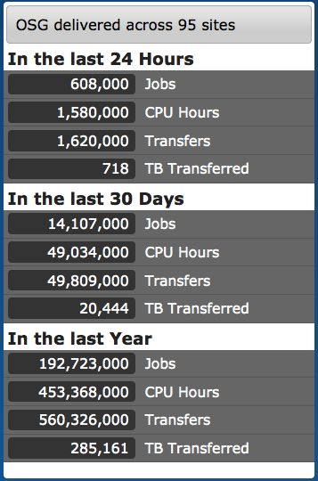
OSG Production Infrastructure
1.2Million CPU-hours/day; 1/ Million Jobs/day ¼ Petabyte over the WAN/day
from >90sites
18 VOs
260 peer reviewed publications /year

Slide 3
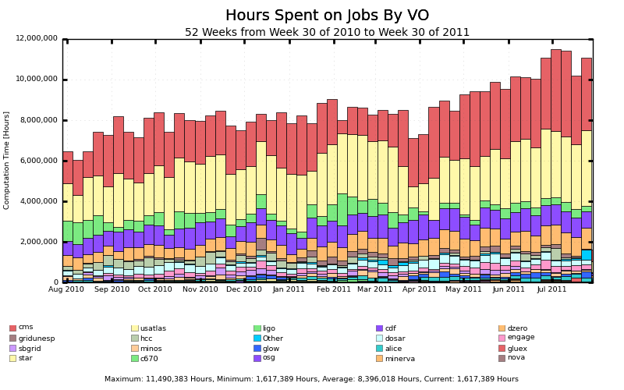

Slide 4
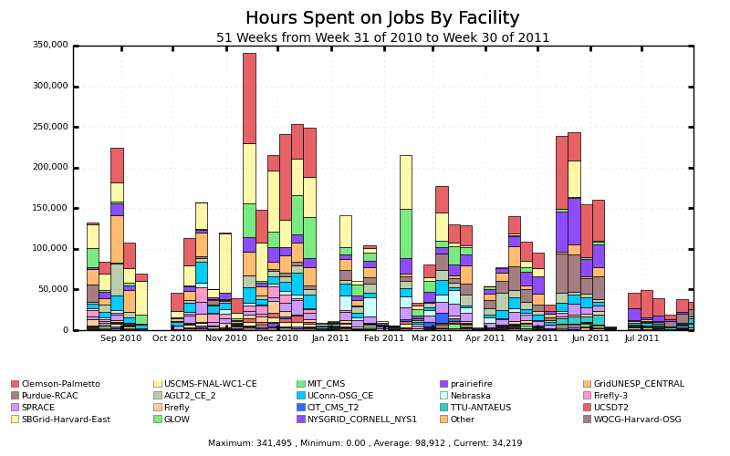
SBGrid

Slide 5
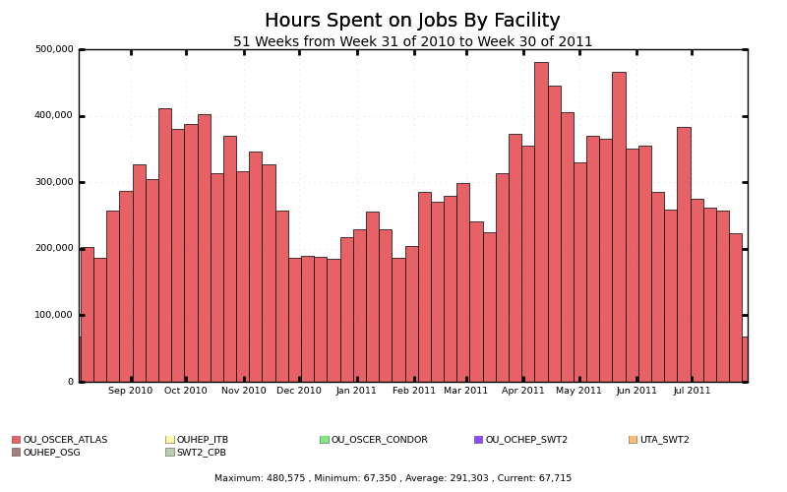
DOSAR

Slide 6
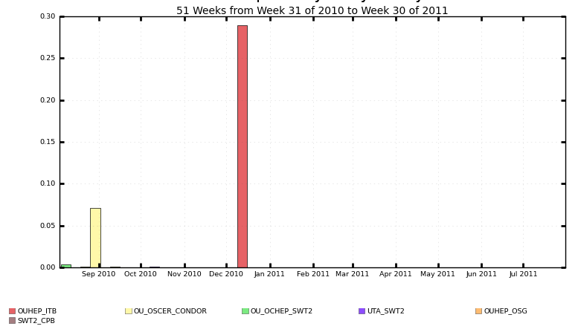

Slide 7
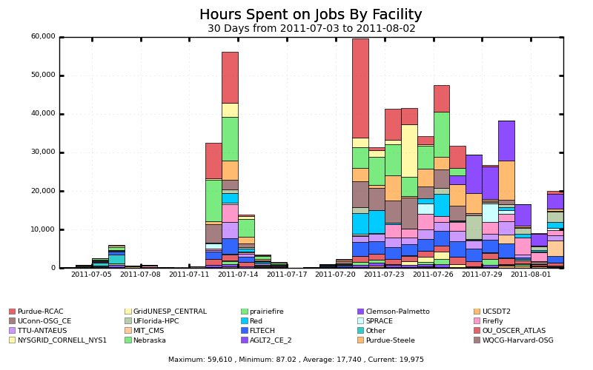
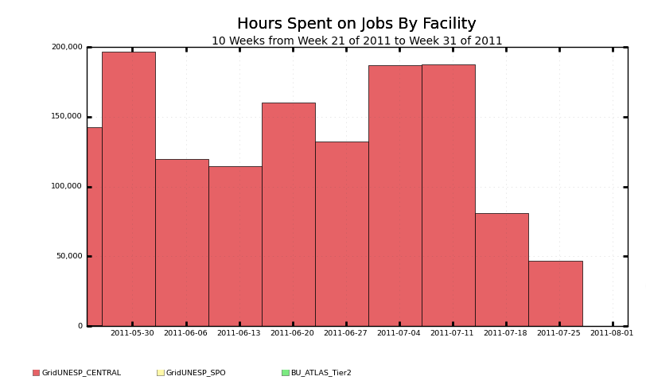
2 representative (different from HCC) campus Vos – Glow, GridUNESP
Glow
GridUNESP

Slide 8
Proposals:
InDHTC proposal to DOE ASCR SciDAC-3 Institute program has been rejected.
OSG proposal for 33.3 FTE has been submitted jointly to DOE OHEP and NSF.
CDIGS-2 1 year extension proposal for $200K submitted to NSF.

Slide 9
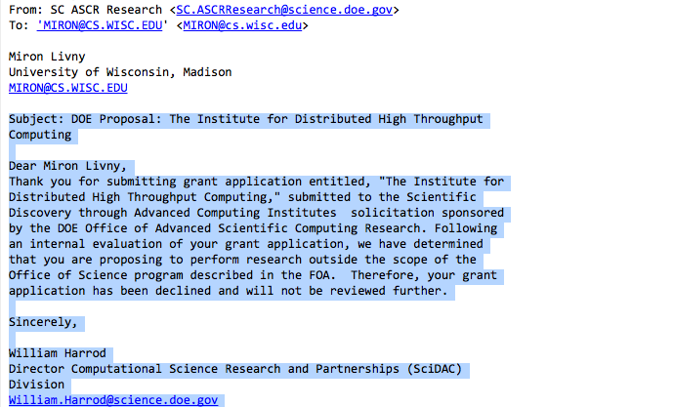
Response from ASCR:

Slide 10
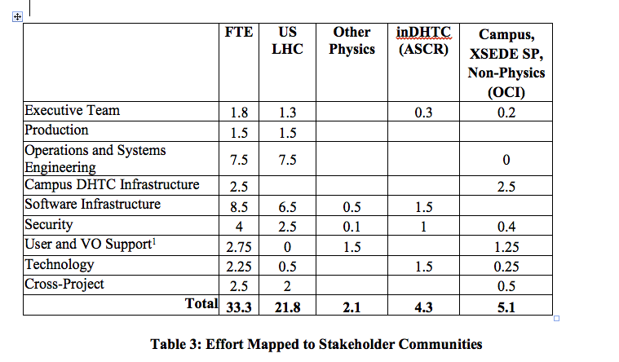
Effort breakdown in OSG Proposal

Slide 11
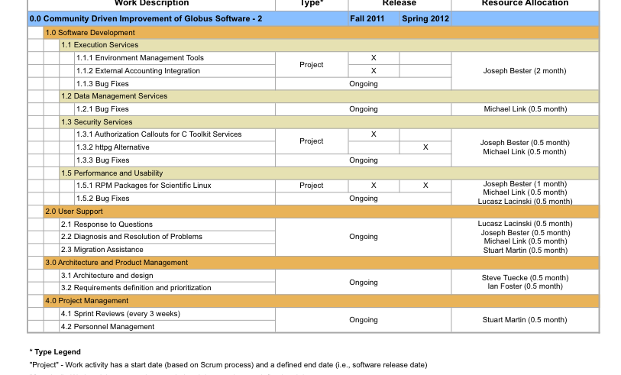
CDIGS Extension

Slide 12
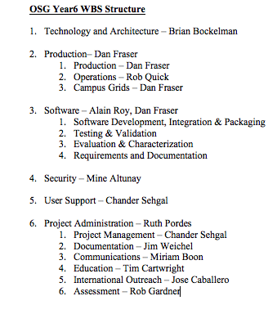
FY12 Planning
Energetic Staff retreat last week in Madison. Preparation by project manager, Chander, and attendance by all FY12 area coordinators + members & delegees of ET.
Planning is for 6 months of FY12 at 28.85 FTEs. Some staff reduction from FY11 – Doug Olson, Robert Engel, transition at NCSA, Uwisc Madison. No new staff due to uncertainty in the funding.

Slide 13
Reminder of the scope

Slide 14
Future Challenges to Address
The heterogeneity of the resource environment of OSG makes it difficult for smaller communities to operate successfully at a significant scale.
EASY EFFECTIVE THROUGHPUT
The complexity of the grid certificate-based authorization infrastructure presents a non-negligible barrier of entry for smaller communities.
URGENCY IN ABILITY TO START
While the LHC communities are moving petabytes worldwide, smaller communities find it exceedingly difficult to manage terabytes. Over the last 5 years we have seen this gap in capability grow rather than shrink.
ALL ASPECTS OF DATA HANDLING – MANAGEMENT, MOVEMENT, STORAGE

Slide 15
Things I am looking for:
Sustain/nurture the WLCG
Sustain/nurture our significant communities and partners.
Action on the Campuses
Action on the s/w – keep up, get back “into the lead”
Requirements that “I can click on and understand”
Assessment that “I can click on and understand”
Appropriate peering with XSEDE
Items I will talk about today
Allocations – first thoughts
ID management – we are working with ESNET, Jim Basney (CILOGON) back as part of OSG.
Software – full steam ahead to move fully to RPM packaged releases

Slide 16
Policies for Use of Opportunistic Resources

Slide 17
Discussion of how to implement allocations

Slide 20
ID Management

Slide 21
ID Management
From proposal:
"We are the major customer for the ESNet DOE Grids Certificate Authority. We are working together with ESNet and the NCSA CILogon project to chart a course for effective identity management across our constituencies and possibly the broader DOE science community.”
Status:
Series of meeting towards paper defining the problem.
Initial tests with Clemson Shib IDP and CILOGON successful earlier this year.
Next steps in testing integration of CILOGON with OSG services starting now.

Slide 22
Software

Slide 23
Focus on Software short term
As you know there is a major push to transition from Pacman based s/w releases to fully RPM based.
Some parts of the release already done via RPMS: LIGO, most of the Storage Software, SE.
GT Gram2 will not be supported in the RPM release.
GT5 and Cream will be supported in the RPM release.
Activity to understand Bestman support past March 2012 is ongoing.

Slide 24
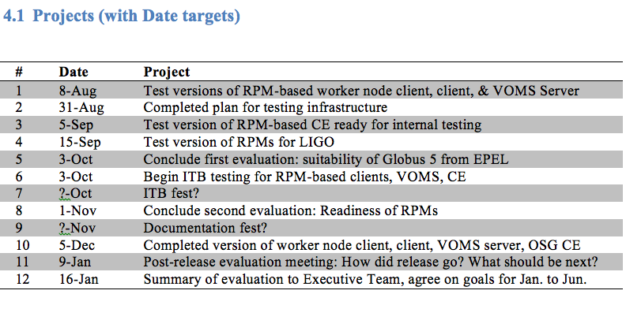
Software – Moving to RPM based distribution

Slide 25
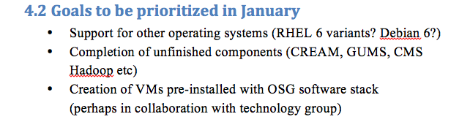
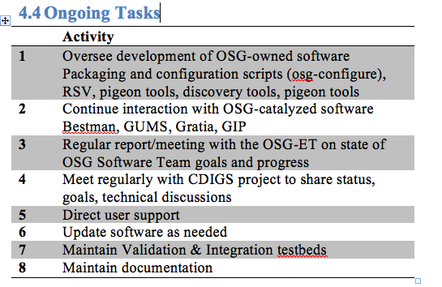

Slide 26

Staffing
Name | Percent | Duties
John Hover | 25% | Integration/Packaging
Xin Zhao | 25% | Integration/Packaging
Doug Strain | 50% | Software
Neha Sharma | 50% | Software
Igor Sfiligoi | 50% | Software/Evaluations
Alain Roy | 100% | Management/Requirements 50/50
Matyas Selmeci | 100% | Software
Scot Kronenfeld | 25% | Software
Tim Cartwright | 50% | Software
UW TBD | 100% | Software
Suchandra Thapa | 100% | Integration
UCSD | 50% | Evaluations, Haifeng Pi, Sanjay Padhi, Terrence Martin
Dan Fraser | 18.5% | Management/Coaching
All staff have responsibility for documentation, training and support.
Additional – timely and flexible - contributed effort from (ITB) site administrators at US CMS, US ATLAS, Caltech, Fermilab, key.
Additional contributions from VOs – ATLAS, CMS, DOSAR, SBGrid etc – very important.
Documentation, understanding, deployment, training - all important items on the docket.
Name | Percent | End Date | Duties
Alex Sim | 33% | Mar 2012 | Bestman support til Mar 2012
Brian Bockelman | 50% | Oct 2011 | Injected effort to help with RPM releases
Derek Weitzel | 75% | Sept 2011 | Injected effort to help with RPM releases
Robert Engel | 50% | Oct 2011 | Documentation oversight/coordination

Slide 27
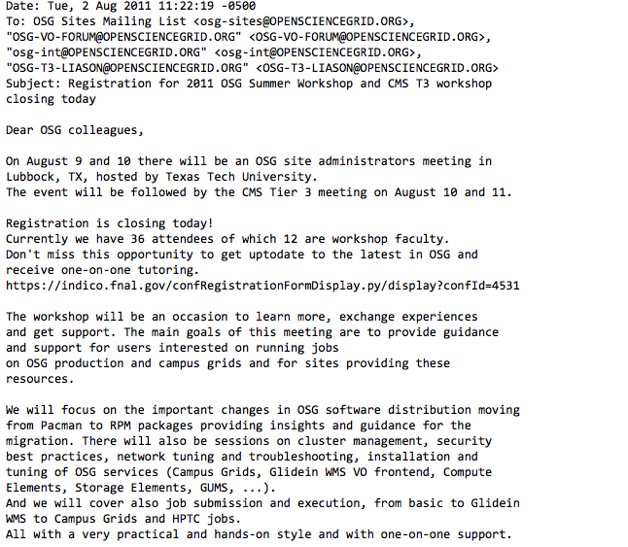

Slide 28
Make sure we are communicating with – trying to make sure all represented at the upcoming (User and Site) Summer Workshop (no particular order)
RENCI √
SBGRID
GRIDUNESP √
GRID COLOMBIA √
CONNECTICUT/Glue-X
ALICE
NYSGRID
SURAGRID
VT √
NERSC
ATLAS TIER-3s
CMS TIER-3s √
LIGO OSG SITES
KISTI √
ORNL
UJ
As well as Non-OSG users of VDT – APAC..

