Slide 1
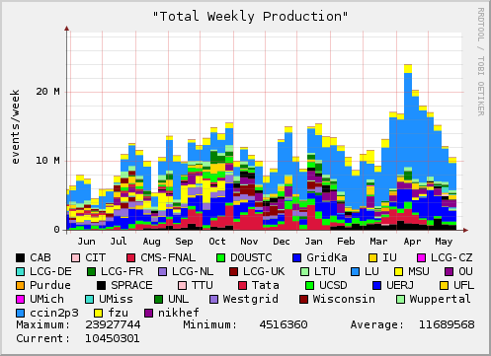
D0 Use of OSG
D0 relies on OSG for a significant throughput of Monte Carlo simulation jobs, will use it if there is another reprocessing needed, and is testing analysis on the infrastructure.
Average weekly OSG production for the past year is 3.4M events. The goal is to increase this to 5.0M events.
This is expected to continue for more than the next 2-3 years.
Efficiency is a large issue - in terms of use of useful throughput and effort.

Slide 2
Issues
The D0-OSG meeting raised several issues:
  Overall efficiency
  Difficulty of mining Condor-logs to diagnose problems on D0 SAMGrid submission nodes.
  Regular collection of D0 accounting to compare /check with OSG accounting information.
As a result:
D0 reports its successful throughput together with main issues weekly to the OSG-accounting-info mail readers.
  e.g. May 30th: Purdue has problem with number of files for DZero jobs. Only site with this problem. Stopped sending jobs there. Ticket was submitted. After negotiation DZero file quota was raised. Production not resumed yet.
Troubleshooting, Jamie Frey of Condor, helping with understanding /diagnosing problems on submission node.
D0 post more monitoring information which helps with identifying problem areas early.
D0 have identified that having local storage improves the efficiency of a site.

Slide 3
 | Number of Local Jobs | Code Application Efficiency | Use Local Storage | Overall Efficiency
grid1.oscer.ou.edu | 2605 | 0.305 | N | 0.305
tier2-01.ochep.ou.edu | 33 | 0.364 | N | 0.364
iut2-grid6.iu.edu | 1785 | 0.606 | Y | 0.484
msu-osg.aglt2.org * down due to power problems | 491 | None | Y | 0.000
caps10.phys.latech.edu | 279 | 0.248 | N | 0.098
abitibi.sbgrid.org | 5968 | 0.387 | N | 0.006
condor1.oscer.ou.edu | 7024 | 0.219 | N | 0.219
ouhep0.nhn.ou.edu | 511 | 0.949 | Y | 0.609
pg.ihepa.ufl.edu | 7036 | 0.226 | N | 0.226
hg.ihepa.ufl.edu | 1813 | 0.247 | N | 0.226
umiss001.hep.olemiss.edu | 1756 | 0.315 | N | 0.309
cit-gatekeeper.ultralight.org | 642 | None | N | 0.000
osg1.loni.org | 1452 | 0.267 | N | 0.267
red.unl.edu * authentication problem since fixed | 5214 | 0.297 | Y | 0.146
antaeus.hpcc.ttu.edu | 1962 | 0.248 | N | 0.098
d0cabosg2.fnal.gov | 9427 | 0.965 | Y | 0.718
osg-ce.sprace.org.br * not sure if local storage available to DZero because of CMS activities | 5121 | 0.246 | N | 0.152

Slide 4
Request for allocation of Local Storage
Statistics suggest that the efficiency increases by about a factor of two when there is a local Storage Element (SRM interfaced) - on the site LAN - where D0 data can be moved and then accessed by the application on the local worker nodes through the use of GridFTP.
The space needed is ~300 Gigabytes per site.
  D0 then manages this as part of the job submissions.
Have tested with dCache SEs, should work with Bestman and xrootd and D0 are happy to test with these if storage is available.

Slide 5
Request to Council
Are there additional sites where D0 can efficiently run?
Are there additional sites that can allocate and support D0 local and/or opportunistic storage ?

