Slide 1





NEES on the OSG Council What, why, what next.
Dr. Thomas Hacker
Co-Leader for Information Technology
George E. Brown Network for Earthquake Engineering Simulation
Assistant Professor, Computer & Information Technology
Purdue University, West Lafayette, Indiana
August 22, 2012
OSG Council Meeting
Fermi National Laboratory

Slide 2
Background
I have been a (proud) member of the OSG Council for the past couple of years as the latest “Purdue representative” but no clear mandate from the organization as a whole.
I am now available to commit on behalf of the NEESComm community to the OSG.

Slide 3
Why does NEES want to benefit from and contribute to OSG at this point in time?
One of main simulation applications OpenSEES used for serial or small-scale-parallel jobs most of the time.
NEES strategic objectives to increase support for simulation in the Earthquake Engineering community.
NEEScomm researchers and sites are distributed and the goals match OSG’s principles of distributed computing support.

Slide 4
NSF Network for Earthquake Engineering Simulation (NEES) Objectives
Develop a national, multi-user, research infrastructure to support research and innovation in earthquake and tsunami loss reduction
Create an educated workforce in hazard mitigation
Conduct broader outreach and lifelong learning activities

Slide 5
Letter of Collaboration between NEES and OSG
Intent for collaboration between NEEScomm and Open Science Grid (OSG)
Objectives
Provide continued access to OSG resources for NEES users through the NEEShub cyberinfrastructure
Seek to expand the community of earthquake engineering researchers who can use OpenSees and other computational simulation tools through the NEEShub
Continue to explore joint projects that provide mutual benefit to the OSG and NEES communities.

Slide 6
Big Focus on addressing Data Issues
Besides the need for computational throughput one of NEES biggest focuses is on managing, curating, providing access to and all activities related to diverse data.

Slide 7
NEES Project Data
Tremendous amounts and variety of data
Type of equipment at experimental facility site
E.g. shake table, wave basin
Unique to individual experiment
NEES sites utilize local data standards
Example project
Experimental and Analytical Investigation of Non-rectangular Walls under Multidirectional Loads
Dr. Catherine French, University of Minnesota
NEES project 22 in NEEShub
Video of experiment
http://www.youtube.com/user/neesit#p/a/660C7AFD70E81C12/1/fWNXMWX9X1o
Displacement increases over the course of the video
Video data is stored as a sequence of JPEG files in NEES repository

Slide 8
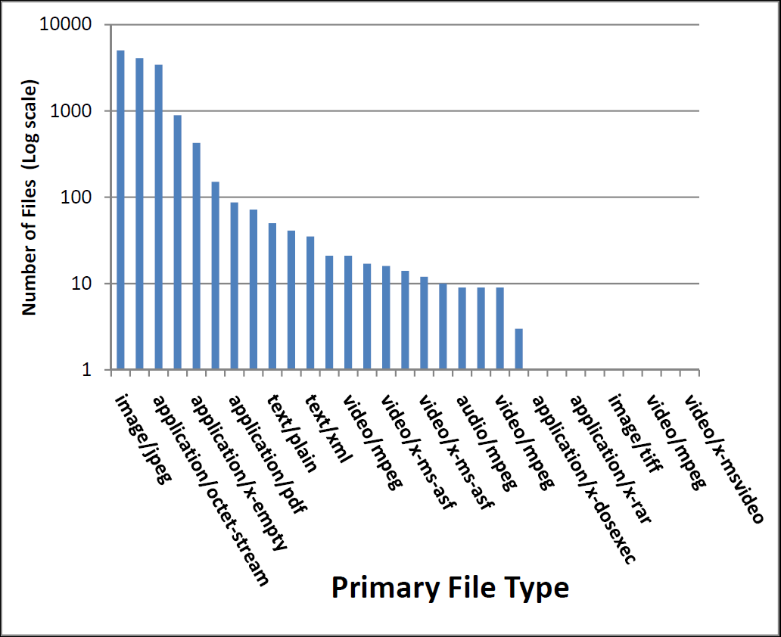
File types in a typical project
Generated using
FITS

Slide 9
Specific NEES Data Challenges
Need to support a variety of metadata and data formats that have been developed at the NEES sites over the years
Need to support bulk upload and download of thousands of files per project
Decrease the time needed to upload and download files from the central NEES repository
Ensure long term data viability and accessibility
Complexity of file types
Diversity of the community makes it difficult to proscribe a limited set of file types
Usability of the NEES cyberinfrastructure
Inherited legacy data and data formats

Slide 10
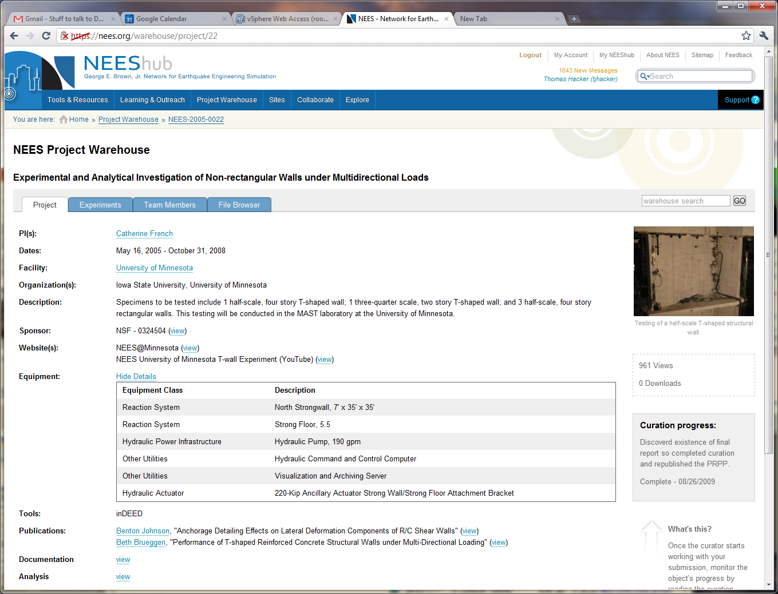

Slide 11
What Next?
NEES is at the OSG table as a member of the Consortium and Council for mutual benefit.
We want to collaborate on issues of Data as well as Computation.

