Slide 1
OSG Council, Aug 22nd -23rd 2012
Ruth Pordes, Council Chair

Slide 2
My Objectives for this Meeting
(1) Take concrete decisions towards ensuring the Council membership and agendas are truly representative of and focused on extending the mutual benefits of new communities (especially non-physics and campus) and the OSG.

Slide 3
My Objectives for this Meeting
(2) Hear about the work plans for OSG, our Satellites and our members.
Identify gaps in addressing the needs and objectives of members.
Decide on sub-groups of (delegees of) the Council to think about whether and/or how to address these gaps.

Slide 4
Background Information

Slide 5
Representative questions on the table (lets add to this list..)
Does the current Council representation move us forward most effectively to our vision and objectives?
Does the current Council structure make best use of our member contributions and energies?
What other services do we need to attract non-physics, small communities and/or individual campus researchers?
Are there communities we should be aiming to attract?
Why does it take 6 months for a “quorum” of sites to support a new VO?
How do we measure why a VO (GLOW) can only get 100,000 hours maximum across the production infrastructure when there are many more cycles available?
Should, and if so, how should the Consortium be engaging with industry?
What is the Consortiums strategy towards sustainability after the next 5 (or 3) years?
…

Slide 6
The Consortium Mission
The Open Science Grid (OSG) advances science through open distributed computing.
The OSG is a multi-disciplinary partnership to federate local, regional, community and national cyberinfrastructures to meet the needs of research and academic communities at all scales.

Slide 7
Consortium Members and Council Members
Consortium Members:
All organizations and their members who benefit from the OSG eco-system. Benefits include use of and/or contributions to one or more of the resources, the fabric of services, software, computer science experimentation, sociological study, etc.
Council Members:
Represent all Consortium Members. Are the most active contributors to the mission. Govern the Projects.

Slide 8
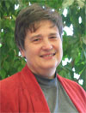
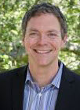


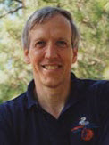
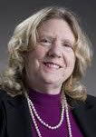
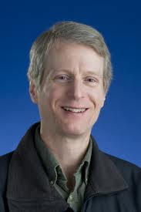
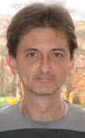
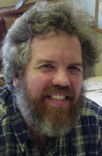
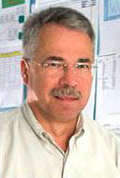
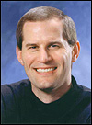
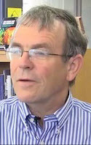
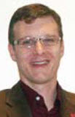
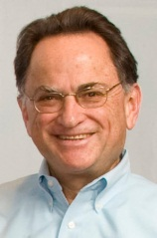
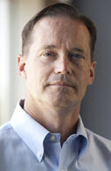


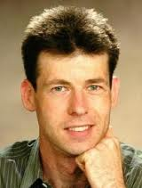
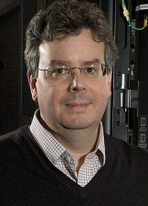
Makeup of the Council today
Ruth -
Chair
i
n
c
p
Piotr – SBGRID
Greg – ESNET
Ken – US CMS
c
p
c
p
p
Paul –
University of Florida
Jerome –
Star
Vicky (Rick) – Fermi
Bob –
US CMS
p
s
p
c
Michael –
BNL,
US ATLAS
n
Steve –
GLOBUS Alliance
Richard (TBD) – SLAC
David – Nebraska
c
s
c
c
p
p
c
Miron –
Condor project,
Wisconsin
Bill (Rob) Quick – Indiana
Brad (Rick) – Tevatron expts
e
n
p
Horst -
DOSAR
TBA
Jim –
US ATLAS
Tom –
NEES

Slide 9
Makeup of the Council today
c - campus – 4
c - campus in progress - 2
s - software projects - 2
i – infrastructure facility – 1
n – non-physics research community - 2
p – physics community – 8
e - education & outreach - 1

Slide 10
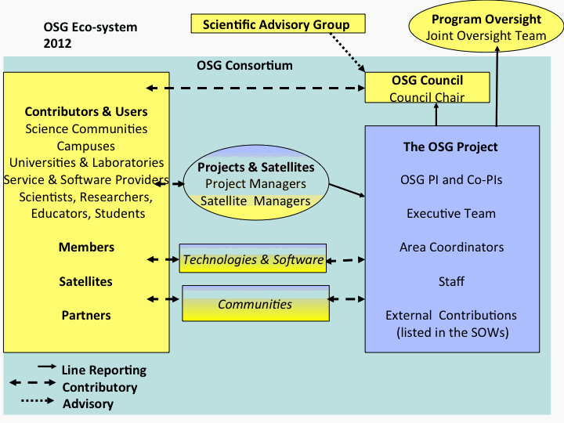
Consortium Organizational Structure (almost identical to 2006 diagram)

Slide 11
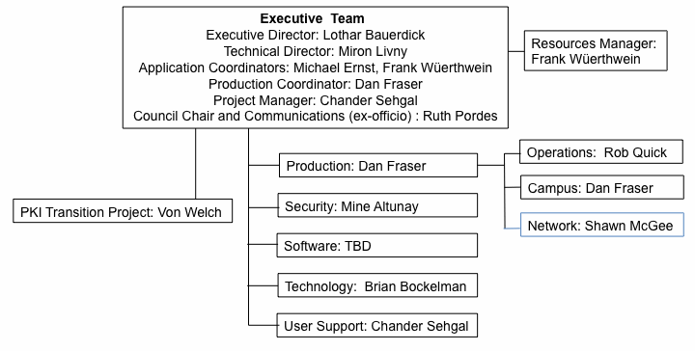
The Current Project Structure
Details of structure changed several times over the past 5 years in response changes in needs, plans and staffing.
Specific project to transition OSG PKI Certificate Authority service implementation from DOEGrids to OSG.
New network activity led by Shawn McGee of U Michigan, current activities:
Perfsonar toolkit – harden and deliver via VDT.
Modular Dashboard deployment and operation.
Link between OSG stakeholders & broader network monitoring efforts.

Slide 12
The Current Project Structure
c
Details of structure changed several times over the past 5 years in response changes in needs, plans and staffing.
p
s
p
p
eng
eng
p
eng
s
s
p
Specific project to transition OSG PKI Certificate Authority service implementation from DOEGrids to OSG.
New network activity led by Shawn McGee of U Michigan, current activities:
Perfsonar toolkit – harden and deliver via VDT.
Modular Dashboard deployment and operation.
Link between OSG stakeholders & broader network monitoring efforts.
s

Slide 13
Registered Communities/VOs
Accelerator
ALICE
Argoneut
ATLAS
belle
CDF
Cdms
CIGI
CMS
CompBioGrid
COUPP
CSIU
DayaBay
DES
DOSAR
DREAM
DZero
Engage
enmr.eu
ESGF
FermiGrid
Fermilab
LBNE
FermiTest
GCEDU
GCVO
geant4
GLOW
Gluex
gm2
GridUNESP
GROW
HCC
i2u2
IceCube
ILC
LBNE
LIGO
LSST
MAP
mars
MicroBooNE
Minerva
Miniboone
Minos
Mipp
MIS
Mu2e
nanoHUB
NEBioGrid
NEES
NERSC
Nova
Numi
NWICG
NYSGRID
Ops
OSG
OSGEDU Patriot
RSV
SBGrid
STAR superbvo.org SURAgrid Theory
VLab

Slide 14
VOs to consider for an increased participation ??
Other Campus Infrastructures (from https://www.opensciencegrid.org/bin/view/CampusGrids/DeployedCampusInfrastructures)
ALICE
belle
CIGI
CompBioGrid
DayaBay
DES
DREAM
enmr.eu
ESGF
LBNE
GCVO
Geant4
Gluex
GridUNESP
GROW
HCC
IceCube
ILC
LBNE
LIGO
LSST
nanoHUB
NEBioGrid
NEES
NERSC
NWICG
NYSGRID
superbvo.org SURAgrid
VLAB
UCSD
Purdue
Virginia Tech
Removed: communities on council already, Fermilab-local communities (to date), OSG “owned” VOs,

Slide 15
Strategy of Satellites and Docked Projects Remains
Eco-system made up of core OSG Project + Docked (essential) Projects + multiple funded Satellite projects + many many Contributions
Besides governing the whole WE the Council make the major Contributions – clearly this needs to be win-win
How do we strengthen and sustain this model of the Consortium? What other projects would benefit the stakeholders most?

Slide 16
Review status of OSG eco-system that we reported in Aug 2011 (composite)
The Americas:
GridUNESP
Colombia Grid
Action Item: Technical Director meeting with IRODS in July
International Project Possibilities with WLCG? LHC? Co-funded by EU and US?
European Grid
Initiative (EGI)
NEES &
NEESHub
Starting to show value to individual users of running simulations (OpenSees) on OSG.
Process of acceptance must be careful and slow.
eNMR structural biology VO working through SBGrid to enable bi-directional partnering across 2 infrastructures.
OSG
Campus
Infrastructures
OSG is an
XD –XSEDE
Service Provider
DOE/NSF aim to make cross agency MAGIC more useful?
Seat on the SP Forum.
Contributions from Campus Champions &
Advanced User Support. Sharing of Security Staff.
Possibility to participate in the Allocation Process
Common/collaborative support for such DES, LSST, NEES.
Condor receives
REDHAT award
Partner with more SciDAC-3 Institutes through InDHTC?
Extension of Data Transport collaborating with Globus Online

Slide 17
Representative questions on the table (lets add to this list..)
Does the current Council representation move us forward most effectively to our vision and objectives?
Does the current Council structure make best use of our member contributions and energies?
What other services do we need to attract non-physics, small communities and/or individual campus researchers?
Are there communities we should be aiming to attract?
Why does it take 6 months for a “quorum” of sites to support a new VO?
How do we measure why a VO (GLOW) can only get 100,000 hours maximum across the production infrastructure when there are many more cycles available?
Should, and if so, how should the Consortium be engaging with industry?
What is the Consortiums strategy towards sustainability after the next 5 (or 3) years?
…

