Slide 1
Education and OISE Activities
Michael Wilde – wilde@mcs.anl.gov
Computation Institute
Argonne National Laboratory and The University of Chicago
Open Science Grid Joint Oversight Team Meeting
February 20th 2007

Slide 2
OSG EOT Mission
Organize and deliver training for OSG
  OSG End Users -
  Site Administrators – requested but not yet staffed in the plan
  Support new communities / VOs joining OSG
Engage young people in (e)Science and CS
  Primary focus: undergraduate and early graduate students
  Reach high schools through I2U2 (QuarkNet follow-on)
  Promote and train in interdisciplinary collaboration
Reach out to under-represented communities
  Engage and assist minority students and minority serving institutions by providing resources and opportunities.
Reach out internationally
  Strengthen and assist emerging, underserved regions of strategic importance to form bonds to US science and Grid communities
  Focus (for outreach) is on Latin America and Africa
  OISE focus on engagement in Europe and Asia

Slide 3
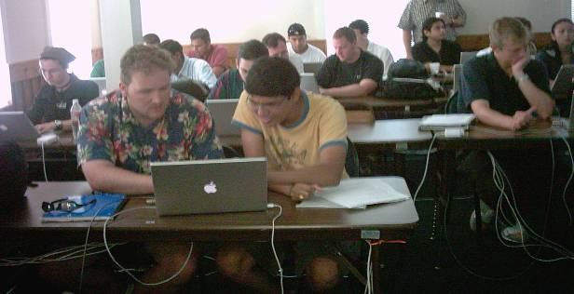
OSG EOT Program Overview
End User Education
  In-person workshops
  Online training
  EOT VO for student engagement, access and support
Community Outreach
  International student/faculty exchange via OISE
  Supporting under-represented and under-resourced communities in US, Latin America and Africa through workshops, technical assistance and grid access
  High School Education – I2U2 support - http://ed.fnal.gov/uueo/i2u2.html
Site Admin Training
  Training grid administrators in setup and support of OSG sites using the OSG/VDT software stack

Slide 4
EOT Staff and Resources
Resources
  Mike Wilde – 25% EOT coordination, 10% for management of I2U2
  Ben Clifford – 50% content prep and lab, presentation, meeting representation (ISSGC and EU efforts)
  Penelope Constanta, Fermilab – coordination
  Forrest Christian, Fermilab – Technical editing – a significant benefit to quality content.
  Operations group currently develops and presents grid site deployment and administration training.
  Significant effort has been/is contributed by other programs: CGWA, CHEPREO, Condor, Globus, GriPhyN, iVDGL, NMI Grids Center, TeraGrid
Seeking full-time coordinator
  Difficult to locate the right person for this
  We may determine that using shared staff is more effective
Costs of workshops
  Local students: $20/day per student
  Add travel: $500/workshop + $100/day per student.
    40 student workshop roughly $50K in student support
    Consider cost/benefit of the interaction it affords
  Support needed: travel & daily support for students.
  Currently funding this from UChicago staff and travel funds.

Slide 5
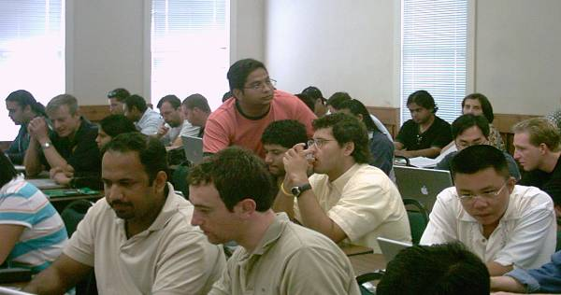
2007 Workshop Program
OSG Collaboration Meeting
  Mar 5-7; hands-on training for end users and site administrators
Argentine Grid Workshop
  March 12-14 at Santa Fe, http://escuelapav.ceride.gov.ar/
Midwest Grid Workshop
  March 24-25 at UIC, Jointly sponsored by UIC and Northwestern (R. Grossman, J. Mambretti)
South Africa Workshop
  I. Foster Grid lecture, March 27, IFIP School on Software Technology & Engineering, http://polelo.cs.up.ac.za/ISS2007
TeraGrid Conference
  Proposed hands-on workshops on Globus/Grid & Workflow
Southern Grid Workshop
  UTexas Brownsville (target), coord with UT-PanAm
  Shorter; regional focus; CS Department sponsorship
Great Plains Workshop
  Fall 2007 (target), 2-day, location TBD (UNebraska?)
Other 2-day workshops under consideration

Slide 6
Workshop Syllabus
Intro to distributed computing and the Grid
Grid security and basic Grid access
Grid resource and job management
Grid data management
Building, monitoring, maintaining & using Grids
Grid applications and frameworks
Workflow and related issues (scheduling, provenance)
Porting applications to the Grid (Lab, 2006)
Web services and the resource framework
Advanced networking; data mining (2007)
Notes:
Dual purpose moving forward

Slide 7
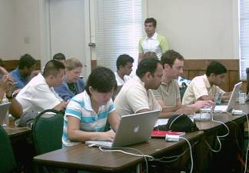
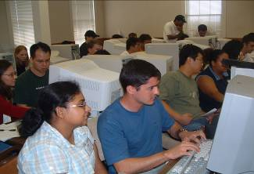
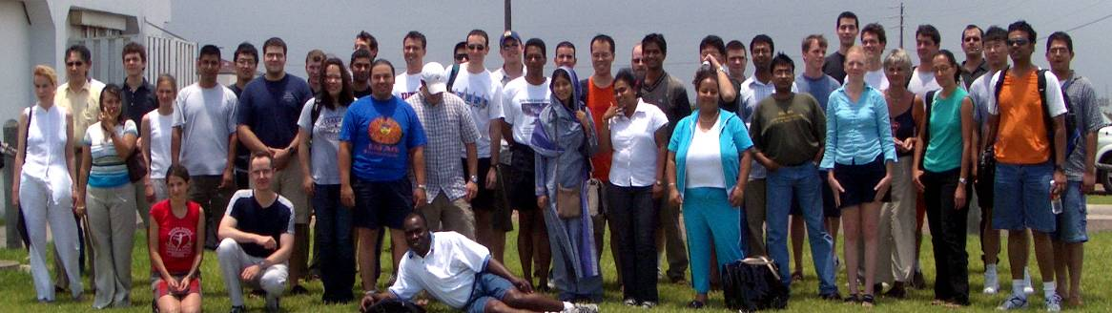
Students
2004:
  36 students from 19 universities, 4 MSIs
  4 international students (Brazil, Canada, Mexico, Russia)
  12 members of minority groups, 10 women
2005:
  42 students from 23 universities; 4 MSIs
  6 international students (Argentina, Brazil, India)
  16 members of minority groups, 10 women.
2006
  40 students from 24 universities; 5 MSIs
  4 International (Argentina, Columbia, Uruguay, New Zealand)
  2 students from Puerto Rico
  9 members of minority groups, 9 women
Note: Our teaching site was very space-limited; we had to stay below 40.
Notes:
Important demographic – 50% science apps – 50% computer science.
Broad range of sciences represented – from HEP to Earth Systems
Collaboration was one of the things we were striving to teach.

Slide 8
Student Survey Feedback
2006: 33 detailed surveys (out of 40 students)
Can now measure / compare workshops
Initial findings
  Students found the workshop very relevant to their work
  Hands-on lab sessions were very valuable
  Labs were valued more than lectures
  Interaction with other students was valued
  Most students want to follow on with further participation
  Detailed per-module feedback was provided
Key success metric: follow-on engagement

Slide 9
Content Enhancement
Lectures
  Add intro to distributed computing and systems
  Better Grid intro material with more pragmatic details
Lab Exercises
  Graduated exercises that provide more exploration and problem solving
  Examples that show real science challenges – enable students to translate to their own needs
  Use of realistic science data and applications

Slide 10
New Modules Planned
Technical content
  Campus Grid Deployment
  Portal usage and development
  Grid information systems
  Build / use own grid services in lab
  Connect to MPI and parallel programming
  More on storage management
  More on application deployment
Prerequisite training
  UNIX skills
  Networking concepts

Slide 11
Education VO
Wiki, email lists, followup discussions
Support, engagement
Continually posting opportunities to students
Create durable certs in workshops
Online lab facilities – sandboxed and “live” resources
Vetting/authorization for student users
Mentor pool and project idea bank

Slide 12
Self-paced / online instruction
Flexible roadmaps for navigating the material
Lab that (valid) students can access, any time
Lecture material needs to be made more book-like – must stand alone.
Provide good set of UNIX and Networking pre-reqs and reference materials
Thoughts about video/Flash-based tutorials
  Audio track and screen shots
Remote participation (partial / full ) is being considered for later years

Slide 13
International Outreach
South Africa Program
  Led by Jeremy Dodd, Columbia/ATLAS
  Providing mentorship to University of Witwatersrand, Johannesburg
  Grid site development
  Student mentorship; students/teachers to US Workshops to facilitate S. African workshops
  Ian Foster to lecture at Cape Town IFIP Workshop
South American Efforts
  Argentine Grid School, March 12-14 2007
  http://escuelapav.ceride.gov.ar/index.php?cursos=1
  http://twiki.grid.iu.edu/twiki/bin/view/Education/ArgentinaGridWorkshop
  Linking to HEP via Brazil, CHEPREO; Columbia.

Slide 14
OISE Interoperability Project
OSG-NorduGrid interoperability of applications and information systems
Interoperability of Information Services between the Open Science Grid and the European Grid infrastructures.
  Using “Glue Schema V1.3”
  bring the NorduGrid (NGDF) information structure to be compatible with EGEE and OSG,
  for delivery by the end of 2006.
  involves junior faculty from the University of Iowa (Shaowen Wang) and possibly the University of South Florida travelling to Lund University to work with the NGDF group.
  Part of the OSG External Project led by Gabriele Garzoglio, Fermilab
D0, LHC and IceCube applications running across the NorduGrid and OSG infrastructures.
  Junior faculty from the University of Wisconsin (coordinated through Albrecht Karleand) and the University of Maryland (coordinated through Nick Hadley and Greg Sullivan)
  The participants will travel to the Stockholm University for this collaboration.

Slide 15
OISE Grid Training
Students at the US Grid Workshops to attend the European International School on Grid Computing. ISSGC0x
Will select 5-7 alumni each year from the Grid Workshops to attend the International Summer school.
Students will attend both schools and provide a written report
  Students to present on the opportunities for using the results of their training.
  will use feedback on their experiences to make the US workshops more productive and effective Will encourage common training segments between the 2 Grid schools
Joint lectureships and material sharing / development efforts
Sponsor US junior faculty instructor at the International School (University of Chicago, ISI, Notre Dame, University of Wisconsin are potential participants.)

Slide 16
Conclusion
Workshop program diversifying in 2007
International outreach starting in South America, South Africa, and via OISE
Education VO starting to provide engagement and access to resources
Need to integrate Grid administration training and continue to integrate efforts with TeraGrid
Measurement tools for metrics improved, need further refinement

Slide 17
Supplementary Material

Slide 18
2006 Workshop Survey results (33 of 40 students)
Does your immediate work, or work planned in the near future, relate to Grid computing?
13 Yes, very much 14 Yes, to some extent 5 Not yet sure 1 No
How useful has this workshop been to you ?
11 Very useful 22 Useful 0 not very useful 0 not useful at all
Did the workshop give you ideas or techniques useful for your research?
2 No 31 Yes
How would you rate this workshop compared to similar workshops you have attended?
12 None to compare to 8 Similar 13 Better
Would you like to participate in similar workshops in the future?
24 Yes, very much 8 Yes, maybe 1 n/a
In what way would you like to participate?
6 Attend same workshop again
29 Attend a more advanced follow-on workshop
9 Develop/review/test lecture or lab material
9 Present lecture
9 Assist in lab
0 No interest in future Grid workshops

Slide 19
2006 Workshop Survey results (33 of 40 students)
Overall, did the lecturers communicate topics effectively?
14 Yes, very much 19 Yes
Were the assistants helpful during the hands-on sessions?
21 Yes, very much 11 Yes 1 not really
Did the curriculum provide a good general overview of Grid computing?
18 Yes, very good 15 Yes
Did the hands-on sessions help you to understand topics better?
18 Yes, very much 11 yes 3 not really 1 n/a
How valuable were the discussion sessions?
13 Very valuable 19 Moderately valuable 1 Not very valuable
How ample was the time provided for discussion?
1 Too little 30 About right 2 Too much
Would you like more time for running your own applications on the Grid?
9 No 23 Yes 1 n/a
The length of this workshop (1 week) was:
10 Too short 23 About right
Overall, the workshop was taught at a level that was:
30 About right 3 Too basic
Did you find it valuable to meet students from other schools?
1 No 32 Yes
Would you like to collaborate on projects with these students in the future?
3 No 30 Yes

