Slide 1

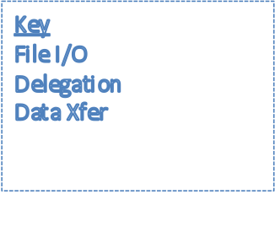
$VDT_LOCATION/vdt-app-data/globus/persisted/{ipaddr}/DelegationResource
grid-proxy-init
globusrun-ws
Delegation
Service
GRAM4
voms-proxy-init
$HOME/.globus/gram_job_proxy_*
/tmp/x509up_u${uid}
condor_submit
Condor-G
$CONDOR_LOCATION/local.*/spool/cluster*.proc*.subproc*/x509up*
GRAM2
globusrun
gsisshd
gsissh
gridftpd
globus-url-copy
/tmp/x509up_p*
gridftpd
$HOME/.globus/job/${HOSTNAME}/*/x509_up
process
file

