Slide 1
ATLAS Goals/Expectations for next 9 months
J. Shank
OSG Council
UCSD 8 March, 2007

Slide 2
ATLAS Needs
Computing System Commissioning (CSC) ongoing since early 2006
  Two new components of CSC looming:
    Calibration Data Challenge (until Sept. 2007)
    Full Dress Rehearsal (until Nov. 2007)
  Full Monte Carlo simulation/reconstruction of 30M events is still ongoing using all ATLAS resources (T1, T2)
    We expect this to be steady-state forever now
    Many problems:
      Event size too large (factor 5 over comp. Model)
      Simulation 4x slower than model
      ➔ huge strain on resources
Result: we need a LOT of CPU/disk from OSG!

Slide 3
ATLAS Needs from OSG
Upgrade to OSG 0.6
  ALL sites will do this, but we are discussing (today!) when we can do this with least disruption to ongoing production.
    Probably soon (<2 months)
Basic grid middleware functionality is already there
  PanDA built assuming we need to run now using scalable middleware, so we don’t depend on extensions to VDT
    But, we would like some and are working on Workflow Management System
Expand our involvement in Integration Test Bed
  We need to use this to test all our new components
Establish OSG Storage Element’s at all T2 sites
  SRM/dCache worries…

Slide 4
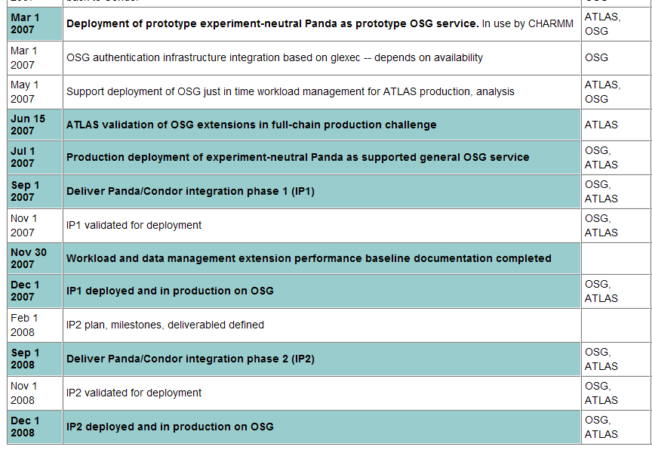
OSG Milestones
PanDA/OSG Milestones

