Slide 1
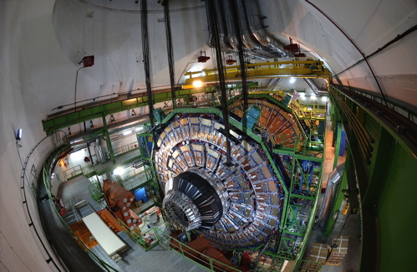


Analyzing Millions of Gigabyte of LHC Data for CMS
-
Discover the Higgs on OSG
Oliver Gutsche - CMS / Fermilab

Slide 2
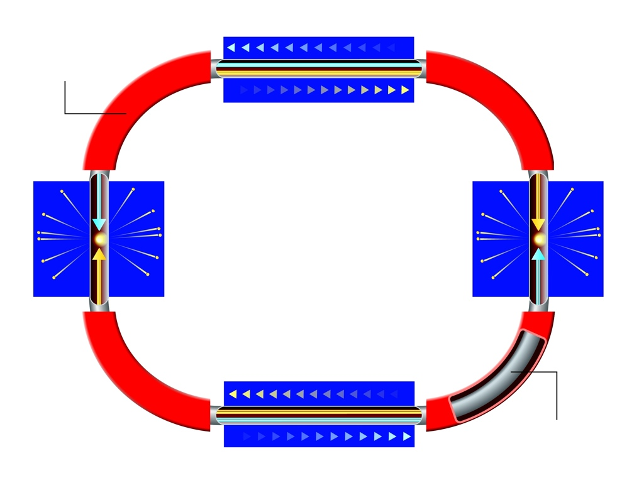
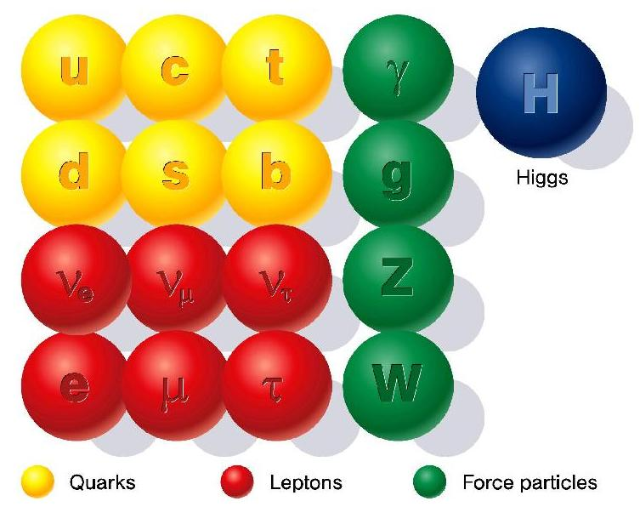
Particle Physics
Acceleration
Describe structure of matter using mathematical concepts: Standard Model
Higgs: concept to describe mass of particles
not discovered yet ➠ LHC
Deflection
Higher Energy
=
Smaller Objects
can be “seen”
Collision
Collision
Vacuum
Acceleration
Investigate structure of matter by
  Colliding elementary particles
  Detecting collision products

Slide 3
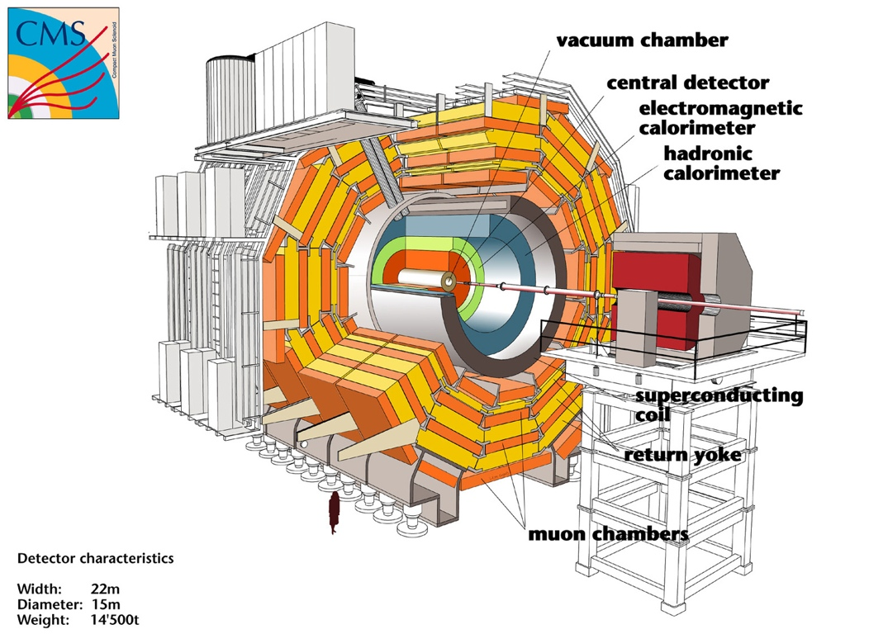
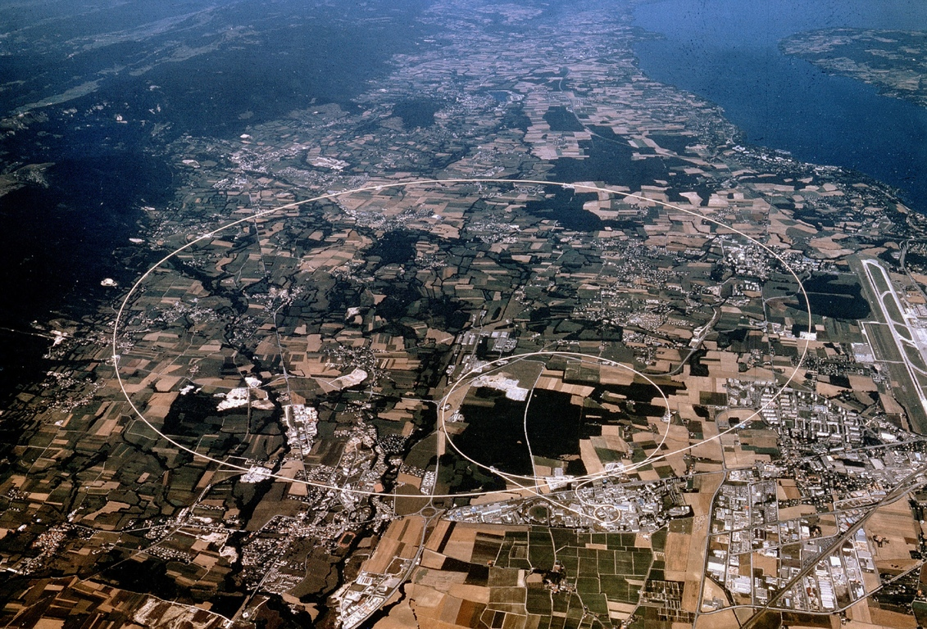
LHC and CMS
Large Hadron Collider at CERN, Geneva, Switzerland
  Proton-Proton collisions
  Beam energy: 7 Terra Electron Volts
    40 t truck hitting wall at 90 MPH
  Circumference: 27 km
Compact Muon Solenoid:One of 4 particle collision detectors at the LHC
Width: 22m, Diameter: 15m
Weight: 14,500 t
International collaboration of 2000 physicist

Slide 4
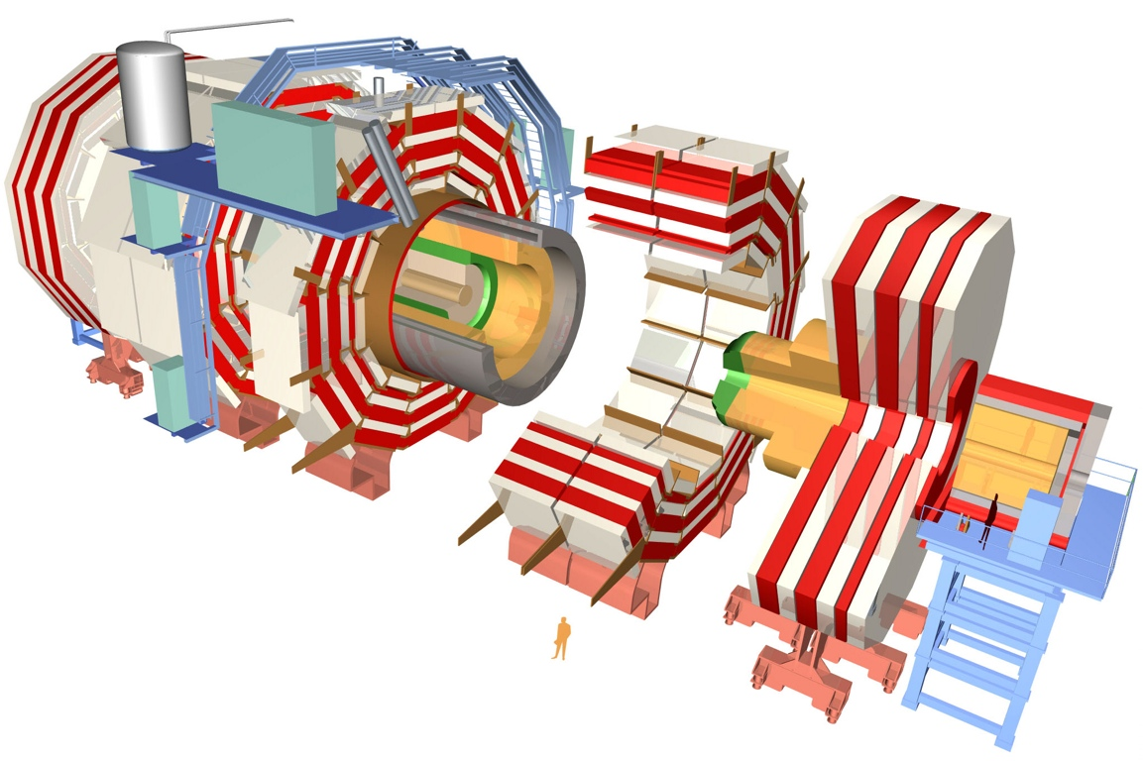
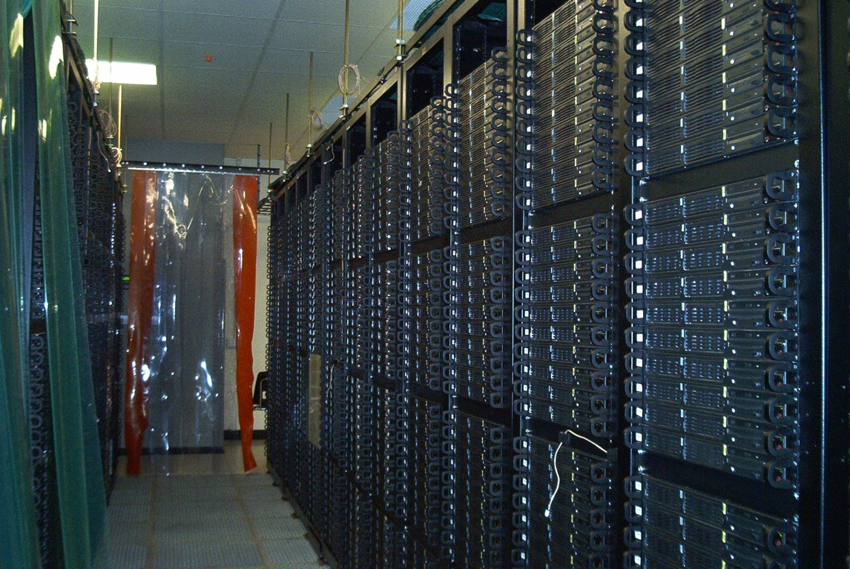
CMS Data Analysis
  Collisions occur at 40 MHz
  Trigger reduces to 150 Hz
  Output contains all recorded detector signals and derived information, called “Event”
  Events are analyzed separately (High degree of parallelization)
Estimated number of recorded and simulated events
2007: 300 million
2008: 3 billion
Peta-scale data volumes
2007: 640 TeraByte
2008: 6400 TeraByte
Data recording:
1.8 MB/evt.
Simulation:
2.5 MB/evt.

Slide 5
CMS Tier Structure
2000 physicists scattered around the globe want to analyze CMS data
Analysis is location driven
  “Job is sent where the data is stored.”
CMS follows GRID approach to distribute data storage and processing world-wide
USA
Recorded and simulated events
Distributed across all Tier 1 centers
Tier 1 main function:
Store events on tape for backup
Provide access to events
For extraction of sub-samples of analysis interests
Extracts of recorded and simulated events
Distributed between Tier 2 centers (several replicas)
Tier 2 main function:
Provide access to events
for user analysis
UK
Italy
France
GER
CERN
Spain
data recording
Taiwan
1 Tier 0
7 Tier 1
~25 Tier 2

Slide 6
Demonstration
https://twiki.cern.ch/twiki/bin/view/Main/MidWestGridWorkshop2007

