Slide 1
perfSONAR
August 9th 2011, OSG Site Admin Workshop
Jason Zurawski – Internet2 Research Liaison

Slide 2

Agenda
Tutorial Agenda:
  Network Performance Primer - Why Should We Care? (30 Mins)
  Introduction to Measurement Tools (20 Mins)
  Use of NTP for network measurements (15 Mins)
  Use of the BWCTL Server and Client (25 Mins)
  Use of the OWAMP Server and Client (25 Mins)
  Use of the NDT Server and Client (25 Mins)
  perfSONAR Topics (30 Mins)
  Diagnostics vs Regular Monitoring (20 Mins)
  Use Cases (30 Mins)
  Exercises
<number> – 11/08/26, © 2011 Internet2

Slide 3
Motivation – Possible Solutions
Finding a solution to network performance problems can be broken into two distinct steps:
  Use of Diagnostic Tools to locate problems
    Tools that actively measure performance (e.g. Latency, Available Bandwidth)
    Tools that passively observe performance (e.g. error counters)
  Regular Monitoring to establish performance baselines and alert when expectation drops.
    Using diagnostic tools in a structured manner
    Visualizations and alarms to analyze the collected data
Incorporation of either of these techniques must be:
  ubiquitous, e.g. the solution works best when it is available everywhere
  seamless (e.g. federated) in presenting information from different resources and domains
<number> – 11/08/26, © 2011 Internet2
Notes:
More examples of metrics of interest are around, these are the most popular.

Slide 4
Motivation – Possible Solutions
Desirable design features for any solution
  Component Based
    Functionality should be split into logical units
    Each function (e.g. visualization) should function through well defined communication with other components (e.g. data storage)
  Modular
    Monolithic designs rarely work
    Components allow choice of how to operate a customized end solution.
  Accessible
    Well defined interfaces (e.g. APIs)
Initial design should facilitate future expansion
<number> – 11/08/26, © 2011 Internet2
Notes:
While these are ‘desirable’, it can also be said that other solutions that do not incorporate these items will still work well. A monolithic solution can work well in isolation, but may fail to scale well.

Slide 5
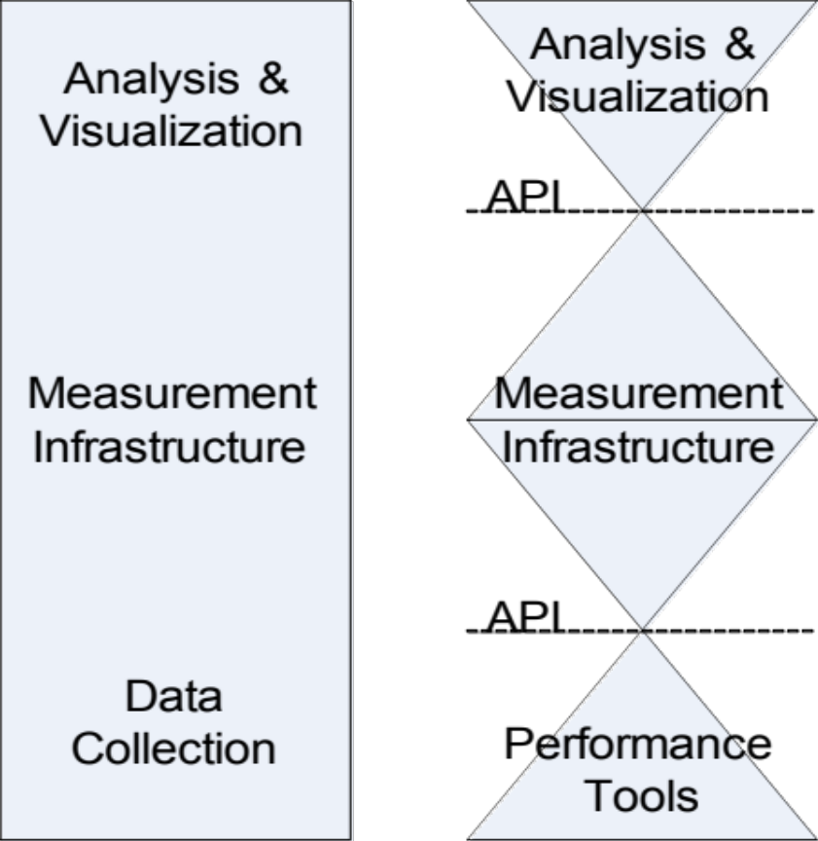
Motivation – Possible Solutions
<number> – 11/08/26, © 2011 Internet2
Notes:
Monolithic on the left. Component based, ‘open access’ on the right.

Slide 6
What is perfSONAR?
Most organizations perform monitoring and diagnostics of their own network
  SNMP Monitoring via common tools (e.g. MRTG, Cacti)
  Enterprise monitoring (e.g. Nagios)
Networking is increasingly a cross-domain effort
  International collaborations in many spaces (e.g. science, the arts and humanities) are common
  Interest in development and use of R&E networks at an all time high
Monitoring and diagnostics must become a cross-domain effort
  Complete view of all paths
  Eliminate “who to contact” and “what to ask for” - 24/7 availability of diagnostic observations
<number> – 11/08/26, © 2011 Internet2

Slide 7
What is perfSONAR?
A collaboration
  Production network operators focused on designing and building tools that they will deploy and use on their networks to provide monitoring and diagnostic capabilities to themselves and their user communities.
An architecture & set of communication protocols
  Web Services (WS) Architecture
  Protocols established in the Open Grid Forum
    Network Measurement Working Group (NM-WG)
    Network Measurement Control Working Group (NMC-WG)
    Network Markup Language Working Group (NML-WG)
Several interoperable software implementations
  perfSONAR-MDM
  perfSONAR-PS
A Deployed Measurement infrastructure
<number> – 11/08/26, © 2011 Internet2

Slide 8
perfSONAR Inception
perfSONAR originated from discussions between Internet2’s End-to-End Performance Initiative (E2Epi), and the Géant2 project in September 2004.
Members of the OGF’s (then GGF) NM-WG provided guidance on the encoding of network measurement data.
Additional network partners, including ESnet and RNP provided development resources and served as early adopters.
The first release of perfSONAR branded software was available in July 2006 (Java based software).
All perfSONAR branded software is open source
All products looking to be labeled as perfSONAR compliant must establish protocol compliance based on the public standards of the OGF
<number> – 11/08/26, © 2011 Internet2

Slide 9
Who is perfSONAR?
The perfSONAR Consortium is a joint collaboration between
  ESnet
  Géant
  Internet2
  Rede Nacional de Ensino e Pesquisa (RNP)
Decisions regarding protocol development, software branding, and interoperability are handled at this organization level
There are at least two independent efforts to develop software frameworks that are perfSONAR compatible.
  perfSONAR-MDM
  perfSONAR-PS
  Others? The beauty of open source software is we will never know the full extent!
Each project works on an individual development roadmap and works with the consortium to further protocol development and insure compatibility
<number> – 11/08/26, © 2011 Internet2

Slide 10
Who is perfSONAR-MDM?
perfSONAR-MDM is made up of participants in the Géant project:
  Arnes
  Belnet
  Carnet
  Cesnet
  CYNet
  DANTE
  DFN
  FCCN
  GRNet
  GARR
  ISTF
  PSNC
  Nordunet (Uninett)
  Renater
  RedIRIS
  Surfnet
  SWITCH
perfSONAR-MDM is written in Java primarily and was designed to serve as the monitoring solution for the Large Hadron Collider (LHC) project.
perfSONAR-MDM is available as Deb (Debian Compatible) and RPM (Red Hat Compatible) packages.
<number> – 11/08/26, © 2011 Internet2

Slide 11
Who is perfSONAR-PS?
perfSONAR-PS is comprised of several members:
  ESnet
  Fermilab
  Georgia Tech
  Indiana University
  Internet2
  SLAC
  The University of Delaware
perfSONAR-PS products are written in the perl programming language and are available for installation via source or RPM (Red Hat Compatible) packages
perfSONAR-PS is also a major component of the pS Performance Toolkit – A bootable Linux CD containing measurement tools.
<number> – 11/08/26, © 2011 Internet2

Slide 12
perfSONAR Adoption
perfSONAR is gaining traction as an interoperable and extensible monitoring solution
Adoption has progressed in the following areas:
  R&E networks including backbone, regional, and exchange points
  Universities on a national and international basis
  Federal labs and agencies in the United States (e.g. JET nets)
  Scientific Virtual Organizations, notably the LHC project
Recent interest has also accrued from:
  International R&E network partners and exchange points
  Commercial Providers in the United States
  Hardware manufactures
<number> – 11/08/26, © 2011 Internet2

Slide 13
perfSONAR Architecture Overview
Interoperable network measurement middleware designed as a Service Oriented Architecture (SOA):
  Each component is modular
  All are Web Services (WS) based
  The global perfSONAR framework as well as individual deployments are decentralized
  All perfSONAR tools are Locally controlled
  All perfSONAR tools are capable of federating locally and globally
perfSONAR Integrates:
  Network measurement tools and archives (e.g. stored measurement results)
  Data manipulation
  Information Services
    Discovery
    Topology
  Authentication and authorization
<number> – 11/08/26, © 2011 Internet2

Slide 14
perfSONAR Architecture Overview
The key concept of perfSONAR is that each entity (e.g. “services”) performs a function
  Each service provides a limited set of functionality, e.g. collecting measurements between arbitrary points or managing the registration and location of distributed services
  The service is a self contained and provides functionality on its own as well as when deployed with the remainder of the framework
Services interact through exchanges
  Standardized message formats
  Standardized exchange patterns (e.g. a communication protocol)
A collection of perfSONAR services within a domain is a deployment
  Deploying perfSONAR can be done À la carte, or through a complete solution
Services federate with each other, locally and globally
  Services are designed to automatically discover the presence of other perfSONAR components
  Clients are designed with this distributed paradigm in mind
<number> – 11/08/26, © 2011 Internet2

Slide 15
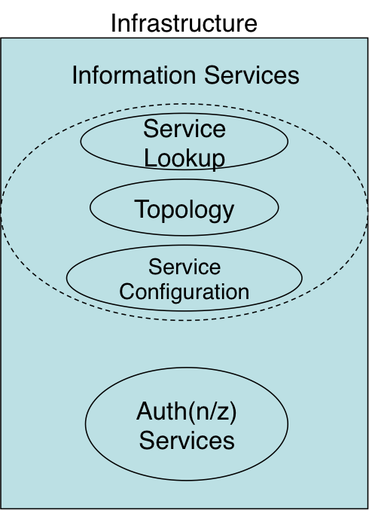
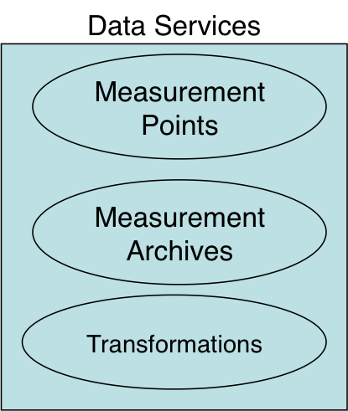
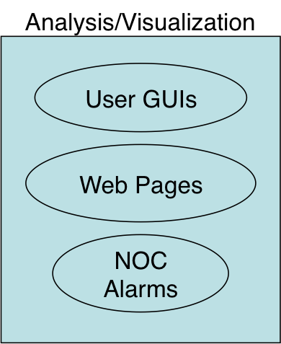
perfSONAR Architecture Overview
<number> – 11/08/26, © 2011 Internet2

Slide 16
perfSONAR Architecture Overview
A perfSONAR deployment can be any combination of services
  An instance of the Lookup Service is required to share information
  Any combination of data services and analysis and visualization tools is possible
perfSONAR services have the ability to federate globally
  The Lookup Service communicates with a confederated group of directory services (e.g. the Global Lookup Service)
  Global discovery is possible through APIs
perfSONAR is most effective when all paths are monitored
  Debugging network performance must be done end-to-end
  Lack of information for specific domains can delay or hinder the debug process
<number> – 11/08/26, © 2011 Internet2

Slide 17
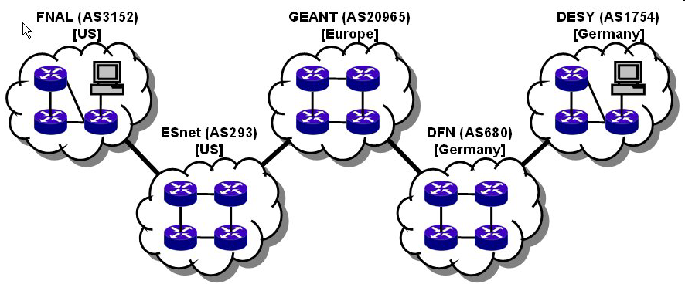


Many collaborations are inherently multi-domain, so for an end-to-end monitoring tool to work everyone must participate in the monitoring infrastructure
user
performance GUI
measurement archive
measurement archive
Analysis tool
measurement archive
measurement archive
m1
m1
m4
m1
m4
m4
measurement archive
m3
m3
m3
GEANT (AS20965)
[Europe]
m1
m4
DESY (AS1754)
[Germany]
FNAL (AS3152)
[US]
m1
m4
m3
ESnet (AS293)
[US]
DFN (AS680)
[Germany]
m3
<number> – 11/08/26, © 2011 Internet2

Slide 18
Service Oriented Architecture (SOA)
Measurement Point (MP) Service
  Enables the initiation of performance tests
Measurement Archive (MA) Service
  Stores and publishes performance monitoring results
Transformation Service
  Transform the data (aggregation, concatenation, correlation, translation, etc)
Resource protector
  Arbitrate the consumption of limited resources
  Other services delegate a limited portion of the authorization decision here
These services are specifically concerned with the job of network performance measurement and analysis
<number> – 11/08/26, © 2011 Internet2
Notes:
The services register themselves to the LS and mention their capabilities. They can also leave or be removed from a LS if a service gets down (keepalives).

Slide 19
Service Oriented Architecture (SOA)
Lookup Service
  Allows the client to discover the existing services and other LS services.
  Dynamic: services registration themselves to the LS and mention their capabilities, they can also leave or be removed if a service goes down.
Topology Service
  Make the network topology information available to the framework.
  Find the closest MP, provide topology information for visualisation tools
Authentication Service
  Authentication & Authorization functionality for the framework
  Users can have several roles, the authorization is done based on the user role.
  Trust relationship between networks
These services are the infrastructure concerned with discovering federating the available network services
<number> – 11/08/26, © 2011 Internet2
Notes:
The services register themselves to the LS and mention their capabilities. They can also leave or be removed from a LS if a service gets down (keepalives).

Slide 20
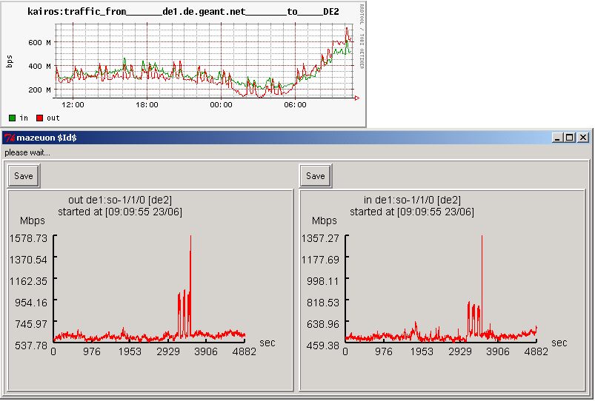
Service Oriented Architecture (SOA)
Where can I get more about
network Doman B/IP d,e,f and
Domain A/IP a,b,c?
gLS
Useful graph
LS A, LS B
Client
Where is link utilization for – IPs a,b,c?
a,b,c : Network A, MA A
Get link utilization d,e,f
Where is link utilization for - IPs d,e,f?
Get Link utilization a,b,c
Here you go
Here you go
d,e,f : Network B, MA B
LS A
MA A
LS B
MA B
a
b
e
f
c
d
Network A
Network B
<number> – 11/08/26, © 2011 Internet2

Slide 21
Architecture Overview - MP
Measurement Point (MP) form the lowest layer of the monitoring infrastructure
  Directly interacts with the measurement tool
  Can offer WS control over on-demand measurement
  Can offer interface to a regular scheduled measurements
Roles of the Measurement Point:
  Utilize well known tools to perform measurements
  Offer, at a minimum, cache storage of recently performed measurements
  Interact with Measurement Archives (MAs) to archive stored measurements
Examples:
  perfSONAR-BUOY (OWAMP and BWCTL Testing)
  PingER (Ping Testing)
  Command Line MP
<number> – 11/08/26, © 2011 Internet2

Slide 22
Architecture Overview - MA
Measurement Archive (MA) stores the results of network and performance measurements
  WS interface for storage and query
  Interacts with backend databases (e.g. SQL, RRD)
Roles of the Measurement Archive:
  Expose historical and current measurements of diverse types
  Draw data queries away from the Measurement Points (MPs)
Examples:
  perfSONAR-BUOY (OWAMP and BWCTL Data)
  PingER (Ping Data)
  SNMP MA/RRD MA
  Status MA
<number> – 11/08/26, © 2011 Internet2

Slide 23
Architecture Overview - TrS
The Transformation Service (TrS) performs operations on data sets (e.g. aggregation, correlation).
  WS interface
  Potential to store well known operations, and replay later
Roles of the Transformation Service:
  Draw complex statistical queries from Measurement Archives
  Provide a conduit for popular operations (e.g. running statistics over several changing dataset).
Examples (Planned):
  Path diagnostics tools
    Combining multiple metrics (network path, utilization, latency, bandwidth)
  Data presentation
    Statistical results for raw measurements.
<number> – 11/08/26, © 2011 Internet2

Slide 24
Architecture Overview - RP
The Resource Protector (RP) monitors the relative performance and availability of the monitoring infrastructure
  Knowledge of the services in a given deployment
  Defined policy regarding access and resources
Roles of the Resource Protector:
  Protects the time and resources of services from being overrun
    Too many queries from a single source
    Too much data for a given query
  Cooperate with the Authentication and Authorization (AA) entities
Examples (Panned):
  Data Protection
    Limits the size, duration, or frequency of a query
  Service Protection
    Limits access to functionality of the service
<number> – 11/08/26, © 2011 Internet2

Slide 25
Architecture Overview - LS
The Lookup Service (LS) is a general name for the service and and data discovery infrastructure
  Facilitates service and data discovery through the concept of registration
  “Summarizes” and distributes the job of location across layers of lookup
    Home Lookup Services – Local cache of data for several services
    Global Lookup Services – Works similar to DNS for locating information through general queries
Roles of the Lookup Service :
  Draws specific queries about the data and services away from the Measurement Points and Archives
  Distribute information globally based on local conditions
  Assure the ‘freshness’ of information in a dynamic infrastructure
<number> – 11/08/26, © 2011 Internet2

Slide 26
Architecture Overview - hLS
The Home Lookup Service (hLS) interacts directly with the other portions of the perfSONAR framework
  Recommended deployment is per domain
Accepts Registration information from around the framework
  E.g. An MA will register its name, location, and available metadata
  Metadata = static portion of a measurment (‘subject’, not results)
Responds to Queries about services and data
  Services looking for each other (e.g. MP looking for an MA)
  Client applications looking for data
<number> – 11/08/26, © 2011 Internet2

Slide 27
Architecture Overview - gLS
The Global Lookup Service (gLS) serves as the oracle of the perfSONAR framework
  Global cloud of services cooperating together to distribute information
  Manage the hLSs at the lower layer
Accepts Registration information from hLSs only(!)
  E.g. An hLS will register its name, location, and a summary of the services and data it contains
  Summary = condensed list of domains, ip addresses, data types
Responds to Queries about services and data
  Similar to hLS queries, but more focused on where instead of what
  Answer is typically an hLS to contact, not a direct result
<number> – 11/08/26, © 2011 Internet2

Slide 28
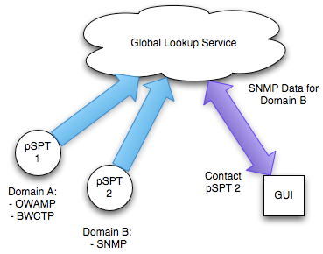
Architecture Overview – Lookup Service
<number> – 11/08/26, © 2011 Internet2

Slide 29
Architecture Overview - TS
The Topology Service (TS) gathers and stores network topology information similar to the Lookup Service (LS)
  Interfaces with external network tools (Dynamic Circuits, NOC databases)
  Provides a query interface
Rolls of the Transformation Service :
  Gather network topology from various sources
  Correlate information found in other TS sources to provide a complete view of network availability
  Interface with measurement tools to associate measurements with specific portions of the infrastructure
<number> – 11/08/26, © 2011 Internet2

Slide 30
Architecture Overview - AS
The Authentication and Authorization (AS) service serves as a front end for identity management.
  Identity management relies on assigning roles to a given user via attributes, e.g. permission to do something
  The AS will communicate via WS with a client and pass along credentials in order to validate an action or task
  The AS will protect access to services and data
Rolls of the Authentication Service :
  Validate services and clients given credentials
  Act on behalf of the users to acquire the necessary permissions
<number> – 11/08/26, © 2011 Internet2

Slide 31
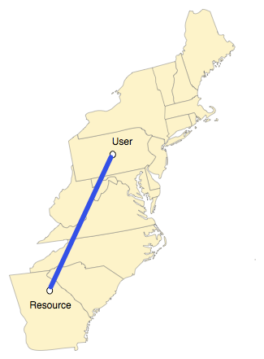
Example perfSONAR Use Case
perfSONAR should be used to diagnose an end-to-end performance problem
  User is attempting to download a remote resource
  Resource and user are separated by distance
  Both are assumed to be connected to high speed networks
Operation does not go as planned, where to start?
<number> – 11/08/26, © 2011 Internet2

Slide 32
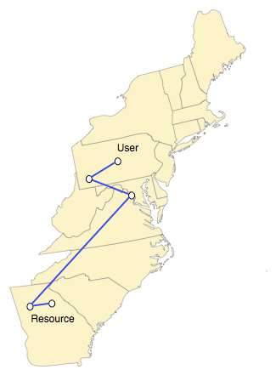
Example perfSONAR Use Case
Simple tools like traceroute can be used to determine the path traveled
There could be a performance problem anywhere in here
The problem may be something we could fix, but the chances are greater that it is not
<number> – 11/08/26, © 2011 Internet2
Notes:
Asymmetric routing may be worth mentioning here…

Slide 33
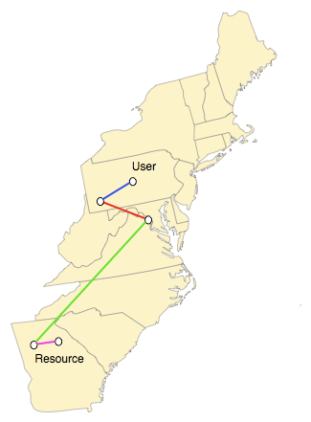
Example perfSONAR Use Case
Each segment of the path is controlled by a different domain.
Each domain will have network staff that could help fix the problem, but how to contact them?
All we really want is some information regarding performance
<number> – 11/08/26, © 2011 Internet2
Notes:
Federation is key – and this is the normal situation due to global and regional science.

Slide 34
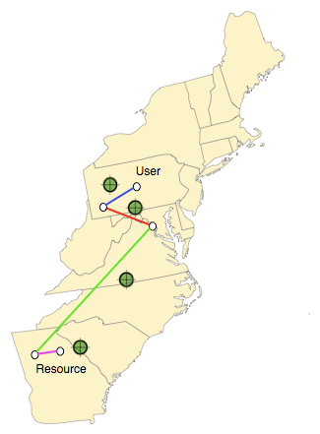
Example perfSONAR Use Case
Each domain has made measurement data available via perfSONAR
The user was able to discover this automatically
Automated tools such as visualizations and analyzers can be powered by this network data
<number> – 11/08/26, © 2011 Internet2
Notes:
Discovery via Information Services

Slide 35

Example perfSONAR Use Case
In the end, the problem is isolated based on testing.
  May have gone unnoticed in some cases (e.g. a “soft failure”)
  Could have been observed by many others … that didn’t think to report it
The user (or operations staff) can contact the domain in question to inquire about this performance problem
When fixed the transfer should progress as intended
<number> – 11/08/26, © 2011 Internet2

Slide 36
Deploying a Service
A perfSONAR service is deployed alongside the measurement infrastructure
Interactions with the lookup service and clients are described
<number> – 11/08/26, © 2011 Internet2

Slide 37
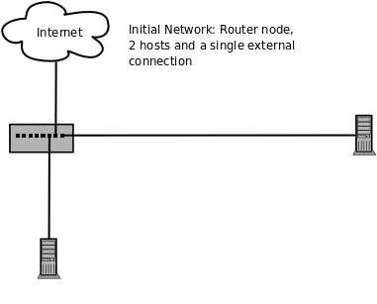
Deploying a Service
<number> – 11/08/26, © 2011 Internet2

Slide 38
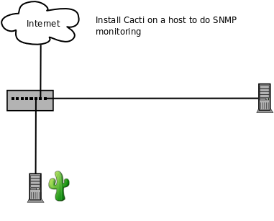
Deploying a Service
<number> – 11/08/26, © 2011 Internet2

Slide 39
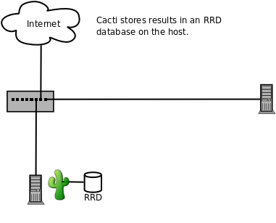
Deploying a Service
<number> – 11/08/26, © 2011 Internet2

Slide 40
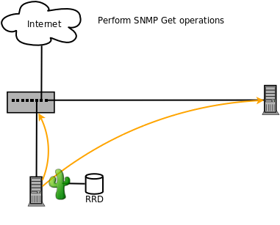
Deploying a Service
<number> – 11/08/26, © 2011 Internet2

Slide 41
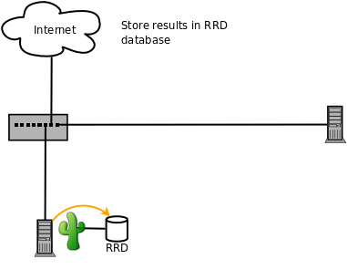
Deploying a Service
<number> – 11/08/26, © 2011 Internet2

Slide 42
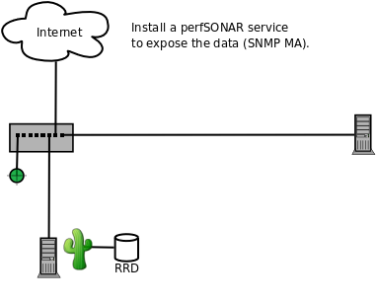
Deploying a Service
<number> – 11/08/26, © 2011 Internet2

Slide 43
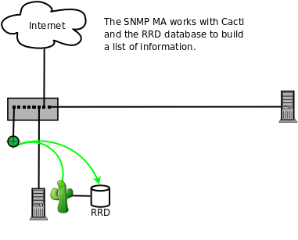
Deploying a Service
<number> – 11/08/26, © 2011 Internet2

Slide 44
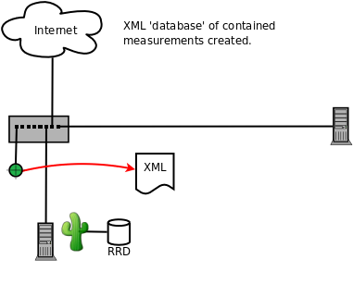
Deploying a Service
<number> – 11/08/26, © 2011 Internet2

Slide 45
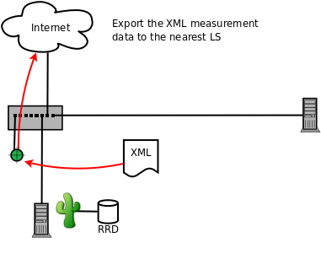
Deploying a Service
<number> – 11/08/26, © 2011 Internet2

Slide 46
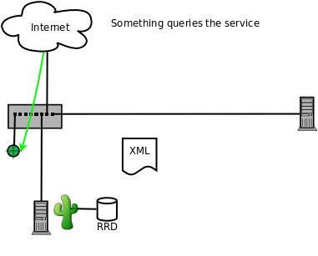
Deploying a Service
<number> – 11/08/26, © 2011 Internet2

Slide 47
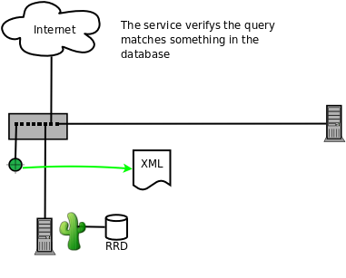
Deploying a Service
<number> – 11/08/26, © 2011 Internet2

Slide 48
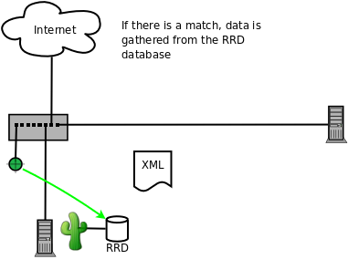
Deploying a Service
<number> – 11/08/26, © 2011 Internet2

Slide 49
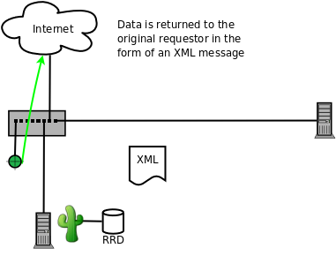
Deploying a Service
<number> – 11/08/26, © 2011 Internet2

Slide 50
Lookup Service Interaction
Services register with an hLS
hLSs summarize what they know and pass to the gLSs
gLSs exchange the information as needed
Clients will need a multi-step process to find information
  Query the gLS
  Query the appropriate hLS
  Query the appropriate services
<number> – 11/08/26, © 2011 Internet2

Slide 51
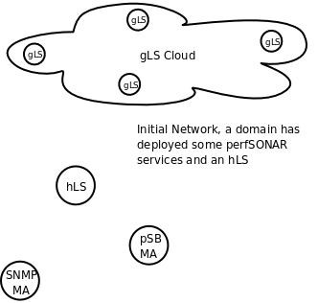
Lookup Service Interaction
<number> – 11/08/26, © 2010 Internet2

Slide 52
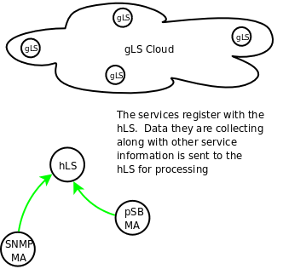
Lookup Service Interaction
<number> – 11/08/26, © 2010 Internet2

Slide 53
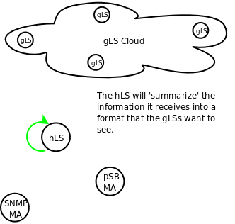
Lookup Service Interaction
<number> – 11/08/26, © 2010 Internet2

Slide 54
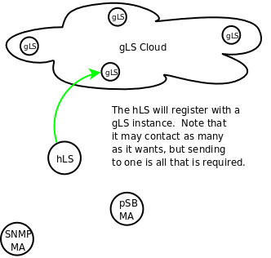
Lookup Service Interaction
<number> – 11/08/26, © 2010 Internet2

Slide 55
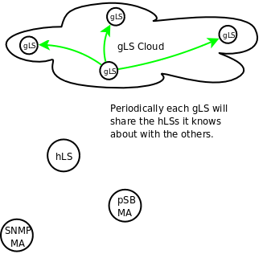
Lookup Service Interaction
<number> – 11/08/26, © 2010 Internet2

Slide 56
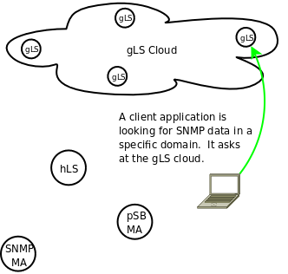
Lookup Service Interaction
<number> – 11/08/26, © 2010 Internet2

Slide 57
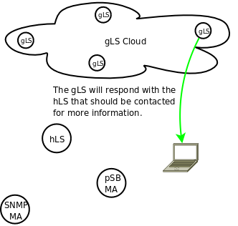
Lookup Service Interaction
<number> – 11/08/26, © 2010 Internet2

Slide 58
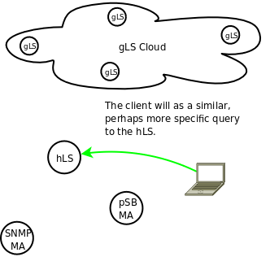
Lookup Service Interaction
<number> – 11/08/26, © 2010 Internet2

Slide 59
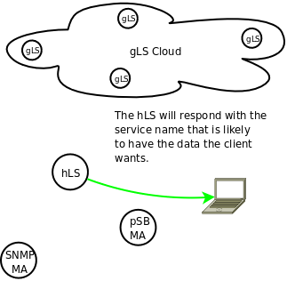
Lookup Service Interaction
<number> – 11/08/26, © 2010 Internet2

Slide 60
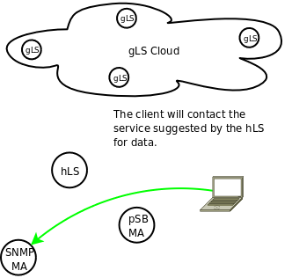
Lookup Service Interaction
<number> – 11/08/26, © 2010 Internet2

Slide 61
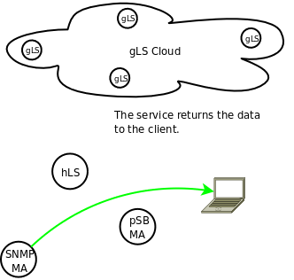
Lookup Service Interaction
<number> – 11/08/26, © 2010 Internet2

Slide 62
perfSONAR-PS Availability
perfSONAR-PS is an implementation of the perfSONAR measurement infrastructure and protocols written in the perl programming language
All products are available as platform and architecture independent source code.
All products are available as RPMs (e.g. RPM Package Manager). The perfSONAR-PS consortium directly supports the following operating systems:
  CentOS (version 5)
RPMs are compiled for the x86 (should work w/ x86 64 bit) architecture.
Functionality on other platforms and architectures is possible, but not supported. Attempts are done at the user’s own risk.
  Should work:
    Scientific Linux (versions 4 and 5)
    Red Hat Enterprise Linux (versions 4 and 5)
  Harder, but possible:
    Fedora Linux (any recent version)
    SuSE (any recent version)
    Debian Variants (…)
<number> – 11/08/26, © 2011 Internet2

Slide 63
perfSONAR-PS Availability
The pS Performance Toolkit (pSPT) is a Linux ISO image (e.g. a LiveCD) packed by Internet2 for both easy of installation and configuration of performance tools
  Prior:
    Based on Knoppix Linux
  Current:
    Based on CentOS (version 5) Linux
  Designed for x86 architecture
  No explicit support for x86 64 bit but compatibility is expected
Product also contains other relevant measurement tools and perfSONAR-PS dependencies.
Support structure is limited to the following goals:
  Updated versions of all software (operating system and performance) with each release
  Monitoring and alerts regarding critical security vulnerabilities for all software. Critical patches and releases available for severe cases
  Semi annual (4 times per year) minor releases
<number> – 11/08/26, © 2011 Internet2

Slide 64
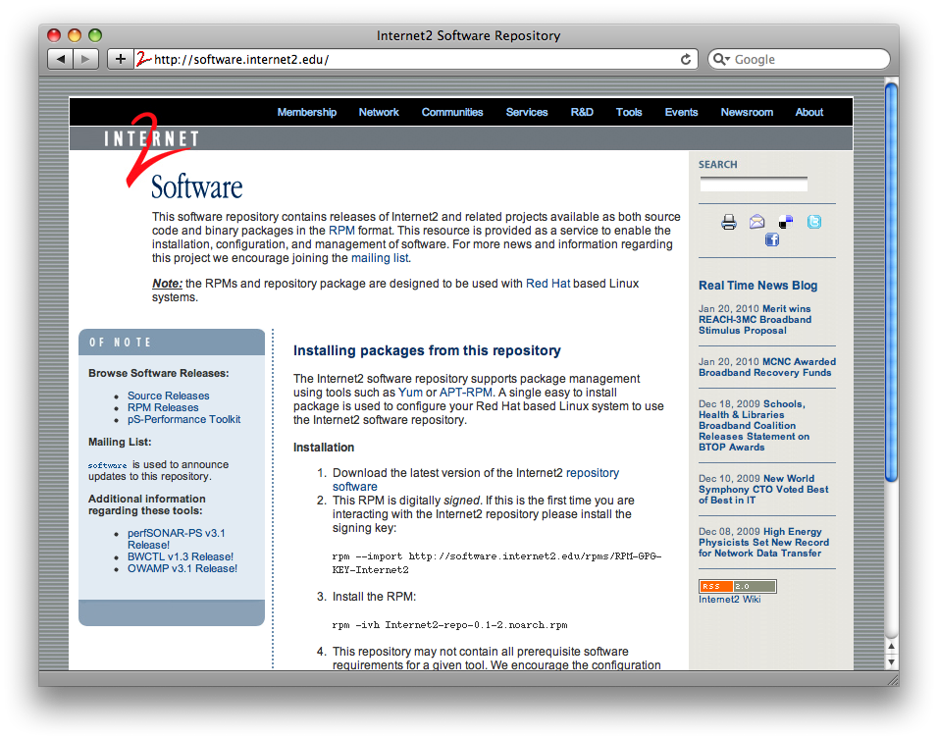
perfSONAR-PS Availability
perfSONAR-PS and the pSPT are available from http://software.internet2.edu
<number> – 11/08/26, © 2011 Internet2

Slide 65
perfSONAR-PS Availability
To facilitate installation and updates on the supported platforms, installation is available through several package managers:
  YUM
  Up2date
  APT-RPM
Instructions to enable are available on http://software.internet2.edu
Installing software becomes a simple one step operation
  Dependencies are managed by the operating system
  Software is identified by name, and can be searched for
<number> – 11/08/26, © 2011 Internet2

Slide 66
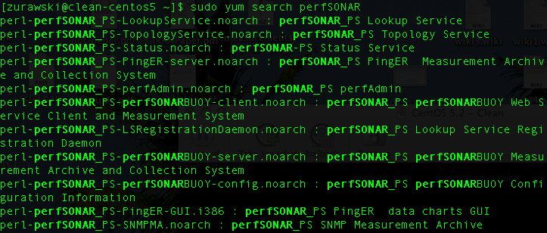
perfSONAR-PS Availability
Using YUM to search for packages:
<number> – 11/08/26, © 2011 Internet2

Slide 67
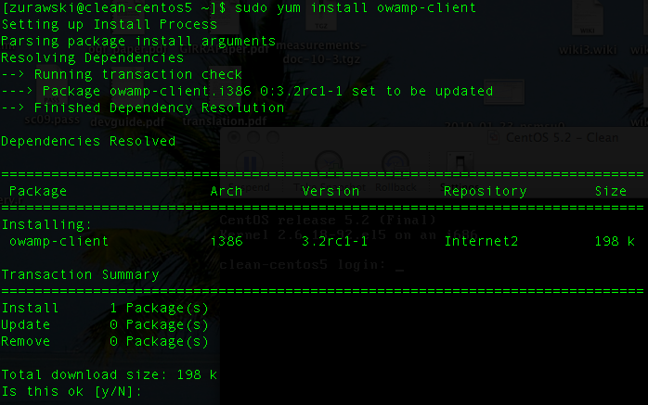
perfSONAR-PS Availability
Using YUM to install packages:
<number> – 11/08/26, © 2011 Internet2

Slide 68
perfSONAR-PS Availability
perfSONAR-PS is working to build a strong user community to support the use and development of the software.
perfSONAR-PS Mailing Lists
  Users List: https://mail.internet2.edu/wws/subrequest/perfsonar-ps-users
  Announcement List: https://mail.internet2.edu/wws/subrequest/perfsonar-ps-announce
pSPT Mailing Lists
  Users List: https://mail.internet2.edu/wws/subrequest/performance-node-users
  Announcement List: https://mail.internet2.edu/wws/subrequest/performance-node-announce
<number> – 11/08/26, © 2011 Internet2

Slide 69
perfSONAR-PS Tools
perfSONAR-PS Tools can be broken into 3 categories:
  Measurement Points and Archives
  Information Services
  Analysis tools and GUIs
The following sections will explain the differences between the categories as well as describe the utility each offers.
Development on perfSONAR-PS continues to be active and new services are added over time
Contributions from the community with regards to ideas or development work are encouraged
<number> – 11/08/26, © 2011 Internet2

Slide 70
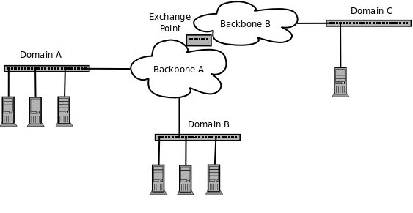
perfSONAR-PS Framework Deployment
<number> – 11/08/26, © 2011 Internet2

Slide 71
perfSONAR-PS Tools - MAs
Measurement Archives store the results of measurements
  Results can come from external sources (e.g. Cacti, MRTG, Cricket)
  Results can come from a perfSONAR MP performing measurements
Designed to run on any machine
  Should be located in the same physical domain, but this is not a requirement
Examples in perfSONAR-PS
  SNMP MA: Results of SNMP collection (interface counters, etc.)
  Status MA: Results of TL1 collection (optical devices)
  perfSONAR-BUOY: OWAMP and BWCTL (one way latency and bandwidth testing) results
  PingER: Ping (round trip latency) results.
<number> – 11/08/26, © 2011 Internet2

Slide 72
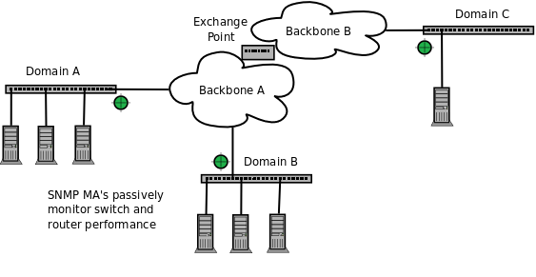
perfSONAR-PS Framework Deployment
<number> – 11/08/26, © 2011 Internet2

Slide 73
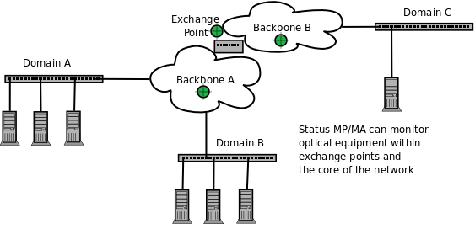
perfSONAR-PS Framework Deployment
<number> – 11/08/26, © 2011 Internet2

Slide 74
perfSONAR-PS Tools - MPs
Measurement Points perform measurements and store the results locally, or in Measurement Archives
  Perform on-demand testing
  Perform test according to a schedule
Designed to run on any machine
  Should be located in the same physical domain, but this is not a requirement
Examples in perfSONAR-PS
  Status MA Scripts: Gather TL1 or SNMP results.
  perfSONAR-BUOY: OWAMP and BWCTL (one way latency and bandwidth testing) scheduled testing
  PingER: Ping (round trip latency) scheduled testing.
<number> – 11/08/26, © 2011 Internet2

Slide 75
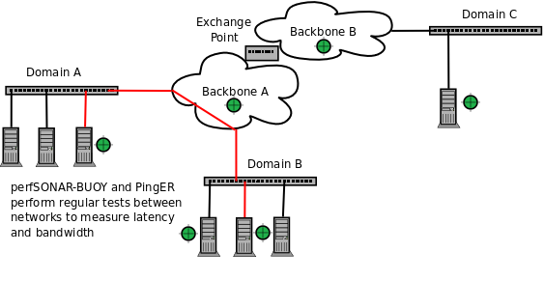
perfSONAR-PS Framework Deployment
<number> – 11/08/26, © 2011 Internet2

Slide 76
perfSONAR-PS Tools - IS
Information services are the glue of the framework
  Collect statistics and status of deployed services
  Answer queries from clients and services
  Allow for federation, e.g. the sharing of information across domains
Designed to run on any machine
  Must be located in the same physical domain
Examples in perfSONAR-PS
  Lookup Service: Manages service and data locality
  Topology Service: Manages topological knowledge for a domain
<number> – 11/08/26, © 2011 Internet2

Slide 77
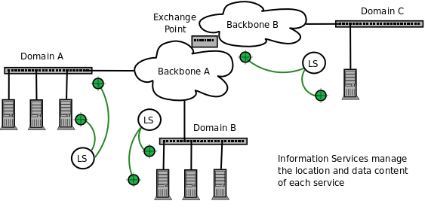
perfSONAR-PS Framework Deployment
<number> – 11/08/26, © 2011 Internet2

Slide 78
perfSONAR-PS Tools - GUIs
Analysis tools and GUIs plot data from perfSONAR services.
  Utilize the IS infrastructure to locate specific data
  Communicate with MAs to gather data
  Communicate with MPs to perform live tests
Designed to run on any machine
Examples in perfSONAR-PS
  perfAdmin: CGI scripts to locate and manage perfSONAR services and data
  PingER GUI: Displays the results of PingER testing
<number> – 11/08/26, © 2011 Internet2

Slide 79
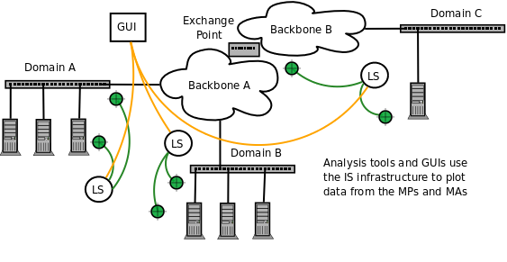
perfSONAR-PS Framework Deployment
<number> – 11/08/26, © 2011 Internet2

Slide 80
perfSONAR-PS Utility
perfSONAR-PS appeals to both network users and operators:
  Operators:
    Easy deployment
    Minimal maintenance
    Results relevant to common problems (e.g. connectivity loss, equipment failure, performance problems)
  Users:
    Immediate access to network data
    Cross domain capabilities
Adoption is spreading to networks of all sizes
The perfSONAR-PS framework has two primary high level use cases:
  Diagnostic (e.g. on-demand) use
  Monitoring Infrastructure
<number> – 11/08/26, © 2011 Internet2

Slide 81
perfSONAR-PS Utility - Diagnostics
The pS Performance Toolkit was designed for one-off diagnostic use
  All tools preconfigured
  Minimal installation requirements
  Can deploy multiple instances for short periods of time in a domain
Enhancements to the original design also allow for use in regular monitoring.
Other perfSONAR-PS and performance tools can function in the same role as the toolkit
  Requires longer installation/configuration phase
  Requires semi-permanent home for services
<number> – 11/08/26, © 2011 Internet2

Slide 82
perfSONAR-PS Utility - Monitoring
Regular monitoring is an important design consideration for perfSONAR-PS tools
  perfSONAR-BUOY and PingER provide scheduling infrastructure to create regular latency and bandwidth tests
  The SNMP MA integrates with COTS SNMP monitoring solutions
The pSPT is capable of organizing and visualizing regular tests
NAGIOS can be integrated with perfSONAR-PS tools to facilitate alerting to potential network performance degradation
<number> – 11/08/26, © 2011 Internet2

Slide 83
For more information
General and MDM impelmentation: http://www.perfsonar.net
The PS implementation: http://psps.perfsonar.net
perfSONAR-PS tools and software: http://software.internet2.edu
A hook to the global lookup service:
http://www.perfsonar.net/activeServices/IS/
More human-readable list of services:
http://www.perfsonar.net/activeServices/
<number> – 11/08/26, © 2011 Internet2

Slide 84
Mailing Lists
Development (by approval of the project)
  https://lists.internet2.edu/sympa/subscribe/perfsonar-dev
User Support
  https://lists.internet2.edu/sympa/subscribe/perfsonar-ps-users
  https://lists.internet2.edu/sympa/subscribe/performance-node-users
Announcements
  https://lists.internet2.edu/sympa/subscribe/perfsonar-ps-announce
  https://lists.internet2.edu/sympa/subscribe/performance-node-announce
Working Groups
  https://lists.internet2.edu/sympa/subscribe/performance-wg
  https://lists.internet2.edu/sympa/subscribe/is-wg
  http://www.ogf.org/mailman/listinfo/nm-wg
  http://www.ogf.org/mailman/listinfo/nmc-wg
  http://www.ogf.org/mailman/listinfo/nml-wg
<number> – 11/08/26, © 2011 Internet2

Slide 85
perfSONAR
August 9th 2011, OSG Site Admin Workshop
Jason Zurawski – Internet2 Research Liaison
For more information, visit http://www.internet2.edu/workshops/npw
<number> – 11/08/26, © 2011 Internet2

Slide 86
perfSONAR Adoption
Networks
  US National R&E Networks
    ESnet, Internet2, NLR, NOAA
  International R&E Networks/Exchange Points
    APAN NOC, CSTNET, GEANT (and NREN Partners), Gloriad, JGN2, JPNet, KRNET, MANLAN, Starlight, TransPac2, RNP
  US Regional R&E Networks
    CENIC, CIC OmniPoP, Florida LambdaRail, Front Range GigaPoP, GPN, Indiana GigaPoP, LEARN, LONI, MAX, MCNC, Merit, MOREnet, Northern Lights GigaPoP, NOX, NYSERNet, OARnet, Pacific Northwest GigaPoP, SoX, UEN
US Based Federal Labs/Facilities
  ANL, BNL, DOE Headquarters, FNAL, LBNL, LLNL, MIT Lab for Nuclear Science, National Library of Medicine, NCAR, NCSA, NERSC, PNNL, PPPL, PSC, SLAC
<number> – 11/08/26, © 2010 Internet2

Slide 87
perfSONAR Adoption
International Sites
  North America
    Simon Frazier University (Canada), University of Western Ontario (London, Ontario, Canada), Camosun College (Canada)
  South America
    MonIPE - RNP (Rio de Janeiro, Brazil), Universidade Federal De Santa Catarina (Brazil), SPRACE (Brazil), UERJ (Brazil), Innova-Red (Buenos Aires, Argentina), UFSC (Florianopolis, Brazil), REUNA (Santiago, Chile), PUCP (Lima, Peru), MRREE (Lima, Peru), RAGIE2 (Universidad Mariano Galvez – Guatemala), UDESC (Brazil), UNIFACS (Salvador, Bahia, Brazil)
  Europe/Middle East
    Universitat Politecnica de Catalunya (Barcelona Spain), GEANT Affiliated NRENs (Europe), Northwestern (Doha, Qatar), Georgetown University (Doha, Qatar)
  Africa
    African Network Information Center, KRNET, UbuntuNet
  Asia/Oceana
    Chinese University of Hong Kong, Chonnam National University (South Korea), KISTI (Korea), Teritary Education Commission (Wellington, NZ), IHEP (China), Advanced Network Lab. at JNU (South Korea), Monash University (Melbourne, Australia), USTC ATLAS Tier-3 in Hefei (AnHui Province, China), NCHC (Taiwan), NICT (Japan), Thaisarn Nectec (Bangkok, Thailand)
<number> – 11/08/26, © 2010 Internet2

Slide 88
perfSONAR Adoption
Universities
Boise State University
Boston University *
California Institute of Technology **
The College of William and Mary
Colorado School of Mines
Colorado State University
Florida Atlantic University
George Mason University
Georgia Tech University
Georgetown University
Hat Creek Radio Observatory
Harvard University *
Hope College
Indiana University *
Indiana Purdue University *
Iowa State University
Johns Hopkins University
Leeward Community College
Louisianna State University
Massachusetts Institute of Technology (MIT) **
Merced County Office of Education
Michigan State University *
Middle Tennessee State University
North Dakota State University
Northwestern University
Oregon State University
Penn State University
Portland Community College
Purdue University **
Scripps College
Southern Methodist University *
Syracuse University
Texas A&M University
Tufts *
Universities
University of California Irvine *
University of California Los Angles
University of California San Diego **
University of California Santa Barbara *
University of California Santa Cruz *
University of Chicago *
University of Connecticut
University of Delaware
University of Florida **
University of Hawaii
University of Houston
University of Illionios *
University of Maryland
University of Michigan *
University of Minnesota
University of Nebraska **
University of Northern Iowa
University of Oklahoma *
University of Oregon
University of Pennsylvania
University of South Dakota
University of South Florida
University of Texas *
University of Utah
University of Washington *
University of Wisconsin * **
Vanderbilt University **
Washington University in St. Louis
Wayne State University
* USATLAS
** USCMS
<number> – 11/08/26, © 2010 Internet2

Slide 89
perfSONAR Adoption
Commercial Networks/Organizations
  AboveNet, BCNet, BBN, Cobham, EagleNet, KDL Inc., Northrop Gruman, Ocala Electric Company, Philadelphia Orchestra, Steelville Telephone Exchange, Viawest, Verizon
Virtual Organizations
  GENI, LIGO, LSST, MeasurementLab, REDDnet, USATLAS, USCMS
Live pS Status:
  Services: http://www.perfsonar.net/activeServices
  Locations: http://www.perfsonar.net/activeServices/IS
<number> – 11/08/26, © 2010 Internet2

Slide 90
Architecture Overview - Communities
Communities = Web 2.0 Content Tagging
  Think Flicker (tag your pictures with a category)
  Think iTunes (tag your music with a genre)
How does this help measurement lookup and discovery?
  One more axis to search on
  More human readable and understandable than IP address or hostnames
Use as many (or as few) as required:
  Networks (e.g. Campus, Regional, Network)
  VO or Project (e.g. USATLAS, eVLBI, etc.)
  Organization (DOE)
  Other?
<number> – 11/08/26, © 2010 Internet2

Slide 91
Architecture Overview - Communities
Example: Some VO is setting up monitoring.
  All sites want to test with each other
  Not everyone is coming online at once, and VO membership may be volatile.
  Strategy 1:
    Central VO coordinator maintains a list of participants (and must update it often)
    All monitoring is manual: add/remove test hosts when the list changes
  Strategy 2:
    VO recommends a tag for all new hosts
    All VO members search for test hosts (periodically) that share this tag – N.B. the GUIs on the disk can organize this automatically
<number> – 11/08/26, © 2010 Internet2

Slide 92
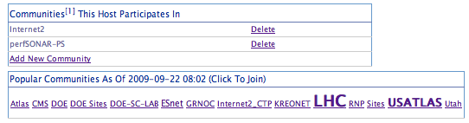
Architecture Overview - Communities
Screenshot from the toolkit (when setting up the host):
Top: Communities the host has chosen to associate with
Bottom: ‘Popular’ communities
  The word cloud is based on what we found in the GLS – the larger the word = the more people that are using this classification
<number> – 11/08/26, © 2010 Internet2

Slide 93
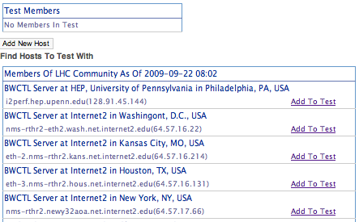
Architecture Overview - Communities
List of hosts from the LHC community:
<number> – 11/08/26, © 2010 Internet2

Slide 94
Client/Service Interaction
EchoRequest
  Sent to a service to test connectivity
  Can be made arbitrarily complex by the service designer
    Test backend storage
    Test internal self-checks
  Minimum is an ‘are you alive’ ping
<number> – 11/08/26, © 2010 Internet2

Slide 95
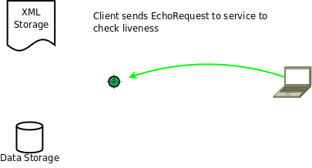
Client/Service Interaction
<number> – 11/08/26, © 2010 Internet2

Slide 96
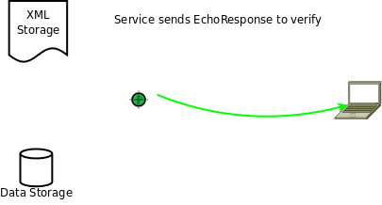
Client/Service Interaction
<number> – 11/08/26, © 2010 Internet2

Slide 97
Client/Service Interaction
MetadataKeyRequest
  For a given (partial) metadata, ask the service to verify that it does or does not exist
  Return a ‘key’, e.g. replayable token, to access the data
<number> – 11/08/26, © 2010 Internet2

Slide 98
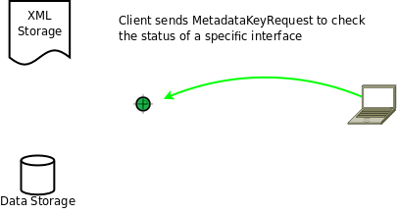
Client/Service Interaction
<number> – 11/08/26, © 2010 Internet2

Slide 99
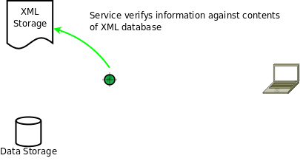
Client/Service Interaction
<number> – 11/08/26, © 2010 Internet2

Slide 100

Client/Service Interaction
<number> – 11/08/26, © 2010 Internet2

Slide 101

Client/Service Interaction
<number> – 11/08/26, © 2010 Internet2

Slide 102
Client/Service Interaction
SetupDataRequest
  Given a key or (partial) metadata, return measurement information.
  Can be ‘filtered’ by time to prevent getting more results than necessary.
<number> – 11/08/26, © 2010 Internet2

Slide 103

Client/Service Interaction
<number> – 11/08/26, © 2010 Internet2

Slide 104

Client/Service Interaction
<number> – 11/08/26, © 2010 Internet2

Slide 105

Client/Service Interaction
<number> – 11/08/26, © 2010 Internet2

Slide 106

Client/Service Interaction
<number> – 11/08/26, © 2010 Internet2

Slide 107

Client/Service Interaction
<number> – 11/08/26, © 2010 Internet2

Slide 108

Client/Service Interaction
<number> – 11/08/26, © 2010 Internet2

