Slide 1
2011 OSG Summer School
Single sign-on in
Open Science Grid
by Igor Sfiligoi
University of California San Diego

Slide 2
Summary of past lessons
HTC is maximizing CPU use over long periods
  And getting lots of computation done
DHTC is HTC over many sites
  Using an overlay system hides most of the change
Grid and Cloud resources are really very similar
  Especially is you use them from inside
  an overlay system

Slide 3
Single sign-on in OSG
Introducing the
Open Science Grid

Slide 4
Scientific Grids
Just a reminder
  Widely distributed (continent wide)
  Many participants O(1k+)
    Just moderate trust (no way everybody knows everybody else)
  Many local HTC technologies
    Joining sites may have existing infrastructure

Slide 5
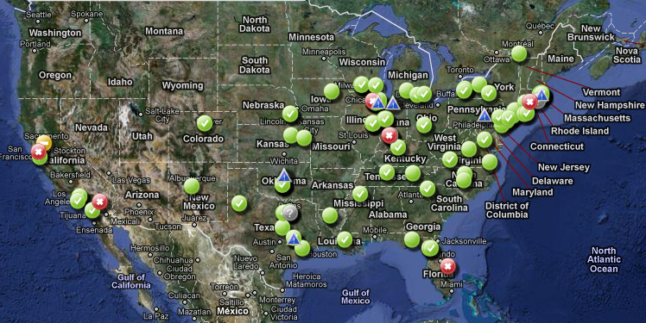
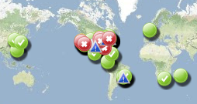
The Open Science Grid
US+ wide scientific Grid
  With partner Grids from around the world (e.g. EGI)
Sponsored jointly by NSF and DOE

Slide 6
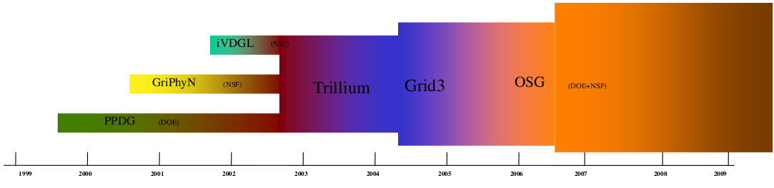
Some history
Built on experience dating to the
previous Millennium

Slide 7
Who is part of OSG
Heavily HEP dominated (LHC, Tevatron)
  They need it to do their science
Followed by other physics communities
(e.g. LIGO, RHIC)
But also a healthy mix of other sciences
  Biology and chemistry related fields
  Math and CS related fields
  Engineering related fields

Slide 8
OSG in numbers
No sites: ~50
  Ranging in size from ~10 cores to ~7k cores
  Small sites may have a 10% of a grad student running the system
  Large ones may have several dedicated sysadmins
No of users: >10k
  Not all active at the same time
  But most of them have used OSG at least once

Slide 9
Scale problem
Requesting and managing
an account at each site
would be a lot of work!

Slide 10


Is it really my problem?
But I will be using an overlay system.
I will only see my local submit system.
Well, someone still needs to send the pilots.
You think it works by magic?
But why should I care?
Why again did you come here???
You will need it
for storage.

Slide 11
Single sign-on in OSG
Single sign-on
using
X.509 PKI

Slide 12

Single sign-on
The idea is simple
  The user should use the same mechanism to submit jobs to all O(100) sites
Hi. I am Igor
Hi. I am Igor
Hi. I am Igor

Slide 13
Passwords a non-starter
We all know username/password is the preferred authentication mechanism
  Almost everybody use it!
But not a good solution
for distributed systems
  Uses a shared secret between
  the user and the service provider
  And secrets stay secret only if few entities know it
    Sharing passwords between sites a bad idea!
How many passwords
do you have for all the
Web pages you use?

Slide 14

Adding an intermediary
A better approach is to introduce a highly trusted intermediary
Have been used in real life for ages
  e.g. States as issuers of IDs
  Getting the ID is lengthy,
  but easy afterwards
Hi. Here is my ID
Hi. Here is my ID
Hi. I am Igor
Hi. Here is my ID
Use this ID

Slide 15
Technical implementations
Many technical solutions
  x.509 PKI
  Kerberos
  OpenID
  many more...
All based on the same basic principle
  Each has strengths and weaknesses
  OSG standardized on x.509
Will not argue
if it is the best one.

Slide 16
x.509 PKI
Based on public key cryptography
  A user has a (public,private) key pair
    one encrypts, the other decrypts
    similarly, one signs, the other verifies
The highly trusted entity is called a
Certification Authority (CA)
  The user is given a certificate
  Cert. has user name in it
  Cert. also contains the (pub,priv) key pair
  Cert. is signed by the CA private key
You should have
gotten one yesterday
from DOEGrids

Slide 17



x.509 authentication
Sites have CA public key pre-installed
User authenticates by signing a site provided string and providing the public part of the cert
Igor's
Cert
Hi, here is my pub cert
Please sign $%@*&
Here it is XYZ^@FR
Hi, Igor
CA pub

Slide 18
x.509 as single sign-on
Use the same cert for all the sites
Hi.
Hi. I am Igor
Hi.
Hi.
Use this cert

Slide 19
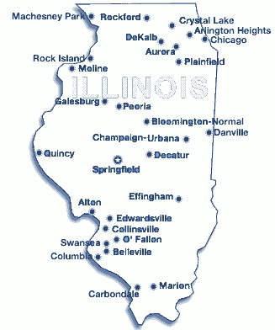
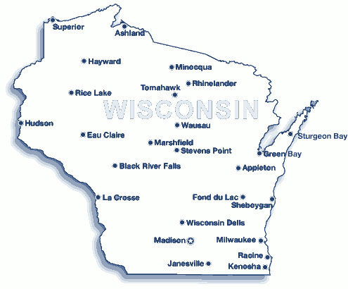
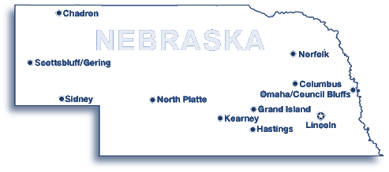
Impersonation
Sometimes your jobs need to impersonate you
  For example to access an FTP server
More on
storage
tomorrow
CE
Scheduler
FTP
Hi... ehm... I am Igor
How will this work?
Job

Slide 20
Impersonation problem
The problem is that the job
does not have your private key
  And it should not, if it is to remain “private”
  (remember, secrets only stay secret
  if few entities know about it)
  So it cannot impersonate you
We have similar problems in real life, too
  e.g. attorney representing you in court
  Nobody will buy it that he is you,
  yet he can speak on your behalf

Slide 21

Proxy delegation
The job is indeed not you
Create a certificate for the job
  And send it in the job sandbox
CE
Proxy
~=
Job cert
Scheduler
FTP
Job

Slide 22
Proxy risks
You are sending private keys with the job
  You risk that they be stolen
To mitigate this risk, the proxy lifetime
should be very limited
  Say, a few hours
  But long enough
  to do the needed work
Risk mitigation can
be annoying!
More on security
Thursday

Slide 23
Delegation and overlays
Not really any different
  Still need priv keys on the remote CPU
But you may exploit
the additional control you have
  e.g. Condor will automatically
  shorten proxy lifetime
  and re-delegate as needed

Slide 24
Are we done yet?
Why should any site
give you access to
their CPUs?
(or disks)

Slide 25
Do I really care?
But I will be using an overlay system.
All I need is contacting my local sysadmin.
YOU AGAIN!!!
Someone still needs to send the pilots!
Just kidding
And don't forget
about storage.

Slide 26
Single sign-on in OSG
Tiered authorization
or
Introduction to
Virtual Organizations

Slide 27
Authentication vs. Authorization
Just because you can authenticate yourself,
it does not mean you are authorized, too
  e.g. your drivers license tells who you are,
  but does not allow you to enter a nuclear plant
x.509 PKI only covers authentication
  Tells the site who you are

Slide 28


Authorization in OSG
Each site in OSG decides autonomously
which users to authorize
  Nobody in OSG can force a site to let a user in
  (but we can ask)
The problem, again, is scale
  Over 10,000 users!
If each site had to worry
about every single user,
very few users would
be authorized!

Slide 29
Adding roles
Sites want to operate on higher level concepts
  Some kind of attribute
Like in real life
  Think about passport vs driver's license
  Both tell a cop who you are
  (and to 1st approx. are issued by the same entity)
  But the driver's license tells him
  you are allowed to use a car, too
    “Class:C”

Slide 30
Attribute authority
Like before, we need
someone trustworthy to issue attributes
  Sites cannot just trust whatever the user says!
  In the case of driver's license it was the DMV
In OSG, the attribute authority is called
the Virtual Organization (VO)
  And the service issuing the attributes VOMS
  Based on issuing augmented x.509 proxies

Slide 31

VO and VOMS
VO decides who is worthy of an attribute
  Site decides based on that attribute
Hi. I work in CMS
Hi.
Hi.
Register
Hi.
I need a CMS proxy
Hi, CMS user
VOMS
Use this proxy

Slide 32
OSG VOs in numbers
O(10) VOs
  Typically one per scientific domain
  e.g. CMS, ATLAS, SBGrid, LIGO, …
  But we have regional VOs as well
  e.g. Holland Computing Center (HCC), Fermigrid
  OSG operates an “Engage VO” for new users
  until there is an appropriate VO for them
Sites typically support a set of VOs
  And all the users inside those VOs
  (although they don't need to)

Slide 33
Are we done yet?
Yes.
At least for now.
More details Thursday

Slide 34
Copyright statement
This presentation contains images
copyrighted by ToonClipart.com
These images have been licensed to Igor Sfiligoi for use in his presentations
Any other use of them is prohibited

