Slide 1
dV/dt : Accelerating the Rate of Progress Towards Extreme Scale Collaborative Science Miron Livny (UW), Ewa Deelman (USC/ISI), Douglas Thain (ND), Frank Wuerthwein (UCSD), Bill Allcock (ANL)
… make it easier for scientists to conduct large-scale computational tasks that use the power of computing resources they do not own to process data they did not collect with applications they did not develop …

Slide 2
An (slightly) different definition of High Throughput Computing:
Offered Load >> System Capacity
The job of an HTC system is to maximize concurrency without exceeding resources.
But this only works if the resources are known!

Slide 3
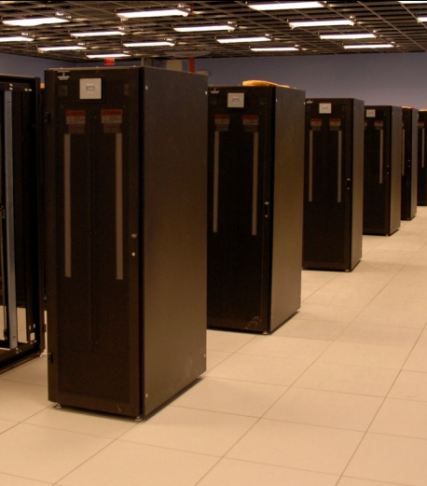
The Ideal Picture
10,000 x:
2000 cores
Resource
Manager:
Run 1000 2-core tasks at a time

Slide 4
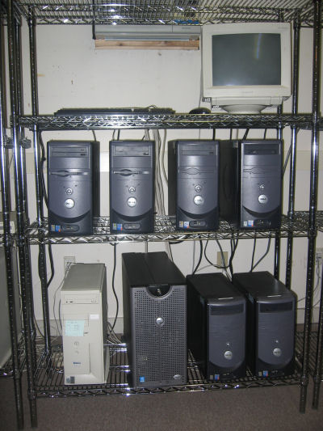
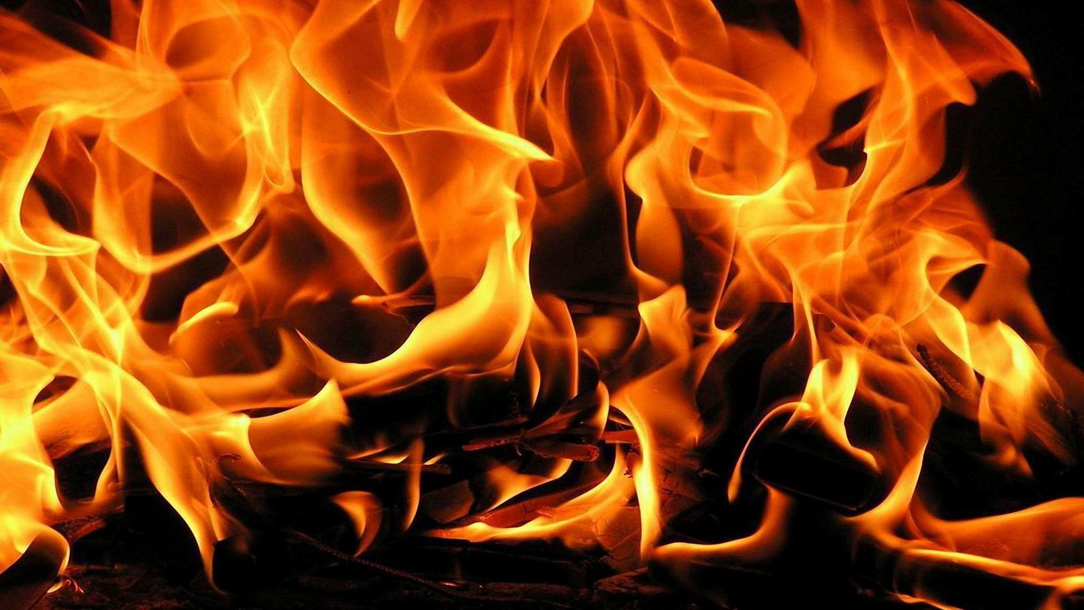
What actually happens:
2000 cores
10,000 x:
Resource
Manager:
1 TB
Run 1000 2-core tasks at a time
128 GB
16 cores
GPU
3M files
of 1K each

Slide 5
Some reasonable questions:
Will this workload at all on machine X?
How many workloads can I run simultaneously without running out of storage space?
Did this workload actually behave as expected when run on a new machine?
How is run X different from run Y?
If my workload wasn’t able to run on this machine, where can I run it?

Slide 6
End users have no idea what resources their applications actually need.
and…
Computer systems are terrible at describing their capabilities and limits.
and…
Nobody likes to say NO.

Slide 7
Stages of Resource Management
Estimate the application resource needs
Find the appropriate computing resources
Acquire those resources
Deploy applications and data on the resources
Manage applications and resources during run.
Can we do it for one task?
How about an app composed of many tasks?

Slide 8
Categories of Applications
Concurrent Workloads
Static Workloads
Dynamic Workloads
Regular Graphs
Irregular Graphs
while( more work to do) {
foreach work unit {
t = create_task();
submit_task(t);
}
t = wait_for_task();
process_result(t);
}
1
2
3
A1
A2
A3
A
B
B1
F
F
F
4
5
6
7
B2
F
F
F
C
D
E
B3
F
F
F
8
9
10
A

Slide 9
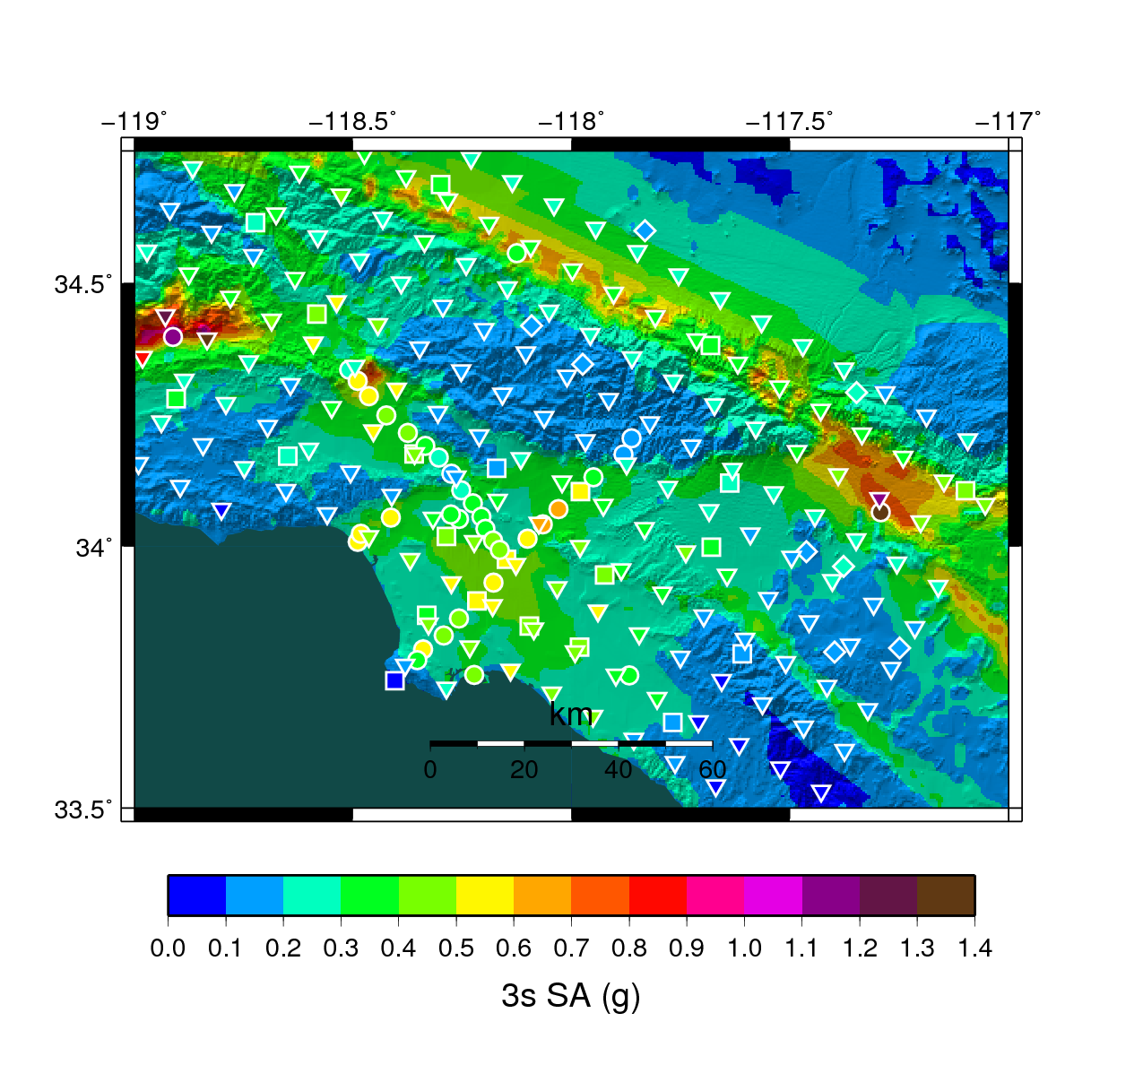
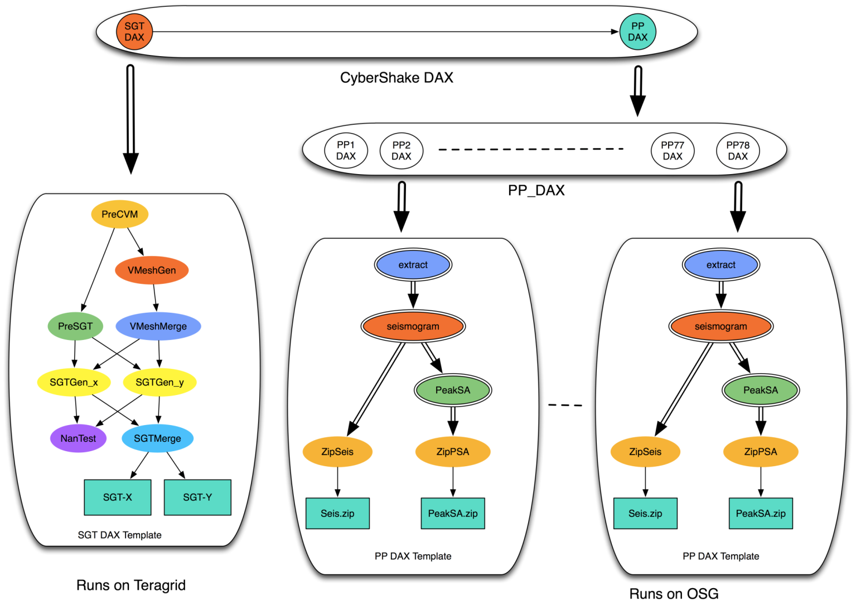
Southern California Earthquake Center
CyberShake PSHA Workflow
Description
Builders ask seismologists: “What will the peak ground motion be at my new building in the next 50 years?”
Seismologists answer this question using Probabilistic Seismic Hazard Analysis (PSHA)
239 Workflows
Each site in the input map corresponds to one workflow
Each workflow has:
820,000 tasks
MPI codes ~ 12,000 CPU hours,
Post Processing 2,000 CPU hours
Data footprint ~ 800GB
Pegasus managed workflows
Workflow Ensembles

Slide 10
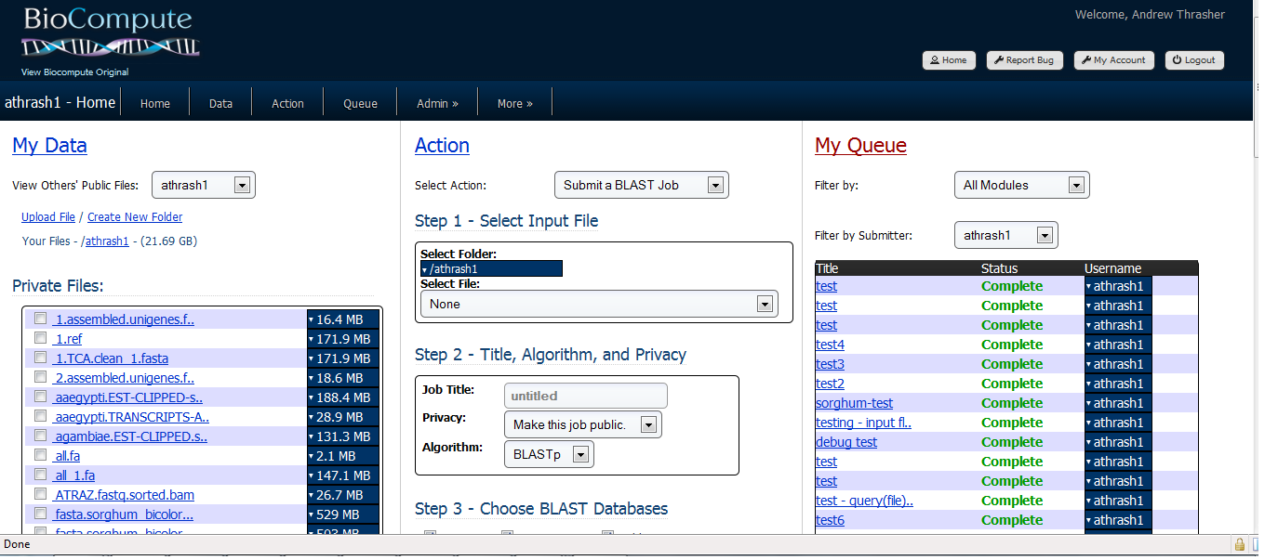
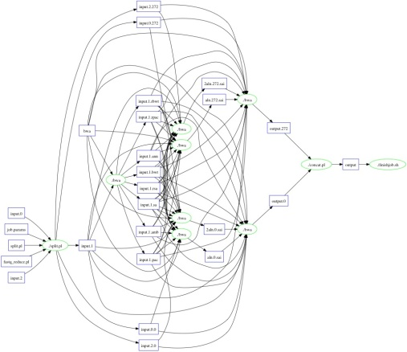
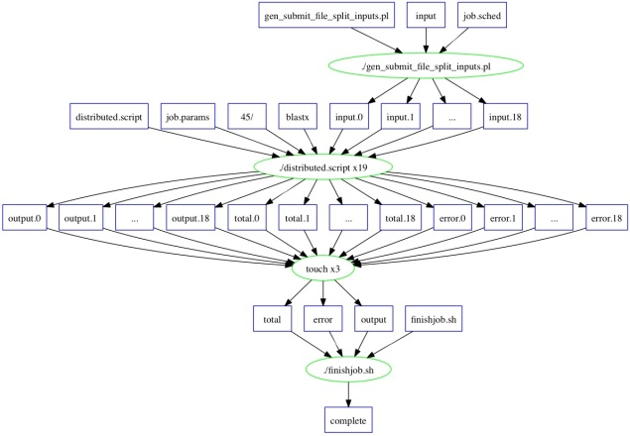
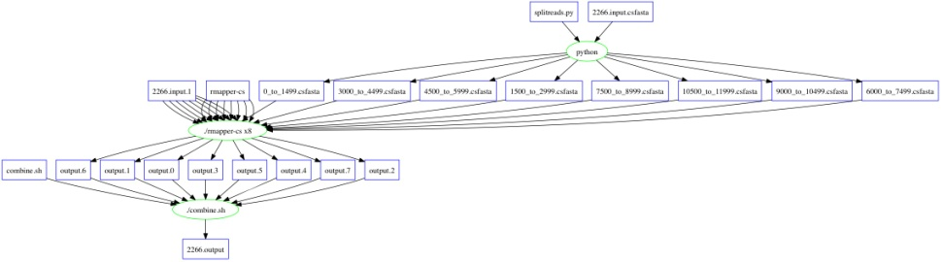
Bioinformatics Portal Generates Workflows for Makeflow
SHRIMP
5080 sub-tasks
~3h on 200 nodes
BLAST (Small)
17 sub-tasks
~4h on 17 nodes
BWA
825 sub-tasks
~27m on 100 nodes

Slide 11
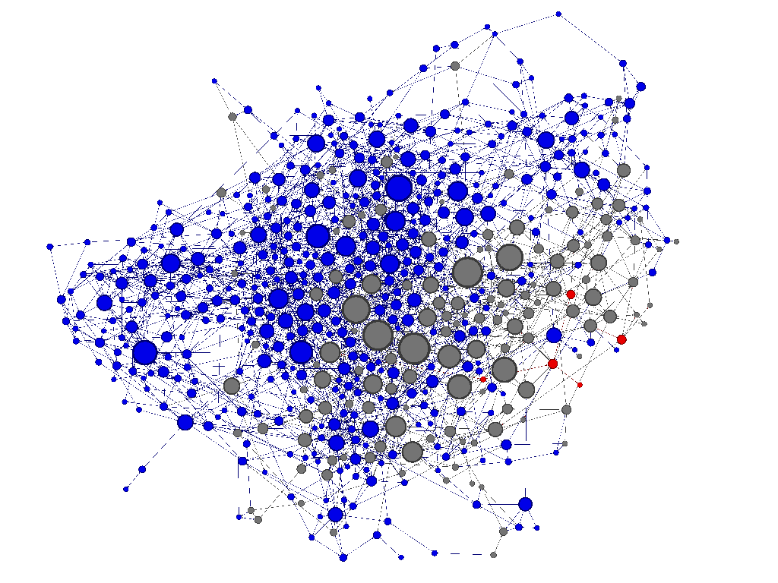
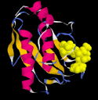
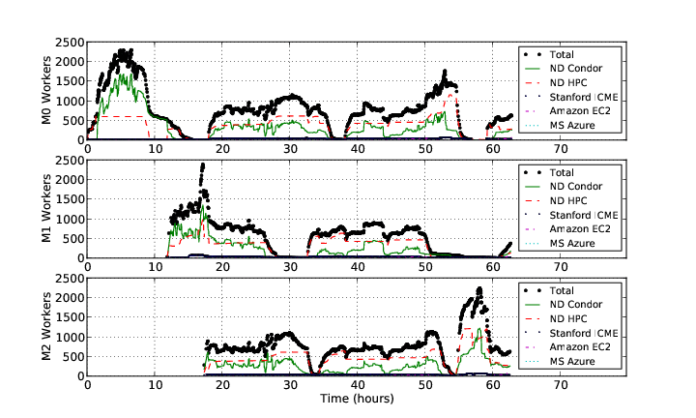
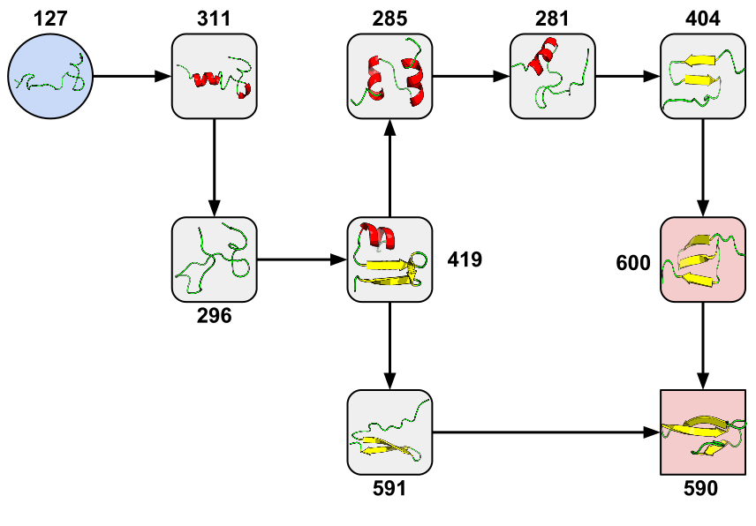
Example: Adaptive Weighted Ensemble
1: Start with Standard
MD Simulation
2: Research Goal:
Generate Network of States
3: Build AWE Logic
Using Work Queue Library
AWE Logic
Work Queue
Amazon EC2
Personal Cloud
HPC Cluster
GPU Cluster
Condor
4: Run on 2000+ CPUs/GPUs at
Notre Dame, Stanford, and Amazon
5: New State Transition Discovered!
Badi Abdul-Wahid, Li Yu, Dinesh Rajan, Haoyun Feng, Eric Darve, Douglas Thain, Jesus A. Izaguirre,
Folding Proteins at 500 ns/hour with Work Queue, IEEE e-Science Conference, 2012
Notes:
This slide shows an example of a recent result generated using parts of the Cooperative Computing Tools.
This work was done in collaboration with Jesus Izaguirre (Notre Dame) and Eric Darve at Stanford University.
Many of you are familiar with the concept of protein folding, in which a molecular dynamics (MD) simulation is run for a long time in order to observe the many ways in which a complex molecule can bend and fold, thus affecting how it interacts with other biomolecules. If we consider each configuration of a protein (#1) to be a distinct state, then we can generate a network (#2) in which each state is a node and the transitions between the states are edges. To fully understand the behavior of the molecule, we would like to know the probability associated with each state and transition. Simulating one protein is excruciatingly slow, and running one simulation would never explore all of these states in any reasonable time.
Using the Cooperative Computing Tools, we were able to build a distributed implementation of the Adaptive Weighted Ensemble technique using the Work Queue library. In about 2000 lines of Python (#3), we created a system to efficiently explore the network of states by running many simulations simultaneously. These codes were easily distributed across multiple clusters, clouds, and grids gained from Notre Dame, Stanford, and Amazon EC2. The Work Queue library transparently handles fault tolerance, data distribution, and task scheduling across this personal cloud.
This implementation scaled up to over 2000 CPUs and GPUs spread across the country, achieving a consistent simulation rate of about 500 simulated nanoseconds per hour of wall clock time. Multiple AWE instances can run simultaneously, and as the needs of each instance fluctuate, the personal cloud reallocates resources automatically. In a recent result (#5) to appear in the IEEE e-Science conference this fall, we discovered a new state transition in the Fip35 protein.
By making use of the Cooperative Computing Tools, the distributed algorithm is not tied to any one computing infrastructure and can migrate to whatever clusters, clouds, or grids that the researcher can access at any given moment.

Slide 12
Task Characterization/Execution
Understand the resource needs of a task
Establish expected values and limits for task resource consumption
Launch tasks on the correct resources
Monitor task execution and resource consumption, interrupt tasks that reach limits
Possibly re-launch task on different resources

Slide 13
Data Collection and Modeling
Records From
Many Tasks
Task Record
Task Profile
workflow
RAM: 50M
Disk: 1G
CPU: 4 C
RAM: 50M
Disk: 1G
CPU: 4 C
RAM: 50M
Disk: 1G
CPU: 4 C
monitor
RAM: 50M
Disk: 1G
CPU: 4 C
P
RAM
task
min
typ
max
A
A
B
C
B
C
D
E
D
E
F
F
Resource Allocations
Workflow Profile
Workflow Structure

Slide 14
Resource Monitor
Log File:
#wall_clock(useconds) concurrent_processes cpu_time(useconds) virtual_memory(kB) resident_memory(kB) swap_memory(kB) bytes_read bytes_written
1 1 0 8700 376 0 385024 0
2 5 20000 326368 6100 0 27381007 1474560
3 6 20000 394412 7468 0 29735839 1503232
4 8 60000 531468 14092 0 36917793 1503232
5 8 100000 532612 16256 0 39285593 1503232
% resource_monitor mysim.exe
RM
Summary File
start: 1367424802.676755
end: 1367424881.236612
exit_type: normal
exit_status: 0
max_concurrent_processes: 16
wall_time: 78.559857
cpu_time: 54.181762
virtual_memory: 1051160
resident_memory: 117604
swap_memory: 0
bytes_read: 4847233552
bytes_written: 256950272
Local
Process
Tree

Slide 15
Monitoring Strategies
Indirect | Direct
Monitor how the world changes while the process tree is alive. | Monitor what functions, and with which arguments the process tree is calling.
Summaries | Snapshot | Events
getrusage and times | Reading /proc and measuring disk at given intervals. | Linker wrapper to libc
Available only at the end of a process. | Blind while waiting for next interval. | Fragile to modifications of the environment, no statically linked processes.

Slide 16

Portable Resource Management
Pegasus
RM
Job-1.res
Job-2.res
job-3.res
Task
Makeflow
other batch system
RM
rule-1.res
Jrule2.res
rule-3.res
Task
while( more work to do) {
foreach work unit {
t = create_task();
submit_task(t);
}
t = wait_for_task();
process_result(t);
}
W
RM
task 1 details:
cpu, ram, disk
task 2 details:
cpu, ram, disk
task 3 details:
cpu, ram, disk
Work
Queue
W
Task
W

Slide 17
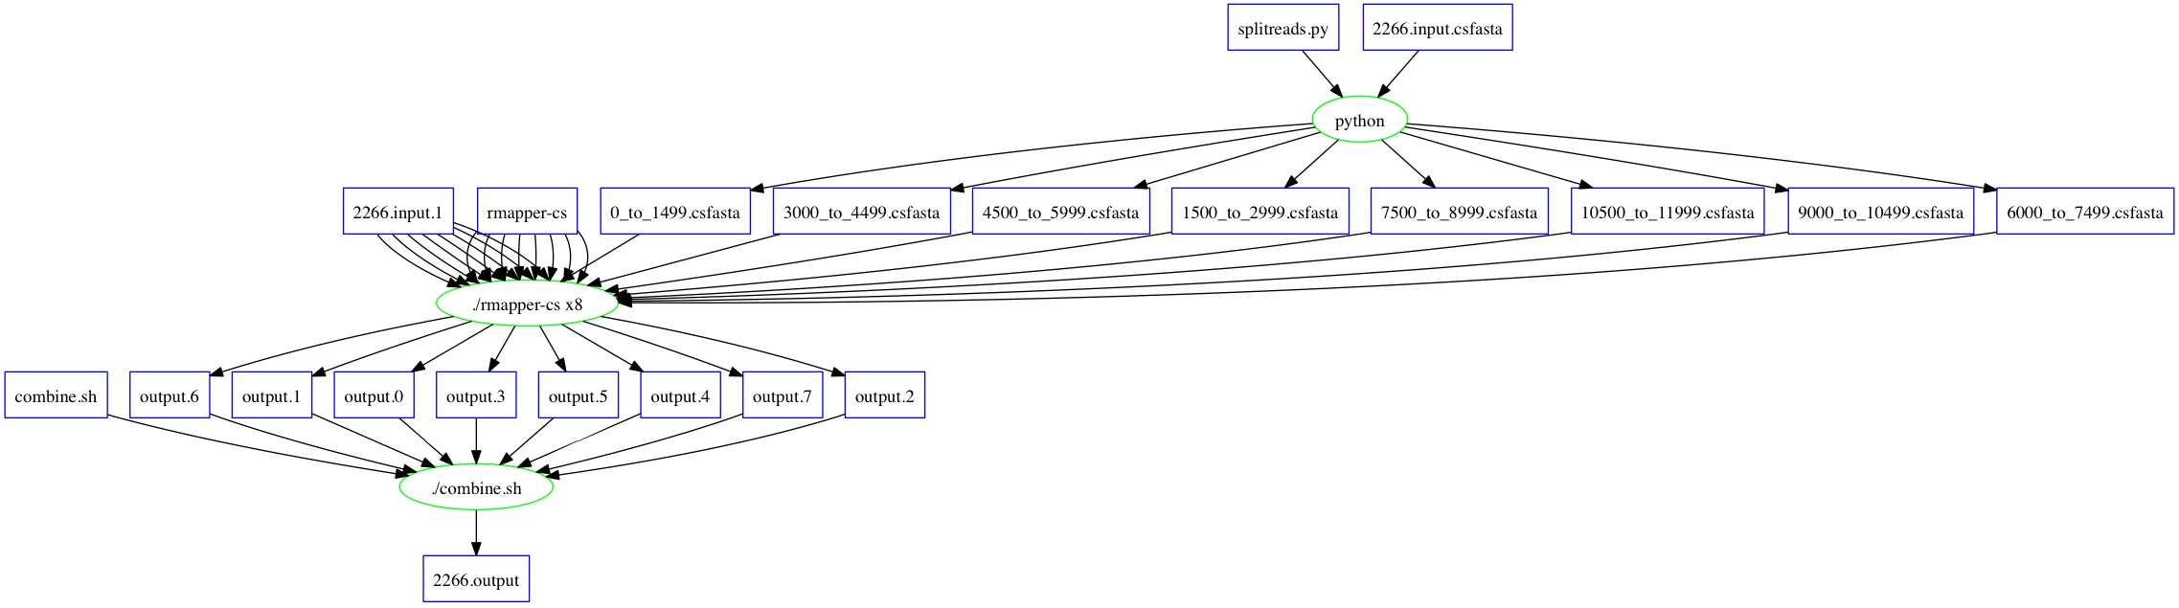
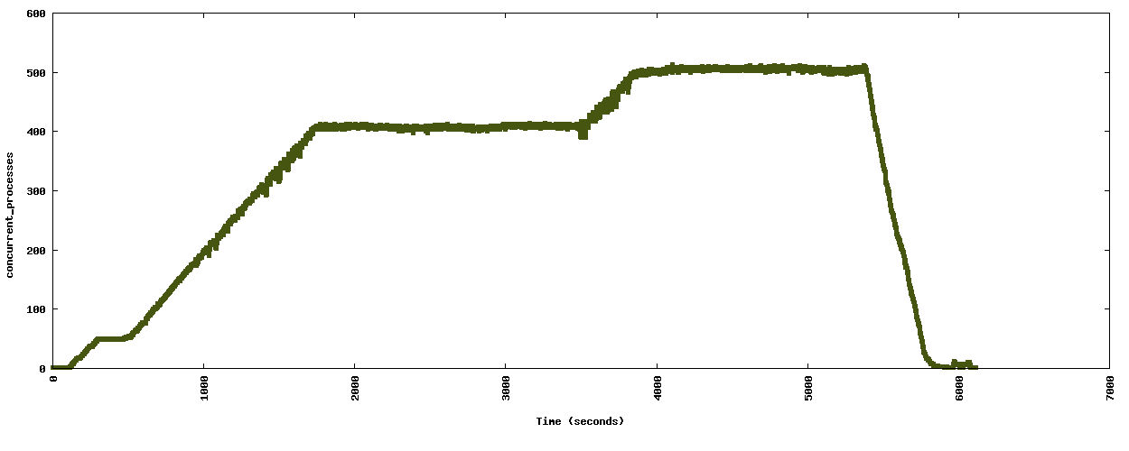
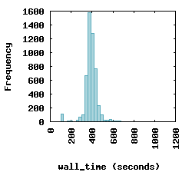
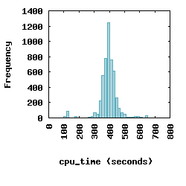
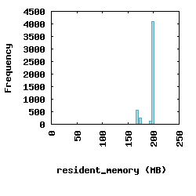
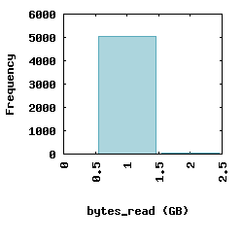
Resource Visualization of SHRiMP

Slide 18
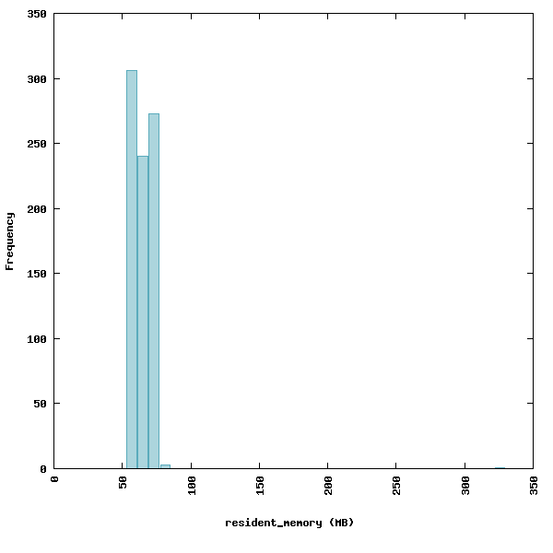
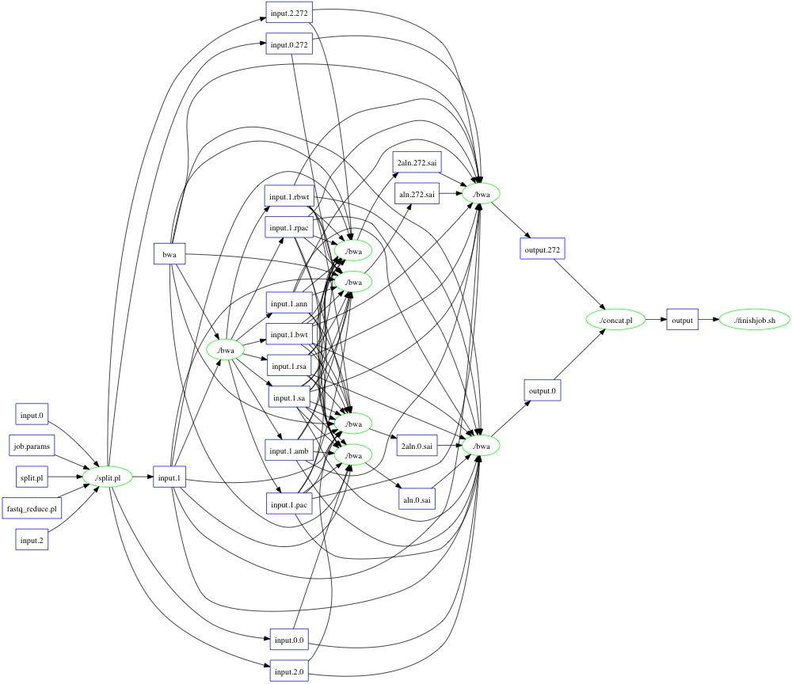
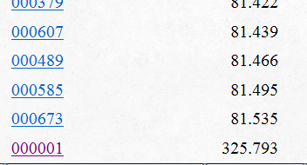
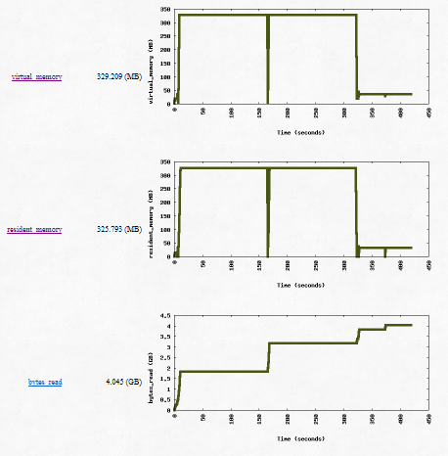
Outliers Happen: BWA Example

Slide 19
Completing the Cycle
Allocate Resources
Measurement
and Enforcement
CPU: 10s
RAM: 16GB
DISK: 100GB
RM
task
Exception Handling
Is it an outlier?
task
Historical Repository
Observed Resources
CPU: 5s
RAM: 15GB
DISK: 90GB
P
RAM
min
typ
max

Slide 20
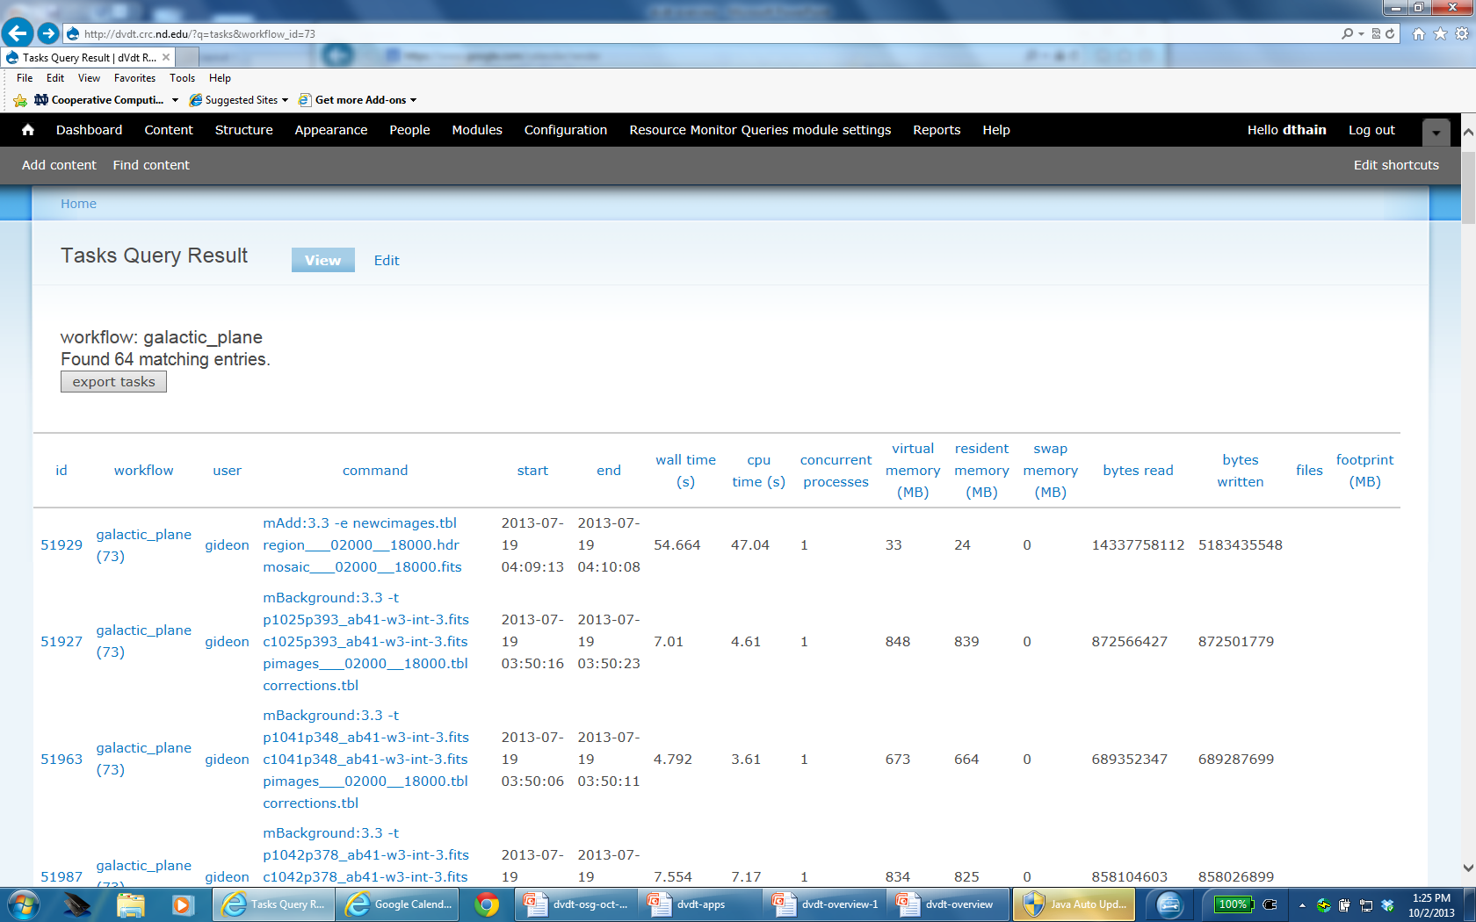
dVdT Online Archive

Slide 21
Complete Workload Characterization
128 GB
32 cores
16 GB
4 cores
12 hours
500 Gb/s I/O
X 1
X 10
128 GB
32 cores
16 GB
4 cores
1 hour
5 Tb/s I/O
X 1
X 100
X 1000
We can approach the question:
Can it run on this particular machine?
What machines could it run on?

Slide 22
Deliverables Relevant to OSG
User-level monitoring tools to report single-task resource usage. (2 prototypes)
An online archive for collecting, reporting, and predicting resource usage records. (Working)
Methods for run-time estimation and adaptation of resources. (In progress)
Techniques integrated into workflow engines compatible with the OSG (Pegasus, Makeflow)
Interoperable components that can be mixed and matched according to local needs.

Slide 23

Acknowledgements
dV/dT Project PIs
Bill Allcock (ALCF)
Ewa Deelman (USC)
Miron Livny (UW)
Douglas Thain (ND)
Frank Weurthwein (UCSD)
Project Staff and Students
Gideon Juve (USC)
Raphael Silva (USC)
Sepideh Azarnoosh (USC)
Ben Tovar (ND)
Casey Robinson (ND)
https://sites.google.com/site/acceleratingexascale

