Slide 1
Andrew J. Younge
Golisano College of Computing and Information Sciences
Rochester Institute of Technology
102 Lomb Memorial Drive
Rochester, New York 14623

Slide 2
The Lattice Project
A community of researchers, scientists, and staff at the University of Maryland are working to integrate and deploy computing resources, Grid middleware, specialized scientific application software and semantic web services in a comprehensive Grid system for scientific analysis.
Regional Globus deployment with around 6000 nodes
BOINC project with over 30,000 hosts
Built a GT4 Gram Job manager for BOINC, setup BOINC server, updated wrapper tool in BOINC code

Slide 3
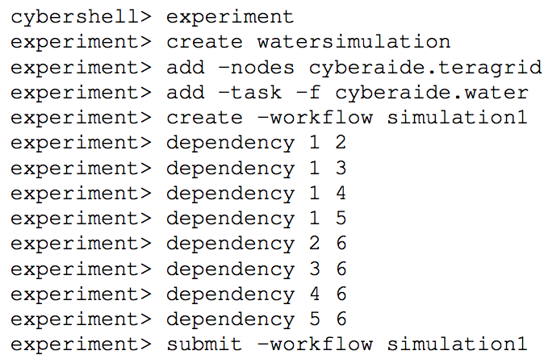
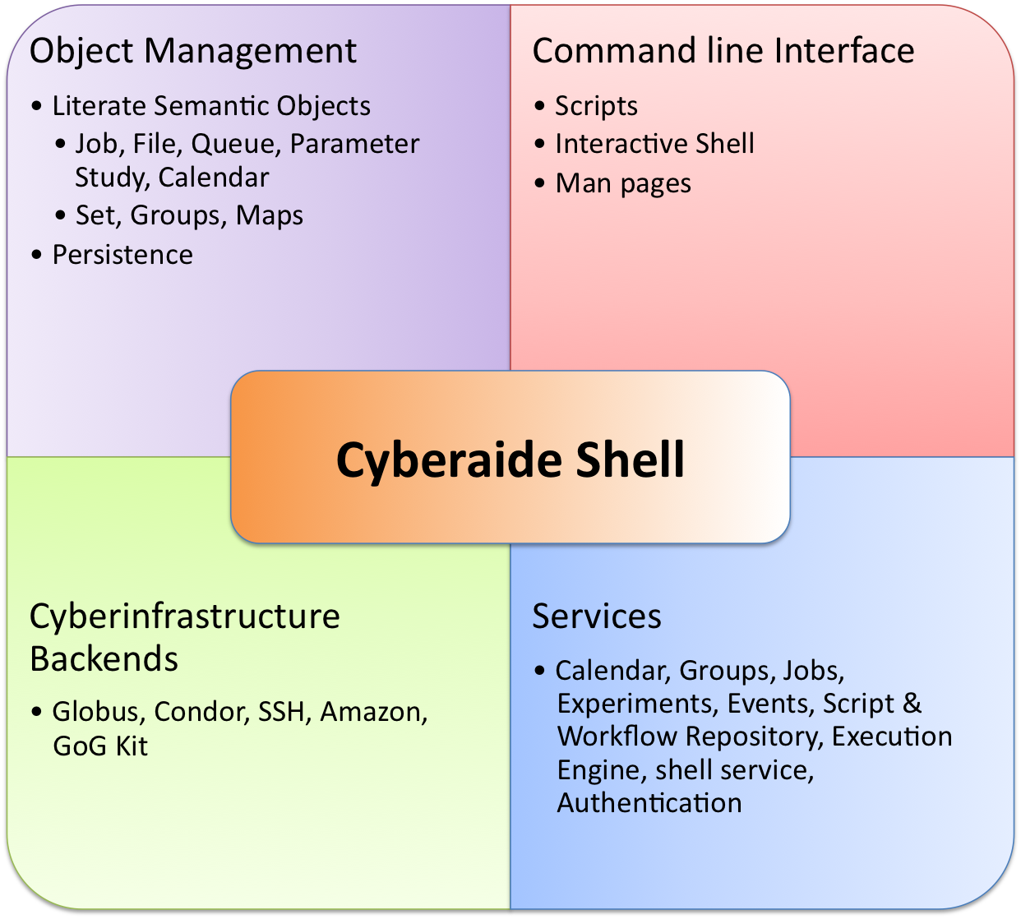
Cyberaide Shell
Simple to use system shell which provides access to the powerful Grids and advanced Cyberinfrastructure that is available today

Slide 4
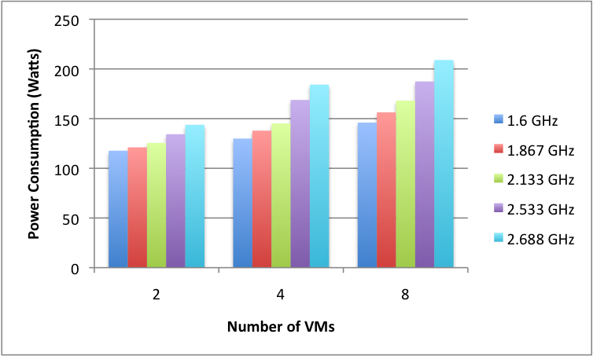
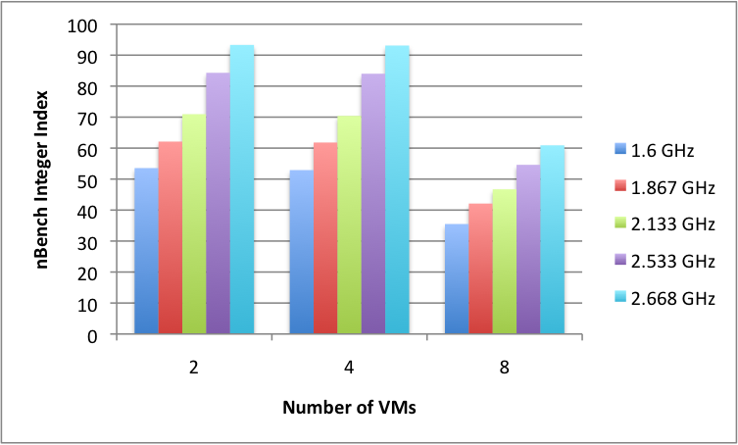
DVFS VM Scheduling
Notes:
Image 1: Shows that the difference in power consumption between 2 VMs and 8 VMs is minimal, therefore the power consumption savings is considerable. Cost 11.5% to use all 8 vcores vs 4
Image 2: Slight impact of scheduling 8 VMs instead of 4, but overall performance is still greater 4*93=372 vs 8*60=480 22.5% more processing power

Slide 5
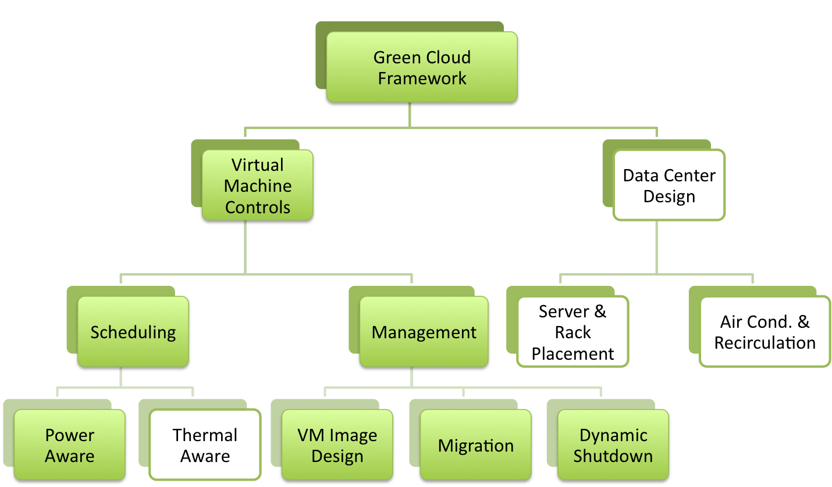
Green Computing Framework for Clouds

Slide 6
Accomplishments
[1] G. von Laszewski, L. Wang, A. Younge, and X. He, “Power-aware scheduling of virtual machines in dvfs-enabled clusters,”, IEEE Cluster, to appear in2009.
[2] G. von Laszewski, A. Younge, X. He, K. Mahinthakumar, and L. Wang, “Experiment and workﬂow management using cyberaide shell,” in 4th International Workshop on Workﬂow Systems in e-Science (WSES 09) in conjunction with 9th IEEE International Symposium on Cluster Computing and the Grid. IEEE, 2009.
[3] L. Wang, G. von Laszewski, A. Younge, X. He, M. Kunze, and J. Tao, “Cloud computing: a perspective study,” New Generation Computing, to appear in 2010.
[4] G. von Laszewski, F. Wang, A. Younge, X. He, Z. Guo, and M. Pierce, “Cyberaide javascript: A javascript commodity grid kit,” in GCE08 at SC’08. Austin, TX: IEEE, Nov. 16 2008. [Online]. Available: http://cyberaide.googlecode.com/svn/trunk/papers/08-javascript/vonLaszewski- 08- javascript.pdf
[5] G. von Laszewski, F. Wang, A. Younge, Z. Guo, and M. Pierce, “Javascript grid abstractions,” in Proceedings of the Grid Computing Environments 2007 at SC07, Reno, NV, Nov. 2007. [Online]. Available: http://cyberaide.googlecode.com/svn/trunk/papers/07- javascript/vonLaszewski- 07- javascript.pdf
Passed PhD Qualification Exam!
Accepted into 2009 International Summer School on Grid Computing in Nice, France.
Accepted as student volunteer for 2009 International Supercomputing Conference in Hamburg, Germany.
First author on an extended abstract and poster accepted to the TeraGrid 2009 conference.

