Slide 1
Production
Oct 31, 2012
Dan Fraser

Slide 2
Current Production Focus
Transition to RPMs
  52(44) sites using RPM based installs
  49(59) sites still using Pacman install
  All the main RPMs have been released
    Incl. Gums and Gratia
  Still working on a few issues / bugs
    No more Blocker Bugs
  Plan to phase out Pacman by mid next year
  BCDT bringing Tim up to speed
    Tim is doing a good job of jumping in

Slide 3
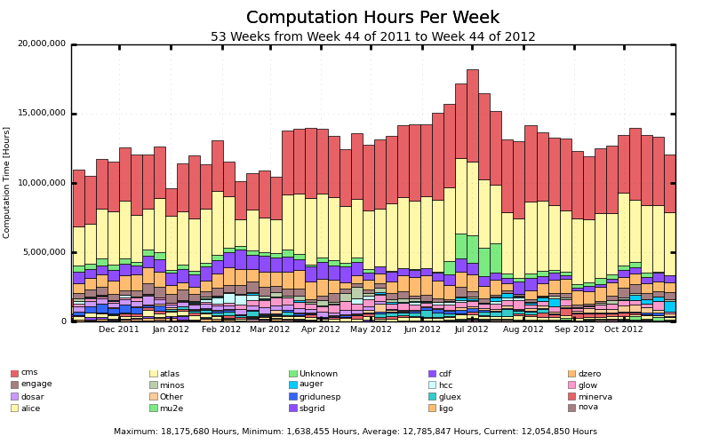
Overall Production

Slide 4
Some Production Issues…
Effort from the entire team
  New root vulnerabilities in Condor
  Procedure for handling CA releases w/o manual intervention
  New critical bug in certain Condor configurations
  Encouraging sites to upgrade to OSG1.25+
    Critical bug in condor
  SE-only publishing issue
  GRAM-5 production issues settling down (memory leaks, scaling, etc.)
  CA updates no longer automated by OSG (RPM)
  GUMS-Voms compatibility with CERN (progress ongoing)
  …

Slide 5
Production Challenges
New monitoring tools suitable for a glide-in based system.
  Working with Ashu to define and visualize new tools.
How “autonomous” are the sites?
  Now that we promise security through a central glide-in system
  What is OSG’s policy on encouraging sites to upgrade?

Slide 6
Campus Grid Status
Campus grid working in production:
  Glow, Diagrid (All Condor campus grids)
  Nebraska
  University of Florida (not used much)
  UC3 (testing the latest Campus Grid Release)
Pre-Production/testing:
  RENCI
  Virginia Tech (Bio-tech)
    http://gratiaweb.grid.iu.edu/gratia/xml/glidein_hours_bar_smry?probe=condor:dhcpseven237.bioinformatics.vt.edu
  Virginia Tech (Belle, DayaBay)
  FIU

Slide 7
Launching the Campus Infrastructure Center
Center where researchers can learn about and adopt campus technologies.
  Led by Rob Gardner
First meeting planned for November
  UC Santa Cruz

Slide 8
Campus Grids Project Plan
    https://twiki.grid.iu.edu/bin/view/CampusGrids/CampusInfrastructureProjectPlan
Pushing toward BOSCO V1.1
  Target for November
    Multi-user capability
    File transfer over SSH
    Use multiple OS’s
  Included Documentation and usability testing.
    Offered to two users (Uwash not a Bosco candidate but is a campus grid candidate via flocking, Pegasus team tested successfully)
Features needed for v1.2 (quick releases):
  Accounting (integrated probe)

Slide 9
Campus Grid Issues
Need more interest in adopting Bosco
  Plan to widen distribution when Bosco is solid
    Condor users mailing list is proposed target
Use OIM for campus map
  Campus registration is in OIM
New Issue with Campus Factory

