Slide 1
Building a Real Workflow
Thursday morning, 9:00 am
Lauren Michael <lmichael@wisc.edu>
Research Computing Facilitator
University of Wisconsin - Madison

Slide 2

non-computing workflows are all around you … especially in science
  grading exams
  instrument setup
  experimental procedures
when planned/documented, workflows help with:
  organizing and managing processes
  saving time
  objectivity, reliability, and reproducibility
  (THE TENENTS OF GOOD SCIENCE!)

Slide 3
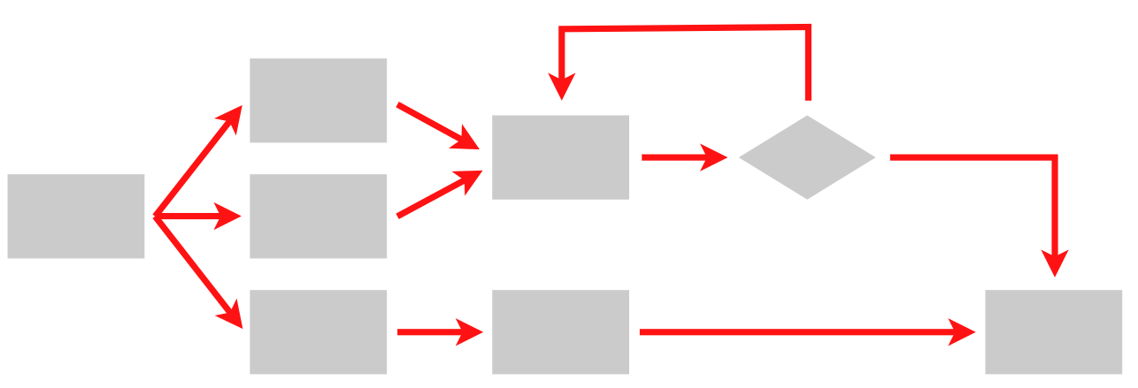
Workflows are like Computing Algorithms
Steps
Connections
(Metadata)

Slide 4
‘Engineering’ a Good Workflow
Draw out the general workflow
Define details (test ‘pieces’ with HTCondor)
Define the computing workflow
  divide or consolidate processes
  off-load file transfers and consider file transfer times
  identify steps to be automated or checked
Build it piece-by-piece; test and optimize
Scale-up: data and computing resources
What more can you automate or error-check?
(And document, document, document)

Slide 5
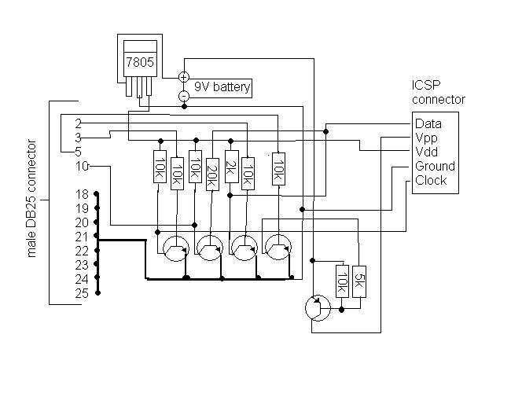
From schematics…

Slide 6
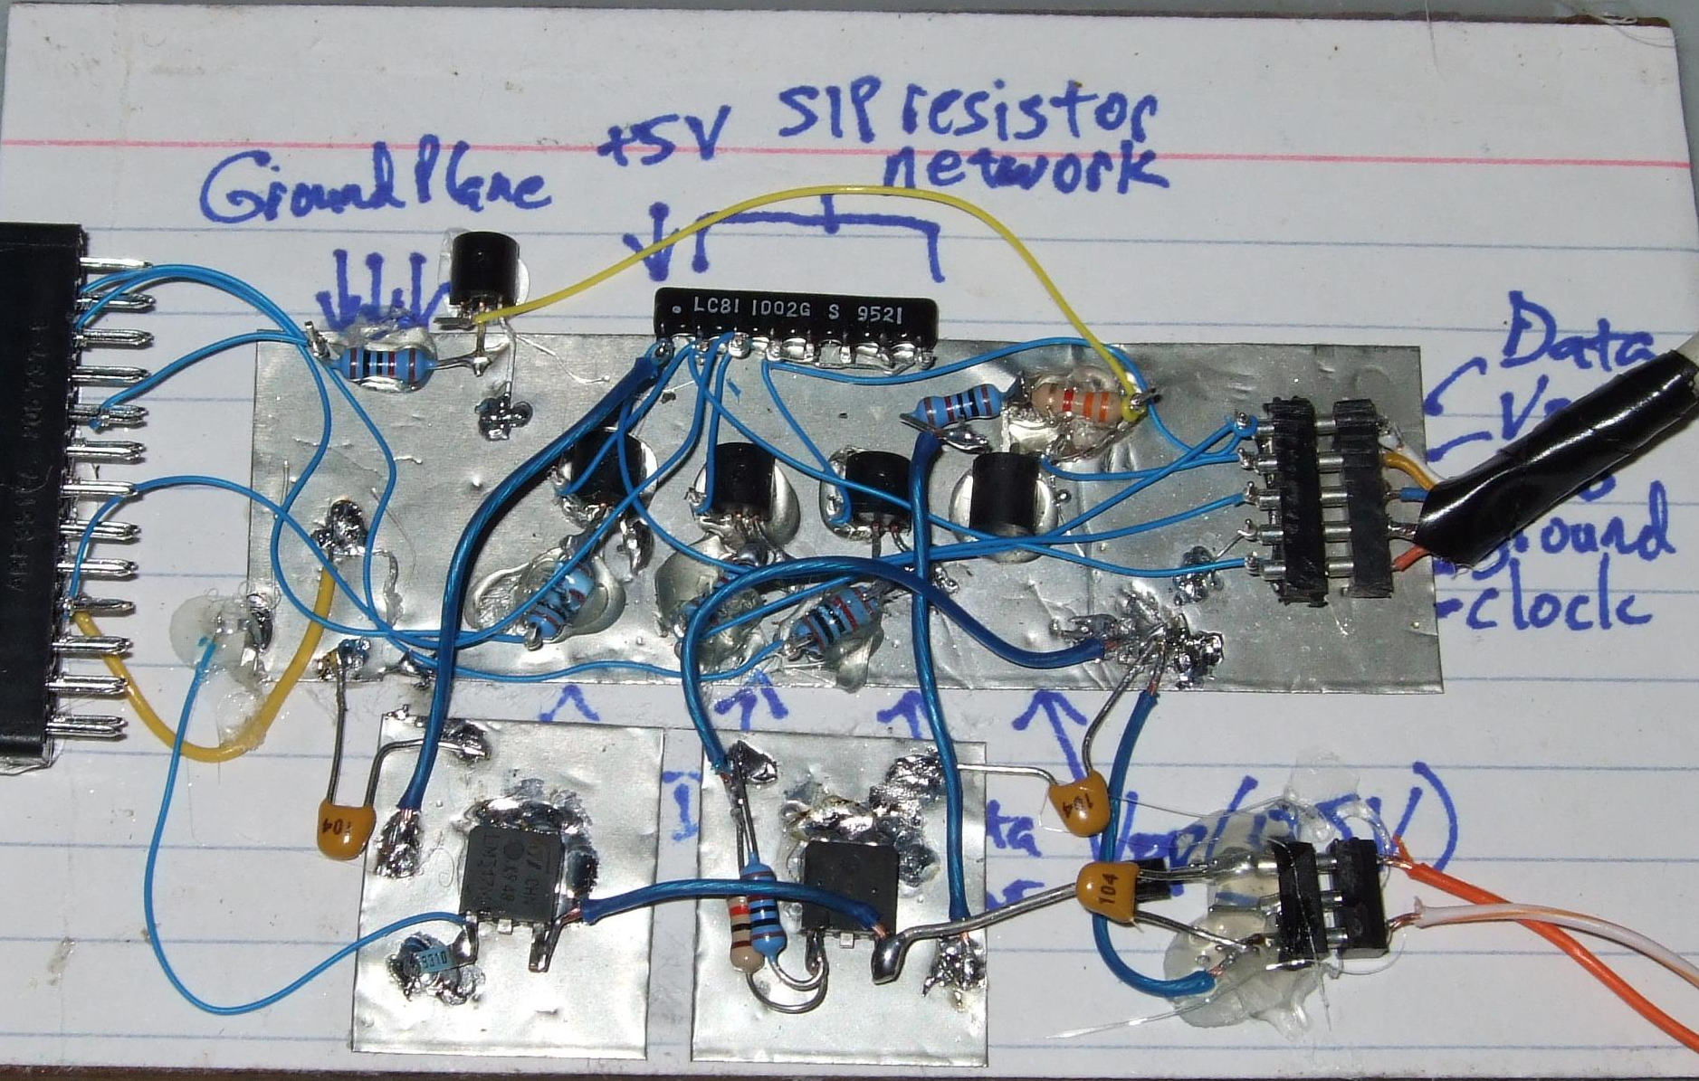
… to the real world

Slide 7
Start with This
file preparation
(minutes)
processing
(days)
transform results
(minutes)

Slide 8
End Up with This
(special transfer)
file prep and split
(POST-RETRY)
1 GB RAM
2 GB Disk
1.5 hours
. . .
100 MB RAM
500 MB Disk
40 min
(each)
process ‘0’
(filter output)
process ‘99’
(filter output)
(POST-RETRY)
(POST-RETRY)
(PRE)
combine, transform results
(POST-RETRY)
300 MB RAM
1 GB Disk
15 min

Slide 9
Key Workflow Principles
Increase Throughput
Be Kind to Your Submit Node
Bring it With You
‘Scriptify’ As Much As Possible
“Testing, testing, 1, 2, 3 …”

Slide 10
Always focus on Throughput
What is High Throughput
  many ‘smaller’ jobs
  constant job pressure
  automation
  long total workflow times
What is not?
  job runtimes less than 5 min
  jobs you expect to start up quickly
  micro-optimizations

Slide 11
‘Engineering’ a Good Workflow
Draw out the general workflow
Define details (test ‘pieces’ with HTCondor)
Define the computing workflow
  divide or consolidate processes
  off-load file transfers and consider file transfer times
  identify steps to be automated or checked
Build it piece-by-piece; test and optimize
Scale-up: data and computing resources
What more can you automate or error check?
(And document, document, document)

Slide 12
Resources Jobs Need
CPU
  #CPUs and time
RAM
Disk
  Working (execute side)
  Total (submit side)
  Bandwidth (file transfer)
Network bandwidth
  Usually for file transfer only

Slide 13
First run locally:
To measure usage
Did it run correctly?
    Are you sure?
Run once remotely
  NOT ON SUBMIT MACHINE!
  Might be surprised
Once working, run a couple of times
If big variance, should you take the…
  Average? Median? Worst case?

Slide 14
User Log shows all
005 (2576205.000.000) 06/07 14:12:55 Job terminated.
(1) Normal termination (return value 0)
Usr 0 00:00:00, Sys 0 00:00:00 - Run Remote Usage
Usr 0 00:00:00, Sys 0 00:00:00 - Run Local Usage
Usr 0 00:00:00, Sys 0 00:00:00 - Total Remote Usage
Usr 0 00:00:00, Sys 0 00:00:00 - Total Local Usage
5 - Run Bytes Sent By Job
104857640 - Run Bytes Received By Job
5 - Total Bytes Sent By Job
104857640 - Total Bytes Received By Job
Partitionable Resources : Usage Request
Cpus : 1
Disk (KB) : 125000 125000
Memory (MB) : 30 100

Slide 15
Golden Rules for DAGs
Beware of the shish kebab!
Use PRE and POST script generously
RETRY is your friend
DAGs of DAGs are good
  SPLICE, SUB_DAG_EXTERNAL

Slide 16
It’s not all about the DAG
PRE and POST scripts run on the submit node
  avoid combining/splitting large files
  avoid compiling
Remember: DAGs don’t do iterative loops well
Solution: move more tasks into a ‘job’

Slide 17
Wrapper Scripts are Essential
Before execution (bring it with you!)
  transfer/prepare files and directories
  setup/configure environment and other dependencies
    including run-time libraries (Matlab, R, Python, etc.)
Execution
  prepare complex command-line arguments
  batch together many ‘small’ tasks
After execution
  filter, divide, consolidate, and/or compress files
  check for errors

Slide 18
Automate All The Things
well, not really, but kind of …
Really: What is the minimal number of manual steps necessary?
  even 1 might be too many; zero is perfect!
Consider what you get out of automation
  time savings (including less ‘babysitting’ time)
  reliability and reproducibility

Slide 19
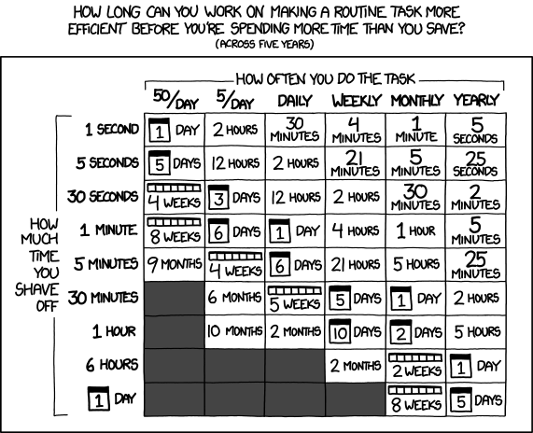
Is It Worth the Time?
http://xkcd.com/1205/

Slide 20
Batching (Merging) is easy
Scripting
  Avoids transfer of intermediate files
  Careful with error conditions
  Debugging can be a bit tricky

Slide 21
Breaking up is hard to do…
Ideally into parallel (separate) jobs
  reduced job requirements = more matches
  not always possible
Often need checkpoints
  standard universe can help
  user-defined check-pointing
  checkpoint images can be hard to manage

Slide 22
Automation: Parameter Sweeps
Command arguments can become complicated and messy.
Wrapper scripts could:
  Hardcode “extra” arguments
  Compute arguments
  Look up arguments from a table
Use $(Process) !!

Slide 23
‘Engineering’ a Good Workflow
Draw out the general workflow
Define details (test ‘pieces’ with HTCondor)
Define the computing workflow
  divide or consolidate processes
  off-load file transfers and consider file transfer times
  identify steps to be automated or checked
Build it piece-by-piece; test and optimize
Scale-up: data and computing resources
What more can you automate or error check?
(And document, document, document)

Slide 24
End Up with This
(special transfer)
file prep and split
(POST-RETRY)
1 GB RAM
2 GB Disk
1.5 hours
. . .
100 MB RAM
500 MB Disk
40 min
(each)
process ‘0’
(filter output)
process ‘99’
(filter output)
(POST-RETRY)
(POST-RETRY)
(PRE)
combine, transform results
(POST-RETRY)
300 MB RAM
1 GB Disk
15 min

Slide 25
Questions?
Feel free to contact me:
  lmichael@wisc.edu
Now: “Joe’s Workflow” Exercise 6.1
  9:30-10am, in groups
Later:
  10-10:30am: From Workflow to Production
  10:30-10:45am: Break
  10:45am-12:15: Exercises 6.2, 6.3

