Slide 1
Condor: BLAST
Monday, 3:30pm
Alain Roy <roy@cs.wisc.edu>
OSG Software Coordinator
University of Wisconsin-Madison

Slide 2

Before we begin…
Any questions on the lectures or exercises up to this point?

Slide 3
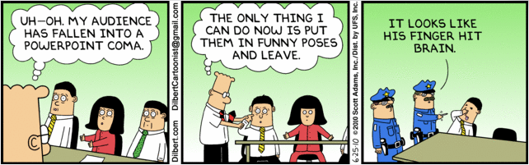
I hope you’re not getting too tired

Slide 4

BLAST
Up to now, you’ve done toy examples
  Simple, easy to use
  Illustrate basics of what you need to know
  The Mandlebrot set is cool… but a toy
Let’s try out a real application: BLAST
  More complex, not so easy to use

Slide 5
First, some honesty
I am a computer scientist
I am not a biologist
My knowledge of BLAST is shallow
But it’s way cooler application than what we’ve done so far!

Slide 6
BLAST Description
From the BLAST web page:
The Basic Local Alignment Search Tool (BLAST) finds regions of local similarity between sequences. The program compares nucleotide or protein sequences to sequence databases and calculates the statistical significance of matches. BLAST can be used to infer functional and evolutionary relationships between sequences as well as help identify members of gene families.

Slide 7
Blast Description
(My understanding)
Biologists have sequences:
  Nucleotides in DNA: ACGTTGCA…
  Amino acids in proteins: GECVASR…
They also have databases of lots of sequences
  From lots of organisms, from tiny bacteria to humans
BLAST helps them answer questions:
    Which bacterial species have a protein that is related in lineage to another protein?
    What other genes encode proteins that exhibit structures or motifs such as ones that have just been determined?
    …
BLAST is widely used and considered important

Slide 8
Is this just string comparison?
It’s harder than just comparing two strings: Is “GCTA == GCTA”?
BLAST can find “similar” sequences, based on metrics that biologists determine.
  “Similar” means this is more computationally expensive than just string comparison
BLAST is a very popular program to ask these questions

Slide 9
BLAST exercise
The final set of exercises have you run queries with BLAST
They are a bit arbitrary, because I know less about the underlying biology
But it’s a real application with real data!
Your challenge: run a bunch of BLAST queries and summarize the results. Do it all within a DAG

Slide 10
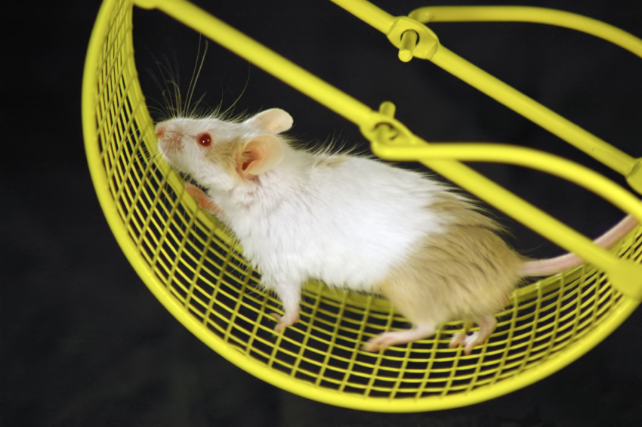
Time to try it out!

Slide 11
Questions?
Questions? Comments?
Feel free to ask me questions later:
  Alain Roy <roy@cs.wisc.edu>
Upcoming sessions
  Now – 5:00pm
    Hands-on exercises
    Finish up earlier exercises
    Try out BLAST
  5:00 – 7:00: Dinner, on your own
  7:00 – 9:00: Optional evening work session
    I’ll be there, with my laptop
    Come and finish up any exercises, try the challenges, ask me hard questions
    Or skip it and get a drink: it’s your choice

