Slide 1




Lecture 7
Building, Monitoring and Maintaining a Grid
Pradeep Padala
University of Florida
ppadala@cise.ufl.edu
Grid Summer Workshop
June 21-25, 2004

Slide 2
Credit Where Credit Is Due
Slides from Jorge Rodriguez
Thanks to the input from Rob Gardner

Slide 3
Outline
Why do you want to build a grid?
What are the issues involved in building in a grid?
Monitoring the health of a grid
Maintaining a robust and reliable grid
Expanding a grid
A Sample Grid (Grid3) and Details of its operations
SC’03 demo – showing the complexity involved in building, using, maintaining and monitoring the grid

Slide 4
Why do you want to build a grid?
Different perspectives
  User: I want to run my scientific application on the grid so that I can get results in 10 hours instead of 10 days
  Organization: Our next big experiment will generate tera-bytes of data and we want to distribute, share and analyze the data
  Organization: We want to tap into the existing grids and share resources

Slide 5
Why grid? User perspective
So, you need
  More CPU cycles
  More disk space
  More bandwidth
  All of the above
Do you really need a grid for the above?
A CPU cycle stealer, A simple Database or SRM (Storage Resource Management) system might do the trick for you

Slide 6
Why grid? User perspective
Your application is complex. Requires
  A lot of resources
  Reservation of resources at a particular time
  Monitoring of status of the submitted jobs to multiple sites
  Storage that is not easily available at a single place

Slide 7
Why grid? Organizational perspective
Federation of scientists – distributing, sharing and analyzing data
Tapping into existing grids
Cost-effective: A grid can be built from commodity software and hardware without spending millions on the next super duper computer.
Reliability: If a site fails, we can simply move our jobs to another site (this can be seen as a user perspective as well)

Slide 8
Broad Division of Grids
Before, we plunge into building a grid, let’s classify them in an easy-to-understand manner
Many confusing names and categorizations
A good way to characterize grids
  Data Grids
    Managing and manipulating large amounts of data. Main objective is to share large amounts of data that is otherwise impossible with out the grid
  Compute Grids
    For compute-intensive tasks. Emphasis is on the federation of CPU cycles and distribution of compute intensive tasks
There is no consensus on these categorization and it only aids in understanding the requirements

Slide 9
Building a Grid - Issues
Infrastructure
  Network
  CPU
  Disk Space
  Deciding on the kind of hardware
  Usually, Grids are built with existing infrastructure
Software
  Globus, Condor, VDT …
  Packaging
  Deciding on the operating system, Package versions. Linux is the most popular OS for building grids
  Standards !!!

Slide 10
Building a Grid - Issues
Policies
  Security
    Certificates
    Authorization mechanisms
  Accounting
Configuration
  One of the most difficult things
  Configuring various pieces of software
  Customization
Monitoring
  Monitoring your jobs
  Monitoring the health of a grid
  Some metrics: Load average, Number of jobs, Network delay …
Maintaining

Slide 11
So, you still want a grid, ☺

Slide 12
Building blocks
Resource Management
Information Services
Data Management
Security

Slide 13
Hardware
You don’t need specific hardware to build a grid, fortunately
You can build a grid out of existing commodity hardware. A cluster of Dell PC will work
But (that’s a big but), you should consider a few questions
  Can your machine handle the load of a CPU intensive job for days?
  Can the gatekeeper machine handle the load?
  Failovers
We will see some details of the hardware used in Grid3 later

Slide 14
Choosing the software
Interoperability
Ease of use
Ease of configuration
Development groups
Maintenance

Slide 15
Starting from Scratch
Buy a cluster of PCs
Download and Install Linux
Download Globus packages
  Packages are available for each component
Install and configure them
Get and install certificates for hosts and users
Assign a gatekeeper and start submitting jobs
Easy, isn’t it?
Unfortunately, it’s pretty difficult to configure and maintain such a grid
  Multitude of configuration files
  Technology overload

Slide 16
Using existing grid packages
VDT (Virtual Data Toolkit)
  Ensemble of grid middleware
  It’s as easy as typing the following command on your command line
    pacman -get VDT:VDT
    source setup.sh
Grid3 Package
  Built on top of VDT
  Provides a particular configuration of the VDT to work in the Grid3 environment
  Provides additional packages needed only by the Grid3 environments

Slide 17
Enter pacman (package manager) !
One of the most useful grid packages
A tool for fetching, installing and managing software pacakges
You can use it to install, configure and manage your applications as well
We will see an example in the exercise

Slide 18
An example pacman file
description = 'Text Editor'
url = 'http://www.nedit.org/'
download = {'*': 'nedit-5.1.1-linux-glibc.tar.gz'}
paths = [['PATH','']]
setup = ['pwd','ls']
Pacman helps you in fetching, installing and configuring software packages effortlessly
.pacman file is similar to a Makefile.

Slide 19
Configuration
Most difficult part of building a grid
VDT is great but some of the software packages require extensive configuration (I had experience with RLS configuration for the SC’03 demo)
Need to understand the technology involved
  Many complex software packages. Each with its own quirks
Use an existing configuration package (Grid3, any more? …)

Slide 20
A Sample Configuration procedure after you install Globus packages (animation)
Notes:
Animation or flowchart showing the steps. Some thing like. Get certs, update gridmap file, start services …

Slide 21
Monitoring a Grid
Why do you need to monitor the grid?
  To find the current status so that you can submit your jobs to the most reliable site
  To find the most suitable site for your jobs
  To predict the usage patterns for a site
Grid Monitoring Software
  Monalisa
  Ganglia
  Many others GridCat (Grid3), GridIce (LCG), Inca (TeraGrid)

Slide 22
Maintaining a Grid
Keeping up with the latest technologies
  New software packages
  Web and Grid Services
  New paradigm
Security updates
User management
  Certificates
  User addition
  Accounting (currently, no easy way of doing this)
Site maintenance

Slide 23
A Sample Existing Grid: Grid3

Slide 24
What is Grid2003/Grid3?
International Data Grid with dozens of sites
Serving applications across various disciplines HEP experiments (LHC, BTeV) Bio-chemical, CS demonstrators…
Currently over 2000 CPUS available for use by over 100 users
A peak throughput of 1100 concurrent jobs with a completion efficiency of approximately 75%
Note: Grid2003 refers to the initial project from 8/2003 – 12/2003
Grid3 refers to the persistent grid infrastructure

Slide 25
Grid3 Organization
Stakeholders:
  US LHC Software and Computing Projects
    US ATLAS, US CMS
  Grid projects (iVDGL, PPDG, GriPhyN)
    CS groups, VDT team, iGOC
  GriPhyN experiments
    LIGO, SDSS as well as ATLAS and CMS
New collaborators
  Vanderbilt BTeV (Fermilab) Group
  Argonne computational biology group
  U Buffalo chemical structure

Slide 26
Contributors
Boston University
Caltech
Hampton University
Harvard University
Indiana University
Johns Hopkins University
Vanderbilt University
University of Oklahoma
University of Chicago
University of Florida
University of Michigan
University at Buffalo
Argonne National Laboratory
Brookhaven National Laboratory
Fermi National Accelerator Laboratory
Kyungpook National University
Lawrence Berkeley National Laboratory
University of California San Diego
University of New Mexico
University of Southern California-ISI
University of Texas, Arlington
University of Wisconsin-Madison
University of Wisconsin-Milwaukee

Slide 27
Contributors
* Team Leads
Argonne National Laboratory: Jerry Gieraltowski, Scott Gose, Natalia Maltsev, Ed May, Alex Rodriguez, Dinanath Sulakhe, Boston University: Jim Shank, Saul Youssef, Brookhaven National Laboratory: David Adams, Rich Baker, Wensheng Deng, Jason Smith, Dantong Yu, Caltech: Iosif Legrand, Suresh Singh, Conrad Steenberg, Yang Xia, Fermi National Accelerator Laboratory: Anzar Afaq, Eileen Berman, James Annis, Lothar Bauerdick, Michael Ernst, Ian Fisk, Lisa Giacchetti, Greg Graham, Anne Heavey, Joe Kaiser, Nickolai Kuropatkin, Ruth Pordes*, Vijay Sekhri, John Weigand, Yujun Wu, Hampton University: Keith Baker, Lawrence Sorrillo, Harvard University: John Huth, Indiana University: Matt Allen, Leigh Grundhoefer, John Hicks, Fred Luehring, Steve Peck, Rob Quick, Stephen Simms, Johns Hopkins University: George Fekete, Jan vandenBerg, Kyungpook National University/KISTI: Kihyeon Cho, Kihwan Kwon, Dongchul Son, Hyoungwoo Park, Lawrence Berkeley National Laboratory: Shane Canon, Jason Lee, Doug Olson, Iowa Sakrejda, Brian Tierney, University at Buffalo: Mark Green, Russ Miller, University of California San Diego: James Letts, Terrence Martin, University of Chicago: David Bury, Catalin Dumitrescu, Daniel Engh, Ian Foster, Robert Gardner*, Marco Mambelli, Yuri Smirnov, Jens Voeckler, Mike Wilde, Yong Zhao, Xin Zhao, University of Florida: Paul Avery, Richard Cavanaugh, Bockjoo Kim, Craig Prescott, Jorge L. Rodriguez, Andrew Zahn, University of Michigan: Shawn McKee, University of New Mexico: Christopher T. Jordan, James E. Prewett, Timothy L. Thomas, University of Oklahoma: Horst Severini, University of Southern California: Ben Clifford, Ewa Deelman, Larry Flon, Carl Kesselman, Gaurang Mehta, Nosa Olomu, Karan Vahi, University of Texas, Arlington: Kaushik De, Patrick McGuigan, Mark Sosebee, University of Wisconsin-Madison: Dan Bradley, Peter Couvares, Alan De Smet, Carey Kireyev, Erik Paulson, Alain Roy, University of Wisconsin-Milwaukee: Scott Koranda, Brian Moe, Vanderbilt University: Bobby Brown, Paul Sheldon

Slide 28
Grid3 Services
Software packaging Service (pacman)
  Virtual Data Toolkit (VDT)
  Additional middleware configuration packages
Monitoring Services
  GridCat
  MonALISA
  ganglia
  Metrics Data Viewer
  ACDC Job Monitor
User Authentication Service
  Virtual Organization Management Service (VOMS)
Grid3 Operations
  The international Grid Operations Center (iGOC)

Slide 29
Grid3 Packaging

Slide 30
Grid Packaging Service
Packaging is the key to success!
  Automation in software installation greatly improves reliability of software deployments
Pacman package manager is used in Grid3
  Complete installation and site configuration is simplified to a single command:
  In reality it takes a little more work. However…
% pacman –get iVDGL:Grid3
ref. pacman --- http://physics.bu.edu/~youssef/pacman/

Slide 31
The VDT packages vers 1.1.14
Globus Alliance
  Grid Security Infrastructure (GSI)
  Job submission (GRAM)
  Information service (MDS)
  Data transfer (GridFTP)
  Replica Location (RLS)
Condor Group
  Condor/Condor-G
  DAGMan
  Fault Tolerant Shell
  ClassAds
EDG & LCG
  Make Gridmap
  Cert. Revocation List Updater
  Glue Schema/Info provider
ISI & UC
  Chimera & related tools
  Pegasus
NCSA
  MyProxy
  GSI OpenSSH
LBL
  PyGlobus
  Netlogger
Caltech
  MonALISA
VDT
  VDT System Profiler
  Configuration software
Others
  KX509 (U. Mich.)

Slide 32
Grid3 Monitoring

Slide 33
Monitoring Services
GridCat - http://www.ivdgl.org/grid3/catalog/
  Site catalog and summary information and site status display
Ganglia - http://gocmon.uits.iupui.edu/ganglia-webfrontend
  Open source tool to collect cluster monitoring information such as CPU and network load, memory and disk usage
MonALISA - http://gocmon.uits.iupui.edu:8080/index.html
  Monitoring tool to support resource discovery, access to information and gateway to other information gathering systems
ACDC Job Monitoring System - http://acdc.ccr.buffalo.edu/statistics/acdc/fullsizeindexqueue.php
  Application uses globus GRAM to query job managers and collect information about jobs. This information is stored in a DB and available for aggregated queries and browsing.
Metrics Data Viewer (MDViewer) - http://grid.uchicago.edu/metrics/
  Application to display and analyze information collected by the different monitoring tools, queries Metrics DBs at iGOC.
Globus MDS
  Information and Index Service for resource discovery, selection and optimization. GLUE schema with Grid3 extension

Slide 34
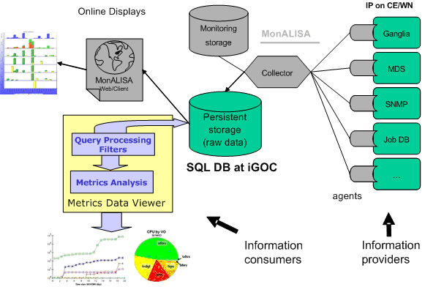
Monitoring Infrastructure

Slide 35
Grid3 Authentication

Slide 36
Grid3 Authentication
edg-mkgridmap
DN mappings
user DNs
gridmap-file
iVDGL VOMS server
site a client
BTeV, LSC, iVDGL
site b client
gridmap-file
user DNs
mapping of user’s grid credentials (DN) to local site group account
FNAL VOMS server
USCMS, SDSS
user DNs
BNL VOMS server
USATLAS
site n client
gridmap-file

Slide 37
Grid3 Operations

Slide 38
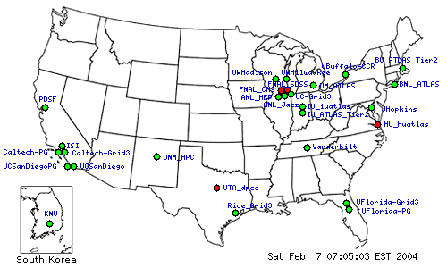
Grid3 Operations: (iGOC)
http://www.ivdgl.org/grid2003/catalog

Slide 39
Grid3 Operations
Support and Policy
Investigation and resolution of grid middleware problems at the level of 16-20 contacts per week
With other iGOC personnel develop Service Level Agreements for iVDGL Grid service systems and iGOC support service.
Membership Charter completed which defines the process to add new VO’s, sites and applications to the Grid Laboratory
Support Matrix defining Grid3 and VO services providers and contact information

Slide 40
Grid2003 Applications

Slide 41
Project Application
Overview
7 Scientific applications and 3 CS demonstrators
  All iVDGL experiments participated in the Grid2003 project
  A third HEP and two Bio-Chemical experiments also participated
Over 100 users authorized to run on Grid3
  Application execution performed by dedicated individuals
  Typically 1, 2 or 3 users ran the applications from a particular experiment
Participation from all Grid3 sites
  Sites categorized according to policies and resource
  Applications ran concurrently on most of the sites
  Large sites with generous local use policies where more popular

Slide 42
Running on Grid3
With information provided by the Grid3 information system
  Composes list of target sites
    Resource available
    Local site policies
  Finds where to install application and where to write data
    Use of Grid3 Information Index Service (MDS)
    Provides pathname for $APP, $DATA, $TMP and $WNTMP
  User sends and remotely installs application from a local site
    Entire application environment is shipped with the executable!
  User submit job(s) through globus GRAM
User never needs to interact with local site administrators other than through the Grid3 services!

Slide 43
Grid3 Metrics

Slide 44
Grid3 Metrics Collection
Grid3 monitoring applications (information consumers)
  MonALISA
  MetricsData Viewer
Queries to persistent storage DB (on the gocmon server)
  MonALISA plots
  MDViewer plots

Slide 45
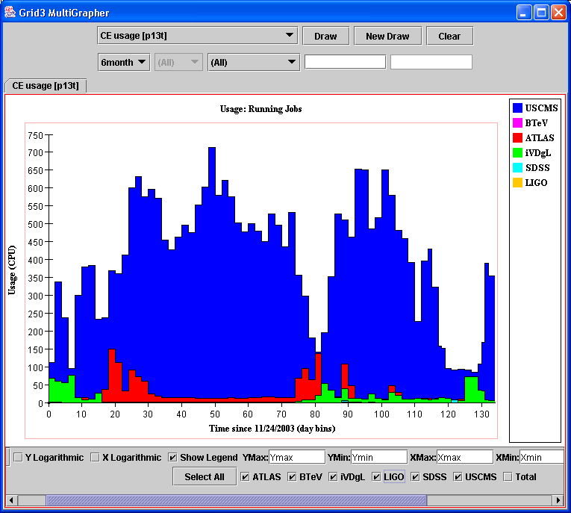
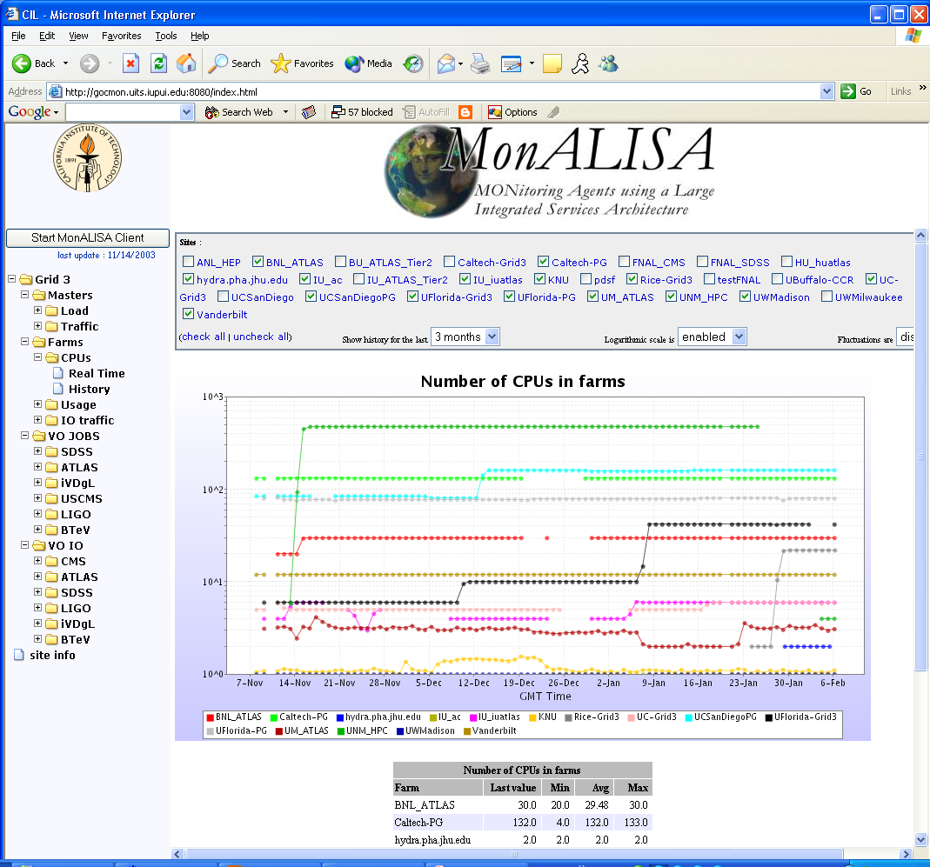
Grid3 Metrics Collection
MDViewer
MonALISA

Slide 46
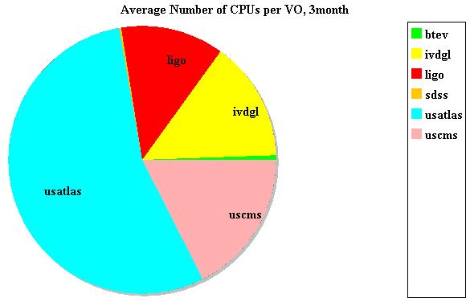
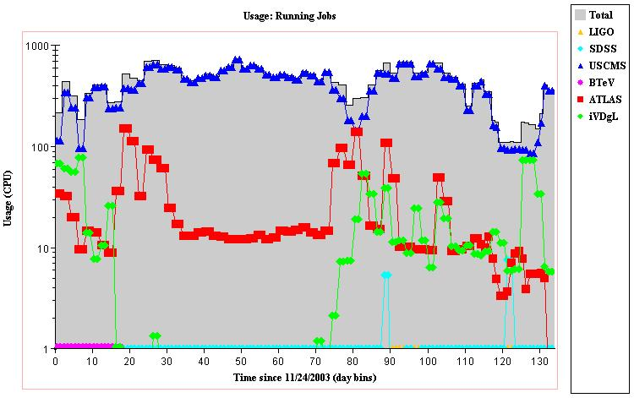
Grid3 Status Summary
Current hardware resources
  Total of 2693 CPUs
    Maximum CPU count
    Off project contribution > 60%
  Total of 25 sites
    25 administrative domains with local policies in effect
    All across US and Korea
Running jobs
  Peak number of jobs 1100
  During SC2003 various Scientific applications were running simultaneously across various Grid3 sites

Slide 47
Conclusions
Grid computing has a long way to go to reach the goal: “plug in and you get the power”
Many complex issues are involved in building and maintaining a grid
Various software packages are developed to ease the burden
Happy Grid hacking ☺

