Slide 1




Ana Damjanovic (JHU, NIH)
JHU:
Petar Maksimovic
Bertrand Garcia-Moreno
NIH:
Tim Miller
Bernard Brooks
OSG:
Torre Wenaus
and team

Slide 2
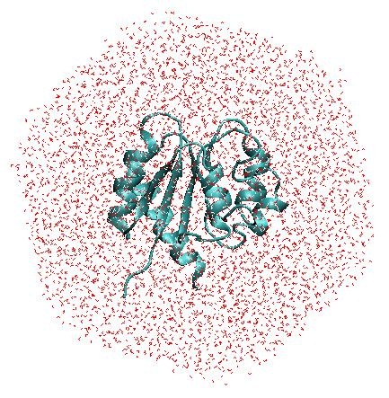
CHARMM and MD simulations
CHARMM is one of the most widely used programs for computational modeling, simulations and analysis of biological (macro)molecules
The widest use of CHARMM is for molecular dynamics (MD) simulations:
Atoms are described explicitly
interactions between atoms are described with an empirical force-field * electrostatic, van der Waals
  * bond vibrations, angle bending, dihedrals …
Newton’s equations are solved to describe
time evolution of the system: timestep 1-2 fs
typical simulation times: 10-100 ns
CHARMM has a variety of tools for analysis of MD
trajectories

Slide 3
Why OSG?
Many biological processes are statistical in nature.
Simulations of such processes parallelize naturally.
Performance of multiple simulations on OSG will help with:
Accuracy
  Sampling necessary for calculation of experimental observables
  Simulate mutants, compare their behavior and compare with experiments
  Test several force-fields - different force-fields may produce different results
Describe long timescale processes (μs and longer)
  Run large number of simulations (increase probability of observation of
  important events)
  Test different “alternative” methods

Slide 4
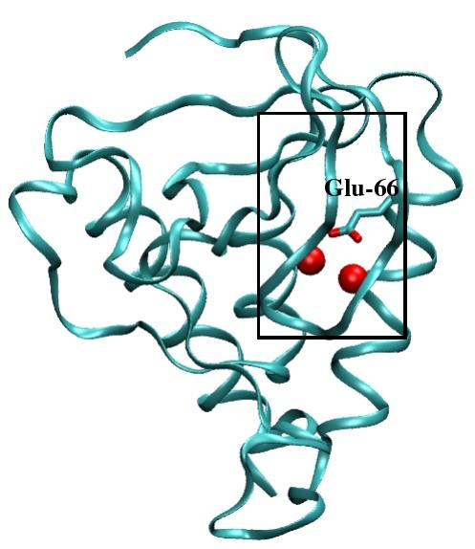
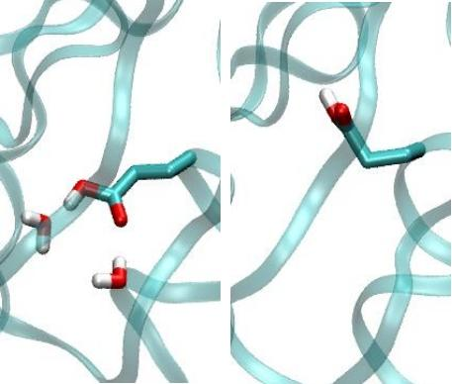
Hydration of the protein interior
Interior water molecules can play key roles in many biochemical processes such as
proton transfer, or catalysis.
Precise location and numbers of water molecules in protein interiors is not always
known from experiments.
Knowing their location is important for understanding how proteins work, but also
for drug design
Crystallographic structures obtained at different temperatures
disagree in the number of observed water molecules.
How many water molecules are in the protein interior?
staphylococcal nuclease
Using traditional HPC resources
we performed 10 X 10 ns
long MD simulations.
Not enough statistics!
Two conformations, each different
hydration pattern
Use OSG to run lots of simulations with different initial velocities.

Slide 5
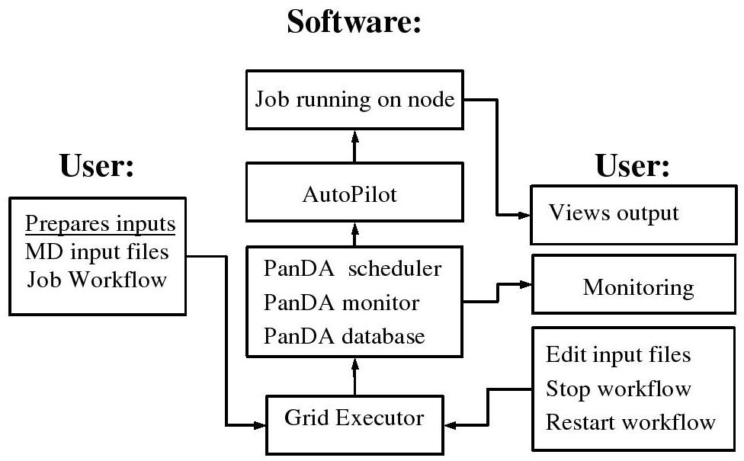
It is easy to run jobs on the OSG
Manual submission and running of a large number of jobs can be
time-consuming and can sometimes lead to errors
OSG personnel very helpful in getting this scheme running
PanDA was developed for ATLAS, and is being evolved into OSG-WMS

Slide 6
Accomplishments with use of OSG
staphylococcal nuclease
2 initial structures X 2 methods
each 40 X 2 ns long simulations
Total: 160 X 2ns.
Total usage: 120K cpu hours
Interior water molecules can
influence protein conformations
Different answers obtained if simulations started with and
without interior water molecules
Longer runs are needed to answer “how many water molecule are in the protein?”
Parallel CHARMM is key to running longer simulations (as simulation time is reduced).
OSG has set up a queue for an MPI version of CHARMM, and this queue is
currently being tested.

Slide 7
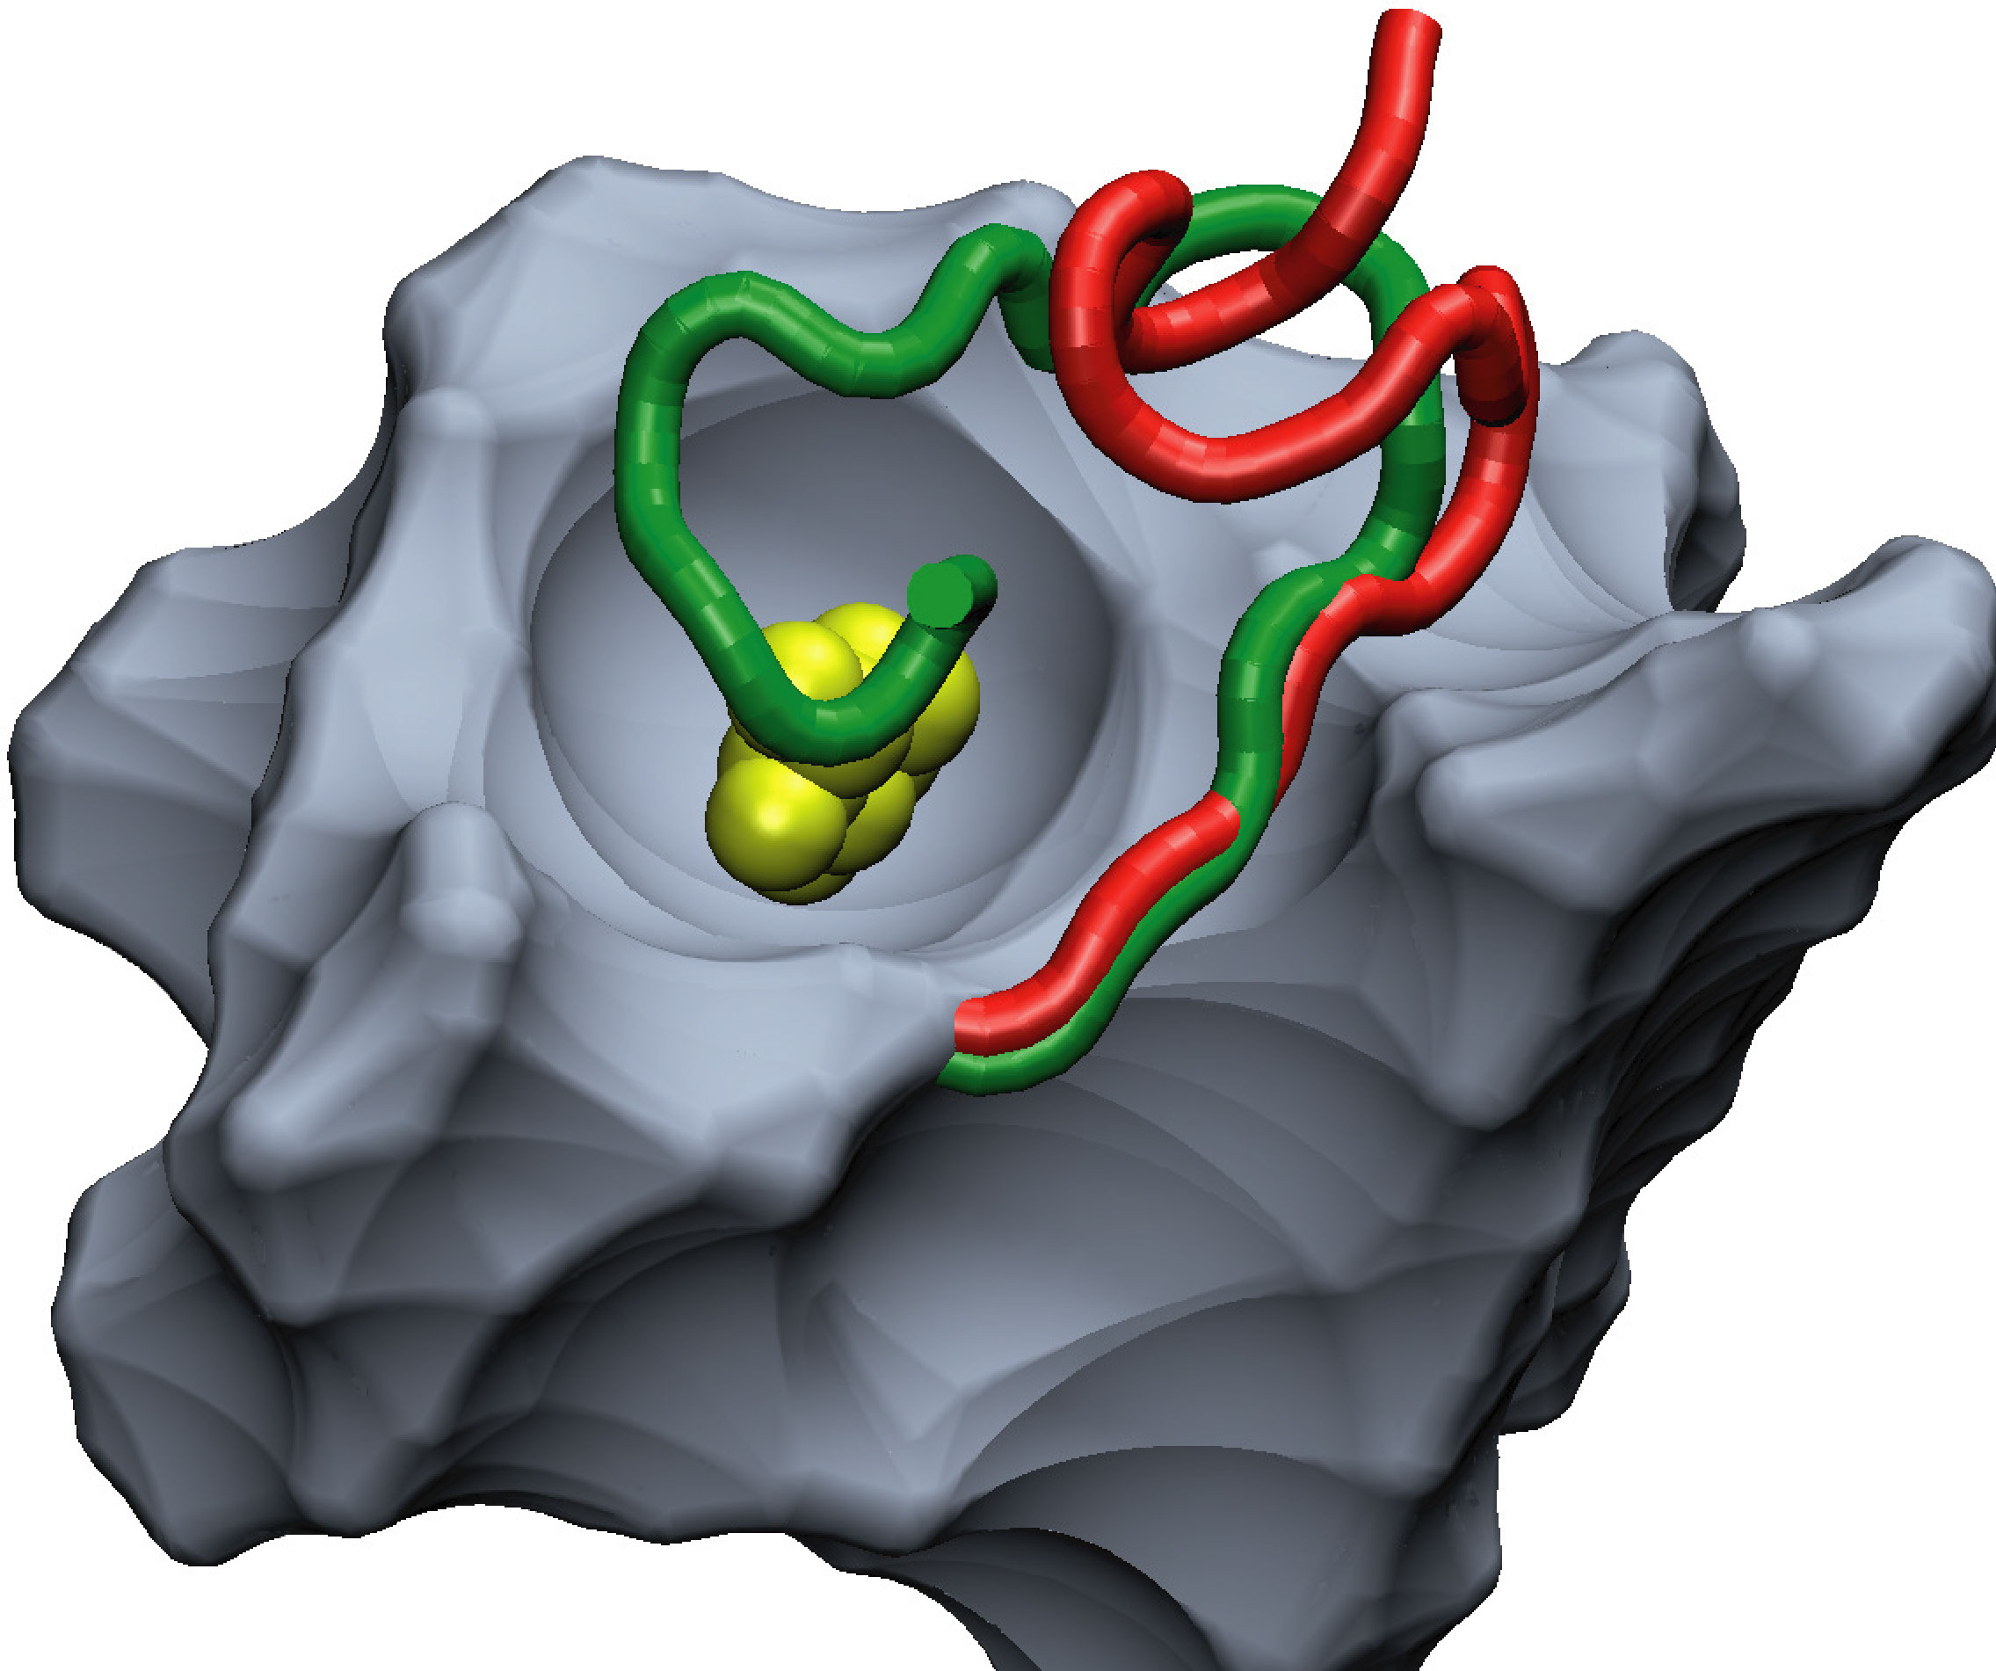
Plans for near term future
Hydration of interior of staphylococcal nuclease:
  answer previous question: (80 X 8 ns = 153K cpu hours)
  test new method for conformational search, SGLD (80 X 8 ns = 153K cpu hours)
Conformational rearrangements and effects of mutations in AraC protein.
    when sugar arabinose is present, “arm”, gene expression on
    when sugar arabinose is absent, “arm”, gene expression off
Computational requirements:
Wild type with and without arabinose (50 X 10 ns)
F15V with and without arabinose (50 X 10 ns)
Total: 100 X 10 ns = 240K cpu hours
Additional test simulations (100 X 25 X 1 ns)
Total: 2500 X 1ns = 600K cpu hours
Provide feedback to experiments

Slide 8
Long term needs
Study conformational rearrangements in other proteins
Conformational rearrangements are at the core of key biochemical processes such as regulation of enzymatic and genetic activity.
Understanding of such processes is pharmaceutically relevant.
Such processes usually occur on timescales of μs and longer, are not readily sampled in MD simulations.
Experimentally little is know about the mechanisms of these processes.
Poorly explored territory, will be “hot” for the next 10 years
    Use brute force approach
    Test performance of different methods
    Test different force fields
    Study effects of mutations -> provide feedback to experiments

Slide 9
Impact on scientific community
CHARMM on OSG is still in testing and development stage so
the user pool is small
Potential is great - there are 1,800 registered CHARMM users
bring OSG computing to hundreds of other CHARMM users
  give resources to small groups
  do more science by harvesting unused OSG cycles
  provide job management software
“Recipe” used here developed for CHARMM, but can be easily extended to
other MD programs (AMBER, NAMD, GROMACS...)‏

