Slide 1
Federal Public Key Infrastructures:
HSPD-12 and
DOE Entrust
John Volmer
Computing and Information Systems
OSG ESnet Requirements Gathering
9 November 2009

Slide 2

























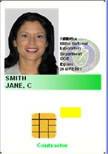



Argonne Public Key Infrastructure Participation
Federal Bridge
TAGPMA
Market: authentication
secure email
Argentina
NCSA
APGridPMA
NASA
DoD
Chile
SDSC
www.igtf.net
www.cio.gov/fbca
Mexico
Australia
DHS
Brasil
India
Ill
US Federal PKI
FNAL
Dartmouth
Phillipines
Japan
Global GRID CAs
TACC
UoV
Malaysia
DoS
Purdue
Thailand
New Zealand
Treas
Venezuela
South Korea
FBCA
G2B
ORNL
HQ PCA
KCP
Viet Nam
Taiwan
China
Common
Policy
LANL
Y-12
DOE
Entrust
PKI
Armenia
LLNL
Estonia
Croatia
Portugal
SNL
Greece
Austria
Switzerland
Market:: authentication
UK
Italy
Canada
HSPD12
RF
HQ CA
Ireland
Germany
Pantex
PNNL
DOE GRIDS
Netherlands
Spain
Hungary
CERN
FIPS 199 = (H, H, M)
FIPS 199 = (M, M, M)
Turkey
EUGridPMA
Market: secure email
FIPS 199 = (L, L L)
Market: authentication
Argonne National Laboratory
(auto enroll)
ANL
Market: authentication
FIPS 199 = (L, M, L)
Notes:
Argonne participates in both the United States federal Public Key Infrastructure but also the academic grid computing
Have contacts across the DOE complex as well as with DOD and GSA.
Chairman of the DOE ScienceGrid Policy Management Authority (PMA) Driving strategic planning and interaction between blue and yellow.
NATO Science for Peace and Security Program
Jens Jensen
Arsen Hayrapetyan
Establish Public Key Infrastructures in NAtO partner countries.
March 2008
Related to EUGridPMA

Slide 3
Argonne Public Key Infrastructure Participation – HSPD-12/PIV
www.igtf.net
www.cio.gov/fbca
US Federal PKI
Global GRID CAs
Market: authentication
HSPD12
FIPS 199 = (H, H, M)
Argonne National Laboratory
Notes:
Argonne participates in both the United States federal Public Key Infrastructure but also the academic grid computing
Have contacts across the DOE complex as well as with DOD and GSA.
Chairman of the DOE ScienceGrid Policy Management Authority (PMA) Driving strategic planning and interaction between blue and yellow.
NATO Science for Peace and Security Program
Jens Jensen
Arsen Hayrapetyan
Establish Public Key Infrastructures in NAtO partner countries.
March 2008
Related to EUGridPMA

Slide 4

Federal Government HSPD-12 Initiative
Driven by Homeland Security Presidential Directive 12 (HSPD-12)
  Secure and reliable forms of identification
  Physical and Logical Access
Vetting Requirements
  Basic background investigation (SF-85)
  fingerprints taken
  photograph
  DOE Order 206.4
Sponsor
Registrar
(federal)
Badge Issuer
Recommends badge issuance
Approves badge issuance
Issues badge
http://www.fedidcard.gov
Mutually Exclusive

Slide 5
Federal Government HSPD-12 Initiative
Card contains three certificates
  Authentication
  Digital Signature
  Encryption (but no directory for certificate lookup!)
Enables Logical Access to Windows & MacOS (Demonstration?)
Discussion has begun on
  PIV-Interoperable (PIV-I) - trusted certificates
  PIV-Compatible (PIV-C) - untrusted certificates
  Enable interoperability with suppliers, contractors, etc
  Exploit PIV standard: Windows 7 support, etc.
Ultimately 10M card holders, 600 at Argonne

Slide 6
Argonne Public Key Infrastructure Participation – DOE Entrust
Federal Bridge
www.igtf.net
www.cio.gov/fbca
US Federal PKI
Global GRID CAs
G2B
ORNL
HQ PCA
KCP
Y-12
LANL
DOE
Entrust
PKI
SNL
LLNL
RF
HQ CA
Pantex
PNNL
FIPS 199 = (M, M, M)
Market: secure email
Argonne National Laboratory
Notes:
Argonne participates in both the United States federal Public Key Infrastructure but also the academic grid computing
Have contacts across the DOE complex as well as with DOD and GSA.
Chairman of the DOE ScienceGrid Policy Management Authority (PMA) Driving strategic planning and interaction between blue and yellow.
NATO Science for Peace and Security Program
Jens Jensen
Arsen Hayrapetyan
Establish Public Key Infrastructures in NAtO partner countries.
March 2008
Related to EUGridPMA

Slide 7

DOE Entrust PKI
70,000 certificates licensed
  450 certificates at Argonne
Used for secure electronic mail: encryption
  DOE Complex
  DOD
  DHS
Logical Access ?
  Version 8 uses Microsoft Certificate Store
Enterprise Product
  Encryption key escrow
  Automatic certificate renewal
G2B
ORNL
HQ PCA
KCP
Y-12
LANL
SNL
LLNL
RF
HQ CA
Pantex
PNNL
http://www.cio.energy.gov/cybersecurity/pki.htm

Slide 8
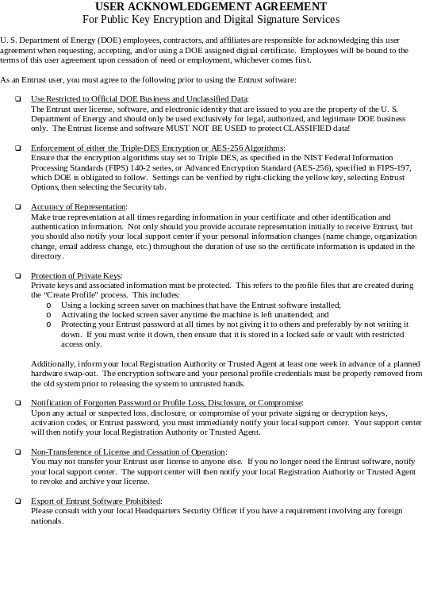
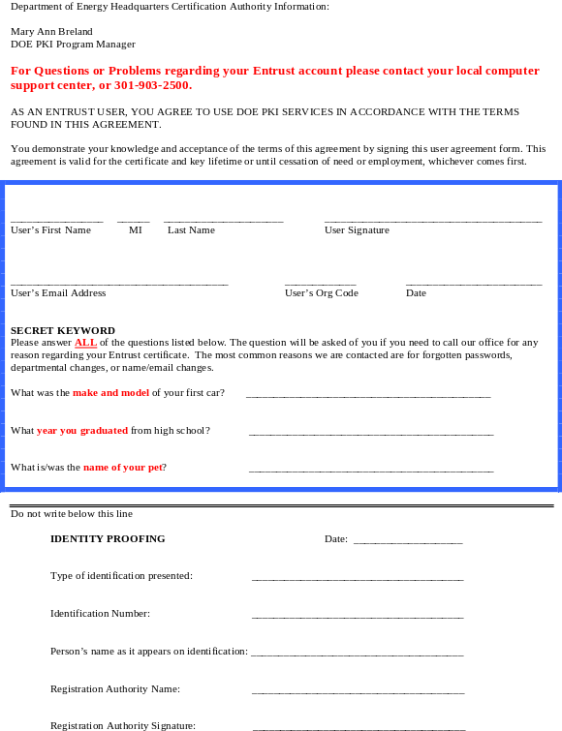
DOE Entrust PKI
Vetting requirements
  In person either RA or Trusted Agent (TA)
  Photo id
Common Policy compliance
  Periodically externally audited

Slide 9
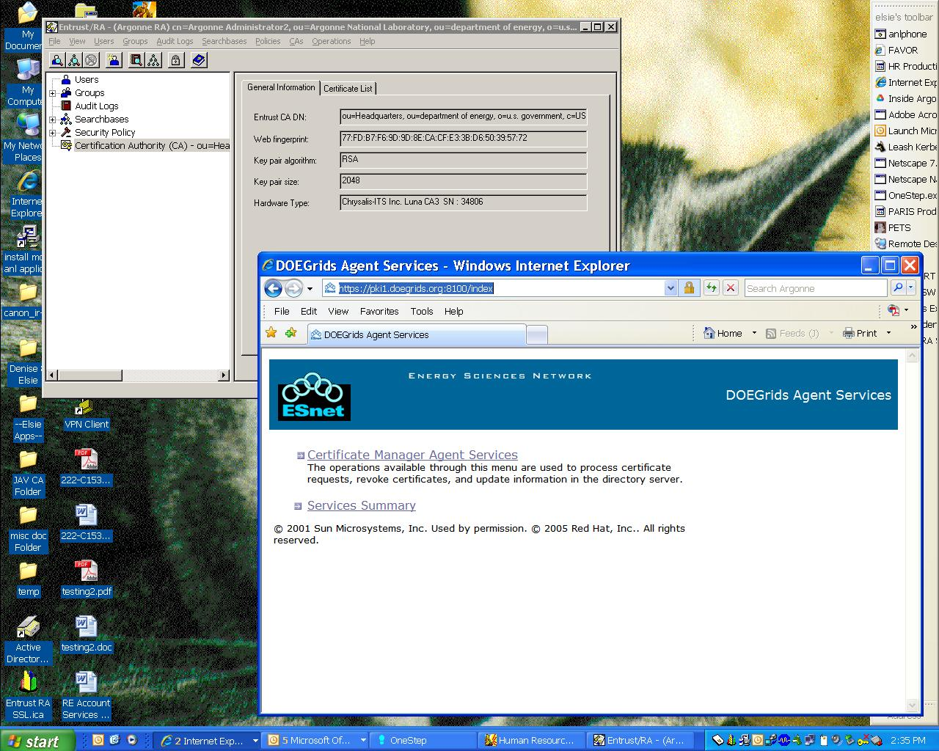
Registration Agent Desktop
DOE Entrust
DOE Grids

Slide 10
Which brings us to …
Questions and discussion

Slide 11
Other

Slide 12
RealID Act 2005
Standardized drivers licenses
  Desire for smartcard platform
Standardized birth certificates

Slide 13
Growth of ISO 14443 RFID

Slide 14
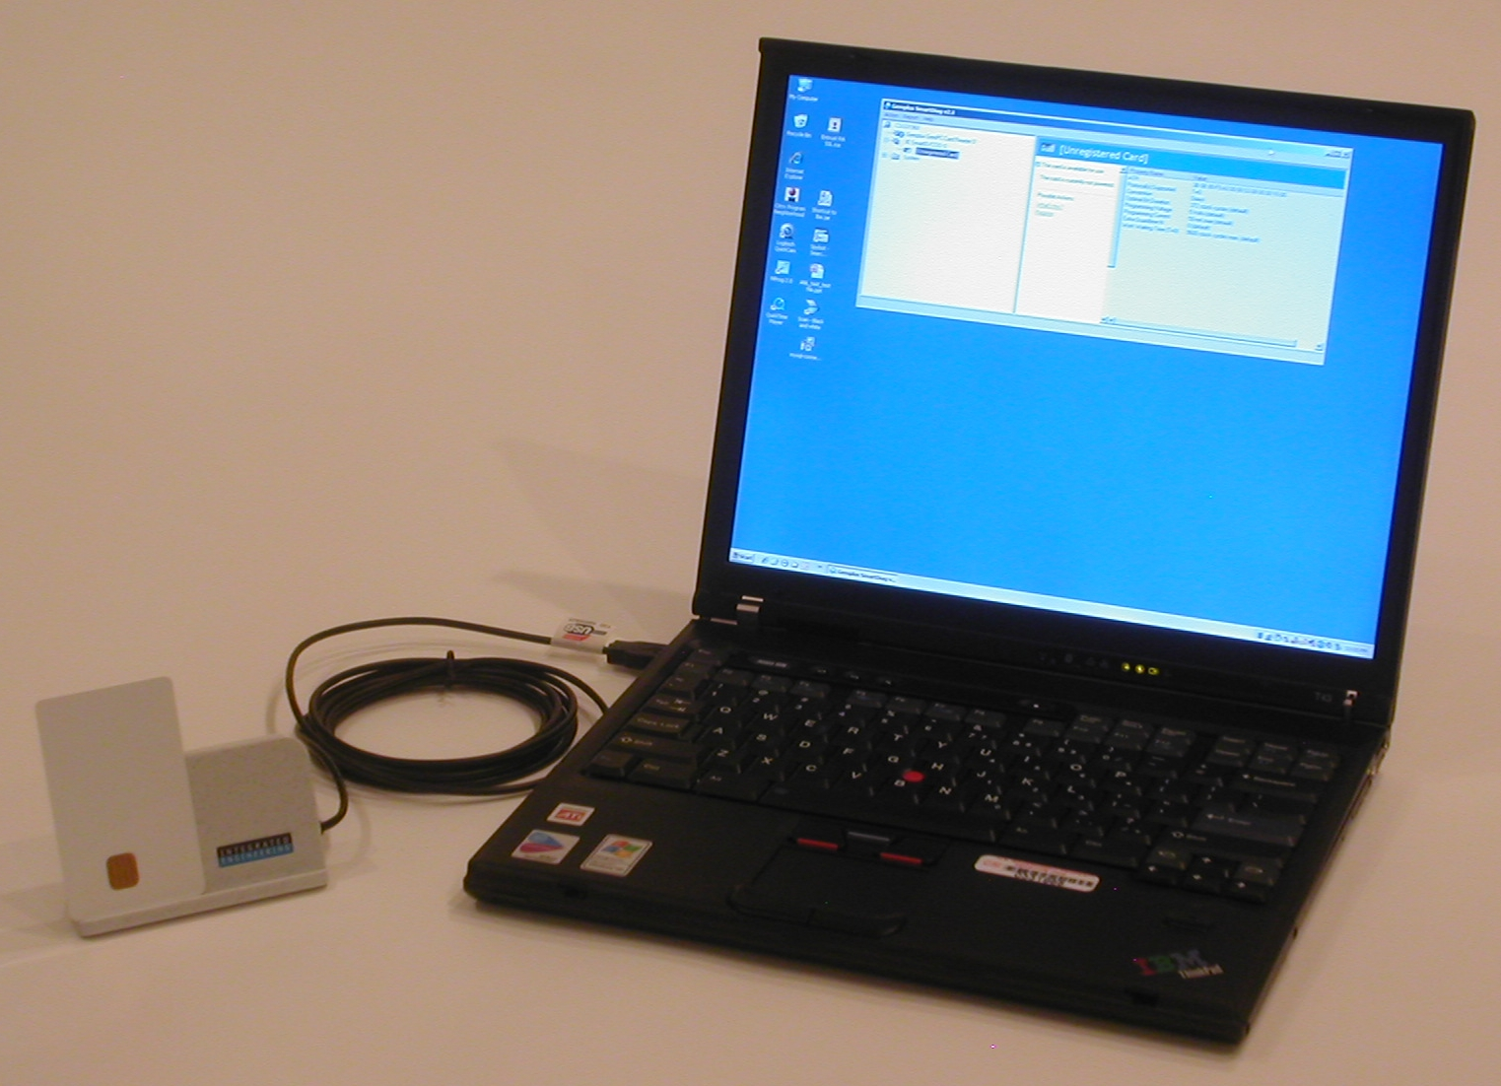
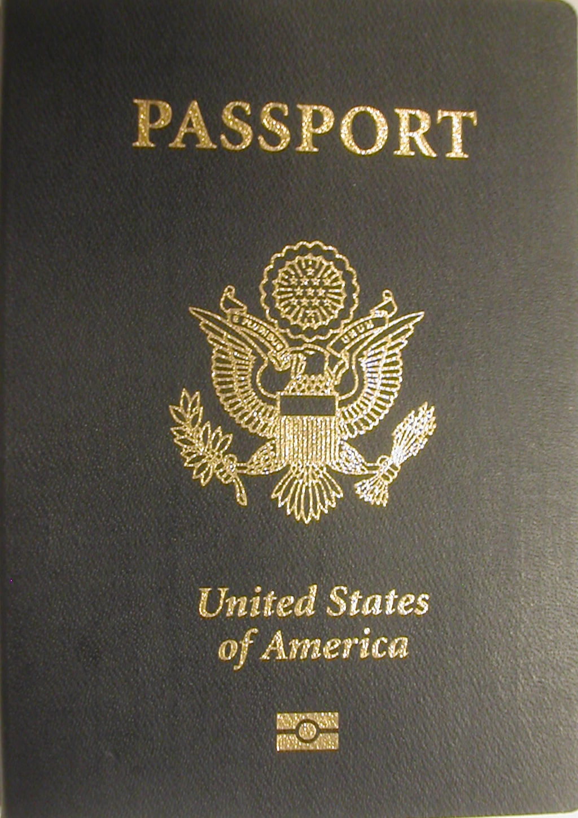
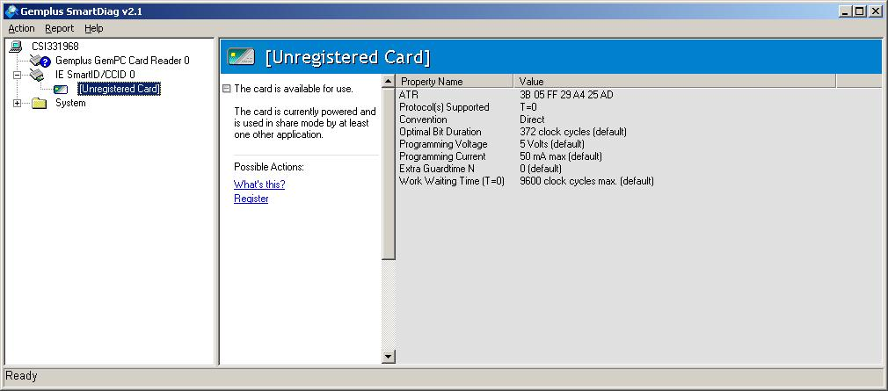
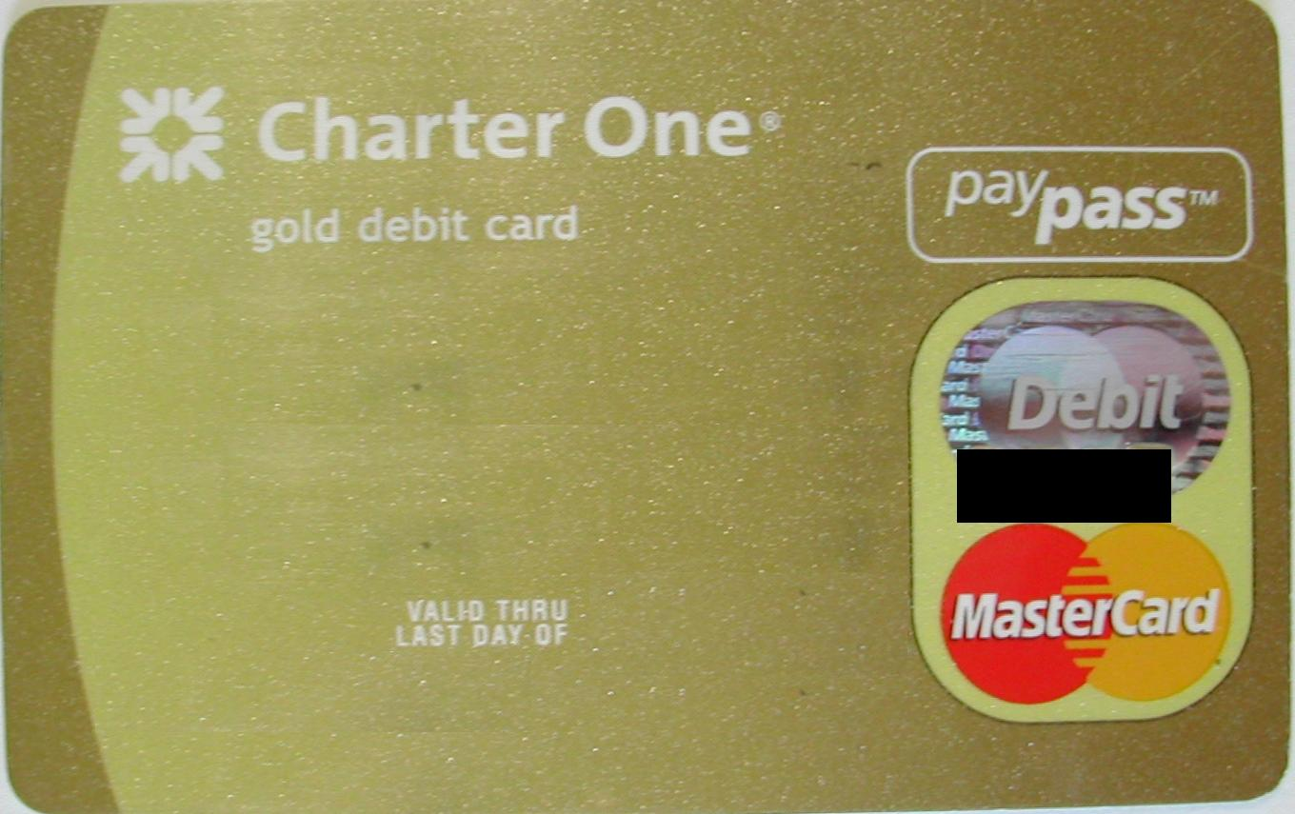

Growth of Personal RFID
ISO 14443: smart card protocol over RFID
ISO 14443 RFID Sources
Detection Tool
Answer-To-Reset (ATR)
Responses
Integrated Engineering
ISO 14443 Reader
Many devices are RFID responsive
HSPD-12/PIV Badges
Est. 10M holders
3B 0B 80 F9 A0 00 00 03 08 00 00 10 00
3B 05 FF 29 A4 25 AD
ePassports
(US + 35 nations)
US issued 13M in 2006
3B 08 00 53 4F 43 53 84 90 00
Contactless Payment Cards
(14M issued in 2006)
3B 05 FF 72 17 E7 E2
Gemalto Smart Card
Diagnostic Utility
Chip and Antenna visible through translucent card
Stay tuned . . .

Slide 15
http://www.fips201.com/articles/2009/11/02/iab-october-meeting-audio

