Slide 1
2011 OSG Summer School
Summary of the
Cloud session live demo
by Igor Sfiligoi
University of California San Diego

Slide 2
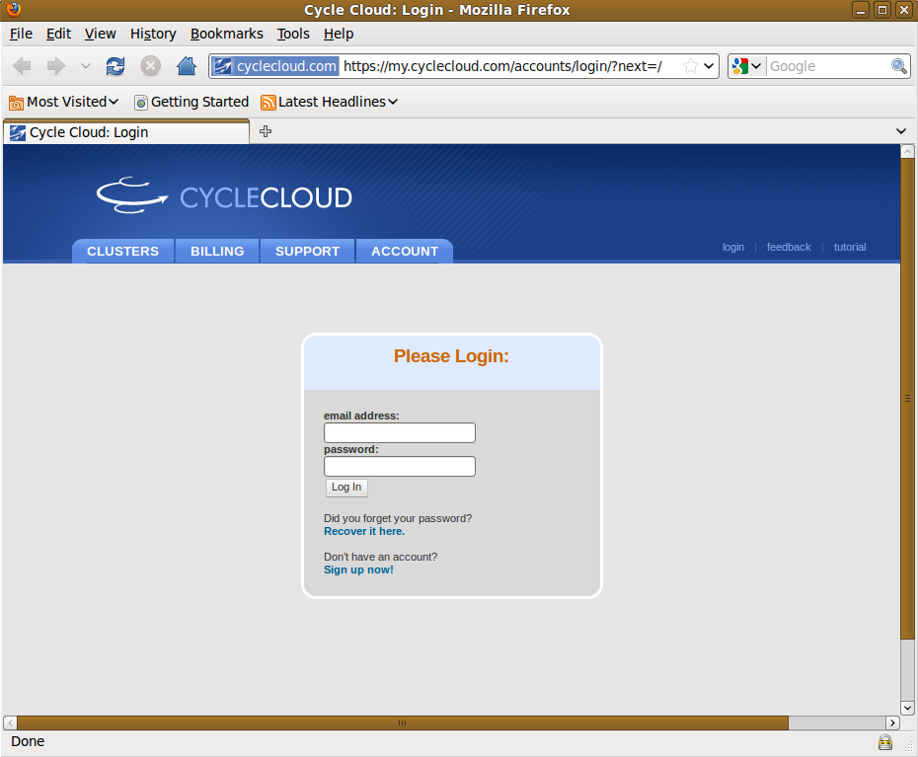
CycleCloud Login

Slide 3
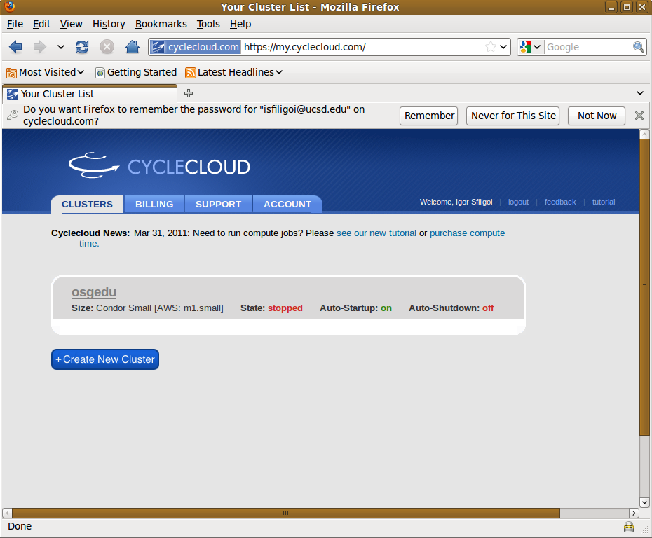
Cloud Cluster Control Center

Slide 4
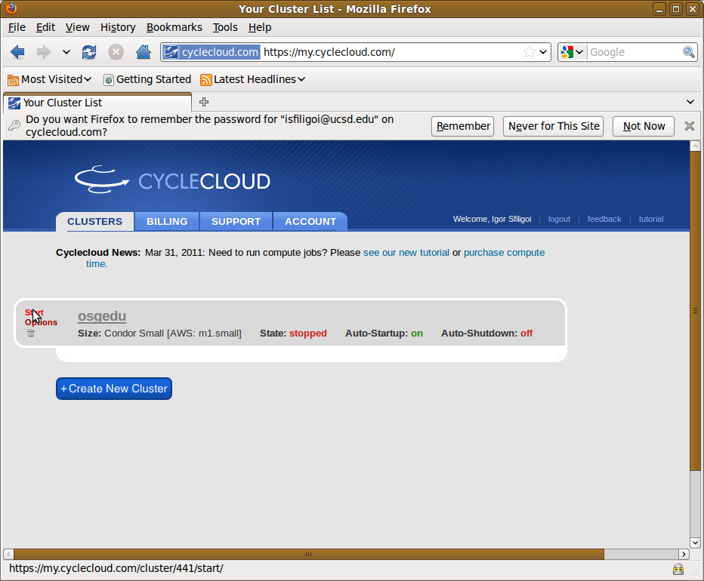
Starting the cluster

Slide 5
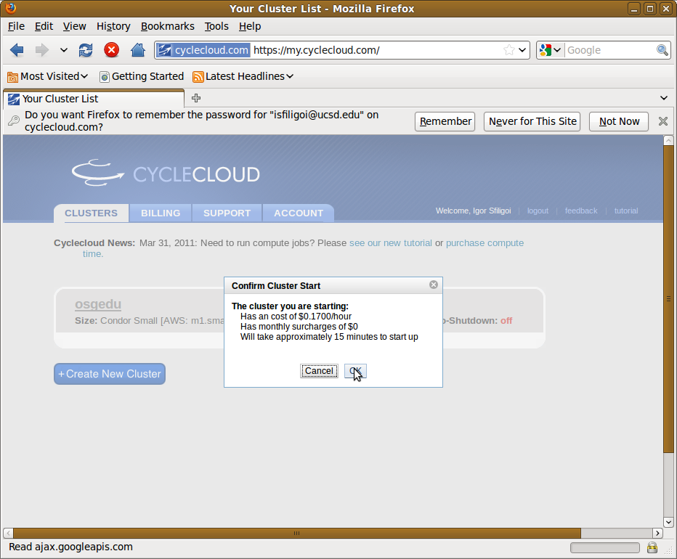
Cost information

Slide 6
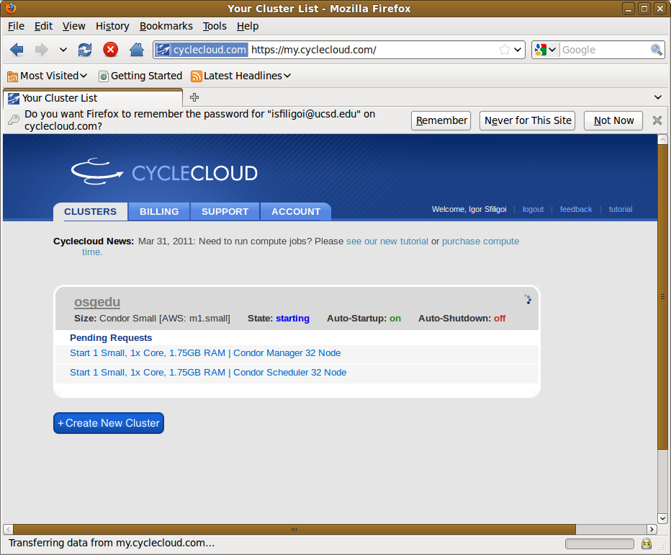
Waiting for login node to start

Slide 7
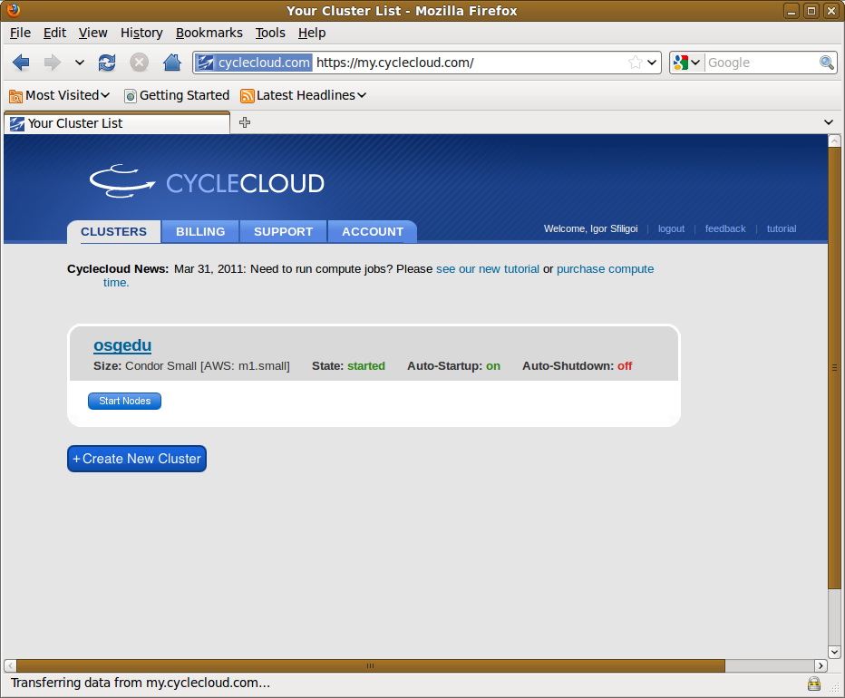
The submit node is ready

Slide 8
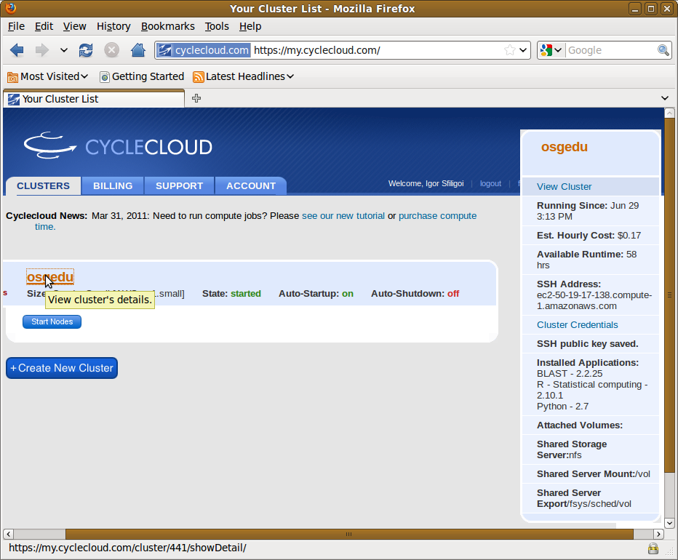
Obtaining the SSH address

Slide 9
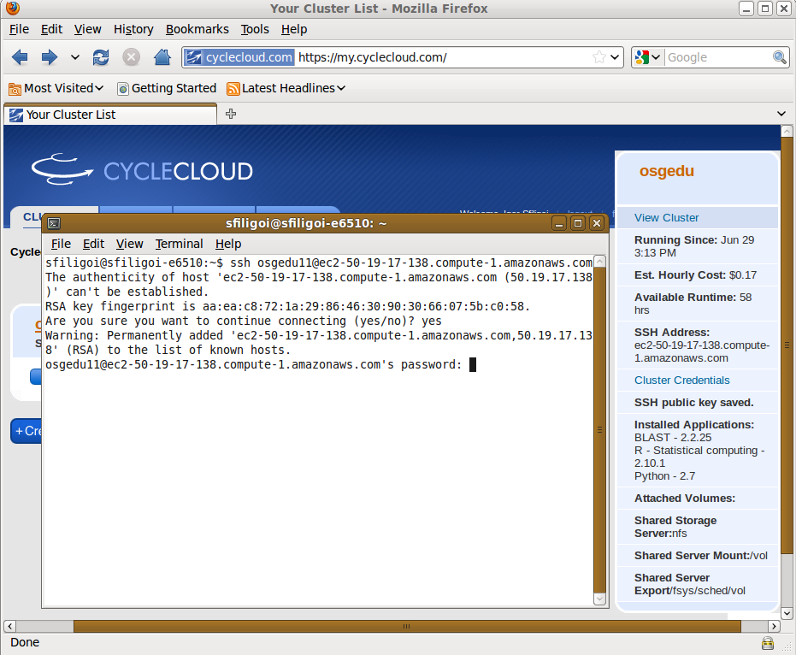
Using ssh to log in

Slide 10
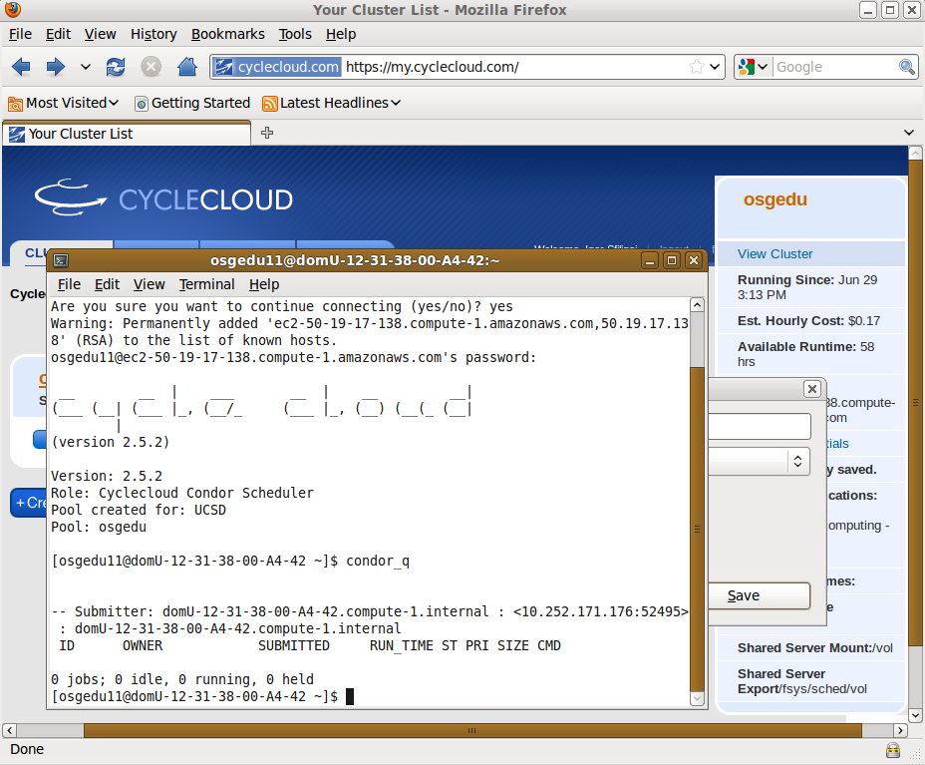
A peek at the Condor system
Students can
prepare and submit
their jobs

Slide 11
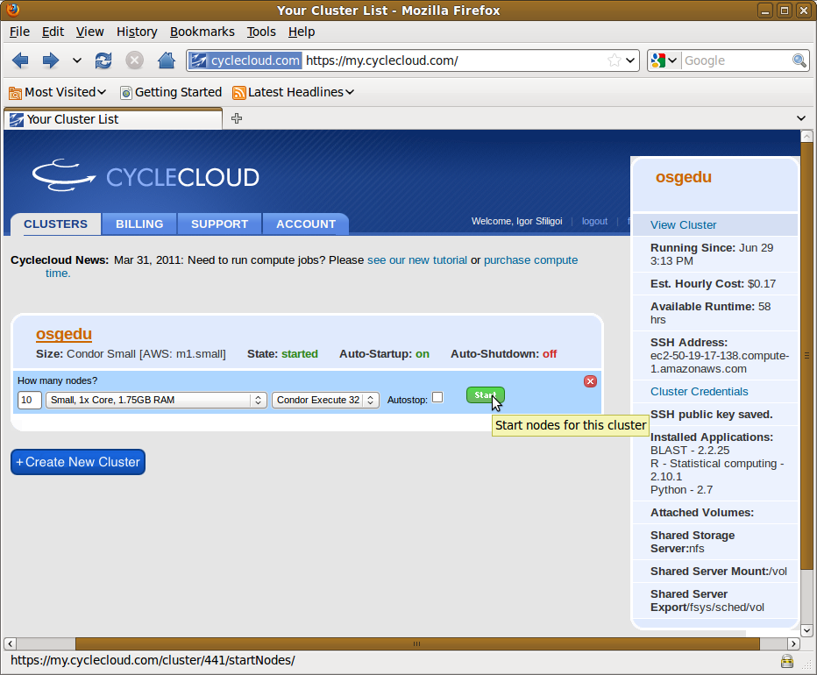
Request worker nodes

Slide 12
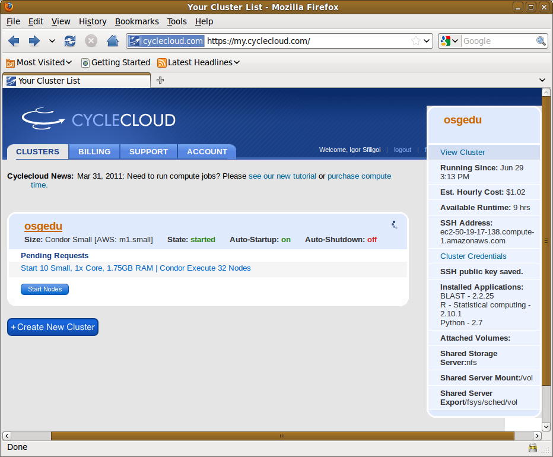
Waiting for worker nodes

Slide 13
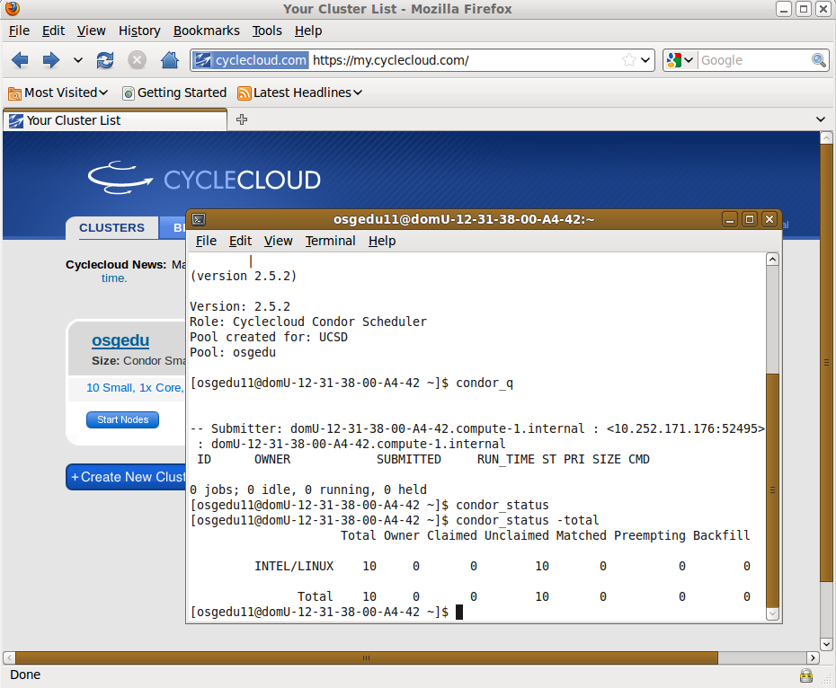
We have our Condor pool
Students' jobs
start to run.

Slide 14
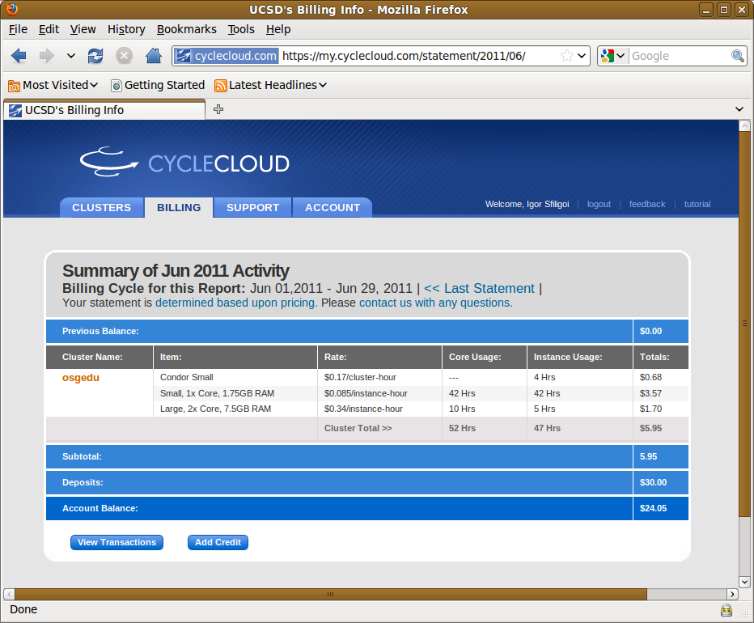
Monitoring the cost

Slide 15
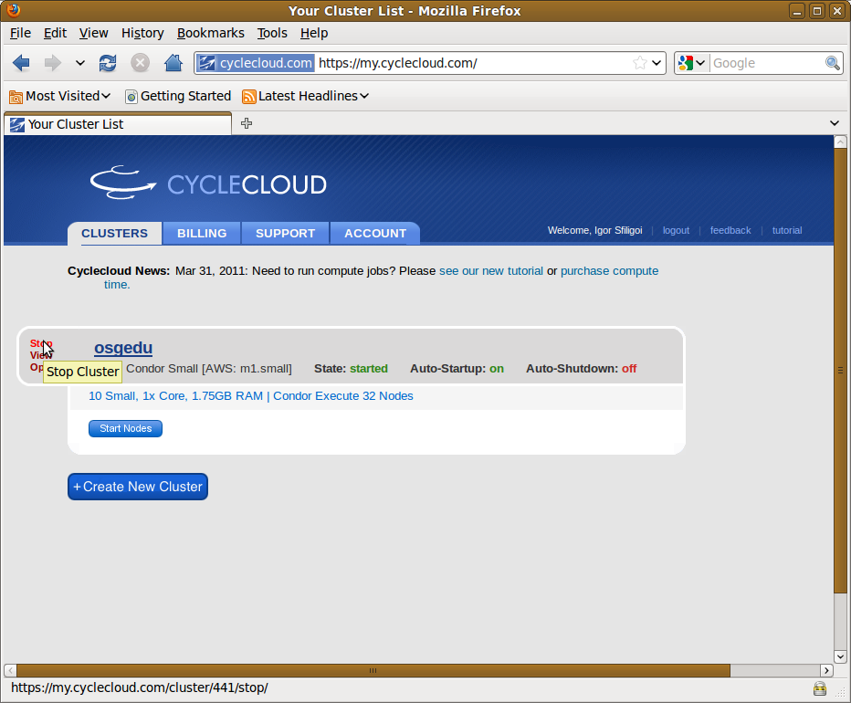
Preparing to stop the cluster

Slide 16
The end

