Slide 1
Campus Grids
Current Initiatives
  Contacted Emory University deputy CIO -> no news
  Invited to UTEP to talk about Condor deployment and applications -> visit in september
  Will meet with Russ Hobby at OSG AHM about UC Davis -> no update
  Setting up Clemson user to submit locally, run globally on Engage through JobRouter -> continued
  Training some undergrads to become OSG admins (now have two students on CI-team and one more student in the pipe learning dcache, plus one student at ISGGC in hungary)
  No OSG jobs for windows pool !
  Monitoring RIT campus grid and their effort to join OSG (Brent Strong and Gurcharan Khanna) -> offered help
  Discussion with New Jersey to put a resources on OSG (Gedaliah Wolosh attended OSG user meeting) -> offered help
  Talks with Ringling and STOLAF -> offered help
  OSG CE Lite (need discussion with Alain).
  Will be at European Condor week in October talking campus grids.

Slide 2
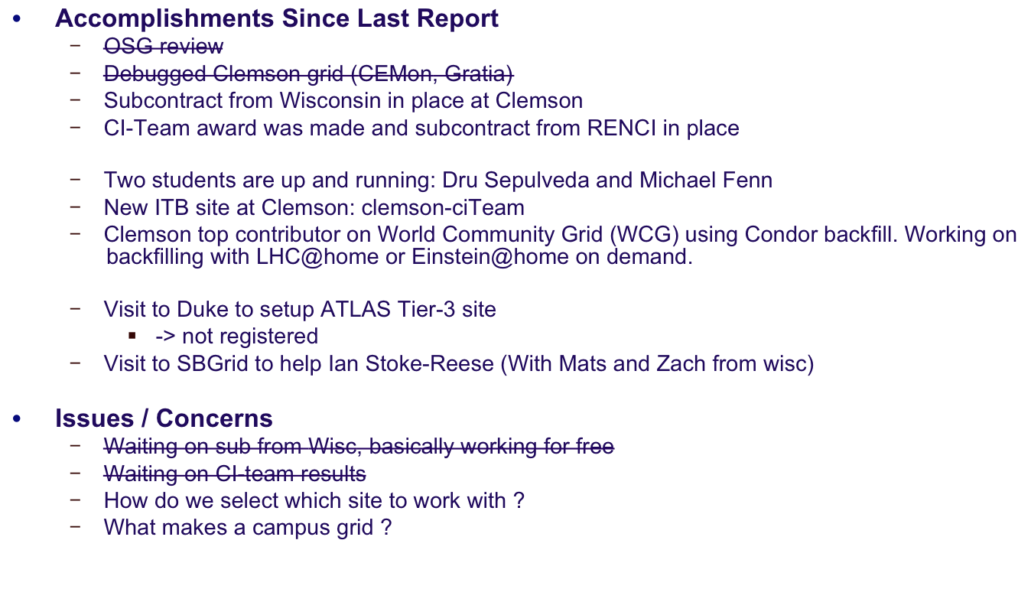
Campus Grids

