Slide 1



Building a Campus Grid
Mats Rynge – rynge@renci.org
Renaissance Computing Institute
University of North Carolina, Chapel Hill

Slide 2
Outline
Recipe
Condor Daemons
ClassAds
Configuration Files
Configuration Examples
  Creating a central manager
  Joining a dedicated processing machine
  Joining a interactive workstation
Troubleshooting
Security

Slide 3
Why a Campus Grid?
Existing, under-utilized, resources all over campus!
Enable departments and researchers on campus to share their existing computers
The same departments and researchers will have access to a larger pool of resources when they need to do large computations
Community driven project
  Enabled by Central IT
Corner stone to join national cyber infrastructure

Slide 4


What is a campus Condor pool? (cont)
Department
HPC
Workstation
Central Manager
Lab/Library
Department
Department
Department
Workstation
Notes:
Central IT dedicated resources, computer labs, libraries, departmental compute resources, computers in research labs, grad student work stations, …

Slide 5
Recipe
Central IT will provide central services (collector, negotiator, one submit node, …)
Campus departments / researches can join their existing compute resources to the pool, and share with the community
Resource owners have full control over the policy for their resources

Slide 6
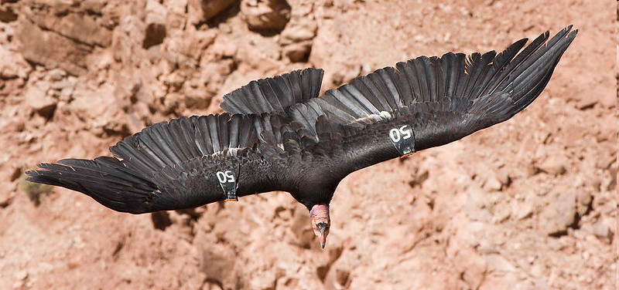

Recipe - Required Tools
Condor
A central IT champion
  Configure and maintain the central services
  Outreach to departments and users (remember, this is about distributed resources!)
  Documentation and support

Slide 7
Condor Daemons
You only have to run the daemons for the services you need to provide
DAEMON_LIST is a comma separated list of daemons to start
  DAEMON_LIST=MASTER,SCHEDD,STARTD

Slide 8
Condor Daemons
condor_master - controls everything else
condor_startd - executing jobs
condor_schedd - submitting jobs
condor_collector - Collects system information; only on Central Manager
condor_negotiator - Assigns jobs to machines; only on Central Manager

Slide 9
condor_master
Provides access to many remote administration commands:
  condor_reconfig, condor_restart, condor_off, condor_on, etc.
Default server for many other commands:
  condor_config_val, etc.

Slide 10
condor_startd
Represents a machine willing to run jobs to the Condor pool
Run on any machine you want to run jobs on
Enforces the wishes of the machine owner (the owner’s “policy”)

Slide 11
condor_schedd
Represents jobs to the Condor pool
Maintains persistent queue of jobs
  Queue is not strictly first-in-first-out (priority based)
  Each machine running condor_schedd maintains its own independent queue
Run on any machine you want to submit jobs from

Slide 12
condor_collector
Collects information from all other Condor daemons in the pool
Each daemon sends a periodic update called a ClassAd to the collector
  Old ClassAds removed after a time out
Services queries for information:
  Queries from other Condor daemons
  Queries from users (condor_status)

Slide 13
condor_negotiator
Performs matchmaking in Condor
  Pulls list of available machines and job queues from condor_collector
  Matches jobs with available machines
  Both the job and the machine must satisfy each other’s requirements (2-way matching)
Handles ranks and priorities

Slide 14
Typical Condor Pool
= Process Spawned
Execute-Only
Central Manager
= ClassAd
Communication
Pathway
master
master
startd
startd
negotiator
Execute-Only
schedd
Submit-Only
collector
master
master
startd
schedd
Regular Node
Regular Node
master
master
startd
startd
schedd
schedd

Slide 15
Job Startup
Central Manager
Negotiator
Collector
Submit Machine
Execute Machine
Schedd
Startd
Starter
Job
Submit
Shadow
Condor
Syscall Lib
Notes:
Steps
1. Startd sends collector ClassAd describing itself. (The Schedd does as well, but it has nothing interesting to say yet.)
2. The user calls condor_submit to submit a job. The job is handed off to the schedd and condor_submit returns.
3. The schedd alerts the collector that it now has a job waiting.
4. The negotiator asks the collector for a list machines able to run jobs and schedd queues with waiting jobs.
5. The negotiator contacts the schedd to learn about the waiting job.
6. The negotiator matches the waiting job with the waiting machine.
7. The negotiator alerts the schedd and the startd that there is a match.
8. The schedd contacts the startd to claim the match.
9. The schedd starts a shadow to monitor the job.
10. The startd starts a starter to start the job.
11. The starter and the shadow contact each other.
11. The starter starts the job.

Slide 16
ClassAds – the basic building block of Condor
Set of key-value pairs
Values can be expressions
Can be matched against each other
  Requirements and Rank
    MY.name – Looks for “name” in local ClassAd
    TARGET.name – Looks for “name” in the other ClassAd
    Name – Looks for “name” in the local ClassAd, then the other ClassAd

Slide 17
ClassAd Expressions
Some configuration file macros specify expressions for the Machine’s ClassAd
  Notably START, RANK, SUSPEND, CONTINUE, PREEMPT, KILL
Can contain a mixture of macros and ClassAd references
Notable: UNDEFINED, ERROR

Slide 18
ClassAd Expressions
+, -, *, /, <, <=,>, >=, ==, !=, &&, and || all work as expected
TRUE==1 and FALSE==0 (guaranteed)

Slide 19
ClassAd Expressions: UNDEFINED and ERROR
Special values
Passed through most operators
  Anything == UNDEFINED is UNDEFINED
&& and || eliminate if possible.
  UNDEFINED && FALSE is FALSE
  UNDEFINED && TRUE is UNDEFINED

Slide 20
ClassAd Expressions:
=?= and =!=
  =?= and =!= are similar to == and !=
  =?= tests if operands have the same type and the same value.
    10 == UNDEFINED -> UNDEFINED
    UNDEFINED == UNDEFINED -> UNDEFINED
    10 =?= UNDEFINED -> FALSE
    UNDEFINED =?= UNDEFINED -> TRUE
  =!= inverts =?=

Slide 21
Configuration Files
Multiple files concatenated
  Later definitions overwrite previous ones
Order of files:
  Global configuration file (only required file)
  Local and shared configuration files

Slide 22
Global Configuration File
Found either in file pointed to with the CONDOR_CONFIG environment variable, /etc/condor/condor_config, or ~condor/condor_config
All settings can be in this file
“Global” on assumption it’s shared between machines. NFS, automated copies, etc.

Slide 23
Local Configuration File
LOCAL_CONFIG_FILE macro
Machine-specific settings
  local policy settings for a given owner
  different daemons to run (for example, on the Central Manager!)

Slide 24
Local Configuration File
Can be on local disk of each machine
/var/adm/condor/condor_config.local
Can be in a shared directory
  Use $(HOSTNAME) which expands to the machine’s name
/shared/condor/condor_config.$(HOSTNAME)
/shared/condor/hosts/$(HOSTNAME)/ condor_config.local

Slide 25
Policy
Allows machine owners to specify job priorities, restrict access, and implement other local policies

Slide 26
Policy Expressions
Specified in condor_config
  Ends up startd/machine ClassAd
Policy evaluates both a machine ClassAd and a job ClassAd together
  Policy can reference items in either ClassAd (See manual for list)

Slide 27
Machine (Startd) Policy Expression Summary
START – When is this machine willing to start a job
RANK - Job preferences
SUSPEND - When to suspend a job
CONTINUE - When to continue a suspended job
PREEMPT – When to nicely stop running a job
KILL - When to immediately kill a preempting job

Slide 28
RANK
Indicates which jobs a machine prefers
  Jobs can also specify a rank
Floating point number
  Larger numbers are higher ranked
  Typically evaluate attributes in the Job ClassAd
  Typically use + instead of &&

Slide 29
RANK
Often used to give priority to owner of a particular group of machines
Claimed machines still advertise looking for higher ranked job to preempt the current job

Slide 30
Configuration Case #1
Central/department IT setting up a central manager

Slide 31
Needed Daemons
  DAEMON_LIST = MASTER, COLLECTOR, NEGOTIATOR
= Process Spawned
Execute-Only
Central Manager
= ClassAd
Communication
Pathway
master
master
startd
negotiator
Submit-Only
Execute-Only
master
collector
master
schedd
startd

Slide 32
Security
  HOST_ALLOW_READ = *.unc.edu, 152.54.0.0/20
  HOST_ALLOW_WRITE = *.unc.edu, 152.54.0.0/20
  HOSTDENY_WRITE = *.wireless.unc.edu
  Limit the number of allowed submit nodes (more on the security later)
  HOSTALLOW_ADVERTISE_SCHEDD = tarheelgrid.isis.unc.edu, fire.renci.org, …

Slide 33
Configuration Case #2
Department or lab wanting to join their existing dedicated processing machine to campus pool

Slide 34
Case #2 - Configuration
  CONDOR_HOST = cm1.isis.unc.edu
  DAEMON_LIST = MASTER, STARTD
  HOST_ALLOW_READ = *.unc.edu, 152.54.0.0/20
  HOST_ALLOW_WRITE = *.unc.edu, 152.54.0.0/20
  HIGHPORT = 12000
  LOWPORT = 10000
  Note that the firewall needs to be open, for the specific port range, against all hosts specified in HOST_ALLOW_READ/HOST_ALLOW_WRITE

Slide 35
Job Startup
Central Manager
Negotiator
Collector
Submit Machine
Execute Machine
Schedd
Startd
Starter
Job
Submit
Shadow
Condor
Syscall Lib
Notes:
Steps
1. Startd sends collector ClassAd describing itself. (The Schedd does as well, but it has nothing interesting to say yet.)
2. The user calls condor_submit to submit a job. The job is handed off to the schedd and condor_submit returns.
3. The schedd alerts the collector that it now has a job waiting.
4. The negotiator asks the collector for a list machines able to run jobs and schedd queues with waiting jobs.
5. The negotiator contacts the schedd to learn about the waiting job.
6. The negotiator matches the waiting job with the waiting machine.
7. The negotiator alerts the schedd and the startd that there is a match.
8. The schedd contacts the startd to claim the match.
9. The schedd starts a shadow to monitor the job.
10. The startd starts a starter to start the job.
11. The starter and the shadow contact each other.
11. The starter starts the job.

Slide 36
Case #2 – Policy
Prefer Chemistry jobs
  START = True
  RANK = Department =!= UNDEFINED && Department == "Chemistry"
  SUSPEND = False
  CONTINUE = True
  PREEMPT = False
  KILL = False

Slide 37
Submit file with Custom Attribute
Prefix an entry with “+” to add to job ClassAd
  Executable = charm-run
  Universe = standard
  +Department = "Chemistry"
  queue

Slide 38
Use Case #3
Department or lab wanting to join a interactive workstation

Slide 39
Case #3 - Configuration
  CONDOR_HOST = cm1.isis.unc.edu
  DAEMON_LIST = MASTER, STARTD
  HOST_ALLOW_READ = *.unc.edu, 152.54.0.0/20
  HOST_ALLOW_WRITE = *.unc.edu, 152.54.0.0/20
  HIGHPORT = 12000
  LOWPORT = 10000
  Note that the firewall needs to be open, for the specific port range, against all hosts specified in HOST_ALLOW_READ/HOST_ALLOW_WRITE

Slide 40
Defining Idle
One possible definition:
  No keyboard or mouse activity for 5 minutes
  Load average below 0.3

Slide 41
Desktops should…
START jobs when the machine becomes idle
SUSPEND jobs as soon as activity is detected
PREEMPT jobs if the activity continues for 5 minutes or more
KILL jobs if they take more than 5 minutes to preempt

Slide 42
Useful Attributes
LoadAvg
  Current load average
CondorLoadAvg
  Current load average generated by Condor
KeyboardIdle
  Seconds since last keyboard or mouse activity

Slide 43
Useful Attributes
CurrentTime
  Current time, in Unix epoch time (seconds since midnight Jan 1, 1970)
EnteredCurrentActivity
  When did Condor enter the current activity, in Unix epoch time

Slide 44
Macros in Configuration Files
NonCondorLoadAvg = (LoadAvg - CondorLoadAvg)
BgndLoad = 0.3
CPU_Busy = ($(NonCondorLoadAvg) >= $(BgndLoad))
CPU_Idle = ($(NonCondorLoadAvg) < $(BgndLoad))
KeyboardBusy = (KeyboardIdle < 10)
MachineBusy = ($(CPU_Busy) || $(KeyboardBusy))
ActivityTimer = \
(CurrentTime - EnteredCurrentActivity)

Slide 45
Desktop Machine Policy
START = $(CPU_Idle) && KeyboardIdle > 300
SUSPEND = $(MachineBusy)
CONTINUE = $(CPU_Idle) && KeyboardIdle > 120
PREEMPT = (Activity == "Suspended") && \
$(ActivityTimer) > 300
KILL = $(ActivityTimer) > 300

Slide 46

Command Line Tools

Slide 47
condor_config_val
Find current configuration values
% condor_config_val MASTER_LOG
/var/condor/logs/MasterLog
% cd `condor_config_val LOG`

Slide 48
condor_config_val -v
Can identify source
% condor_config_val –v CONDOR_HOST
CONDOR_HOST: condor.cs.wisc.edu
Defined in ‘/etc/condor_config.hosts’, line 6

Slide 49
condor_config_val -config
What configuration files are being used?
% condor_config_val –config
Config source:
/var/home/condor/condor_config
Local config sources:
/unsup/condor/etc/condor_config.hosts
/unsup/condor/etc/condor_config.global
/unsup/condor/etc/condor_config.policy
/unsup/condor-test/etc/hosts/puffin.local

Slide 50
Querying daemons condor_status
Queries the collector for information about daemons in your pool
Defaults to finding condor_startds
condor_status –schedd summarizes all job queues
condor_status –master returns list of all condor_masters

Slide 51
condor_status
-long displays the full ClassAd
Optionally specify a machine name to limit results to a single host
condor_status –l node4.cs.wisc.edu

Slide 52
condor_status -constraint
Only return ClassAds that match an expression you specify
Show me idle machines with 1GB or more memory
  condor_status -constraint 'Memory >= 1024 && Activity == "Idle"'

Slide 53
condor_status -format
Controls format of output
Useful for writing scripts
Uses C printf style formats
  One field per argument
“slanting” by Stefano Mortellaro (“fazen”) © 2005
Licensed under the Creative Commons Attribution 2.0 license http://www.flickr.com/photos/fazen/17200735/ http://www.webcitation.org/5XIhNWC7Y

Slide 54
condor_status -format
Census of systems in your pool:
% condor_status -format '%s ' Arch -format '%s\n' OpSys | sort | uniq –c
797 INTEL LINUX
118 INTEL WINNT50
108 SUN4u SOLARIS28
6 SUN4x SOLARIS28

Slide 55
Examining Queues condor_q
View the job queue
The “-long” option is useful to see the entire ClassAd for a given job
supports –constraint and -format
Can view job queues on remote machines with the “-name” option

Slide 56
condor_q –better-analyze
(Heavily truncated output)
The Requirements expression for your job is:
( ( target.Arch == "SUN4u" ) && ( target.OpSys == "WINNT50" ) && [snip]
Condition Machines Suggestion
1 (target.Disk > 100000000) 0 MODIFY TO 14223201
2 (target.Memory > 10000) 0 MODIFY TO 2047
3 (target.Arch == "SUN4u") 106
4 (target.OpSys == "WINNT50") 110 MOD TO "SOLARIS28"
Conflicts: conditions: 3, 4

Slide 57
Debugging Jobs: condor_q
Examine the job with condor_q
  especially -long and –analyze
  Compare with condor_status –long for a machine you expected to match

Slide 58
Debugging Jobs:
User Log
Examine the job’s user log
  Can find with:
condor_q -format '%s\n' UserLog 17.0
  Set with “log” in the submit file
Contains the life history of the job
Often contains details on problems

Slide 59
Debugging Jobs:
ShadowLog
Examine ShadowLog on the submit machine
  Note any machines the job tried to execute on
  There is often an “ERROR” entry that can give a good indication of what failed

Slide 60
Debugging Jobs:
Matching Problems
No ShadowLog entries? Possible problem matching the job.
  Examine ScheddLog on the submit machine
  Examine NegotiatorLog on the central manager

Slide 61
Debugging Jobs:
Local Problems
ShadowLog entries suggest an error but aren’t specific?
  Examine StartLog and StarterLog on the execute machine

Slide 62
Debugging Jobs:
Reading Log Files
Condor logs will note the job ID each entry is for
  Useful if multiple jobs are being processed simultaneously
  grepping for the job ID will make it easy to find relevant entries

Slide 63
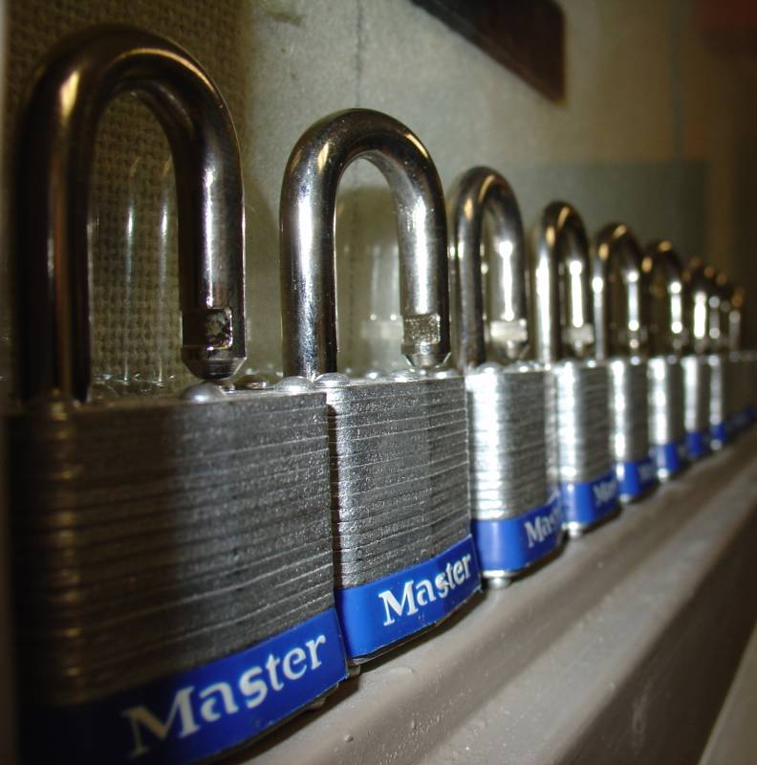
Security

Slide 64
Security Threats
Condor System
  Authentication / Authorization
    Next couple of slides
Using Condor as a vehicle for attacks
  Hard to prevent
  Local exploits (privilege escalation)
    Condor jobs are not sandboxed
  Another example: Distributed DoS

Slide 65
Security
Authentication
  Users
    Done on the submit machine, using OS authentication mechanisms
  Machines
    IP based
    Machines on the wireless subnet are not allowed to join the pool
    Other subnets to block?

Slide 66
Security - Users
Based on the local UID
Example: cdpoon@tarheelgrid.isis.unc.edu
Note that these are not Campus wide identifiers. The components of the identifier is local username @ hostname of the submit node.
Another example: engage@belhaven-1.renci.org
These are getting logged during the negotiation cycle on the central manager
Authorization can be done at the central manager, or in the policy on the execution machine

Slide 67
Security – Machines
Anybody on campus can join a machine for job execution
Only a set of machines will be allowed for job submits – this will ensure we have an audit trail
  The allowed set is configured on the central manager

Slide 68
Security Links
Condor documentation on security:
http://www.cs.wisc.edu/condor/manual/v7.2/3_6Security.html
Building a secure Condor pool in an open academic environment
http://www.allhands.org.uk/2005/proceedings/papers/435.pdf

